Slide 1
Object Oriented Programming
Notes:
‹#›

Slide 2
What is Object Oriented Programming
Object-Oriented Programming (OOP) is a programming model that is based on the concept of classes and objects. As opposed to procedural programming where the focus is on writing procedures or functions that perform operations on the data, in object-oriented programming the focus is on the creations of objects which contain both data and functions together.
Benefits of OOPS :
It provides a clear modular structure for the programs.
It helps you adhere to the "don't repeat yourself" (DRY) principle, and thus make your code much easier to maintain, modify and debug.
It makes it possible to create more complicated behaviour with less code and shorter development time and high degree of reusability.

Slide 3
PHP : Classes and Objects
Classes and objects are the two main aspects of object-oriented programming.
Class & Objects : A class is a self-contained, independent collection of variables and functions which work together to perform one or more specific tasks.
It is a programmer-defined data type.
while objects are individual instances of a class.
A class acts as a template or blueprint from which lots of individual objects can be created. When individual objects are created, they inherit the same generic properties and behaviors, although each object may have different values for certain properties.
For example, think of a class as a blueprint for a house. The blueprint itself is not a house, but is a detailed plan of the house. While, an object is like an actual house built according to that blueprint. We can build several identical houses from the same blueprint, but each house may have different paints, interiors and families inside, as shown in the illustration below.

Slide 4
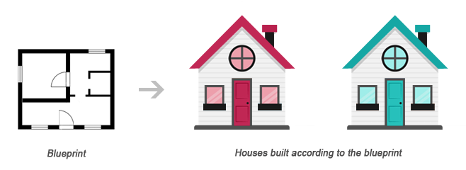
House Blueprint & two different implementation using same blue print

Slide 5
Classes and Objects
A class is defined by using the class keyword, followed by the name of the class and a pair of curly braces ({}). All its properties and methods goes inside the braces:
// Basic class Syntax
class class_name {
// class member variable
<modifier> variable_name;
// class member function
<modifier> function_name(){
}
}
// create a object for the class
obj_name = new class_name();
PHP Classes and Objects

Slide 6
Constructor and Destructor
Constructor & Destructor
A constructor allows you to initialize an object's properties upon creation of the object.
If you create a __construct() function, PHP will automatically call this function when you create an object from a class.
A destructor is called when the object is destructed or the script is stopped or exited.
If you create a __destruct() function, PHP will automatically call this function at the end of the script.
Notice that the construct and destruct function starts with two underscores (__)!
PHP OOP Constructor

Slide 7
PHP OOP Access Modifiers
Access Modifier :
There are mainly 3 type of access modifier in PHP.
public - the property or method can be accessed from everywhere. This is default
private - the property or method can ONLY be accessed within the class
protected - the property or method can be accessed within the class and by classes derived from that class

Slide 8
OOPS Concepts
Basic Concepts of OOPS :
Encapsulation
In today’s technical world, maintaining privacy has become one of the demanding needs for the protection of important data.
To overcome this problem, object-oriented programming in PHP uses the concept of Encapsulation.
OOPs concept of Encapsulation means, The wrapping up of data and methods into a single unit (called class) is known as encapsulation.
In the encapsulation technique, we are restricting the data members from access to outside world end-user.
Data is not accessed directly, in fact, they are accessed through functions(GET or SET) written inside the class. Attributes are kept private but getter(GET) and setter(SET) methods are kept public for manipulation of these attributes.

Slide 9
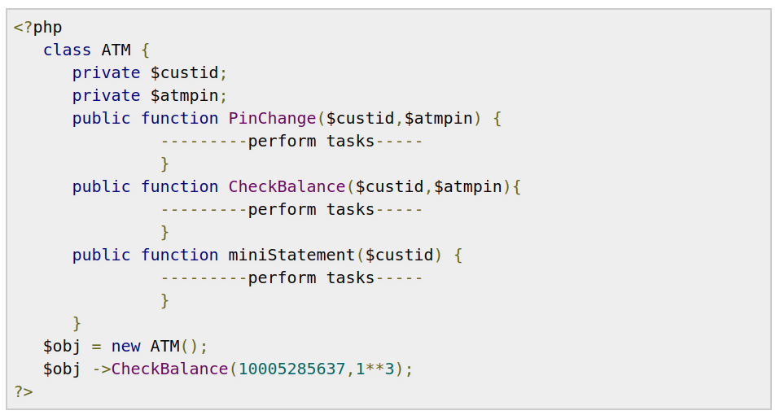
OOPS Concepts
Encapsulation Example :

Slide 10
OOPS Concepts
Explanation:
In this example,
all the ATM class data members (variable) are marked with the private modifier.
It implies that we can not directly access ATM class data members (property).
So, we can't change the class property directly.
The only approach to change the class property (data members) is calling a method (function).
That’s the reason we have stated all the ATM class methods with a public access modifier.
The user can pass the expected arguments to a class method to perform a particular task.
Suppose anyone wants to check balance then he needs to access the CheckBalance() method with the required arguments custid="10005285637"and atmpin="1**3".
This is called Data hiding through Encapsulation.

Slide 11
OOPS Concepts
2). Inheritance
Inheritance is a well-established programming principle, and PHP makes use of this principle in its object model. This principle will affect the way many classes and objects relate to one another.
For example, when you extend a class, the subclass inherits all of the public and protected methods from the parent class. Unless a class overrides those methods, they will retain their original functionality.
This is useful for defining and abstracting functionality, and permits the implementation of additional functionality in similar objects without the need to reimplement all of the shared functionality.
An inherited class is defined by using the “extends” keyword.

Slide 12
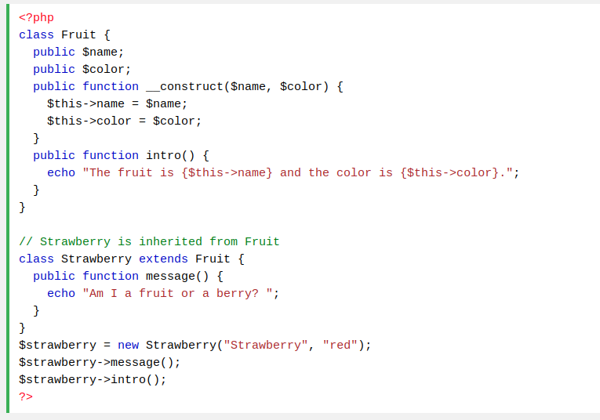
Inheritance Example :
PHP Inheritance

Slide 13
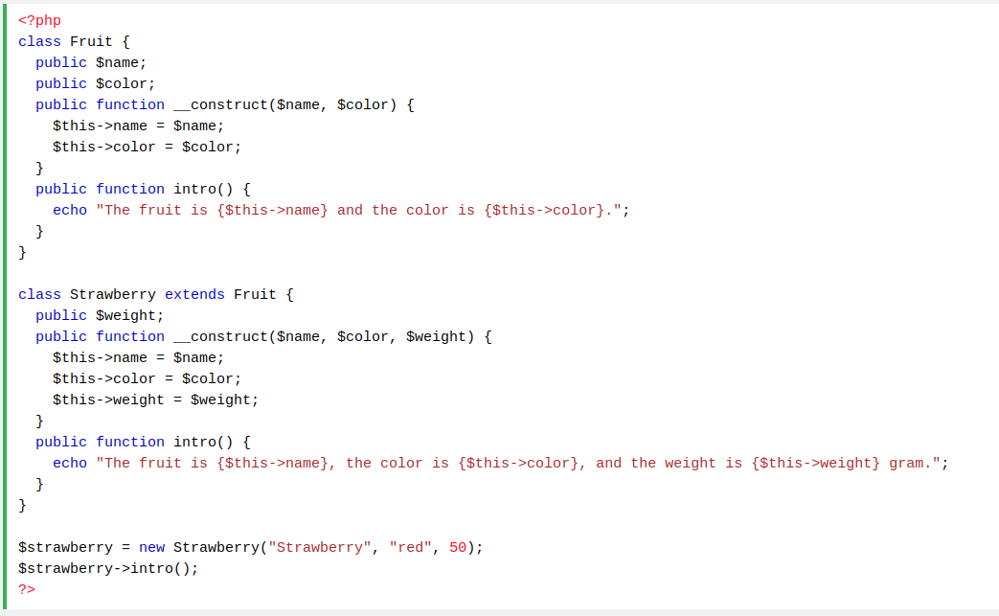
OOPS Concepts
Method Overriding
Inherited methods can be overridden by redefining the methods (use the same name and parameters) in the child class.The purpose of overriding is to change the behavior of parent class method. The two methods with the same name and same parameter is called overriding.

Slide 14
OOPS Concepts
Abstraction
In OOP, abstraction is a concept in which a class has methods without implementation. The idea is to have a template and let the child class that inherits the parent class implement the method.
An abstract class is a class that contains at least one abstract method. An abstract method is a method that is declared, but not implemented in the code.
An abstract class or method is defined with the “abstract” keyword:
Example:
abstract class Sample {
//abstract method
public abstract function foo();
}
Since an abstract class is just a template without completely implemented methods hence it is not allowed to create its object.

Slide 15
OOPS Concepts
Abstraction (Cont...)
When inheriting from an abstract class, the child class method must be defined with the same name, and the same or a less restricted access modifier.
So, if the abstract method is defined as protected, the child class method must be defined as either protected or public, but not private.
Also, the type and number of required arguments must be the same. However, the child classes may have optional arguments in addition.
So, when a child class is inherited from an abstract class, we have the following rules:
The child class method must be defined with the same name and it redeclares the parent abstract method
The child class method must be defined with the same or a less restricted access modifier
The number of required arguments must be the same. However, the child class may have optional arguments in addition

Slide 16
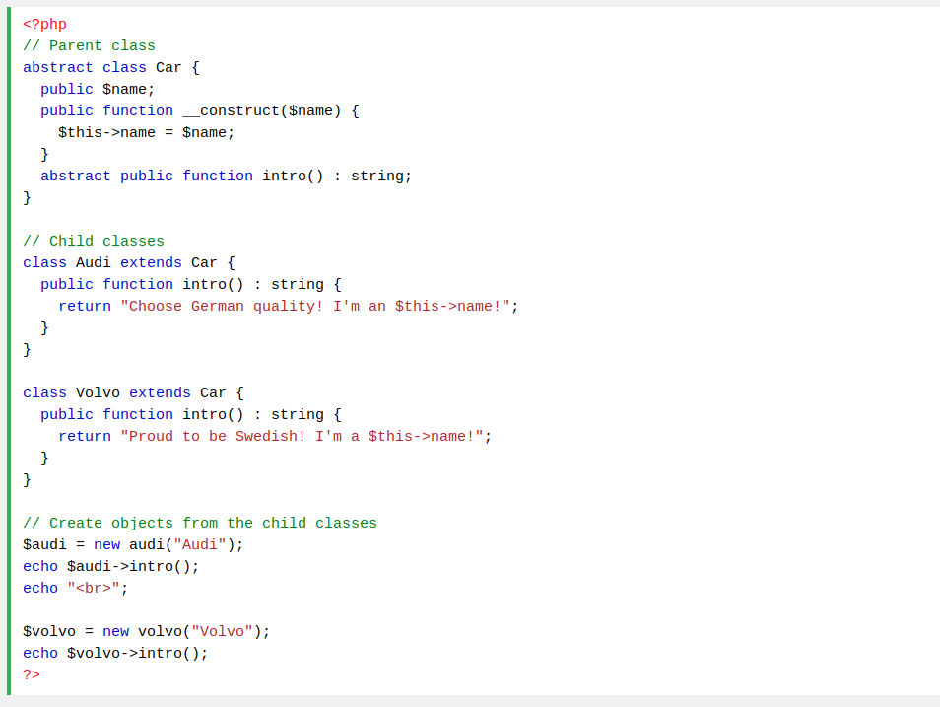
Abstraction (Cont...)
Example:
PHP Abstract Class

Slide 17
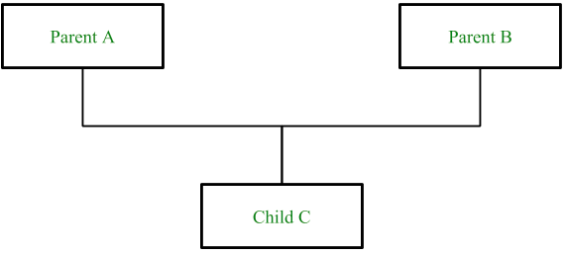
Multiple Inheritance in PHP
Multiple inheritance
Multiple Inheritance is the property of the Object Oriented Programming languages in which child class or sub class can inherit the properties of the multiple parent classes or super classes.
PHP doesn’t support multiple inheritance but by using Traits in PHP instead of classes, we can implement it.

Slide 18
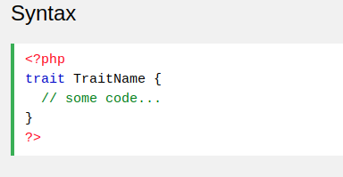
Multiple Inheritance in PHP
Traits
The trait is a type of class which enables multiple inheritance. Classes, case classes, objects, and traits can all extend no more than one class but can extend multiple traits at the same time.

Slide 19
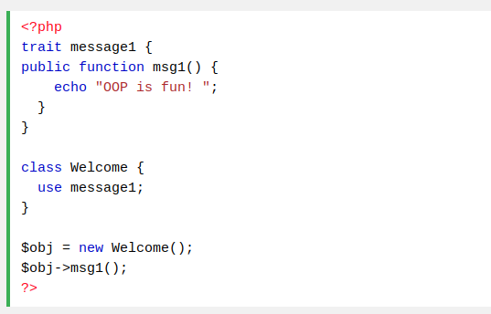
Trait Usage Example
To use a trait in a class, use the “use” keyword:
Example
Example Explained : Here, we declare one trait: message1. Then, we create a class: Welcome. The class uses the trait, and all the methods in the trait will be available in the class. If other classes need to use the msg1() function, simply use the message1 trait in those classes. This reduces code duplication, because there is no need to redeclare the same method over and over again.
PHP Traits

Slide 20
Thank you

