Slide 1
Object Oriented Programming

Slide 2
OOPS (Cont...)
Constants
It is possible to define constant values on a per-class basis which remains the same and unchangeable.
Constants differ from normal variables in that you don't use the $ symbol to declare or use them.
The default visibility of class constants is public.
Constants cannot be changed once it is declared.
A class constant is declared inside a class with the “const” keyword.
Class constants are case-sensitive. However, it is recommended to name the constants in all uppercase letters.

Slide 3
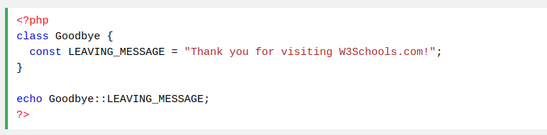
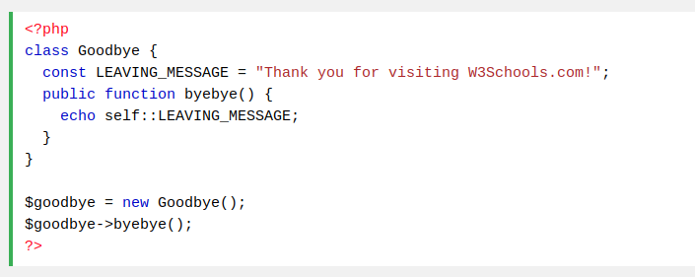
OOPS : Constants (Cont...)
We can access a constant from outside the class by using the class name followed by the scope resolution operator (::) followed by the constant name, like here:
To access constant inside the class , use “self” keyword

Slide 4
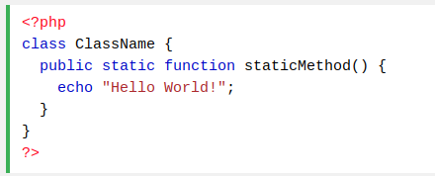

OOPS : Static Keyword
The static keyword is used in the context of variables and methods that are common to all the objects of the class. Therefore, any logic which can be shared among multiple instances of a class should be extracted and put inside the static method.
PHP Static Methods
Static methods can be called directly - without creating an instance of a class.
Static methods are declared with the “static” keyword:
To access a static method use the class name, double colon (::), and the method name:

Slide 5
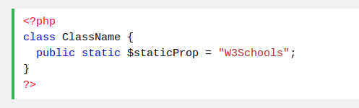

OOPS : Static Keyword (Cont ...)
PHP Static Properties
Class properties can also be declared as static same as class methods
Static properties can be called directly - without creating an instance of a class.
Static properties are declared with the “static” keyword:
To access a static property use the class name, double colon (::), and the property name:

Slide 6
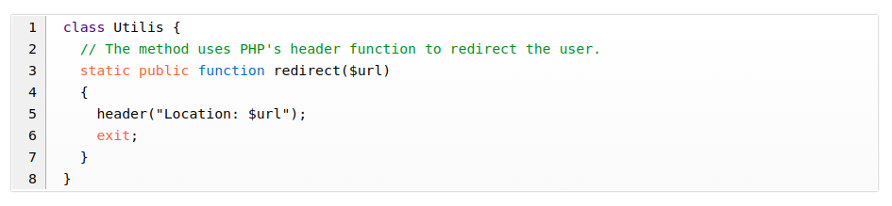
OOPS : Static Keyword (Cont ...)
PHP Static Method Example:
in order to use the redirect() method, all we need to do is call it from the scope of the Utilis class without having the need to create an object. It's as simple as this:
Static functions

Slide 7
OOPS : Interface
Interface
Object interfaces allow you to create code which specifies which methods a class must implement, without having to define how these methods are implemented.
Interfaces are defined in the same way as a class, but with the interface keyword replacing the class keyword and without any of the methods having their contents defined.
All methods declared in an interface must be public; this is the nature of an interface.
Implements
To implement an interface, the “implements” operator is used.
All methods in the interface must be implemented within a class; failure to do so will result in a fatal error.
Classes may implement more than one interface if desired by separating each interface with a comma.
It's possible for interfaces to have constants. Interface constants work exactly like class constants except they cannot be overridden by a class/interface that inherits them.

Slide 8
OOPS : Interface (Cont...)
Interface
Interfaces resemble abstract classes in that they include abstract methods that the programmer must define in the classes that inherit from the interface.
In this way, interfaces contribute to code organization because they commit the child classes to abstract methods that they should implement.
The use of interfaces becomes very helpful when we work in a team of programmers and want to ensure that all the programmers write the methods that they should work on, or even in the case of a single programmer that wants to commit himself to write certain methods in the child classes.
An Interface enables us to make programs, indicating the public methods that a class must execute, without including the complexities and procedure of how the specific methods are implemented.
An interface commits its child classes to abstract methods that they should implement.

Slide 9
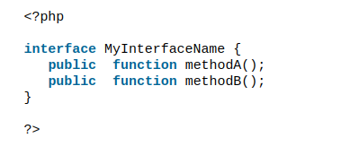
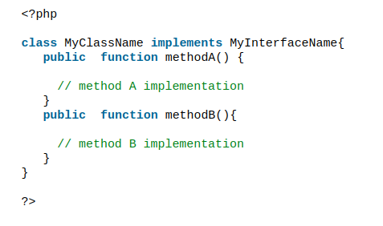
OOPS : Interface (Cont...)
Declaring an Interface
Following is an example of how to define an interface using the interface keyword.
To implement an interface, use the implements operator as follows:

Slide 10
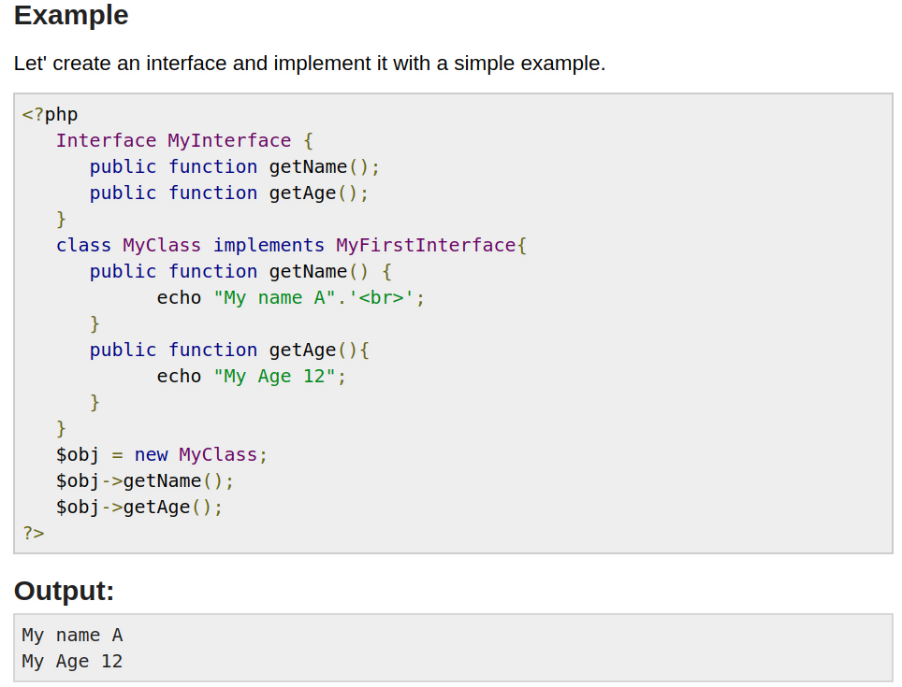
OOPS : Interface (Cont...)

Slide 11
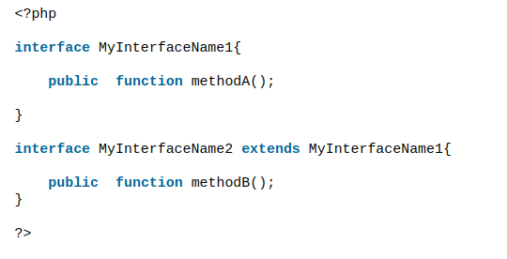
OOPS : Interface (Cont...)
Just like any class, an interface can be extended using the extends operator as follows:
Note : A class can implement more than one interface, hence we can achieve multiple inheritance using an interface, Lets understand with this simple example

Slide 12
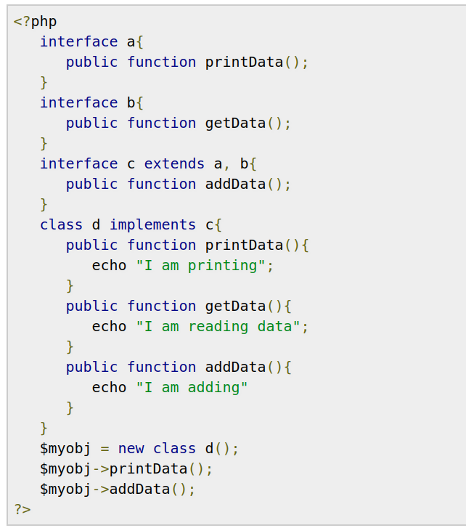
OOPS : Interface (Cont...)
Example Explained “Multiple Inheritance”

Slide 13
OOPS : Magic Methods
The function names
__construct(),
__destruct(),
__call(),
__callStatic(),
__get(),
__set(),
__isset(),
__unset(),
__sleep(),
__wakeup(),
__toString(),
__invoke(),
__set_state(),
__clone()
__debugInfo() are magical in PHP classes.
We cannot have functions with these names in any of your classes unless you want the magic functionality associated with them.
Note: All magic methods MUST be declared as public

Slide 14
OOPS : Property & Method Overloading
Method Overloading
It is a type of overloading for creating dynamic methods that are not declared within the class scope. PHP method overloading also triggers magic methods dedicated to the appropriate purpose. Unlike property overloading, PHP method overloading allows function call on both object and static context.
__call() – triggered while invoking overloaded methods in the object context.
__callStatic() – triggered while invoking overloaded methods in static context.
Property Overloading
Property overloading is used to create dynamic properties in the object context.
__set(): triggered while initializing overloaded properties.
__get(): triggered while using overloaded properties with PHP print statements.
__isset(): This magic method is invoked when we check overloaded properties with isset() function
__unset(): Similarly, this function will be invoked on using PHP unset() for overloaded properties.
Lets understand this by example :

Slide 15
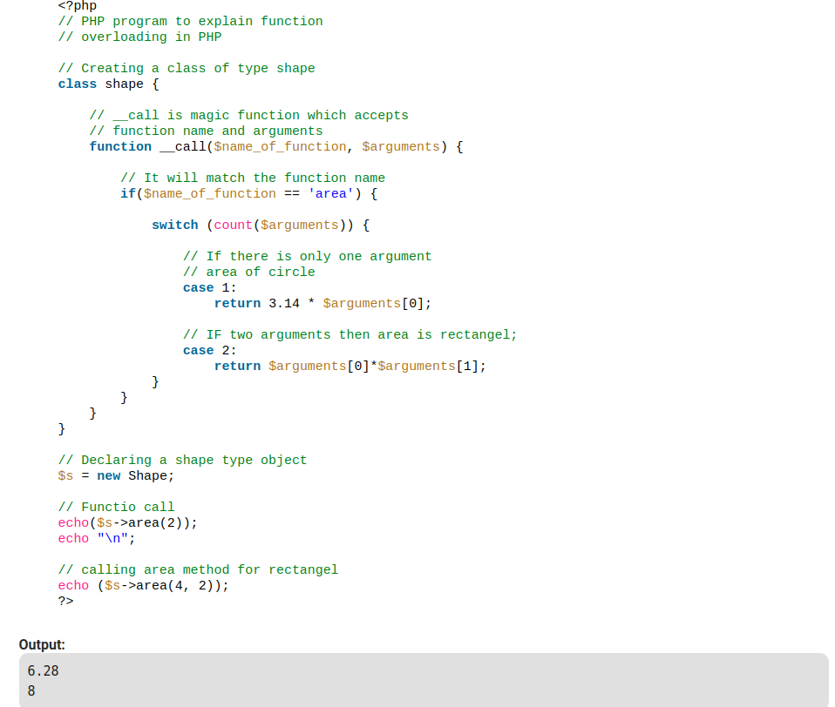
OOPS : Property & Method Overloading
Method Overloading using __call()

Slide 16
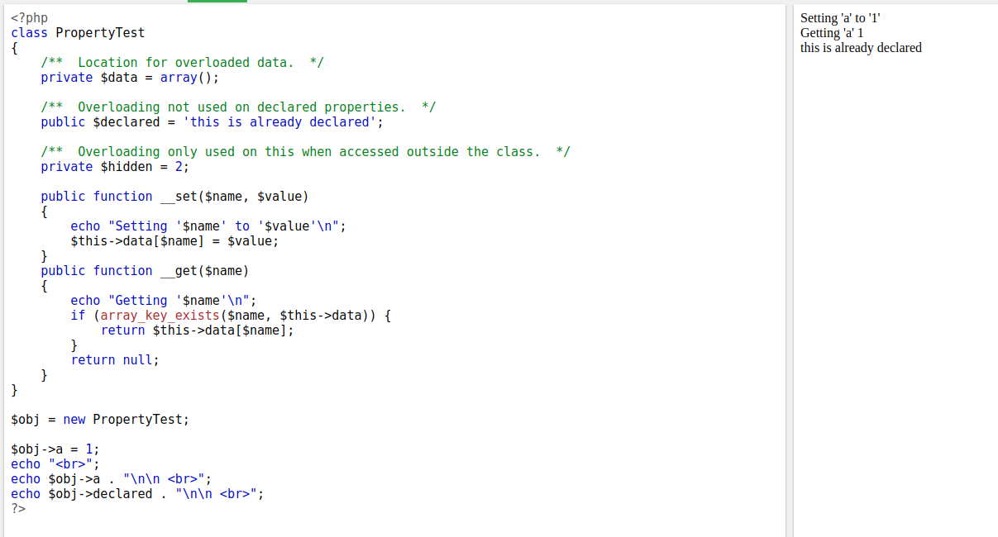
OOPS : Property & Method Overloading
Property Overloading using __set()

Slide 17
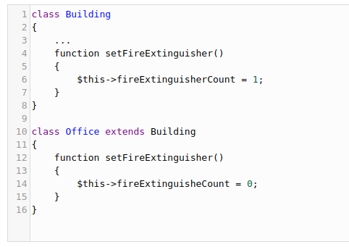
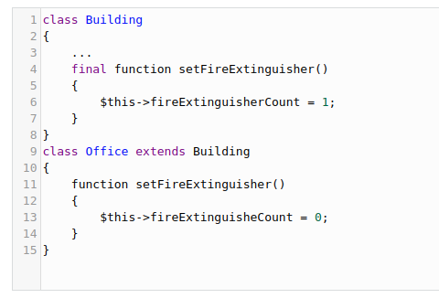
OOPS : Final Keyword
Final
PHP introduces the final keyword, which prevents child classes from overriding a method by prefixing the definition with final. If the class itself is being defined final then it cannot be extended.
Example #1 : Presume that the mayor of our imaginary city decided that all buildings must have at least one emergency exit. Take a look at the following sample of our code.
Overrides the rule, which is illegal
To control that, declare that method as final, will give fatal error if anyone tries overrides that

Slide 18
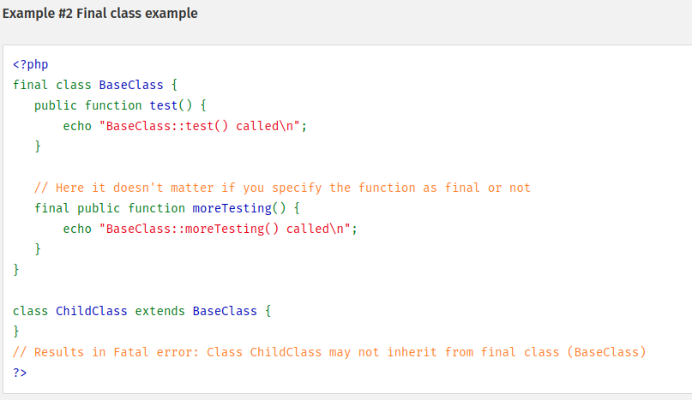
OOPS : Final Keyword (Cont...)
Note: Properties and constants cannot be declared final, only classes and methods may be declared as final.

Slide 19
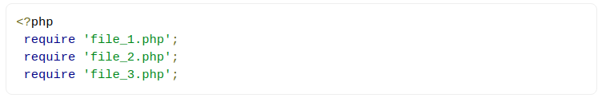
OOPS : Autoloading Classes
Autoloading Classes
Many developers writing object-oriented applications create one PHP source file per class definition. One of the biggest annoyances is having to write a long list of needed includes at the beginning of each script (one for each class).
In PHP 5, this is no longer necessary. The spl_autoload_register() function registers any number of autoloaders, enabling for classes and interfaces to be automatically loaded if they are currently not defined. By registering autoloaders, PHP is given a last chance to load the class or interface before it fails with an error.
Why to use an autoloader ?
How often have you seen code like this at the top of your PHP files?

Slide 20
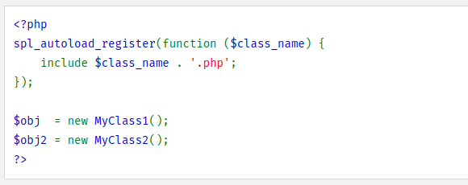
OOPS : Autoloading Classes (Cont...)
All too often, right? The require(), require_once(), include(), and include_once() functions load an external PHP file into the current script, and they work wonderfully if you have only a few PHP scripts.
However, what if you need to include a hundred PHP scripts? The require() and include() functions do not scale well, and this is why PHP autoloaders are important. An autoloader is a strategy for finding a PHP class, interface, or trait and loading it into the PHP interpreter on-demand at run-time, without explicitly including files.
Example :
Note: Autoloader function will be called upon creation of object

Slide 21
Thank you

