Slide 1
Landmark Lens
PRESENTED BY:
M.SRILEKHA 22RH1A05E6
MD.ASRA 22RH1A05F3
M.SAI VARSHITHA 22RH1A05F5
UNDER THE GUIDANCE OF
Mrs . P .SUDHESHNA
ASSISTANT PROFESSOR

Slide 2
CONTENTS
Abstract
Introduction
Need and scope of the project
Key Features
Technologies and algorithms used
System architecture diagram
Software and Hardware requirements
Output Screens
Financial analysis
Marketing analysis
Implementation
Conclusion

Slide 3
ABSTRACT
Landmark Lens is an AI-powered web application that identifies famous Indian landmarks from user-uploaded images. The system uses advanced image–text models to recognize landmarks and instantly provide information such as name, location, coordinates, history, and fun facts. It enhances travel planning by integrating maps, nearby attractions, restaurants, and accommodation details, making tourism smarter and more interactive.

Slide 4
INTRODUCTION
Landmark Lens is an AI-powered web application designed to identify iconic Indian landmarks such as the Taj Mahal, Charminar, and Golden Temple from user-uploaded images.
It instantly provides key details like the landmark's name, location, coordinates, and fun facts.
The app features an Explore section where users can directly view and select from the supported landmarks to learn more about them without uploading an image. With a user-friendly interface and multi-language support, it enhances the travel experience.
In Extension features include Google Maps integration, nearby attractions, top-rated restaurants, accommodation options, and travel routes with estimated time and distance—making it a smart and interactive travel companion.

Slide 5
NEED OF THE PROJECT
Many travelers and students face difficulty in identifying landmarks and finding accurate information instantly.
Existing solutions depend on manual searches or tour guides, which are time-consuming and not always reliable.
Landmark Lens uses AI and image recognition to identify landmarks directly from user-captured images. It provides quick, accurate, and informative details in real time.
This project improves learning and tourism experiences through smart automation.

Slide 6
SCOPE OF THE PROJECT
The project focuses on developing an AI-based application to recognize landmarks from images.
It provides landmark name, historical details, and location information to users.
Initially, it supports well-known landmarks with scope for future expansion.
The system is scalable using cloud infrastructure.
Future enhancements can include multilingual support features.

Slide 7
KEY FEATURES
AI-based landmark recognition from uploaded images
Automatic landmark details: name, history, location
Detects user’s current location
Estimates travel distance (in km) and time required to reach
Suggests transport options: road, rail, and air
Shows nearby famous places and restaurants
Includes restaurant ratings and distance from landmark
Allows users to save and share favorite landmarks
Provides Accomidation to the visitors

Slide 8
TECHNOLOGIES USED
Frontend:
React – for building UI components
Vite – for fast development and build setup
Tailwind CSS – for styling
Framer Motion – for smooth animations
Backend:
Python with FastAPI (or Flask as an alternative) – for handling image uploads and sending AI-generated landmark data

Slide 9
ALGORITHMS USED
AI Algorithm
BLIP (Bootstrapped Language Image Pretraining)
CLIP-based image-text understanding
APIs & Database
Google Maps API
Geolocation API
JSON / SQLite for data storage

Slide 10
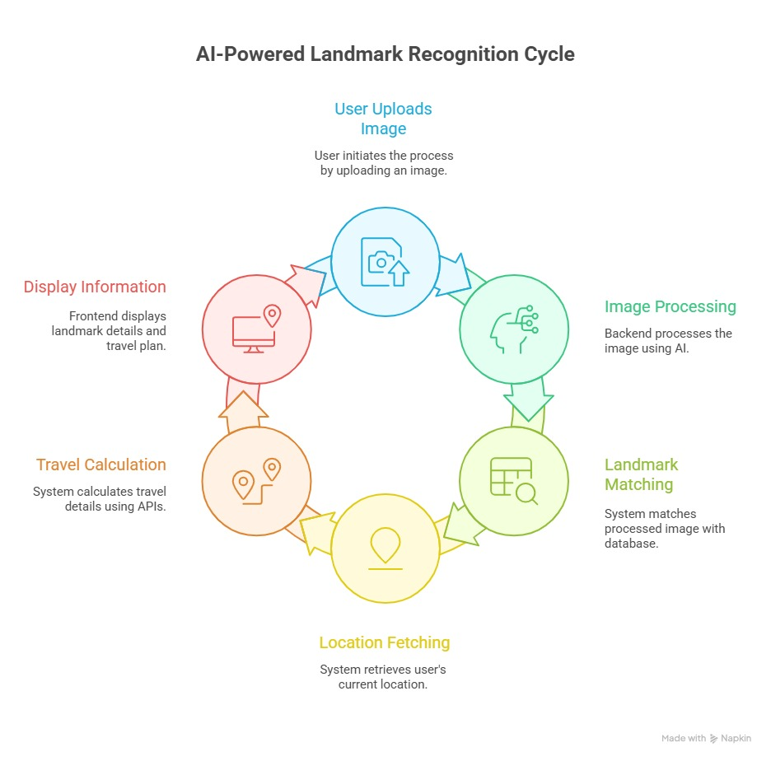
SYSTEM ARCHITECTURE DIAGRAM

Slide 11
SOFTWARE AND HARDWARE REQUIREMENTS
Software Requirements
Operating System: Windows / Linux
Frontend: React, Vite
Backend: Python, FastAPI / Flask
APIs: Google Maps
Hardware Requirements
Minimum 8GB RAM
Internet connection
Standard processor (Intel i5 or above recommended)

Slide 12
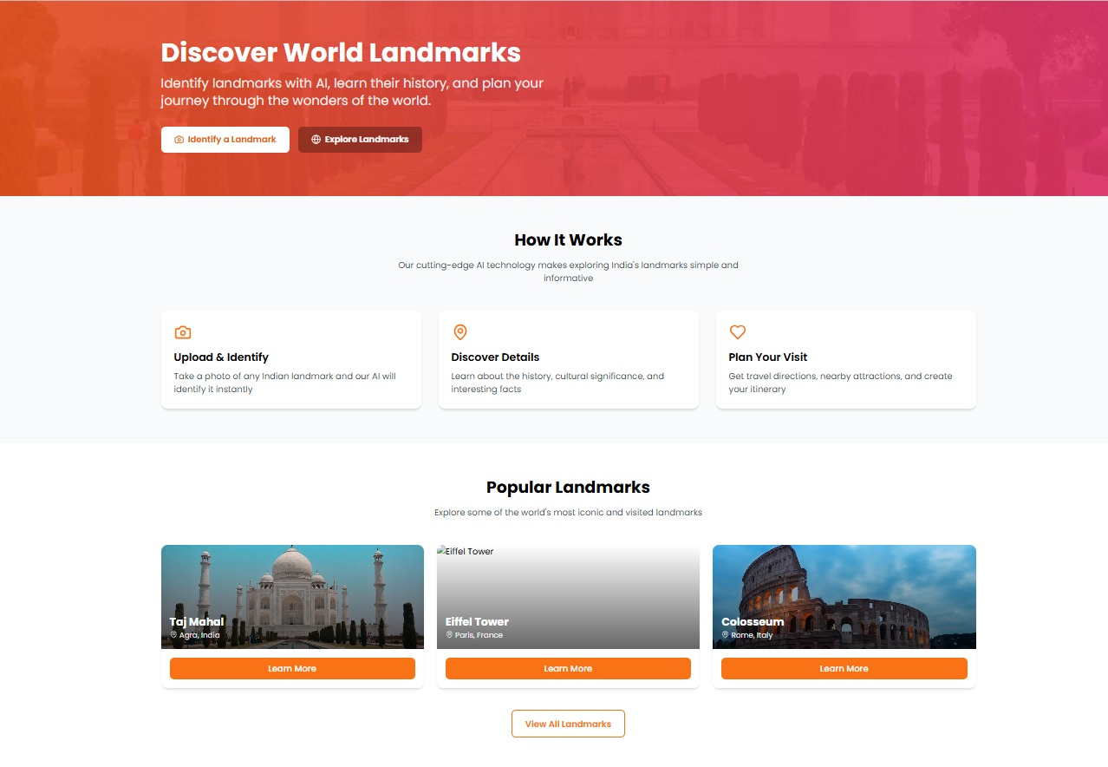
OUTPUT SCREENS

Slide 13
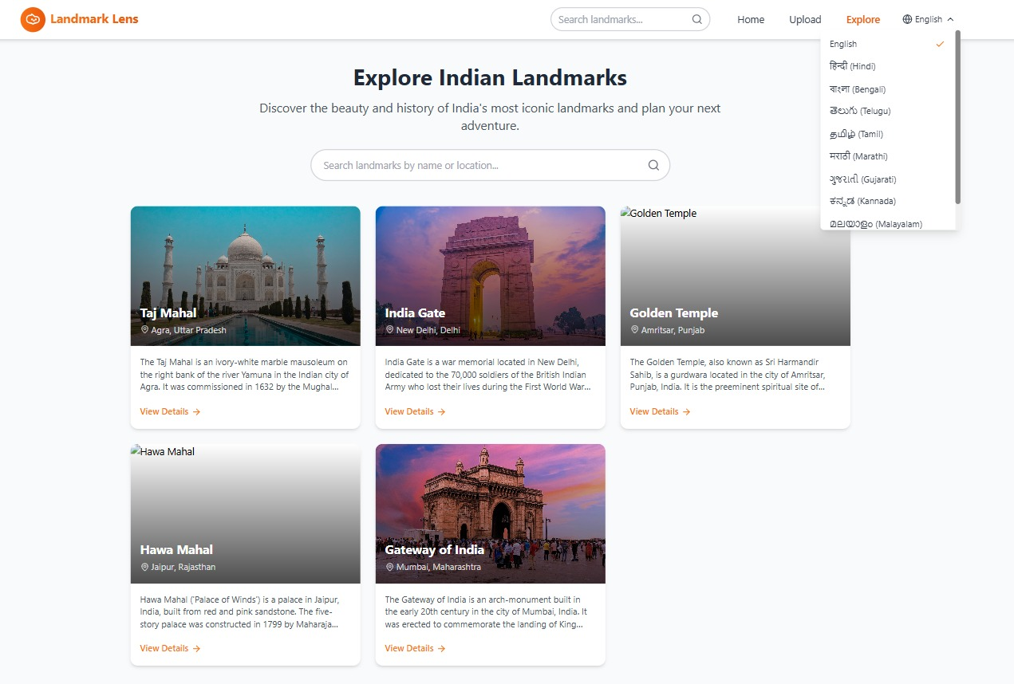

Slide 14
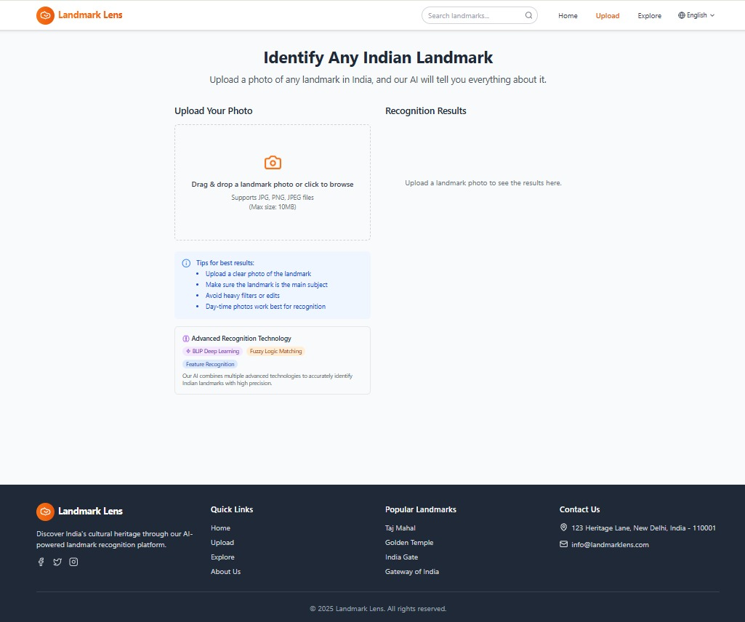

Slide 15
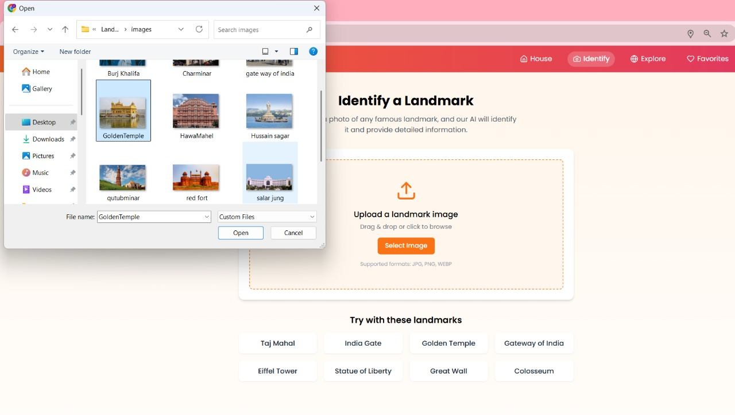

Slide 16
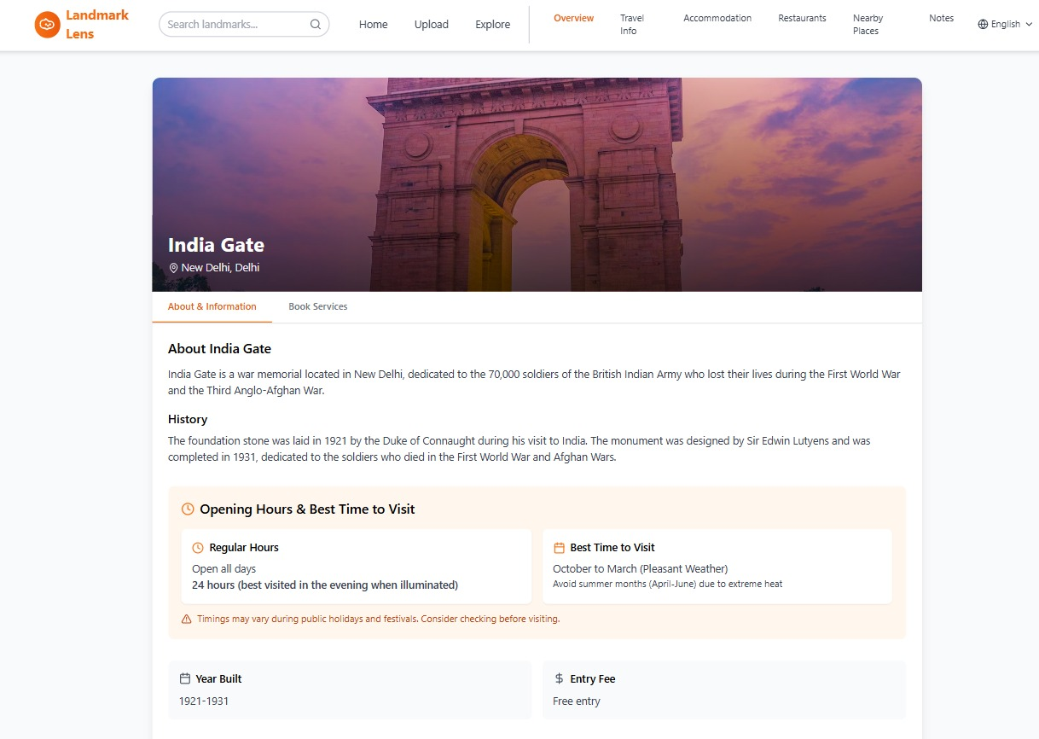

Slide 17
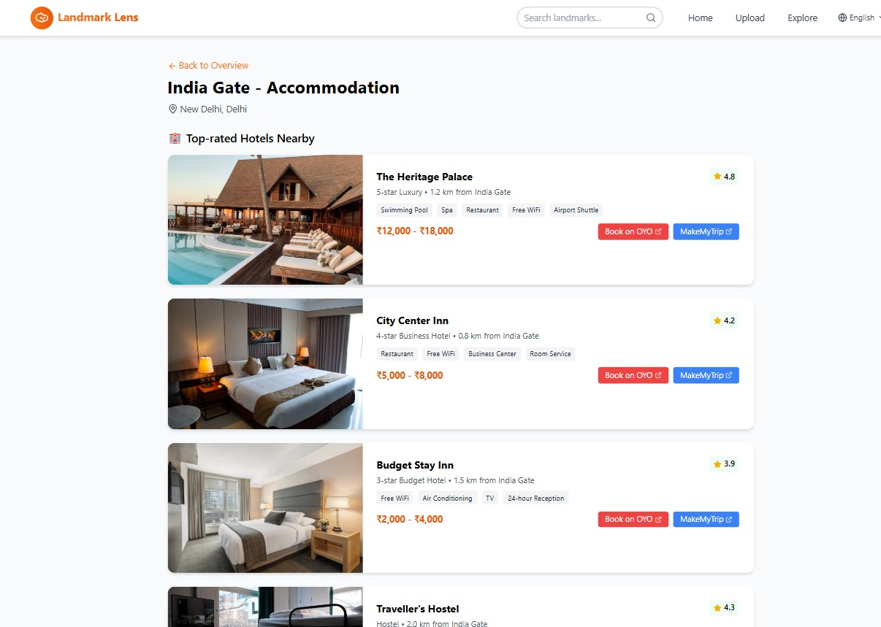

Slide 18
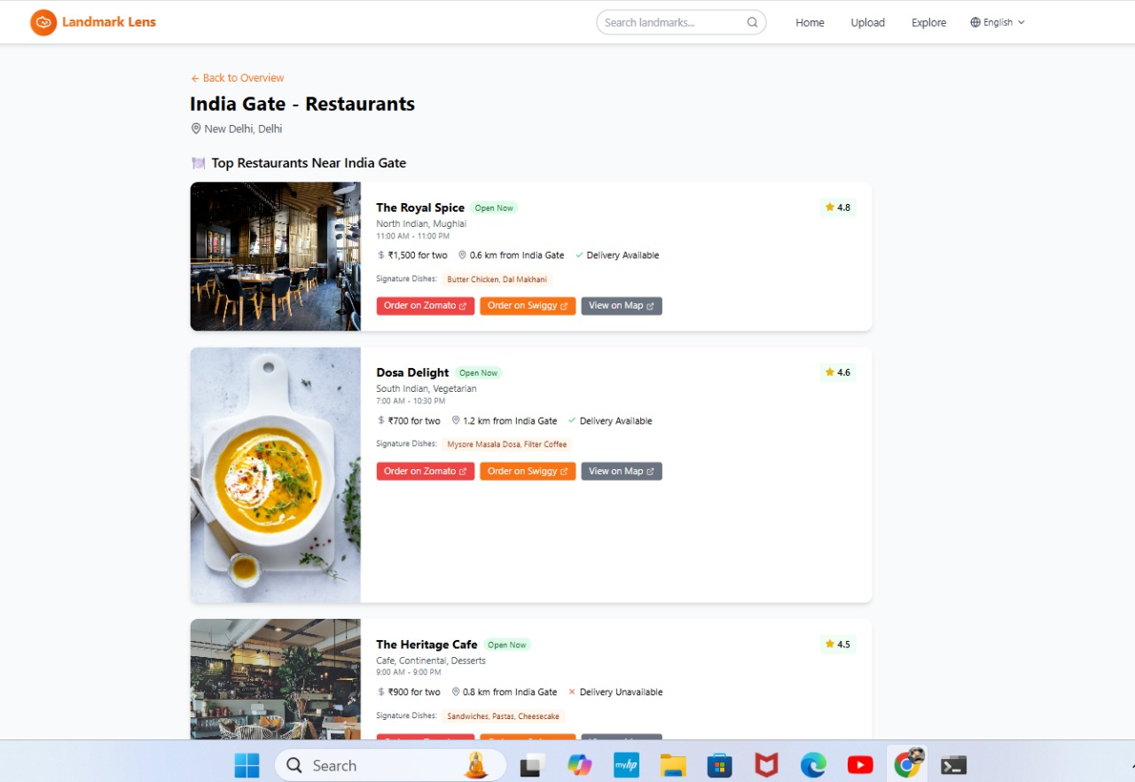

Slide 19
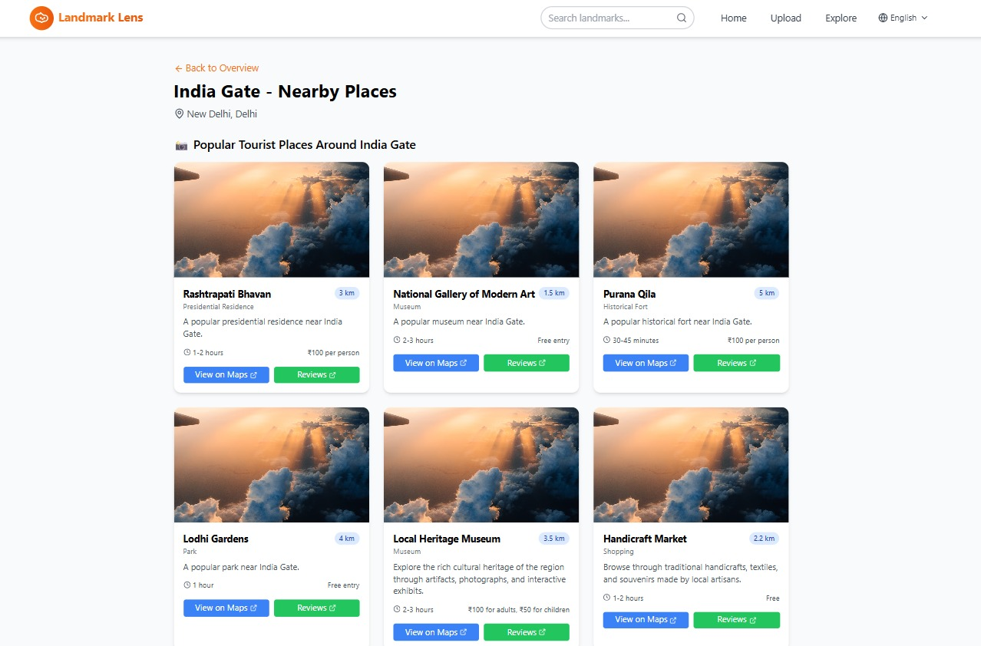

Slide 20
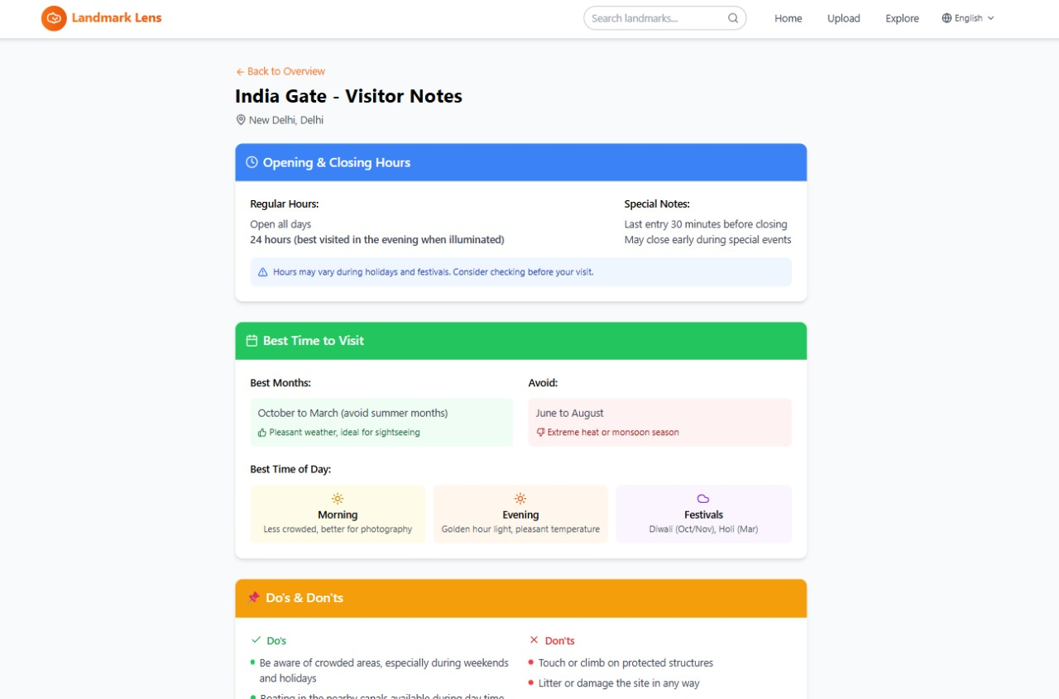

Slide 21
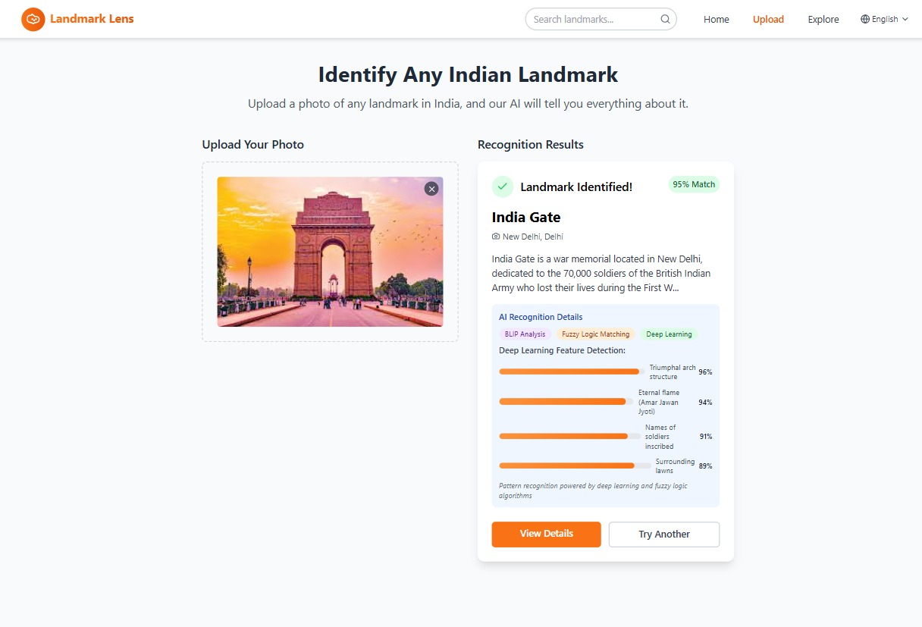

Slide 22
FINANCIAL ANALYSIS
CONSTRAINTS | SCOPE AND SCALE | BUDGET (In $)
Project Cost | Development of web application with image recognition, landmark detection, and information display | $5,000
Capital | Initial investment for development, testing, deployment, and basic infrastructure | $6,500
Fixed Assets | Servers, cloud storage, development systems, testing devices | $2,000
Software Cost | AI frameworks, cloud services, APIs, database, development tools | $1,200
License | Third-party APIs, AI model usage, cloud service licenses | $800
Break Even Point | Achieved within 10–12 months through premium subscriptions, ads, and partnerships | —

Slide 23
MARKETING ANALYSIS
Product Strategy: AI-based smart landmark identification with integrated travel information
Price Strategy: Free basic access with low-cost premium features in future
Place Strategy: Web-based platform accessible anytime from anywhere
Promotion Strategy: Digital promotion through social media, travel blogs, and tourism platforms

Slide 24
IMPLEMENTATION
1. Positioning Strategies
Positioned as an AI-powered smart landmark identification app providing instant and accurate information.
2. Targeting Customers
Targets tourists, travelers, students, and educators seeking quick landmark details.
3. Corporate Social Responsibility (CSR)
Promotes cultural awareness and digital learning using ethical and responsible AI tools.

Slide 25
CONCLUSION
The Landmark Lens application successfully demonstrates how AI can simplify landmark identification and travel planning. By simply uploading an image, users can instantly get accurate details about the place, including its name, location, description, nearby attractions, restaurants with ratings, and directions from their current location. The system also calculates travel distance, time, and modes like road, rail, or air. This solution enhances user convenience, saves time, and makes exploration more accessible and enjoyable. Overall, the app offers an intelligent, user-friendly experience for travelers across India.

