Slide 1
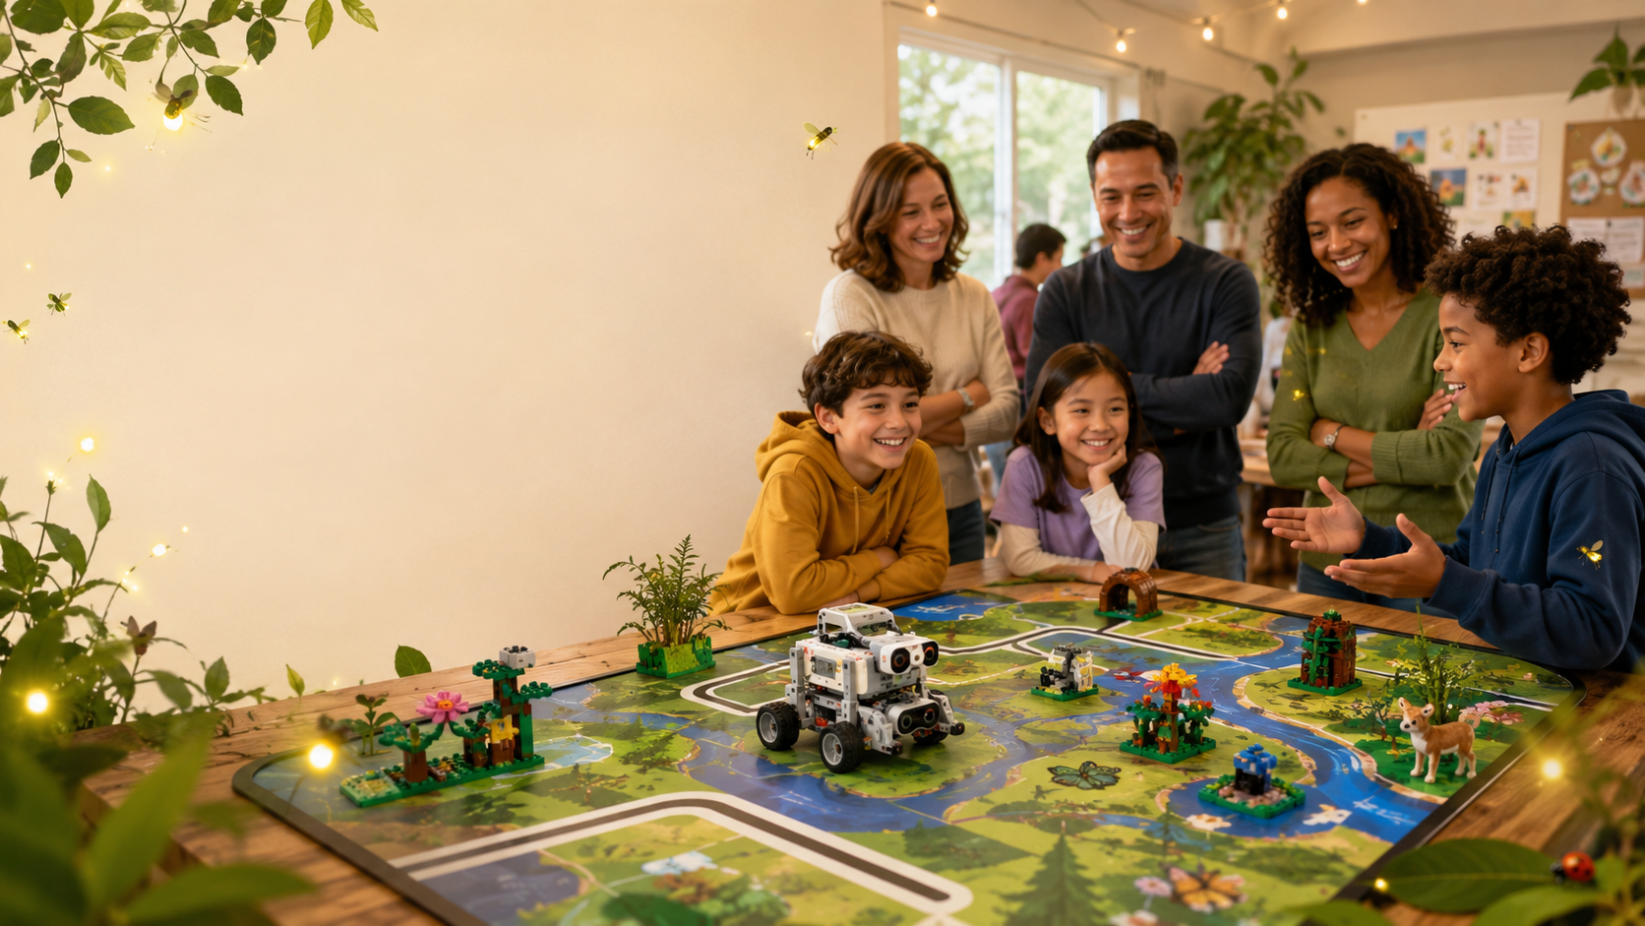
Parent Opening Day
FLL Challenge
BIOGLOW
Founders Edition planning discussion
for 5-student team
Today we align on name, schedule, roles, cost, parent support, and meeting rhythm.
Team name: Folsom Fireflies • Website live
Notes:
Opening: Welcome parents, introduce the season, make it clear this is a discussion deck not a final contract. Emphasize that we are choosing Founders Edition with SPIKE Prime, not Future Edition with the AI kit.

Slide 2

FLL Challenge Overview
BIOGLOW Founders Edition • Parent Kickoff
16

Slide 3
Opening-day decisions
What we need to agree on before the season gets busy
Challenge Level
Team name
Schedule
Founders Edition vs Future Edition
Dashboard, website, related innovation project, software demo, field trip, t-shirts, and labels
Pick regular weekly times and parent backup coverage
Budget
Parent + Student Roles
Logistics
Agree expected cost split and optional extras
2 main parent coaches
Optional sibling coach
Student roles
Communication, attendance, food, transportation and safety
Desired outcome: parents leave knowing how the season works and exactly how they can help without taking over the kids’ work.
BIOGLOW Founders Edition • Parent Kickoff
02
Notes:
Use this slide to set expectations: this meeting should end with practical decisions, not just inspiration.

Slide 4
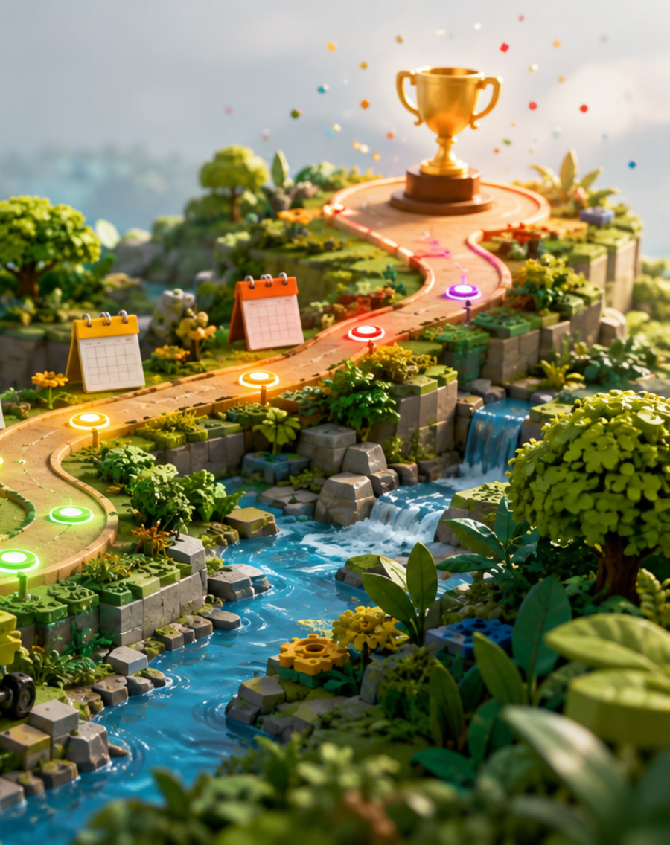
Confirmed season facts
Use official sources for rules; teaser videos are useful but not binding
BIOGLOW kickoff
Tuesday, Aug 4, 2026 • 9:00 AM Pacific
Spike Kit Edition
SPIKE Prime robot, autonomous missions, 2½-minute matches
SPIKE AI Learning Kit, remote control, interactive missions
Theme
Biodiversity and healthy balance between people and nature
Local path
NorCal Founders registration expected around Sep 2026; exact events/fees TBD
Sources: FIRST Game & Season; FIRST Cost & Registration; FIRST LEGO League global overview; NorCal FLL Challenge news.
BIOGLOW Founders Edition • Parent Kickoff
03
Notes:
Say: we will not design final mission routes from predictions. We wait for official rulebook and then build the real strategy.

Slide 5
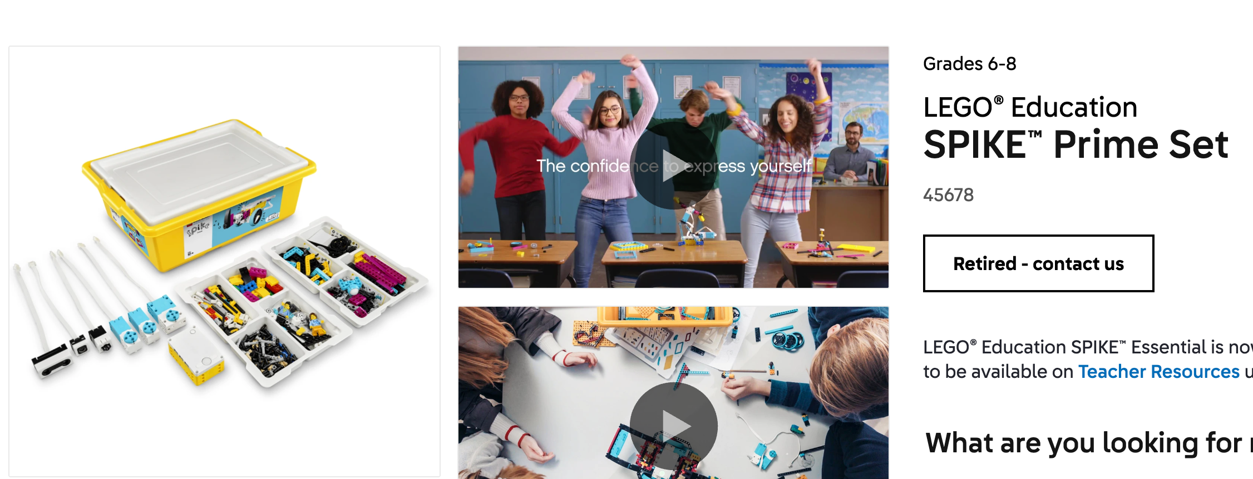
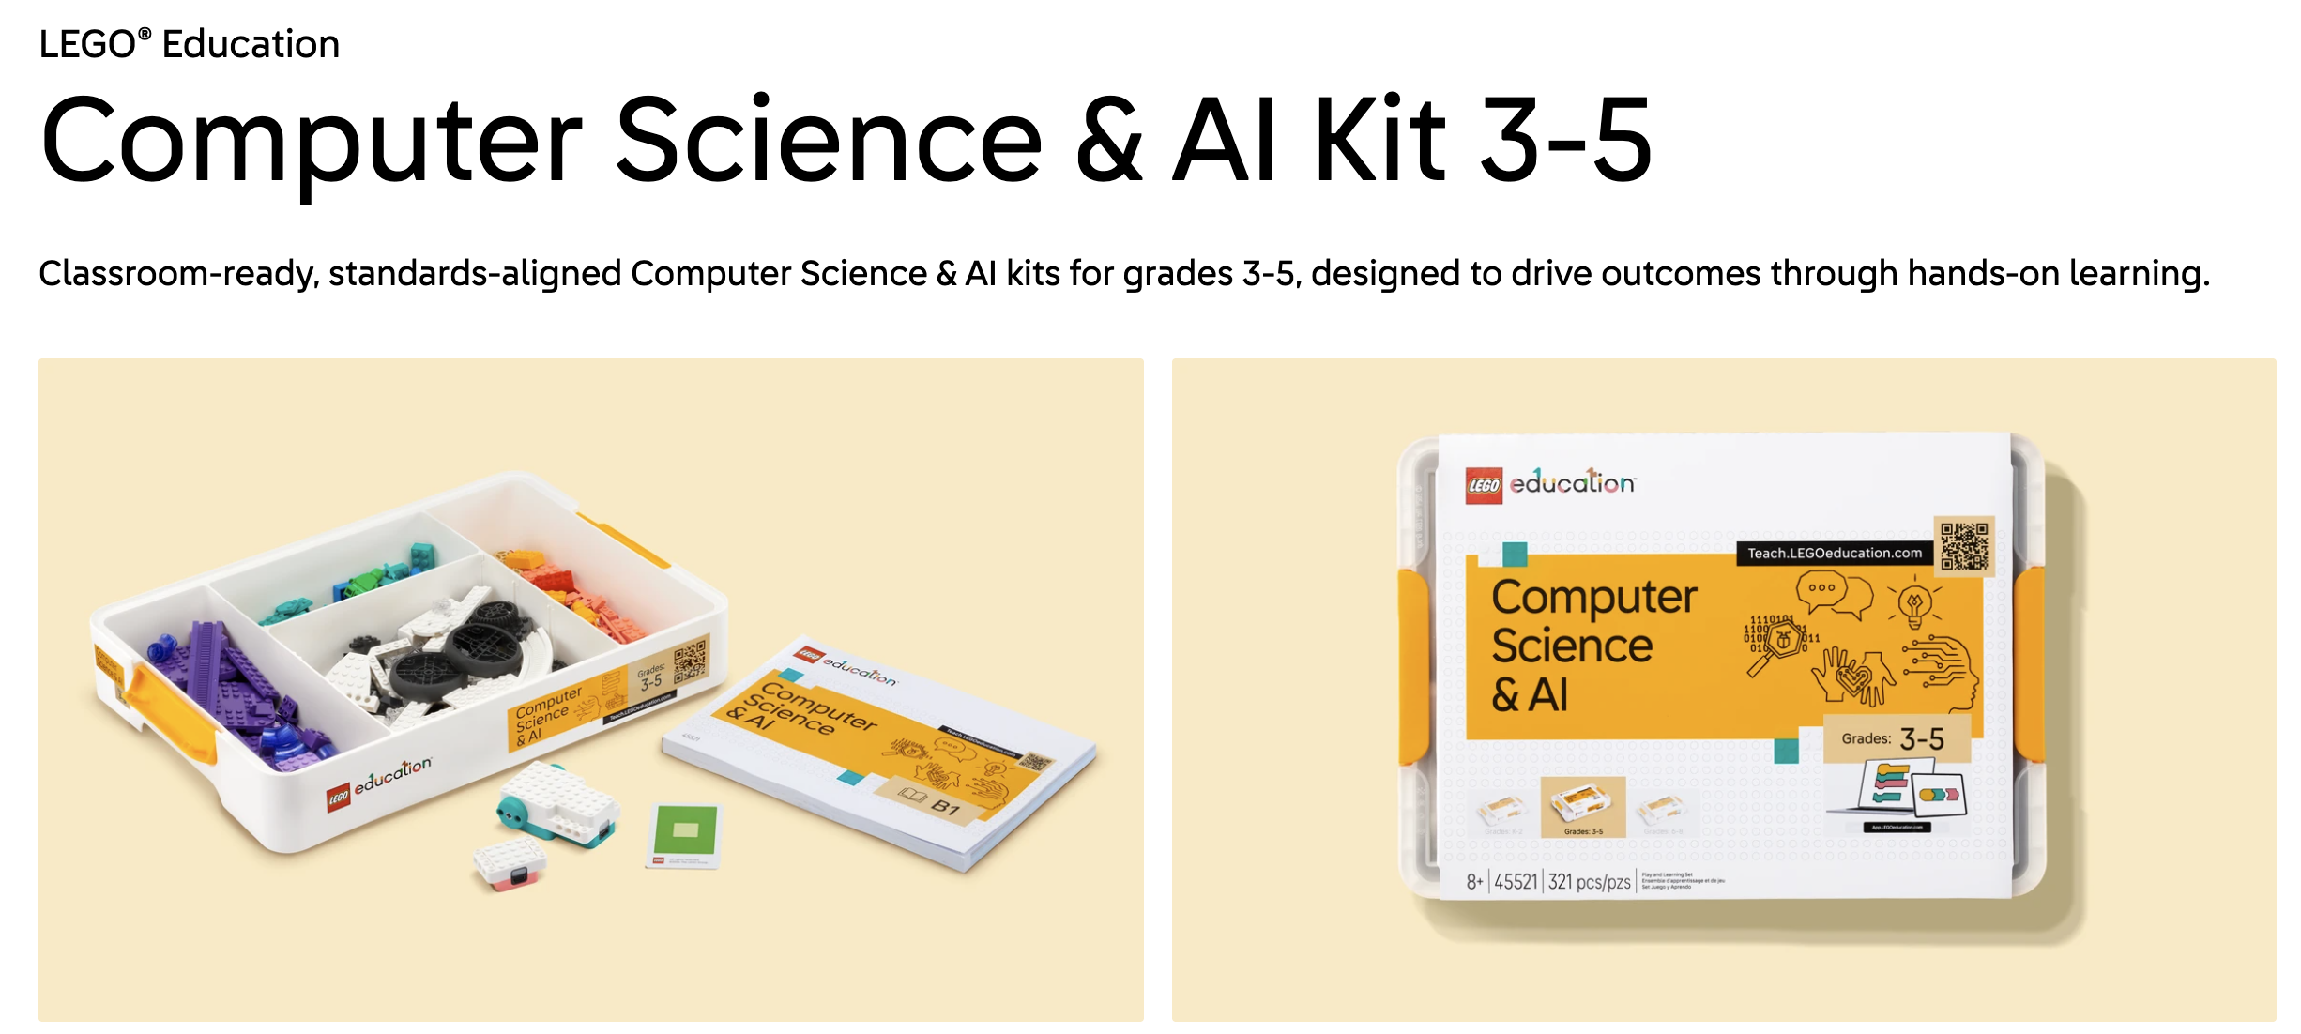
Challenge Level to be picked
We already have SPIKE Prime and extra SPIKE Essential
Founders Edition
Future Edition
Best fit for us
Not ideal
• Autonomous robot game
• Classic FLL Challenge judging
• Strong path from Explore to Challenge
• SPIKE Prime works
• Uses Computer Science & AI hardware
• Includes official Driver / Operator / Technician / Specialist roles
• More interactive, alliance-style play
• New format with more unknowns
• SPIKE Computer Science & AI Kit needed
Decision to confirm today: Founders Edition unless the official release reveals a major issue.
Sources: FIRST LEGO League global overview; FIRST Cost & Registration.
BIOGLOW Founders Edition • Parent Kickoff
04
Notes:
Clarify the earlier role confusion: Future has the named roles, Founders can use similar internal roles but the robot must act autonomously.

Slide 6
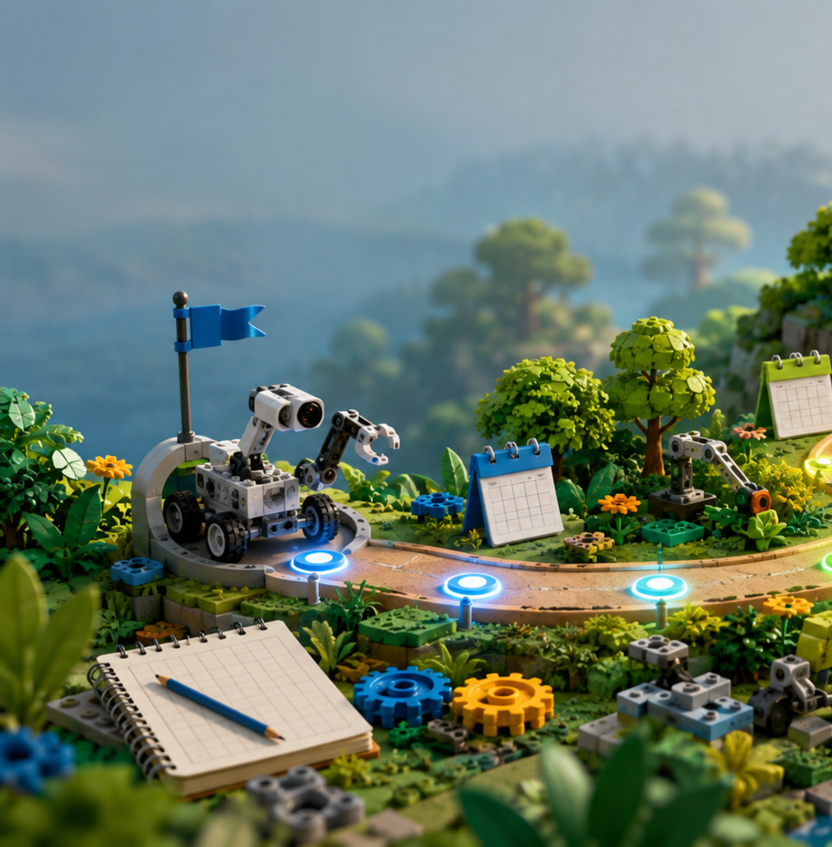
Team name to be confirmed
Relevant to theme, and has potential for innovation project
Team name | Biodiversity relevance | Global challenge
Folsom Fireflies | Fireflies decline signal habitat loss, pesticide exposure and excessive artificial light. | Light pollution disrupts insects, birds, bats and other nocturnal wildlife.
Folsom BioBeacons | A beacon helps people notice and understand biodiversity that is normally difficult to observe. | Communities often lack affordable, local biodiversity information needed to protect species.
Folsom Wild Sparks | “Sparks” can represent both the energy of wildlife and the ecological damage caused by wildfires. | Increasingly severe wildfires destroy habitats, fragment ecosystems and make natural recovery difficult.
Folsom Eco Explorers | Biodiversity protection begins with observing, identifying and documenting local species. | Many children and communities do not recognize the plants and animals living around them, making conservation harder.
Folsom Monarchs | Monarch butterflies depend on milkweed and connected migration habitats across North America. | Habitat loss, pesticide use and disappearance of native milkweed threaten monarch populations.
Folsom River Otters | River otters depend on healthy rivers, fish populations and protected riverbank habitats. | Water pollution, plastics and damaged riparian habitats reduce aquatic biodiversity.
Folsom Glowhawks | Hawks help balance ecosystems by controlling rodent populations. “Glow” connects the name to BIOGLOW and nighttime urban environments. | Birds are injured by window collisions and affected by city lighting.
Folsom Nature Ninjas | Nature “ninjas” quietly identify and defend ecosystems from threats. | Invasive plants and animals can spread before communities recognize them.
Folsom Habitat Heroes | The name directly represents protecting and restoring places where species live. | Roads, buildings and fences divide habitats and prevent animals from safely finding food, water and mates.
Folsom BioBots | It combines biology and robotics—the two central ideas of the season and the team’s technical work. | Scientists cannot manually inspect every habitat, count every species or identify every invasive plant.
BIOGLOW Founders Edition • Parent Kickoff
Now use the name consistently on the website, FIRST dashboard, notebook, shirts, robot labels, and judging materials.
Notes:
A light, fun slide. Let the kids feel ownership here.

Slide 7
High-level Schedule
A high-level timeline we can adjust after NorCal posts events
Aug 4
Aug
Sep
Oct
Nov
Dec/Jan?
Official release
Build models + choose project
Chassis + first runs
Prototype + full match
Mock tournament
Qualifier window
Rulebook, missions, project prompt
Read rules, assemble field, research problems
2–3 short mission runs, first expert interview
Project prototype, robot reliability data
Practice judging + 3 timed matches
Exact NorCal schedule TBD
Parent decision today: pick regular meeting days and a backup adult for each session.
BIOGLOW Founders Edition • Parent Kickoff
06
Notes:
Point out that Dec/Jan is a placeholder. The exact NorCal dates and fees are not final yet.

Slide 8
Meeting Schedule
Every meetup should end with a demo, a notebook update, and one next action
10 min
35 min
35 min
10 min
Stand-up
Robot work
Project work
Demo + record
Goals, attendance, Core Values check-in
Chassis, code, attachments, mission tests
Research, interviews, prototype, presentation
Show progress, log failures, assign next step
Default cadence: 90 minutes weekly in August/September; add optional weekend practice closer to tournament.
BIOGLOW Founders Edition • Parent Kickoff
11
Notes:
This is the segue from parent logistics to the kids’ actual weekly flow.

Slide 9
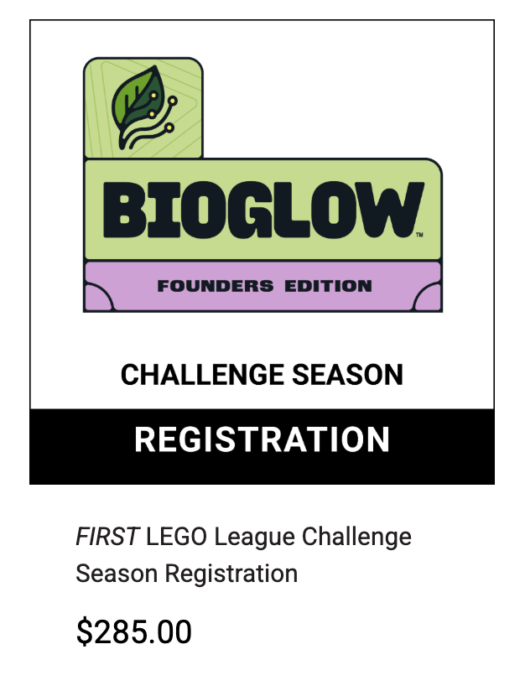
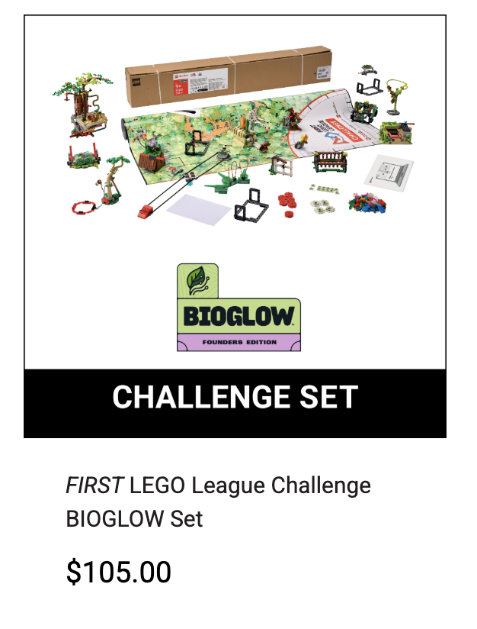
Budget
Keep the budget transparent and separate required vs optional
Type
Item
Cost
Notes
Required
FIRST national team registration
$285
Official team number + digital resources
Required
BIOGLOW Founders Challenge Set
$105
Mission mat and models
Required
NorCal / local tournament fee
Cost of tournament varies
$375
Likely
Spare parts, table supplies, printing, volunteer registration
$50–$150
LEGO challenge table to build/ buy, Livescan for parent volunteer, Parts reuse what we already have
Optional
Team shirts / field-trip / props
TBD
Not mandatory
Can use split-wise like previous years
Sources: FIRST Cost & Registration; local event availability and fees vary by Program Delivery Partner.
BIOGLOW Founders Edition • Parent Kickoff
05
Notes:
Ask parents to agree on a budget cap and reimbursement method. Mention that we are assuming existing SPIKE Prime access.

Slide 10
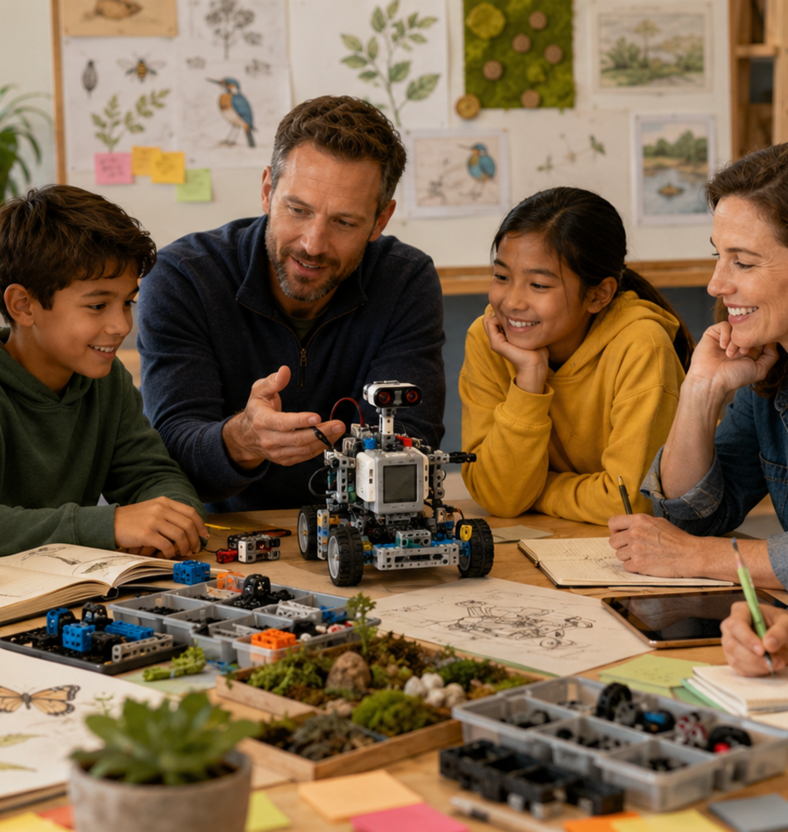
Adult coach and parent responsibilities
Support the process; do not solve the season for the kids
Head coach
Season plan, rules, safety, parent communication, meeting flow
Assistant coach
Backup adult, materials, timekeeping, child engagement
Parent volunteers
Snacks, transport, field setup, expert contacts, photos
All adults
Ask questions, encourage testing, let kids make final decisions
Parent ask: each family helps with at least one logistics job or expert/project connection.
BIOGLOW Founders Edition • Parent Kickoff
09
Notes:
Keep this gentle but clear. Adult help is welcome, adult-built robot/project is not.

Slide 11
Student roles for a 5-kid Founders team
Role ownership rotates; everyone must understand robot, project, and Core Values
Navigation Lead
Mechanical Lead
Mission Strategy Lead
1
2
3
Routes, launch positions, gyro turns
Chassis, attachments, gears, strength
Scoring, route grouping, timing
Innovation Lead
Communication Lead
4
5
Biodiversity problem, interviews, prototype
Notebook, presentation, Core Values evidence
Practice rotation: every child owns one robot run and one project/presentation contribution.
BIOGLOW Founders Edition • Parent Kickoff
08
Notes:
Emphasize no permanent silos. Judges can ask any child about any part of the season.

Slide 12
Logistics to decide today
Small choices now prevent big friction later
Meetings
Communication
Materials
• Weekly day/time
• Location and table access
• Arrival/pickup buffer
• Parent chat group
• Shared folder
• One weekly summary
• SPIKE hub + charger
• Parts bins + labels
• Notebook + photos
Safety & conduct
Tournament
Project help
• Two-adult coverage
• Food/allergy notes
• Respectful teamwork rules
• Registration owner
• Transport plan
• Backup laptop/programs
• Expert contacts
• Field trip ideas
• Prototype supplies
Make commitments visible: who owns what, by when, and where updates live.
BIOGLOW Founders Edition • Parent Kickoff
10
Notes:
Turn this into a parent sign-up list after the presentation.

Slide 13
FLL practice table plan
Buying/building, storage, and how we use the field during meetings
Option A: DIY rigid table
• Best field consistency
• 4×8 plywood surface with border walls
• Heavy; needs garage or dedicated space
• Good if one family can host most practices
Option B: folding / portable
• Easier to store and move
• Good for shared hosting
• Must stay flat and stable during runs
• More setup/teardown time each meeting
Option C: floor first, table later
• Fastest opening-week start
• Okay for model building and early coding
• Less like tournament height
• Upgrade before precision run testing
Target field specs to match official practice
• Inside wall-to-wall area: 93 ± 1/8 in × 45 ± 1/8 in
• Border wall height range: about 2½–3 15/16 in
• Use 2×3 walls if possible; tournament wall heights can vary
• Keep the surface smooth, clean, level, and free of crumbs/dust
Meeting logistics
• Assign one table owner and one setup/checklist owner
• Store mission models in labeled bins by bag/mission
• Photograph model positions before teardown
• Protect the mat; avoid kinks, spills, heat, and sharp bends
1
Setup
2
Calibrate
3
Run tests
4
Record data
5
Pack cleanly
Reference for dimensions: official FLL Challenge Robot Game table-building instructions; verify against the current BIOGLOW rulebook after release.
BIOGLOW Founders Edition • Parent Kickoff
16

Slide 14
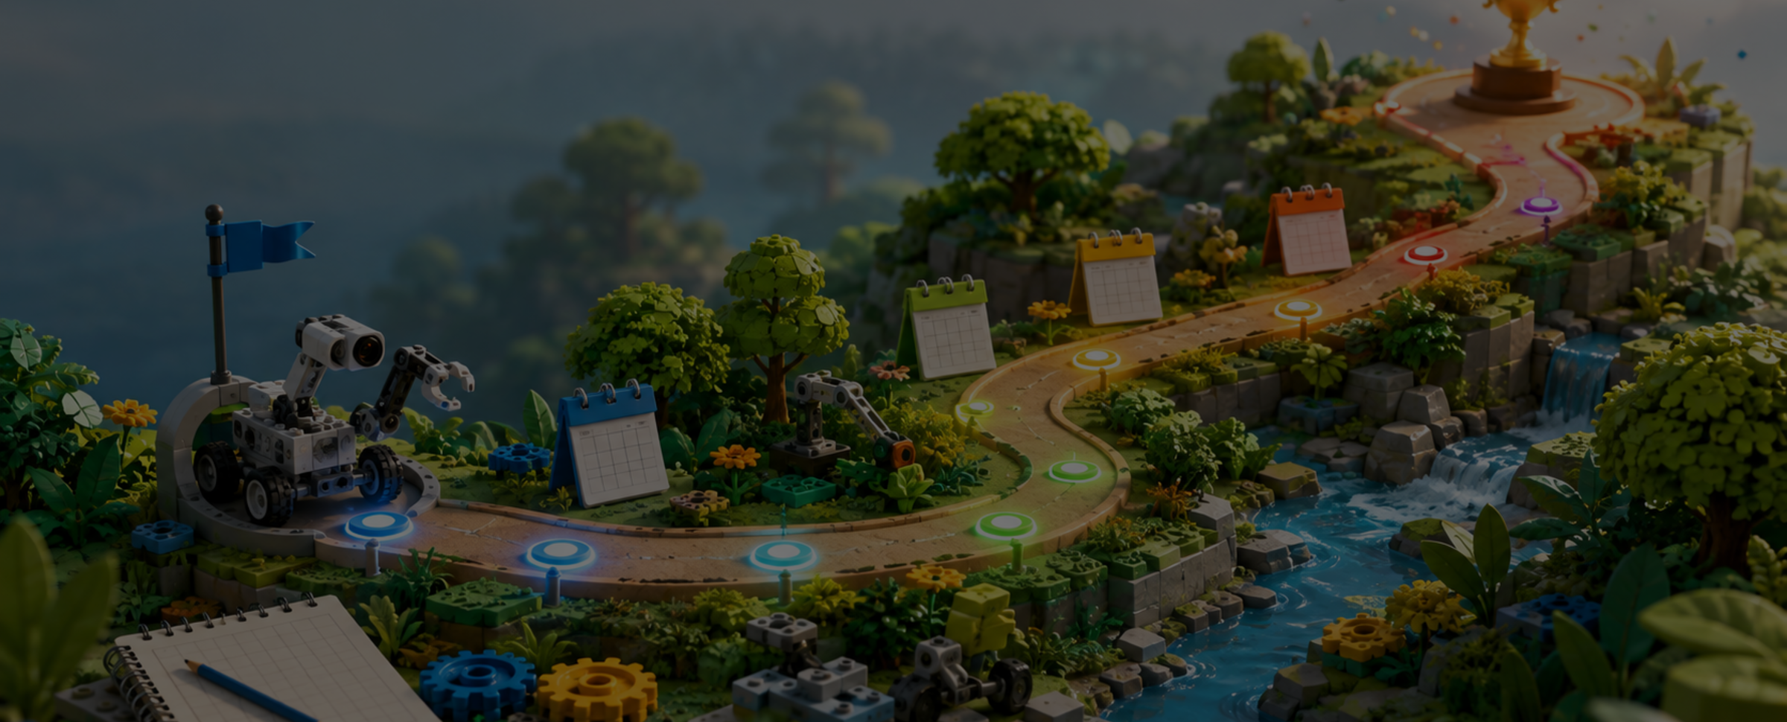
High-level goals for each phase
We measure progress by ownership, testing, and reliability—not one lucky high score
August
September
October
November
Understand
Build basics
Test + improve
Prep for tournament
Build models, read rules, rank missions, explore biodiversity problems
Stable chassis, first attachments, select Innovation Project problem
Short mission runs, field-trip + expert feedback, prototype iteration, Innovation project finish
Full matches, judging practice, freeze major changes
Target: by tournament day, all 5 students can explain the robot, project, failures, and teamwork story.
BIOGLOW Founders Edition • Parent Kickoff
12
Notes:
This slide reinforces high-level season goals, not detailed mission strategy.

Slide 15
Next steps and source links
After the official release, we turn this into a detailed mission plan
Today
Complete registration and order material, decide meeting schedule
Aug 4
Watch official launch of FLL season online, assign initial roles
Week 1
Collect material, books, assemble LEGO table, share website with team for planning / tracking
Week 2
Build main model, and mission models and attachments; create mission scoring matrix
Week 3
Confirm student website access and add discussion, trial run on main table, begin project problem discovery
After rules
Create run plan, attachment plan, judging script, and parent schedule
References used for official facts
FirstInspires Dashboard • FIRST Cost & Registration • FIRST LEGO League global overview • Folsom Fireflies Website
Reminder: teaser-video mission predictions are not official rules.
BIOGLOW Founders Edition • Parent Kickoff
14
Notes:
This slide is deliberately practical. Send the deck after the parent meeting so people have the source list and next steps.

Slide 16
What “successful season” means
A confident, child-owned team beats an adult-polished result
Robot
4–6 manageable runs; reliable launches; documented fixes
Project
Real biodiversity problem; expert feedback; tested prototype
Judging
Every child speaks; evidence of iteration and teamwork
Core Values
Shared ownership, respectful disagreement, resilient debugging
Parent decisions today: meeting day/time • budget cap • table plan • logistics owner • communication channel.
BIOGLOW Founders Edition • Parent Kickoff
13
Notes:
Close with the specific decisions and sign-up sheet.

Slide 17
Team setup is now live
Use these links for parent coordination, FIRST registration, and public season updates
Team name
Parent access
• Bookmark the website
• Use the FIRST dashboard for official registration items
• Keep private details off the public site
What goes public
• Team story and progress
• Meeting summaries and milestones
• Project evidence without private child info
Public website
https://msriram.github.io/folsom-fireflies/
What stays private
• Children's full names
• School schedules and addresses
• Parent contact info and exact meeting location
Next updates
• Add official team number when assigned
• Add kickoff photos only with parent approval
• Post one short journal entry per meetup
FIRST dashboard
Team Profile ID: 1818412 Coach/admin access required
Parent decision: who owns website updates, FIRST dashboard checks, and weekly meeting summaries?
BIOGLOW Founders Edition • Parent Kickoff
15

