Slide 1
Retail Competition, Open Access, Power Markets and DISCOMs A medium-term outlook
Ann Josey
Prayas (Energy Group)
Distribution Utility Meet (DUM 2017)
29th November 2017, Bangalore

Slide 2

About Prayas (Energy Group)
Energy (Policy, Planning & Governance)
Electricity Regulation
Rural Energy
Renewable Energy
Fossil fuels governance
Energy and Resources
Energy Efficiency
Not-for-profit organisation founded in 1994
Analysis based policy advocacy for promoting public interest
Focus on governance aspects & policy innovation
Part of several high-level Govt. Committees & regulatory processes
MoP and MNRE: RE Law, 12th Plan and Tariff Rationalisation Committee
Regulatory commissions: Consumer Representative before MERC and CERC, Advisory Committees of CERC and 5 SERCs
NITI Aayog: 175 GW Expert Committee, Low Carbon Inclusive Growth, India Energy Security Scenarios, New Integrated Energy Policy; Indo-US energy dialogue.

Slide 3
Utility Business Model at cross roads
Significant sales migration via open access, captive and rooftop solar
Alternative options competitive for large consumers
Average cost of supply already > Rs. 6.5/kWh for some DISCOMs
Energy charges @ Rs. 7- 8/kWh for cross-subsiding consumers
Technological and Market Structure changes
Falling RE prices and rising costs of thermal power
Advent of storage
Increasing trades in power exchanges, bilateral market
Rise of consultancy services to facilitate/aggregate procurement solutions.

Slide 4
Significant Sales Migration in the recent past..1
Open Access
Extent of Open Access in 2016-17 (MUs)
Note: Estimates for Rajasthan for FY 16. Estimates for Madhya Pradesh from Sept ’15 to Aug’16.
Source: PEG compilation from regulatory orders and petitions based on estimates or actual sales reported by DISCOMs
Open access power purchase through PXs : ~ 24,000 MUs in FY 17.
Accounts for more than 60% of the trade on power exchanges
Most of the trade from Tamil Nadu, Andhra Pradesh, Gujarat and Haryana
Open Access has also been growing in many states in the recent past:
Rajasthan: 74% ↑ (FY 15- FY 16)
Karnataka: 105% ↑ (FY 16 - FY 17)
Gujarat: 16% ↑ (FY 16 - FY 17), despite levy of additional surcharge
Maharashtra: 29% ↑ (FY 16 - FY 17)

Slide 5
Significant Sales Migration in the recent past..2
Captive
Steady 4% increase in captive consumption in the past three years
Between FY 14 and FY 15, 9% ↑ in Odisha, 12%↑ in Chattisgarh and 34% ↑ in Karnataka
Consumption patterns change across years in states which adds to uncertainty.
Captive consumption (MUs) , relative % to DISCOM sales
Source: CEA
Roof-top solar
1345 MW is estimated capacity till September 2017.
Another 1500 MW expected to be added in the next year itself.
Tamil Nadu, Karnataka, Maharashtra, Gujarat have the highest penetration
Competitive prices and rising DISCOM tariffs will further increase penetration

Slide 6
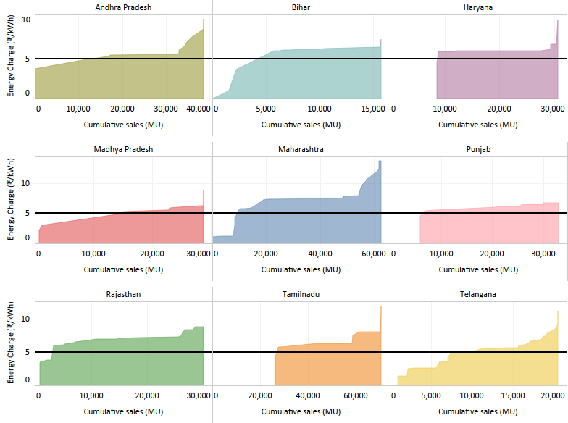
Tariff for large consumers > competitive rates
About 60% to 70% of non- agricultural sales higher than Rs.5/unit .
This is comparable to indicative rooftop-solar prices.
The eligible sales will increase in coming years with increasing ACoS, tariffs of DISCOMs.
DISCOMs will have small consumer demand to service.
Storage options will further sales migration.
Source: Various tariff orders

Slide 7
Short-term Open Access (STOA)
Majority of open access in India is short-term
60% of Day-Ahead Market trade in Power Exchanges due to Open Access
Pose Challenges with :
Power Procurement Planning
Scheduling
More than 100% variation in monthly open access quantum across states within a year.
Significant diurnal variation in some states
Power procurement planning less challenging if consumers go for good.
Increases certainty in demand
Opens up avenues to manage surplus
Possibility of year-long open access contracts?
Need for market instruments to cater to longer term open access?
For Distribution Open Access, DISCOMs submit combined schedules to SLDCs
DISCOM+ embedded OA consumers
Cost of deviation due to open access borne by DISCOM
penalties for overdrawal, load shedding
Need for equitable, transparent mechanism for deviation settlement for embedded open access consumers
Basis for sharing costs for deviation?
Methodology used for aggregation and revision of schedules?
Allowing higher deviation for RE power?

Slide 8
Renewable Energy Open Access: Increasing competitiveness
Data for 2017-18
Coal | Wind |  | Coal | Wind |  | Coal | Wind |  | Coal | Wind
Gujarat |  |  | Maharashtra |  |  | Rajasthan |  |  | Tamil Nadu
Source: Various regulatory orders
Increasing viability of renewable energy (RE) based open access
Cheaper than coal if base price for both RE and coal assumed @ Rs. 3.5/unit.
This is due to concessions for RE open access
Need to re-evaluate RE related concession in states.
Loss of revenue due to concessions being borne by DISCOM/consumers- evaluate support options
Significant impact in RE-rich states
Andhra Pradesh: Removal of concessions for RE-based open access generates as much revenue as levying an additional surcharge of Rs. 1/kWh on all open access consumers.

Slide 9
Renewable Energy Open Access: Banking
Variation between infirm generation from RE sources, open access load →absorbed by DISCOM
Needed due to seasonal, diurnal variations, low CUF, mismatch of generation and load in real time
Generation in excess of demand can be banked and later unbanked
Characteristics of Banking services
Charges: usually , 2% of banked energy , Buy-back period: mostly one year
DISCOMs incurs cost due to service especially due to difference in cost of power at the time of injection and drawal of banked energy
Difference passed on to the non-open access consumers of DISCOM
MSEDCL’s proposal to compensate DISCOM for banking services
Settlement and valuation linked to Merit Order Dispatch and marginal cost incurred by DISCOM
Value of banked energy at time of injection → lowest variable cost of backed down power
Value of banked energy at time of drawal → highest variable cost of dispatched power (incl.PXs)
Estimations to take place on a 15 minute block basis with monthly settlement
Proposal will ↑ banking charge from Rs.0.06/kWh to Rs.0.28/kWh →landed price inc, only 3%
Impact will vary from DISCOM to DISCOM

Slide 10
Sales Migration charges…1
Uncertainty in CSS, Wheeling charges
Changes on a year on year basis
Maharashtra (FY 11 to FY 18): +100% to -50% in CSS, +175% to -40% in wheeling
Gujarat (FY 11 to FY 18) : +150% to – 40% in CSS, +10% to -1% in wheeling
Changes the viability of open access, encourages opportunistic switching
Can think of a fixed trajectory for wheeling and CSS charges over a 5 year period?
Per unit CSS (Rs/kWh) fixed thus reducing real rates over time
Wheeling charge trajectory → fixed with incentives for efficiency improvement
Additional surcharge estimation
Typically estimated on the basis of overall average fixed cost of power
Could lead to under-estimation/over-estimation
Under-estimation : If new plants with high fixed cost being backed down.
Over-estimation : with depreciated or gas-based plants being backed down.
Ideally, it should reflect cost of backing down –i.e: the average fixed cost of the plants backed down due to open access

Slide 11
Sales Migration charges..2
Standby charges estimation
Some states use mutually agreed rates with consumer- practice not preferred.
Given the risk of load shedding for low paying DISCOM consumers, open access consumers should be encouraged to find other standby options.
Should standby power be provided at prohibitive rates (1.5 times applicable tariff) like in some states?
Should standby power till a certain level (say, 20% of contracted demand) be provided at nominal rates to encourage open access?
Sales migration charges cannot address loss of revenue
Cross-subsidy levels are much higher than the 20% of ACoS
With surplus power, several states levying additional surcharges
Open access → 10% to 25% of backing down
ACoS high and ↑- cost competitiveness unlikely with efficiency improvements.
High sales migration charges can incentivise consumers migration to captive.

Slide 12
DISCOM Strategy: Reducing ABR for HT consumers
Time of Day (ToD) tariff in Maharashtra
Source : MERC order in Case 48 of 2016
Open Access is high in off-peak times even with a tariff rebate of Rs.1.50 per unit.
In fact, off-peak open access comparable to Peak open access despite peak tariffs
Power available at PXs at Rs.2.19/kWh during off-peak hours.
Industrial consumer tariff reduction
ToD time slot | Time Slot | ToD Tariff (Rs./kWh) | Open Access as % of open access in A
6:00-9:00 | A: Other than peak, off-peak | 0 | 726
12:00 to 18:00
9:00 to 12:00 | B: Peak | 0.8 | 728
18:00 to 22:00 |  | 1.1 | 729
22:00 to 6:00 | C: Off-peak | -1.5 | 731
Punjab
FY 16 - FY 17:2% ↓ in energy charges
Maharashtra
FY 15- FY 16: Subsidy for HT consumers reduced tariff by about 16%
In same period, open access ↑ by 29%
FY 17 : New industries charged subsidised tariff of Rs. 4.99/kWh
In same period, open access ↓ by only 46 MUs (2%)

Slide 13
Other strategies
Increasing revenue from captive sales
Parallel operation charges in Gujarat and Tamil Nadu for grid support services
Levy of electricity duty
On all users of the grid including captive consumers
Revenue used to support loss making DISCOMs
Change cross-subsidy model
Increase in intra-category cross- subsidy
Reduce average cost of supply
Increase in generation efficiency
Reduction in T&D losses
Rationalisation of coal costs
At most these measures will slow the rate of increase of ACoS in many states
Many of these measures might slow sales migration
Provide short-term relief: At most it will buy a year or two for the DISCOM
Falling prices and storage options will change the market

Slide 14
Observations…1
Sales migration is an inevitability
Will take place even without the introduction of multiple supply licensees as envisages in E-Act Amendment
Cheaper alternatives and increasing cost of supply major factors
Tweaks in tariff design at most brings short-term relief
DISCOM Business Model needs to change
Provider of wires and supply → Provider of wires
Universal supply obligation → Supplier of last resort
Dominant grid user → Grid Balancing
Catering to state demand → Catering to demand of small consumers (LT domestic, agriculture)
Cross subsidy based model → Cost of supply/ Subsidy model, Possibility of other revenue streams
Need to prepare for the transition in DISCOM business
Demand uncertainty: Assessment needs to include impact of sales migration
Power procurement: Rethink flexibility, Duration of PPAs

Slide 15
Observation …2
Market operations fundamental to transition
Need to move towards capacity markets
Facilitate utilisation of stranded capacity, backed down power
More flexibility in terms of contracts, instruments
Is the Indian power market ready?
Lack of flexible longer-term market instruments in PXs, traders
Fragmentation in markets
different players, prices, lack of information, varied instruments
Regulation of new players?
Need for analysis based reports at state level
Similar to CERC Market Monitoring reports
Need for increasing institutional capacity during transition
LDCs, DISCOMs: to plan operations given uncertain demand, supply and provide grid services
SERCs : to ensure robust market operations, protect interest of small consumers
PXs, Traders, Generators: To provide innovative market instruments to optimise assets and increase flexibility.

Slide 16
Thank you
ann@prayaspune.org
shantanu@prayaspune.org

