Slide 1
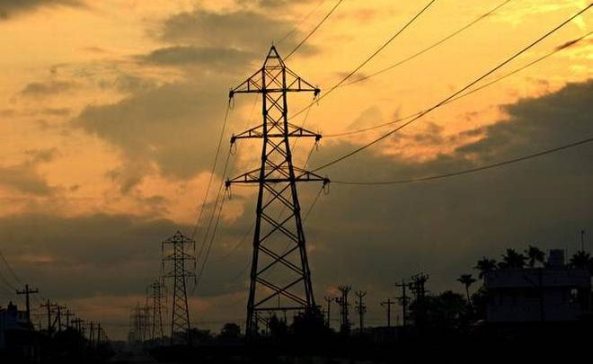
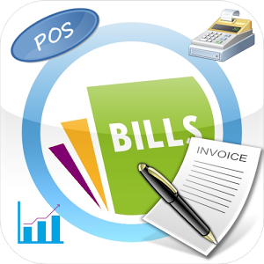

Billing & Energy Accounting
Tuesday, December 5, 2017

Slide 2

Flow of Presentation
Reliance Energy Overview
Building robust billing system
Energy Accounting
IT Driven process transformation
Future plans

Slide 3

“90 Years” of Distribution Business
Reliance Energy - Overview
Serving Mumbai Since 1926!!

Slide 4
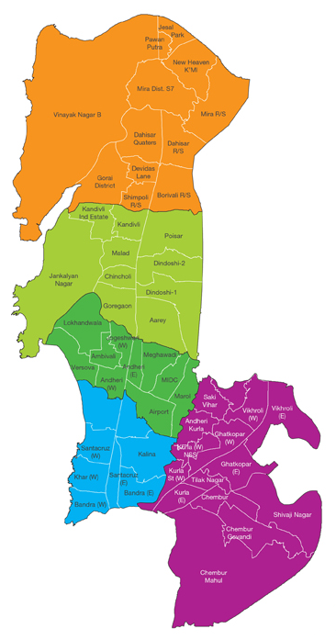
Reliance Energy - Overview
Distribution Area
400 Sq Km
PT Capacity
3341 MVA
No of Customers
~ 3 Million
DT Capacity
4804 MVA
Max. System Demand
1892 MW
HT Cable Length
4253 Kms
Reliability Index
99.97 %
LT Cable Length
22000 Ckt Kms
One of the Lowest Distribution Losses in the Country @ 8.83%
4

Slide 5
Building robust Billing System
COBOL
(14)
Migration
SAP-ISU-CCS
Legacy Applications
Foxpro
(17)
VB6/D2K
(18)
Implementation of MBC for 2.2 Million customers @ 11 Months

Slide 6
Building robust Billing System
SAP Standard (4.6 C)
Customer Service,
Device Management
Billing & Invoicing
FICA
Business specific customization
Reports 78
SAP India Localisation release
ECS Mandate
Late Payment surcharge
Workflows 06
Prompt Payment Incentive
Interest on overdue
Security deposit enhancements
Pro rated clearing options
Seal Management
Reliance Energy customization
Correspondence Handling
New scenarios/technology
Paperless bill
Amendment
Case Management
Bill Amendment
Migration/Reverse Migration
Mass printing
Seal Management
Mobile Apps
Smart meter integration
Customer portal pilot
Open access
EODB initiatives
NACH
Dashboards
Customer supply Delivery on time (CSDOT)
Roof top solar
Interfaces 15
Enhancements 46
CIC 42
Forms 32
2005
2008
2008-2013
2014-2017
Faster adoption of new Scenarios/Technology

Slide 7
Meter to Cash Process
Day 0
Day 1
Day 2
Day 3
Create Meter Reading Order
Meter Readings + Upload
Generate Print Documents (Batch)
Dispatch (Courier, Post)
MR Error Correction
Download meter reading data
Meter Reading Validation
Billing Exception & Errors
Printing
Billing (Online)
E-Bill,SMS)
Billing (Batch)
Invoicing (Online)
Invoicing (Batch)
Bill delivery in T+3 Days!!

Slide 8
Building robust Billing System
Residential
Commercial
Commercial Industrial
Changeover
~ 6 Lakh
40 Nos
160 Nos
Ready
Single/Multi register
TOD
TPC Migration
Roof Top
Solar
MYT
Open Access
RTP
EV
2005
2007
2009
2014
2016
Future
Journey towards complex Billing

Slide 9
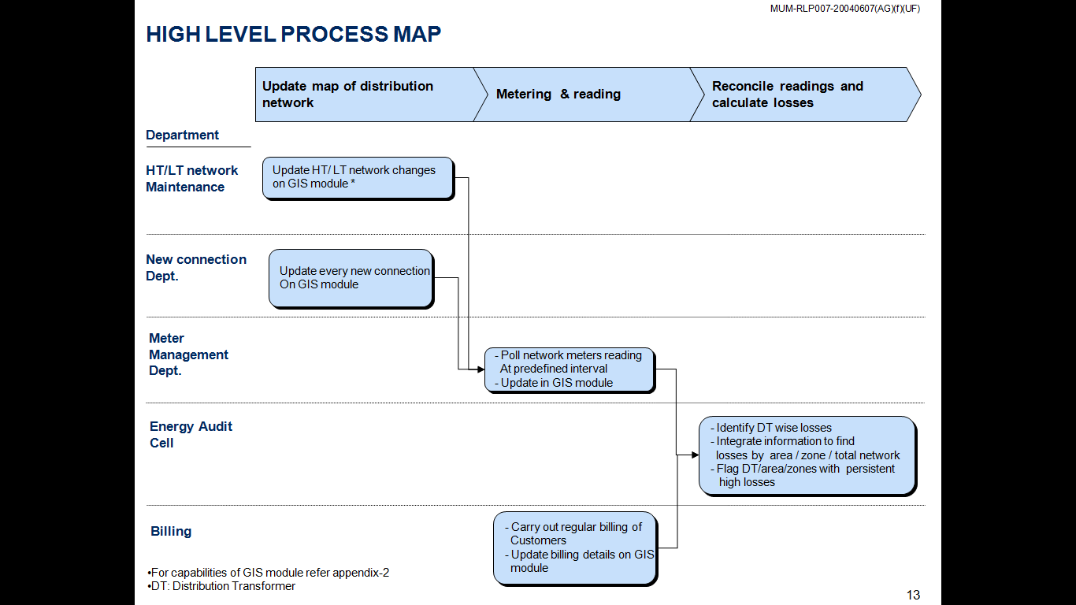
Energy Accounting
Energy Audit Process
GIS integrated Dot Net Portal
1
Automated
WIP
1
2
2
SAP-ISU
DM-BI
3
→Canopy Pilot
→ Smart Metering
5
5
SAP-ISU
DM-BI
4
4
Reduced cycle time for data updates from 7 days to 1 day

Slide 10
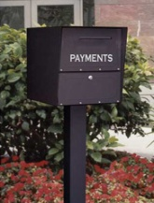



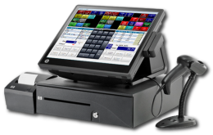
Payment Process Overview
SFTP/E-mail
SAP-ISU-CCS
Batch Upload
Payment Avenues
Payment files
Wallets
OFC
POS
Cashless Payments : Receipts 54 %,Amount 80%

Slide 11
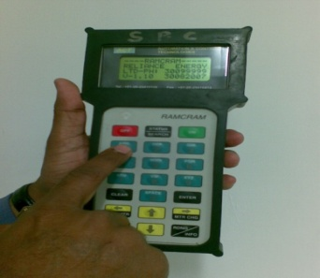









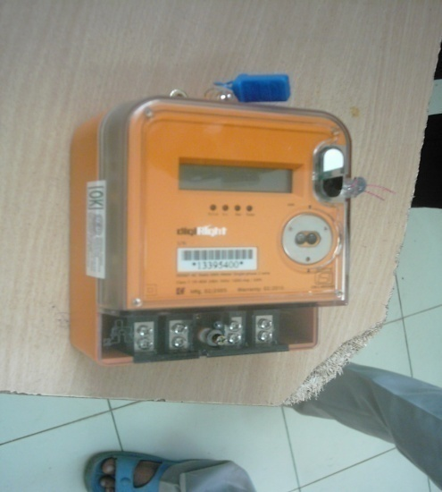
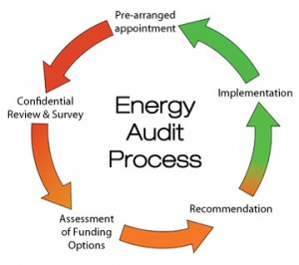
IT driven Transformation – Business Processes
Monthly Meter Reading & Billing for all customers
ISU-CCS system for Customer Billing started
BDTS System for distribution of bills
Enf. Analytics process started
AMR based meter readings initiated for PV / HV customers
Mapping of Migration process iin ISU
BDTS
2004 2006 2008
2003 2005 2007 2009
Electromechanical Meter replacement initiated
Use of MRI for reading
SAP based Energy Audit Solution
Implemented "Law Suit Tracker" software for tracking of theft booking cases
LST

Slide 12
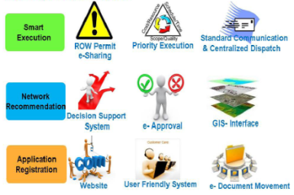
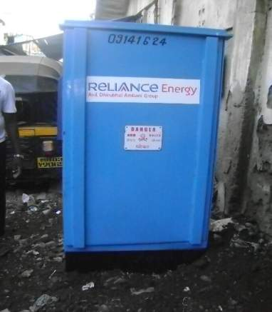
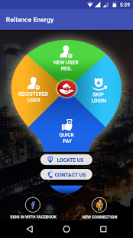
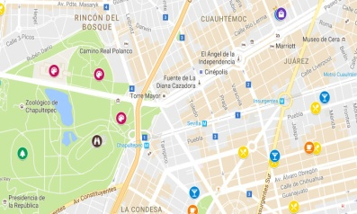
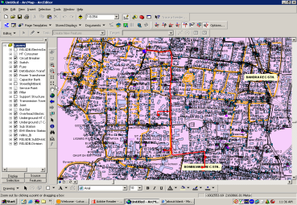
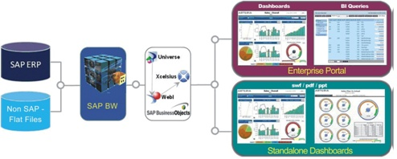
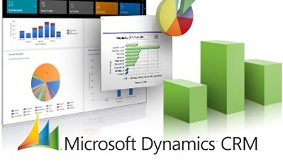
IT driven Transformation – Business Processes
CS-DOT process launched
Bill delivery info. over SMS
Theft proof Pillars introduced
Outbound calling for Recovery initiated
Theft proof Pillars introduced
Outbound calling for Recovery initiated
Mobile App for Customers
Open Access Billing
GIS based Mobile Apps
Fiori Apps and Dashboard
2012 2014 2016
2011 2013 2015 2017
GIS based EA
Technical solutions initiated for theft mgmt. in Slums
Dashboard for Business function
Design of New Metering specs.
CRM implementation
Roof top Solar
EODB initiatives

Slide 13
Reliance Energy Evolution
2003 | 2017
Efficient Indian Power utility | World-class Utility
Basic service levels | Value-added services
Multiple Legacy systems | Integrated State-of-art Systems
Product-centric | Customer-centric
Operating practice oriented Process Driven | Process & Workforce Automation, Data Driven
Vision
Offerings
Systems
Approach
Operational Excellence
Transforming Reliance Energy into a World-class Utility
13

Slide 14

Future
Challenges
Data Points
Enabler
The Deliverables
Data retention policy?
Remote Disconnection/ Reconnection
Time of Use
Real Time Tamper & Theft Detection
Demand & Load profile
Real Time Energy Auditing
Scalability of Billing System?
Power Quality
Alert /Notification (Outages) to Customer
Interval Data
Real Time Consumption Management
Alrams & Events
Licensing compliance?
Smart Meter
Real Time Demand Side Management
Cry-Out Alarms
Integrated Home Automation
Integration platform?

Slide 15




Recognition

Slide 16
Thank You

