Slide 1
Manual for poster creation

Slide 2
Get Started
Install typst (https://typst.app/open-source/) (not mandatory, but enables terminal commands)
Install typst packages in VS code (Tinymist Typst)
Clone the git folder

Slide 3
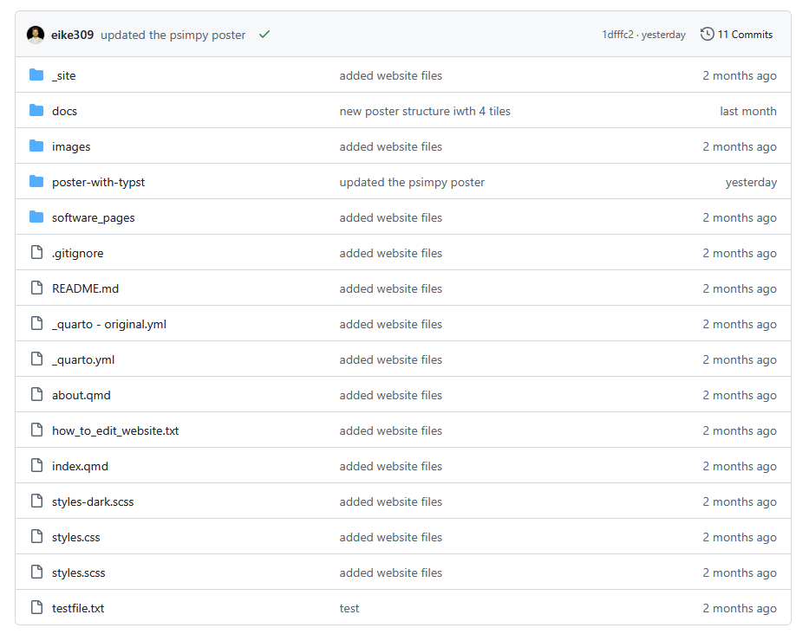
Navigate to „poster-with-typst“ folder

Slide 4
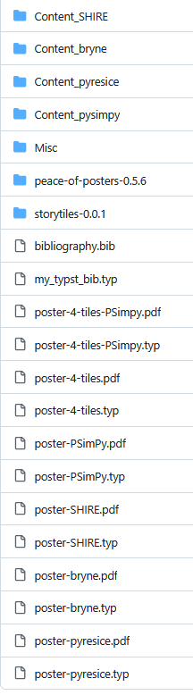
File Overview
Content folders for each poster
Folder with content several posters use (MSS logo, etc.)
Typst Bibliotheken deren Funktionen benutzt werden
Bib file in denen die Veröffentlichungen gelistet sind
Typst Bibliothek mit custom Funktionen
IN PROGRESS
-> New screenshot einfügen
Jeweils .typ und .pdf files mit gleichem Namen (pdf von typst generiert)
Altes Format: poster-…
Neues Format: poster-4-tiles-…

Slide 5

Sample Poster - Overview
Name of Software
Authors, name of chair, etc …
Logo of Chair
Catchphrase to get reader hooked
Software logo
QR code to access software
Box to highlight purpose of software
Box to show example use case for software
Citation of software publication

Slide 6
Sample Poster – Division
As used in the typst template
Title Box
Software Logo Box
Content Boxes
Bibliography
Bottom Box

Slide 7

How to render
This button renders the PDF and opens the preview window. If button is not there, press on the „execute“ button (in the image left to the render button)

Slide 9
Typst tipps
Units:
% -> how many percent of the current box
Pt -> absolut unit of measure (1pt=1/72 inch)
Terminal commands:
See available fonts on system: >> typst fonts

Slide 10
How to create your own poster
Title: enter max 19 characters, otherwise the font-size of the title will shrink

Slide 11
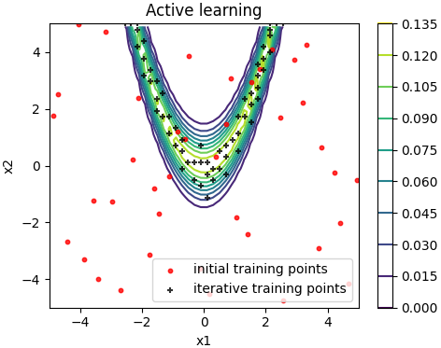

Slide 12

4
3
5
1
7
6
2
rgba(191, 208, 209)
rgba(199, 221, 242)
rgba(64, 127, 183)
rgba(142, 186, 229)
rgba(184, 214, 152)
rgba(0, 84, 159)
rgba(87, 171, 39)
rgba(99, 101, 102)
3
8
6
4

