Slide 1
Manual for poster creation

Slide 2
Get Started
It is recommended to use Visual Studio Code
Install typst (not mandatory, but enables terminal commands)
Install typst packages in VS code (Tinymist Typst)
Clone the git folder

Slide 3
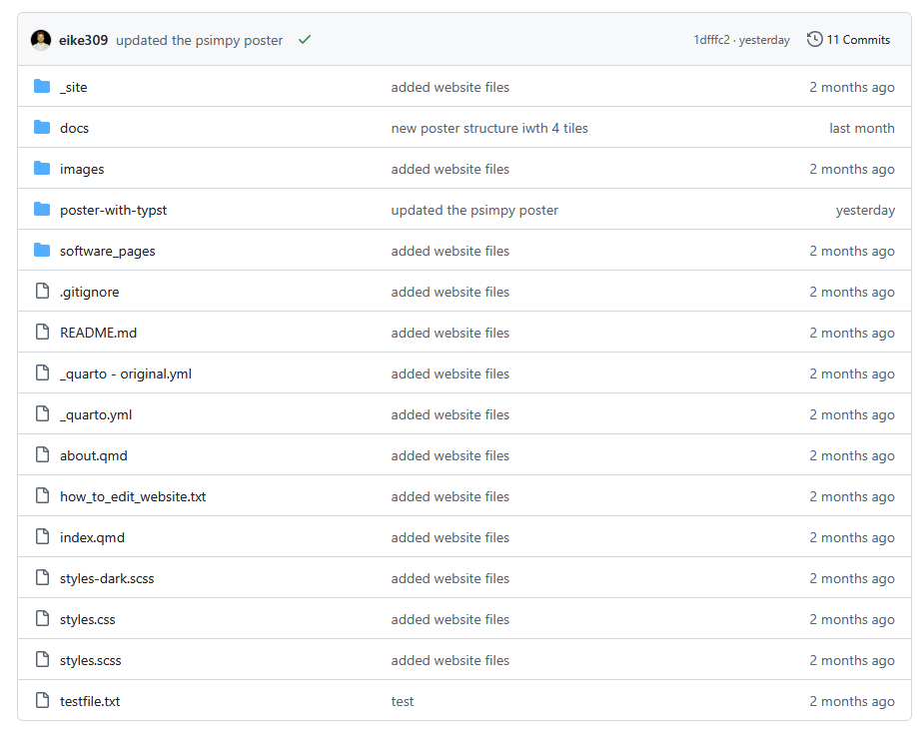
Navigate to „poster-with-typst“ folder

Slide 4
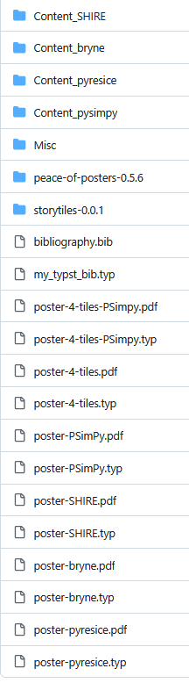
File Overview
Content folders for each poster
Folder with content several posters use (MSS logo, etc.)
Typst Bibliotheken deren Funktionen benutzt werden
Bib file in denen die Veröffentlichungen gelistet sind
Typst Bibliothek mit custom Funktionen
IN PROGRESS
-> New screenshot einfügen
Jeweils .typ und .pdf files mit gleichem Namen (pdf von typst generiert)
Altes Format: poster-…
Neues Format: poster-4-tiles-…

Slide 5

Sample Poster - Overview
Name of Software
Authors, name of chair, etc …
Logo of Chair
Catchphrase to get reader hooked
Software logo
QR code to access software
Box to highlight purpose of software
Box to show example use case for software
Citation of software publication

Slide 6
Sample Poster – Division
Names as used in the typst template
Title Box
Software Logo Box
Content Boxes
Bottom Box

Slide 7
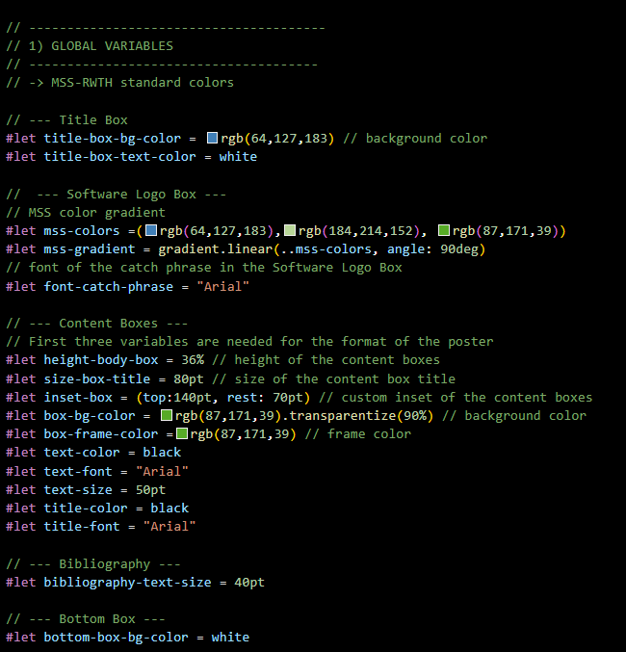
Global Variables
It is recommended to keep the global variables for colors and format unchanged.

Slide 8
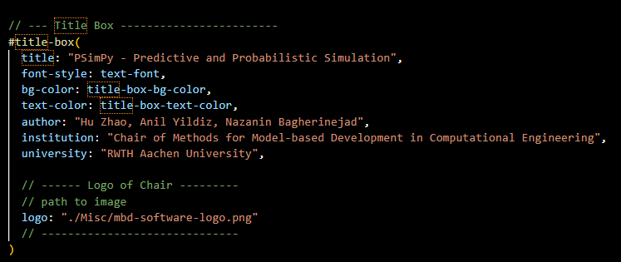


Title Box
Adjust for your software
Insert path to your chair/institute logo
Image will be clipped to fit the circle. The Circle has a white background. It is recommended to also use a logo with white background.
In the following example you can see how it would look like, if the logo had a different colored background:
Logo
On Poster
You can use the next slide to adjust your chairs logo to fit the circle

Slide 9
Adjust Chair Logo to fit template
Use this slide in powerpoint to adjust your image
How to make your logo fit the template:
Replace MBD logo with your own logo
Place central in the circle
Group the logo and circle
Change the outline of the circle to „No Outline“ (or make it white)
Save the group as png
Software

Slide 10
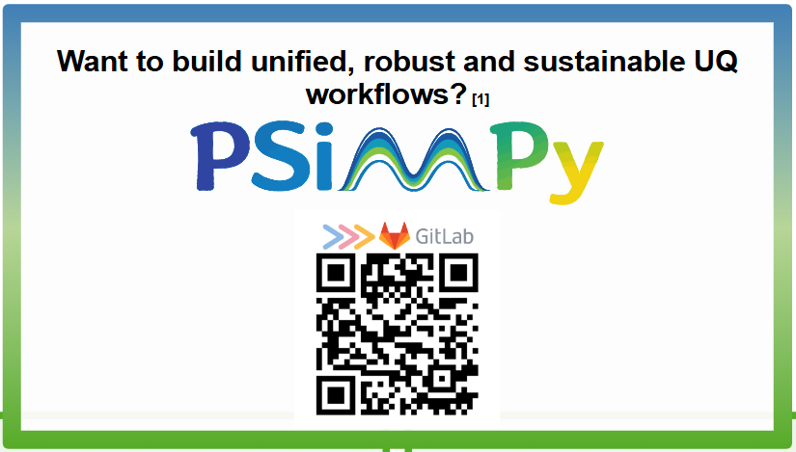
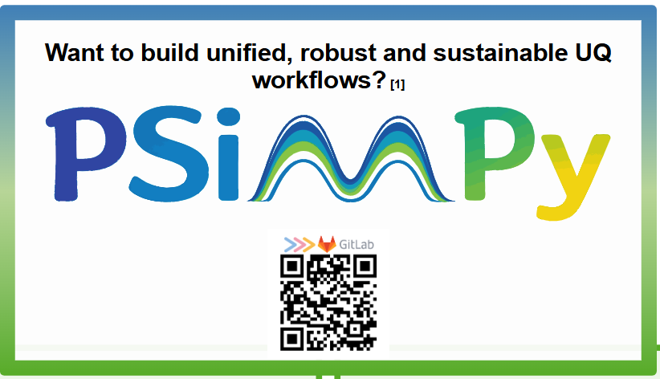

Software Logo Box
The Software Logo Box consists of the catch phrase, the Software Logo and the Software QR-Code.
The upper y-position of the logo and QR-Code is fixed, as well as the space they take up together in y-direction.
They share the available space via the variable logo-ratio in the function #software-logo-box().
Examples
Set the logo-ratio to a value between 0 and 100
Extreme Cases
logo-ratio: 0 → logo disappears
logo-ratio:100 → QR-Code disappears
logo-ratio: >70 → the logo has already reached the available space in x-direction here and wont get bigger, only the QR code shrinks.
logo-ratio: 30
logo-ratio: 50
Tipps:
It is recommended to cut excess white spaces around the logo to prevent gaps on the poster.
If your catch phrase is too long, it will be covered by the logo and QR-Code.
logo-ratio: 70

Slide 11

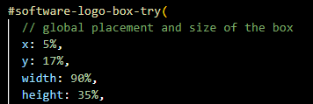

Slide 12
Folder Structure
The typst file for all posters lies in the same folder, to make it easier for typst to find the library mss_bib.typ which contains necessary custom functions.

Slide 13

How to render
This button renders the PDF and opens the preview window. If button is not there, press on the „execute“ button (in the image left to the render button)

Slide 14

Typst tipps
#linebreak() : starts new line
Units:
% -> how many percent of the current box
Pt -> absolut unit of measure (1pt=1/72 inch)
Terminal commands:
See available fonts on system: >> typst fonts

Slide 15
How to create your own poster
Title: enter max 19 characters, otherwise the font-size of the title will shrink

Slide 16
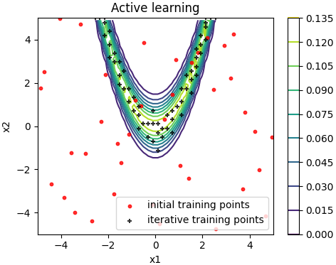

Slide 17

4
3
5
1
7
6
2
rgba(191, 208, 209)
rgba(199, 221, 242)
rgba(64, 127, 183)
rgba(142, 186, 229)
rgba(184, 214, 152)
rgba(0, 84, 159)
rgba(87, 171, 39)
rgba(99, 101, 102)
3
8
6
4

