Slide 1
Packages
By
Sana mateen

Slide 2
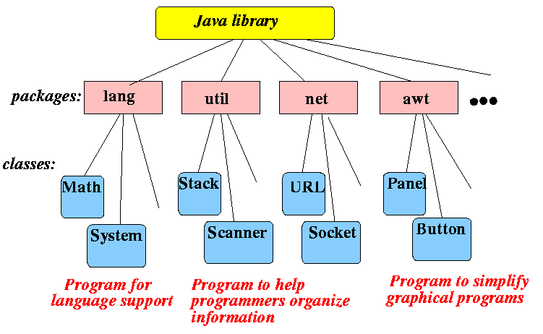
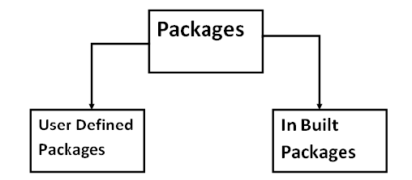
PACKAGES
A java package is a group of similar types of classes, interfaces and sub-packages.
Package in java can be categorized in two form, built-in package and user-defined package.
There are many built-in packages such as java, lang, awt, javax, swing, net, io, util, sql etc.
Creating Package:
To create a package, you choose a name for the package and put a package statement with that name at the top of every source file.

Slide 3
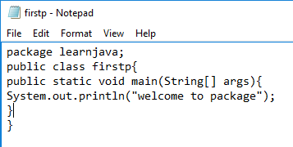
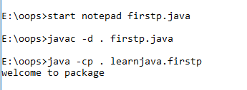

How to compile java package?
The -d switch specifies the destination where to put the generated class file.
How to run java package program?
You need to use fully qualified name e.g. LearnJava.FirstProgram etc to run the class.
To Compile: javac -d . FirstProgram.java
To Run: java LearnJava.FirstProgram
Output: Welcome to package

Slide 4

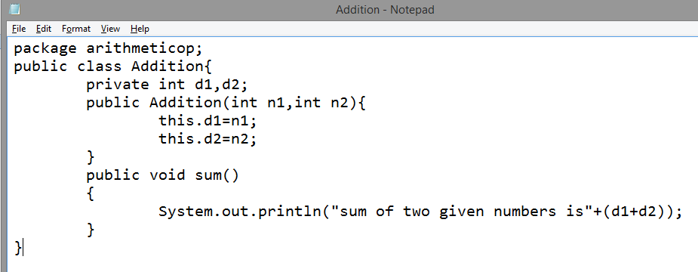
this keyword is used to refer to current object.
It can also be used inside any method

Slide 5
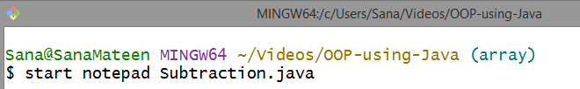
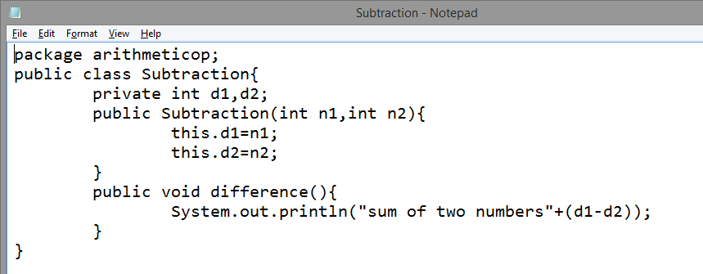

Slide 6

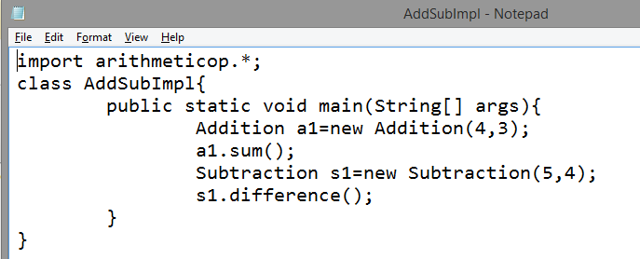

Slide 7

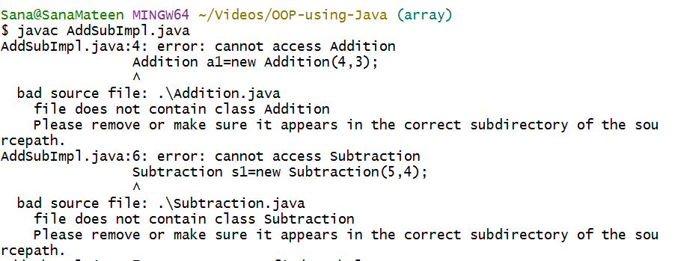

Slide 8

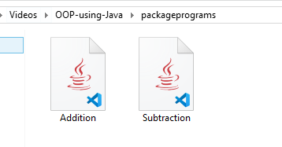
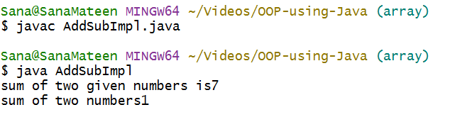

Slide 9
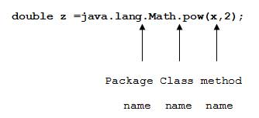
MULTILEVELED PACKAGE
You can create a hierarchy of packages. To do so, simply separate each package name from the one above it by use of a period. The general form of a multileveled package statement is shown here:
package pkg1[.pkg2[.pkg3]];
A package hierarchy must be reflected in the file system of your Java development system.
For example, a package declared as
package java.awt.image;
needs to be stored in java\awt\image in a Windows environment.

Slide 10

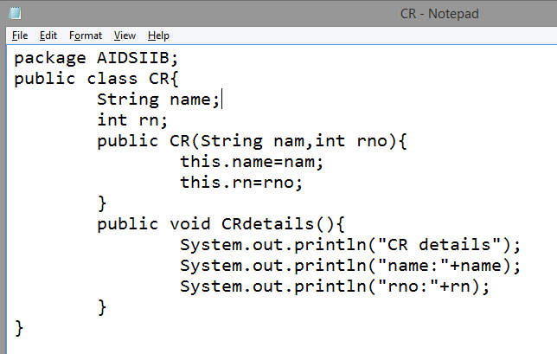

Slide 11

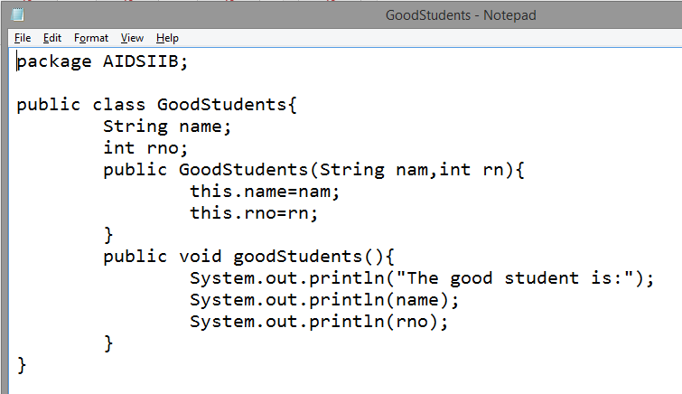

Slide 12
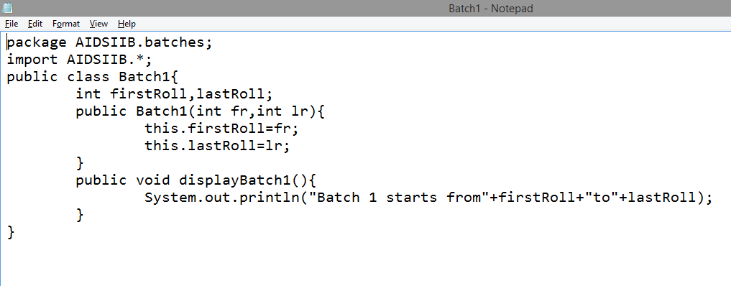

Slide 13

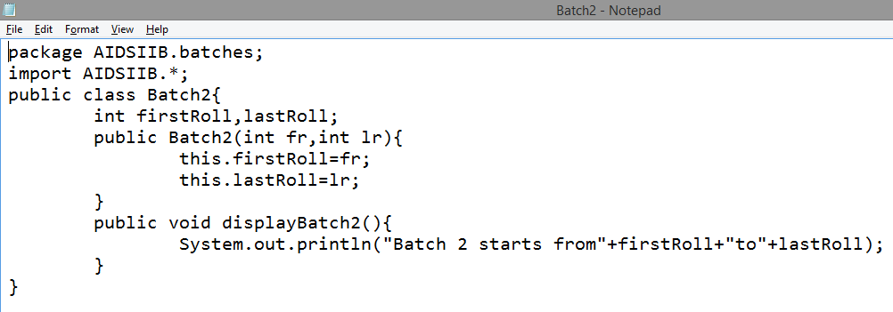

Slide 14
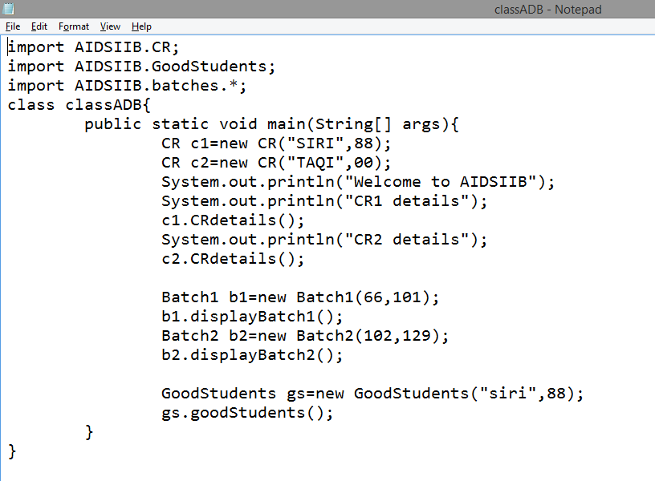

Slide 15

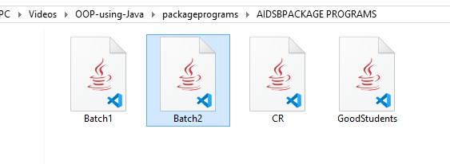

Slide 16
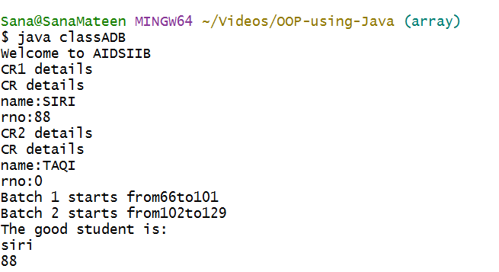

Slide 17
How does the Java run-time system know where to look for packages that you create?
First, by default, the Java run-time system uses the current working directory as its starting point. Thus, if your package is in a subdirectory of the current directory, it will be found.
Second, you can specify a directory path or paths by setting the CLASSPATH environmental variable.
Third, you can use the -classpath option with java and javac to specify the path to your classes.

Slide 18
ACCESS PROTECTION
Classes and packages are both means of encapsulating and containing the name space and scope of variables and methods.
Packages act as containers for classes and other subordinate packages. Classes act as containers for data and code.
Java addresses four categories of visibility for class members:
• Subclasses in the same package
• Non-subclasses in the same package
• Subclasses in different packages
• Classes that are neither in the same package nor subclasses
The three access modifiers, private, public, and protected, provide a variety of ways to produce the many levels of access required by these categories
When a class is declared as public, it is accessible by any other code.
If a class has default access, then it can only be accessed by other code within its
same package.
When a class is public, it must be the only public class declared in the file, and the file must have the same name as the class.

Slide 19
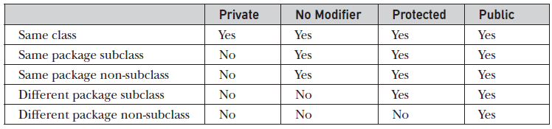
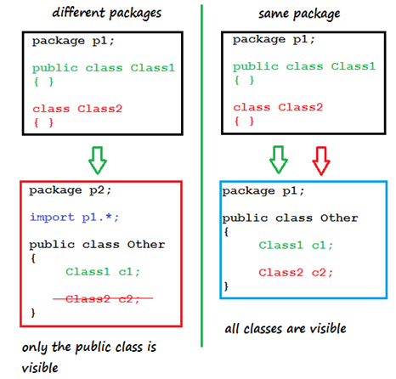

Slide 20

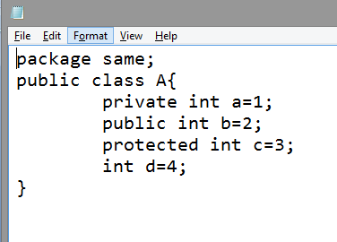
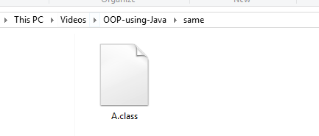
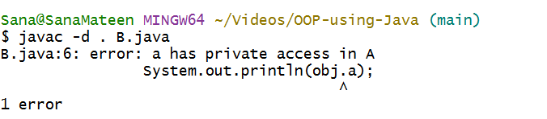
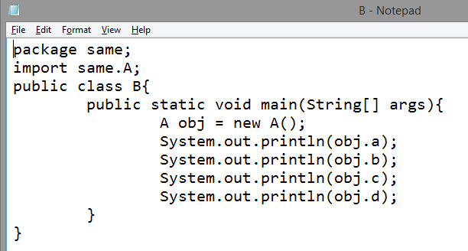

Slide 21
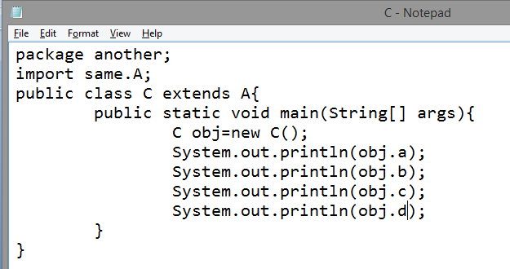
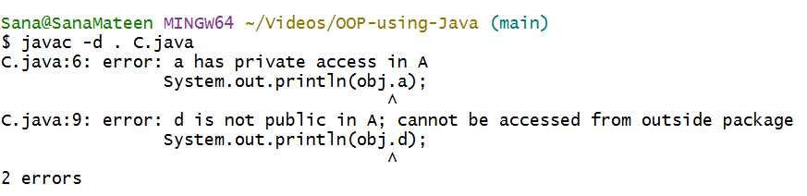

Slide 22
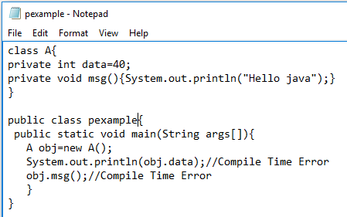
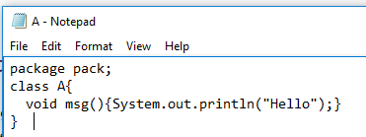
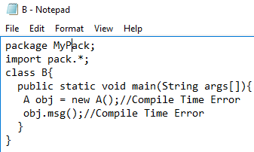
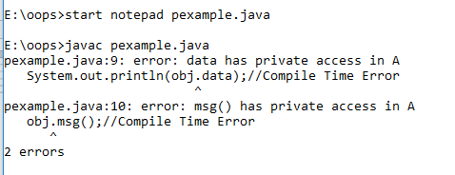
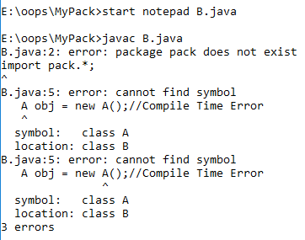
private
private
default

Slide 23
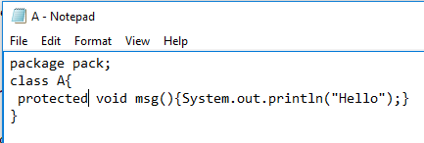
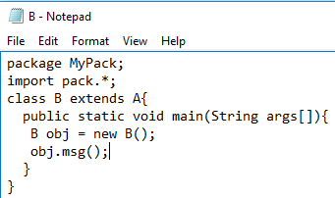

Slide 24
IMPORTING PACKAGES
Since classes within packages must be fully qualified with their package name or names, it could become tedious to type in the long dot-separated package path name for every class you want to use.
For this reason, Java includes the import statement to bring certain classes, or entire packages, into visibility.
Once imported, a class can be referred to directly, using only its name.
In a Java source file, import statements occur immediately following the package statement (if it exists) and before any class definitions. This is the general form of the
import statement:
import pkg1 [.pkg2].(classname | *);
Here, pkg1 is the name of a top-level package, and pkg2 is the name of a subordinate package inside the outer package separated by a dot (.).

Slide 25
This code fragment shows both forms in use:
import java.util.Date;
import java.io.*;
All of the standard Java classes included with Java are stored in a package called java.
The basic language functions are stored in a package inside of the java package called java.lang.
Normally, you have to import every package or class that you want to use, but since Java is useless without much of the functionality in java.lang, it is implicitly imported by the compiler for all programs.
This is equivalent to the following line being at the top of all of your programs:
import java.lang.*;
If a class with the same name exists in two different packages that you import using the star form, the compiler will remain silent, unless you try to use one of the classes.
In that case, you will get a compile-time error and have to explicitly name the class specifying its package.

Slide 26
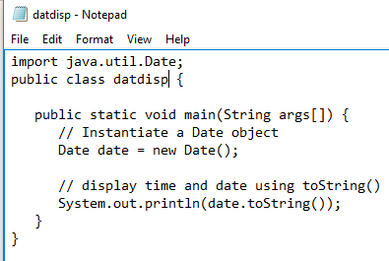
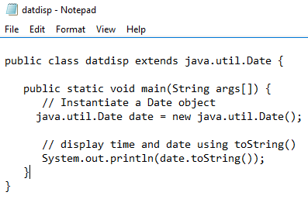
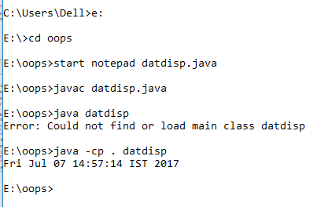


Slide 27
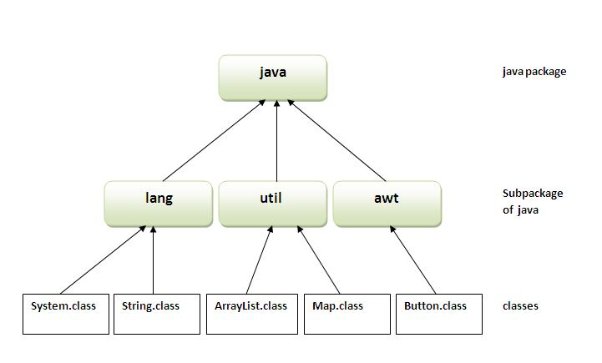
ADVANTAGE OF JAVA PACKAGE
1) Java package is used to categorize the classes and interfaces so that they can be easily maintained.
2) Java package provides access protection.
3) Java package removes naming collision.

