Slide 1
String Tokenizer

Slide 2
StringTokenizer
The java.util.StringTokenizer class allows you to break a String into tokens.
It is simple way to break a String. It is a legacy class of Java.

Slide 3
StringTokenizer Constructors
Constructor | Description
StringTokenizer(String str) | It creates StringTokenizer with specified string.
StringTokenizer(String str, String delim) | It creates StringTokenizer with specified string and delimiter.
StringTokenizer(String str, String delim, boolean returnValue) | It creates StringTokenizer with specified string, delimiter and returnValue. If return value is true, delimiter characters are considered to be tokens. If it is false, delimiter characters serve to separate tokens.

Slide 4
Methods
Methods | Description
boolean hasMoreTokens() | It checks if there is more tokens available.
String nextToken() | It returns the next token from the StringTokenizer object.
String nextToken(String delim) | It returns the next token based on the delimiter.
boolean hasMoreElements() | It is the same as hasMoreTokens() method.
Object nextElement() | It is the same as nextToken() but its return type is Object.
int countTokens() | It returns the total number of tokens.

Slide 5
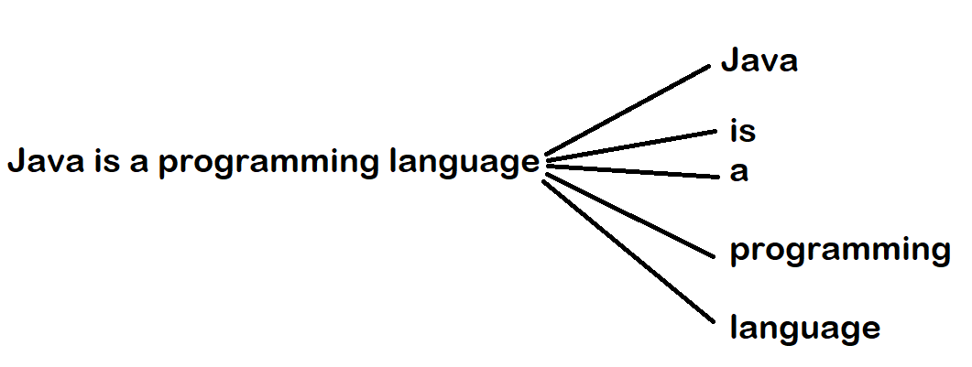
Example

Slide 6
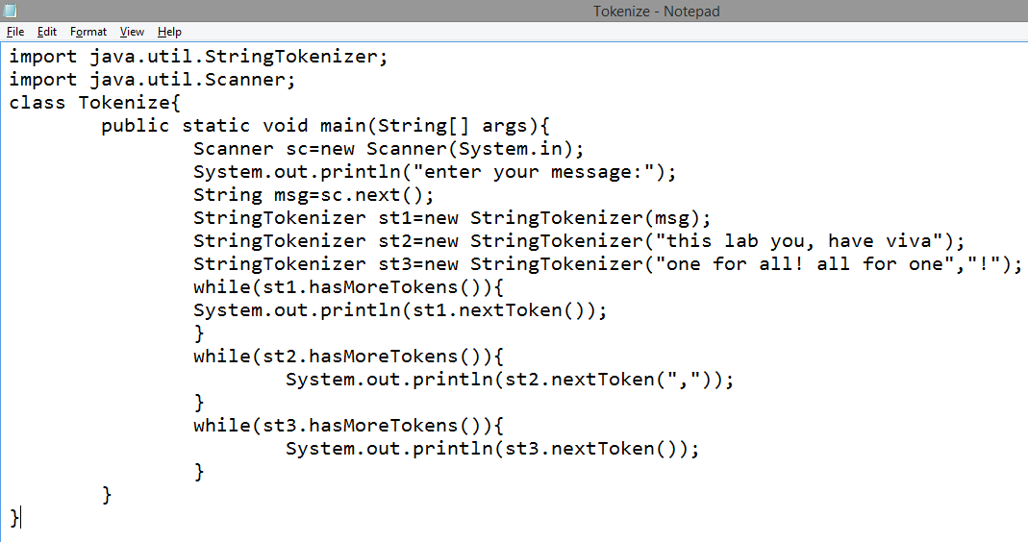

Slide 7
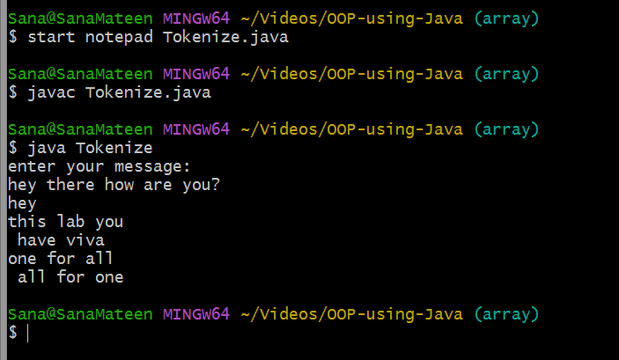

Slide 8
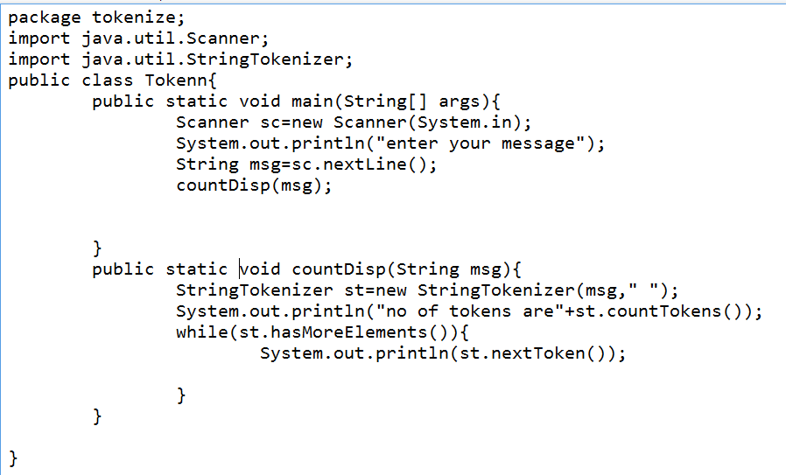

Slide 9
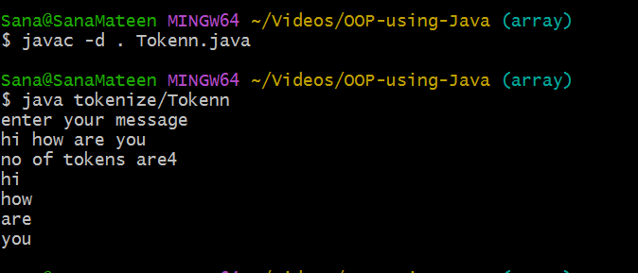


Slide 10
