Slide 1
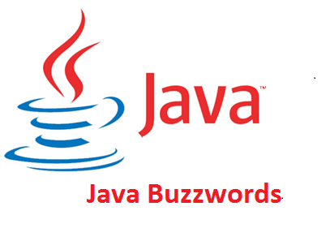
By
Sana Mateen

Slide 2
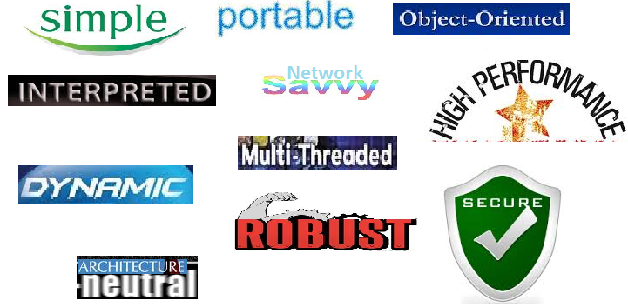

Slide 3
According to Sun, Java language is simple because:
syntax is based on C++ (so easier for programmers to learn it after C++).
removed many confusing and/or rarely-used features e.g., explicit pointers, operator overloading etc.
No need to remove unreferenced objects because there is Automatic Garbage Collection in java.

Slide 4
Object-oriented programming(OOPs) is a methodology that simplify software development and maintenance by providing some rules.
Basic concepts of OOPs are:
Object Class Inheritance Polymorphism Abstraction Encapsulation

Slide 5
A platform is the hardware or software environment in which a program runs. There are two types of platforms software-based and hardware-based. Java provides software-based platform.

Slide 6
The Java platform differs from most other platforms in the sense that it is a software-based platform that runs on the top of other hardware-based platforms. It has two components:
Runtime Environment
API(Application Programming Interface)
Java code can be run on multiple platforms e.g. Windows, Linux, Sun Solaris, Mac/OS etc.
Java code is compiled by the compiler and converted into bytecode.
This bytecode is a platform-independent code because it can be run on multiple platforms i.e. Write Once and Run Anywhere(WORA).

Slide 7
Java provides data security through encapsulation. Classloader: adds security by separating the package for the classes of the local file system from those that are imported from network sources. Bytecode Verifier: checks the code fragments for illegal code that can violate access right to objects.

Slide 8
Robust Robust simply means strong. Java uses strong memory management. There are lack of pointers that avoids security problem. There is automatic garbage collection in java. There is exception handling and type checking mechanism in java. All these points makes java robust.

Slide 9
Architecture-neutral There is no implementation dependent features e.g. size of primitive types is fixed. In C programming, int data type occupies 2 bytes of memory for 32-bit architecture and 4 bytes of memory for 64-bit architecture. But in java, it occupies 4 bytes of memory for both 32 and 64 bit architectures.

Slide 10
Portable We may carry the java bytecode to any platform.

Slide 11
Java is faster than traditional interpretation since byte code is "close" to native code still somewhat slower than a compiled language (e.g., C++)

Slide 12
We can create distributed applications in java. RMI and EJB are used for creating distributed applications. We may access files by calling the methods from any machine on the internet.

Slide 13
Multi-threaded A thread is like a separate program, executing concurrently. We can write Java programs that deal with many tasks at once by defining multiple threads. The main advantage of multi-threading is that it doesn't occupy memory for each thread. It shares a common memory area. Threads are important for multi-media, Web applications etc.

Slide 14
•The Java Virtual Machine(JVM) maintains a lot of runtime information about the program and the objects in the program. •Libraries are dynamically linked during runtime. •So, even if you make dynamic changes to pieces of code, the program is not effected.

Slide 15
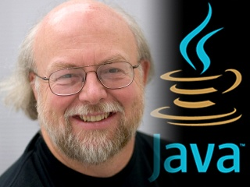
JAVA
Java programming language was originally developed by Sun Microsystems which was initiated by James Gosling and released in 1996 as core component of Sun Microsystems' Java platform (Java 1.0 [J2SE]).
The latest release of the Java Standard Edition is Java SE 21. With the advancement of Java and its widespread popularity, multiple configurations were built to suit various types of platforms. For example: J2EE for Enterprise Applications, J2ME for Mobile Applications.

Slide 16
Version | Release date | End of Public Updates (Free)
JDK 1.0 | 23rd January 1996 | May 1996
JDK 1.1 | 18th February 1997 | October 2002
J2SE 1.2 | 4th December 1998 | November 2003
J2SE 1.3 | 8th May 2000 | March 2006
J2SE 1.4 | 13th February 2002 | October 2008
J2SE 5.0 | 30th September 2004 | October 2009
Java SE 6 | 11th December 2006 | April 2013
Java SE 7 | 28th July 2011 | July 2015
Java SE 8 (LTS) | 18th March 2014 | April 2019 for Oracle July 2026 for Amazon Corretto^{[12]} November 2026 for Eclipse Temurin^{[13]} November 2026 for Red Hat^{[7]} December 2030 for Azul^{[10]} March 2031 for BellSoft Liberica^{[9]}

Slide 17
Version | Release date | End of Public Updates (Free)
Java SE 9 | 21st September 2017 | March 2018
Java SE 10 | 20th March 2018 | September 2018
Java SE 11 (LTS) | 25th September 2018 | April 2019 for Oracle October 2024 for Eclipse Temurin^{[13]} October 2024 for Red Hat^{[7]} March 2027 for BellSoft Liberica^{[9]} October 2027 for Amazon Corretto^{[12]} January 2032 for Azul^{[10]}
Java SE 12 | 19th March 2019 | September 2019
Java SE 13 | 17th September 2019 | March 2020
Java SE 14 | 17th March 2020 | September 2020
Java SE 15 | 16th September 2020 | March 2021
Java SE 16 | 16th March 2021 | September 2021
Java SE 17 (LTS) | 14th September 2021 | September 2024 for Oracle^{[15]} October 2027 for Eclipse Temurin^{[13]} October 2027 for Red Hat^{[7]} October 2028 for Amazon Corretto^{[12]} September 2029 for Azul^{[10]} March 2030 for BellSoft Liberica^{[9]}

Slide 18
Version | Release date | End of Public Updates (Free)
ava SE 18 | 22nd March 2022 | September 2022
Java SE 19 | 20th September 2022 | March 2023
Java SE 20 | 21st March 2023 | September 2023
Java SE 21 (LTS) | 19th September 2023 | September 2026 for Oracle^{[15]} September 2029 for Eclipse Temurin^{[13]} September 2029 for Red Hat^{[7]} October 2030 for Amazon Corretto^{[12]} September 2031 for Azul^{[10]} March 2032 for BellSoft Liberica^{[9]}
Java SE 22 | 19th March 2024 | September 2024

Slide 19
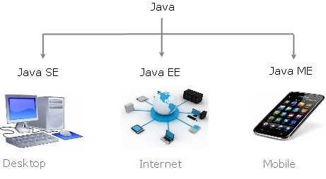
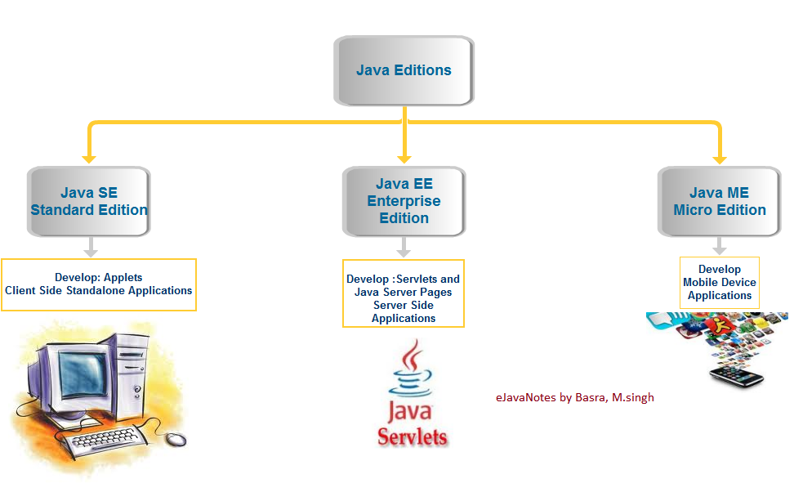

Slide 20
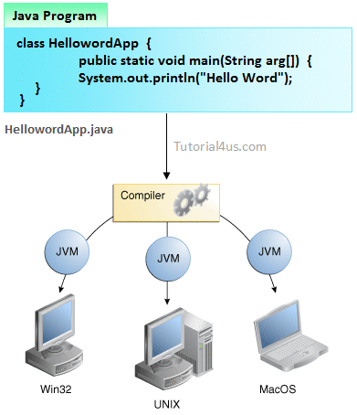

Slide 21
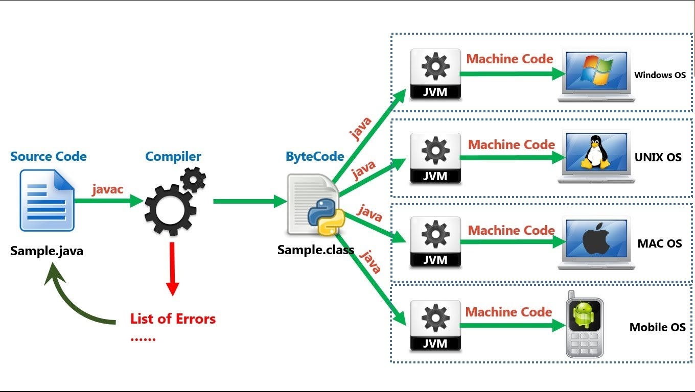

Slide 22
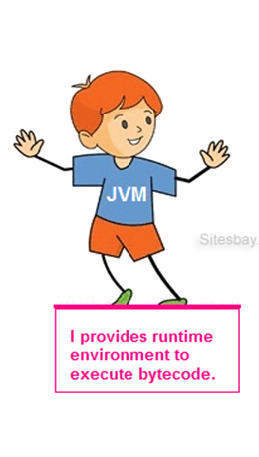
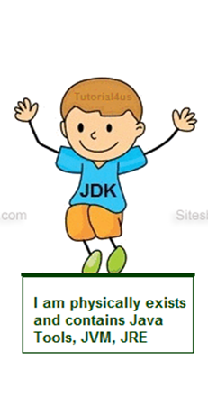
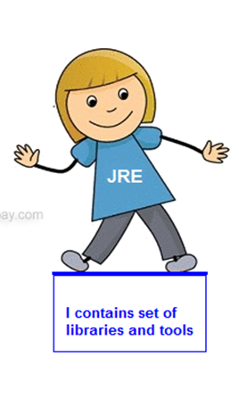
JVMs are not same for all hardware and software, for example for window os JVM is different and for Linux VJM is different. JVM, JRE and JDK are platform dependent because configuration of each OS differs. But, Java is platform independent.

Slide 23
The Java Development Kit (JDK) is primary components. It physically exists. It is collection of programming tools and JRE, JVM.

Slide 24
The Java Runtime Environment (JRE) is part of the Java Development Kit (JDK). It contains set of libraries and tools for developing java application. The Java Runtime Environment provides the minimum requirements for executing a Java application. It physically exists. It contains set of libraries + other files that JVM uses at runtime.

Slide 25
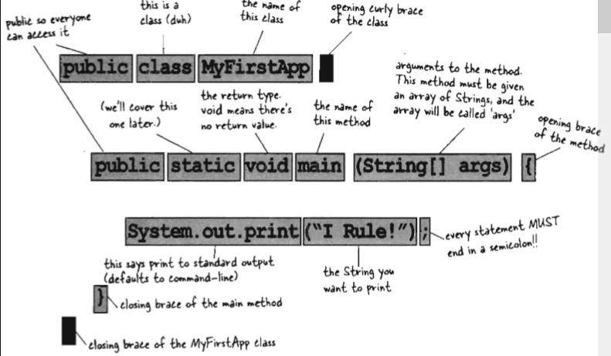

Slide 26
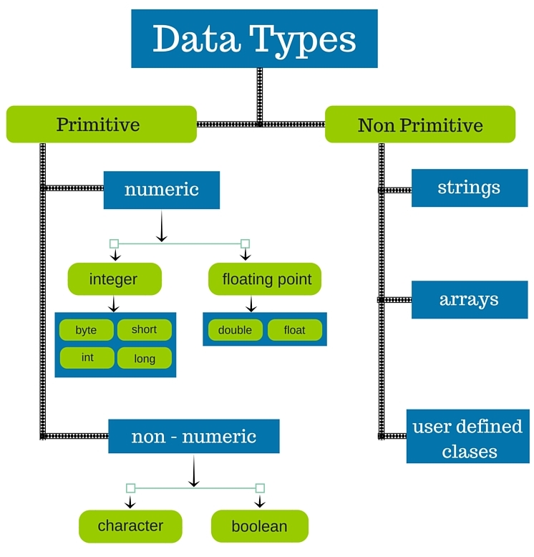

Slide 27
Data types
Data type is a special type of keyword which is useful for allocating sufficient memory for that data. I
Java defines eight (primitive data types) simple types:
1)byte – 8-bit integer type
2)short – 16-bit integer type
3)int – 32-bit integer type
4)long – 64-bit integer type
5)float – 32-bit floating-point type
6)double – 64-bit floating-point type
7)char – symbols in a character set
8)boolean – logical values true and false

Slide 28
byte: 8-bit integer type.
Range: -128 to 127.
Example: byte b = -15;
Usage: particularly when working with data streams.
short: 16-bit integer type.
Range: -32768 to 32767.
Example: short c = 1000;
Usage: probably the least used simple type.
int: 32-bit integer type.
Range: -2147483648 to 2147483647.
Example: int b = -50000;
Usage:
1) Most common integer type.
2) Typically used to control loops and to index arrays.
3) Expressions involving the byte, short and int values are promoted to int before calculation.

Slide 29
long: 64-bit integer type.
Range: -9223372036854775808 to 9223372036854775807.
Example: long l = 10000000000000000;
Usage: 1) useful when int type is not large enough to hold the desired value
float: 32-bit floating-point number.
Range: 1.4e-045 to 3.4e+038.
Example: float f = 1.5;
Usage:
1) fractional part is needed
2) large degree of precision is not required
double: 64-bit floating-point number.
Range: 4.9e-324 to 1.8e+308.
Example: double pi = 3.1416;
Usage:
1) accuracy over many iterative calculations
2) manipulation of large-valued numbers

Slide 30
char: 16-bit data type used to store characters.
Range: 0 to 65536.
Example: char c = ‘a’;
Usage:
1) Represents both ASCII and Unicode character sets; Unicode defines a
character set with characters found in (almost) all human languages.
2) Not the same as in C/C++ where char is 8-bit and represents ASCII only.
boolean: Two-valued type of logical values.
Range: values true and false.
Example: boolean b = (1<2);
Usage:
1) returned by relational operators, such as 1<2
2) required by branching expressions such as if or for

Slide 31
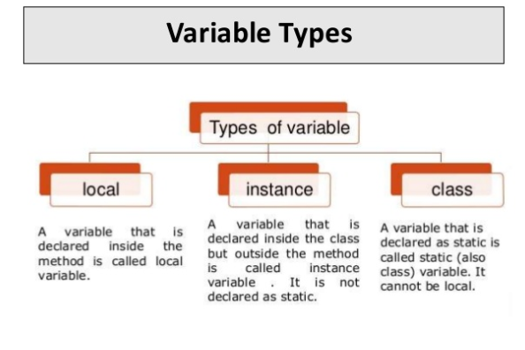
Variable is a name of memory location. There are three types of variables in java: local, instance and static.
Variable is name of reserved area allocated in memory. In other words, it is a name of memory location. It is a combination of "vary + able" that means its value can be changed.

Slide 32
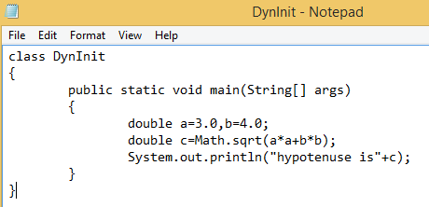
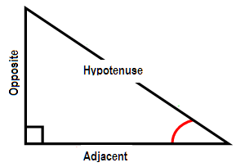


Slide 33
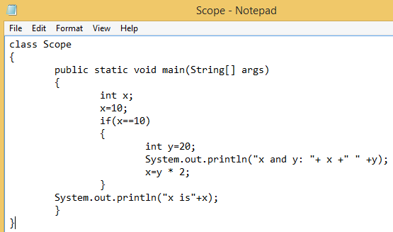


Slide 34
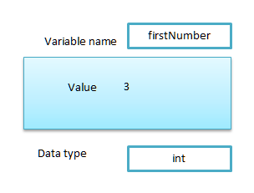
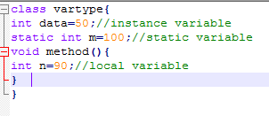
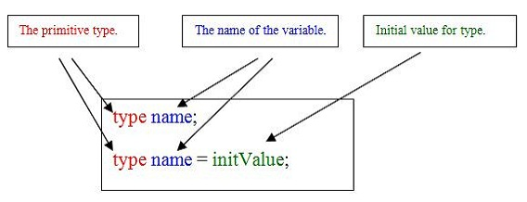
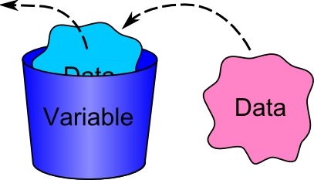

Slide 35
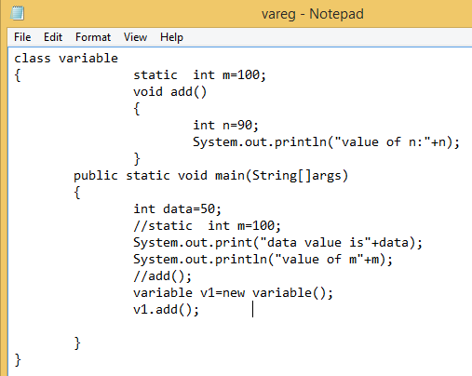
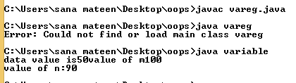

Slide 36
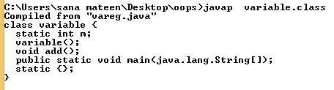
javap
java disassembler, which enables us to convert bytecode files into a program description.
When used with no options the javap command prints the package,
protected and public fields, and methods of the classes passed to it.

Slide 37
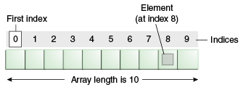
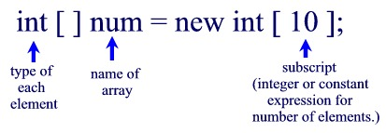
Java Array
Normally, array is a collection of similar type of elements that have contiguous memory location.
Java array is an object the contains elements of similar data type. It is a data structure where we store similar elements. We can store only fixed set of elements in a java array.
Array in java is index based, first element of the array is stored at 0 index.

Slide 38
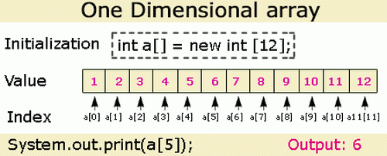
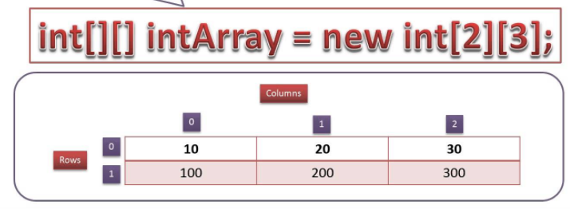

Slide 39
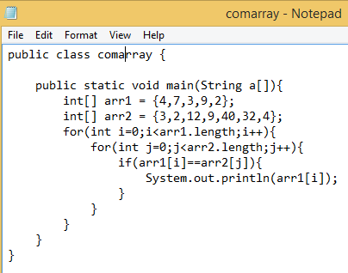
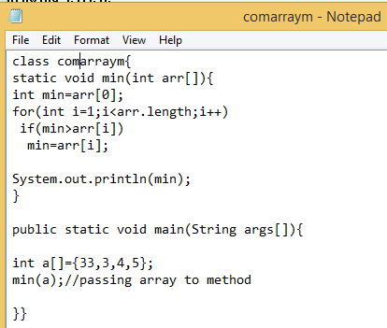
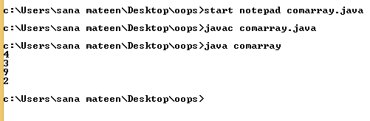
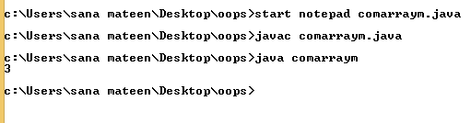

Slide 40
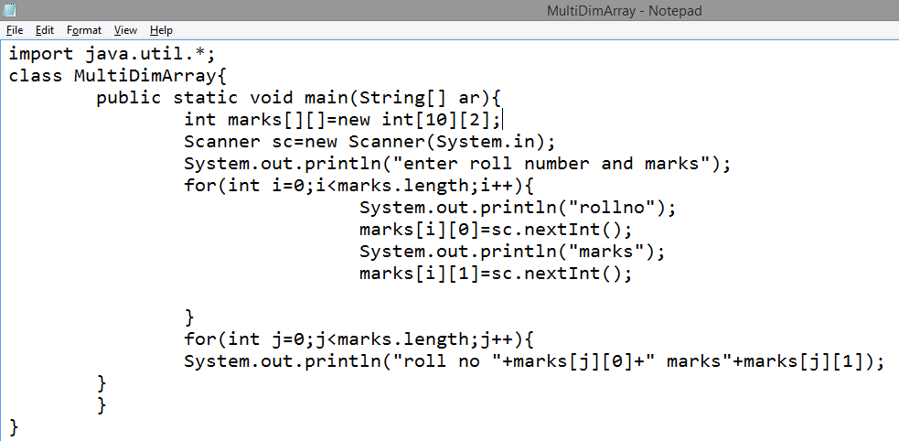

Slide 41
