Slide 1
Dictionaries
By
Sana Mateen

Slide 2
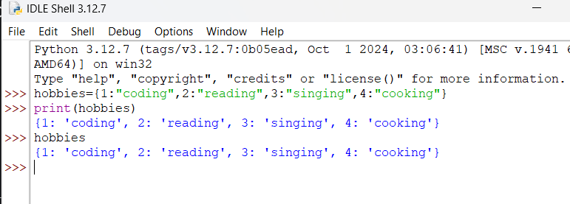
Dictionaries
Dictionaries are used to store data values in key:value pairs.
A dictionary is a collection which is ordered, changeable and do not allow duplicates.
Dictionaries are written with curly brackets, and have keys and values:

Slide 3
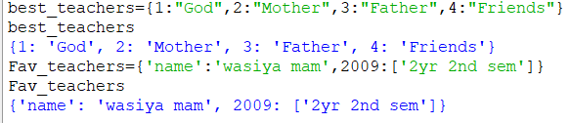
Dictionary keys are case sensitive
Dictionary keys are case sensitive, the same name but different cases of Key will be treated distinctly.

Slide 4
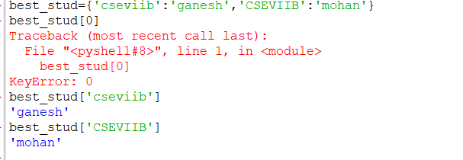
Access Elements in dictionary
Dictionary items are presented in key:value pairs, and can be referred to by using the key name.

Slide 5
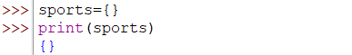
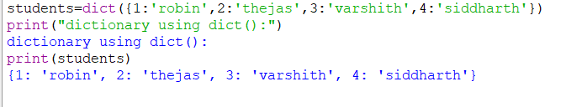
Different Ways to Create a Python Dictionary

Slide 6

Different Ways to Create a Python Dictionary

Slide 7
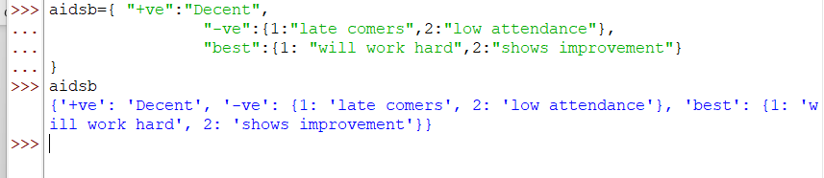
Nested Dictionaries

Slide 8
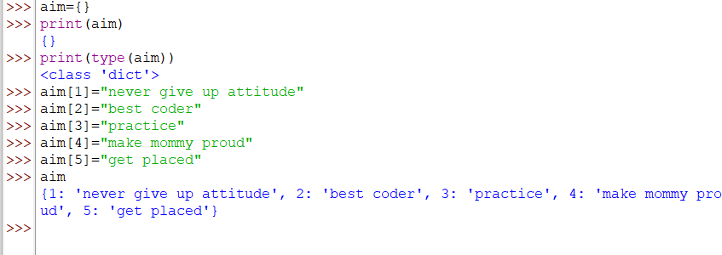
Adding elements to dictionary

Slide 9
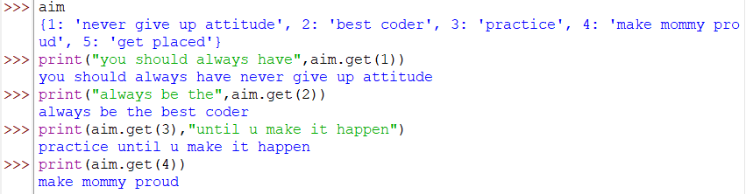
Access a value using get()
This method provides a safe way to access dictionary values, avoiding KeyError if the key doesn’t exist.

Slide 10
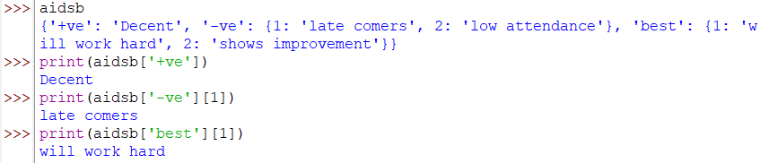
Accessing an Element of a Nested Dictionary

Slide 11
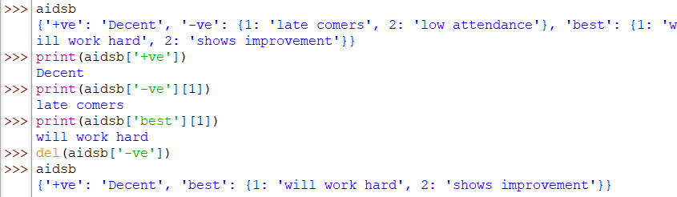
Deleting Elements using ‘del’ Keyword

Slide 12

clear()
The clear() method removes all items from the dictionary.
Syntax:
dict.clear()
Parameters:
The clear() method doesn't take any parameters.

Slide 13

copy()
Syntax: dict.copy()
Return: This method doesn’t modify the original, dictionary just returns copy of the dictionary.

Slide 14
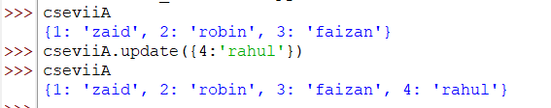
update()
Python Dictionary update() method updates the dictionary with the elements from another dictionary object or from an iterable of key/value pairs.

Slide 15
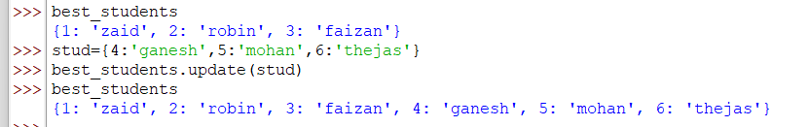
update()
Python Dictionary update() method updates the dictionary with the elements from another dictionary object or from an iterable of key/value pairs.

Slide 16
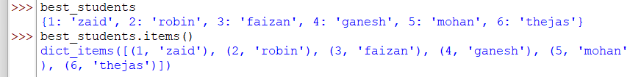
items()
displays a list of a given dictionary’s (key, value) tuple pair

Slide 17
values()
Displays the values of dictionary as a list.

Slide 18
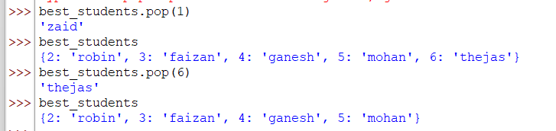
pop()

Slide 19

keys()
Returns a list containing dictionary’s keys

Slide 20
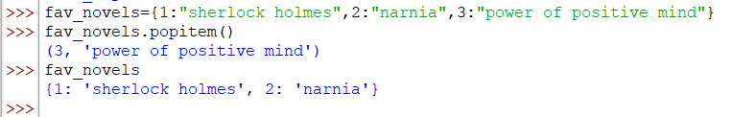
popitem()
Python dictionary popitem() method removes the last inserted key-value pair from the dictionary and returns it as a tuple.

