Slide 1
Sets
By
Sana Mateen
Asst.Prof,CSE

Slide 2
Set
It is an unordered collection that is iterable and has no duplicate elements.
While sets are mutable, meaning you can add or remove elements after their creation, the individual elements within the set must be immutable and cannot be changed directly.
Set are represented by { } (values enclosed in curly braces).
Since sets are unordered, we cannot access items using indexes as we do in lists.

Slide 3
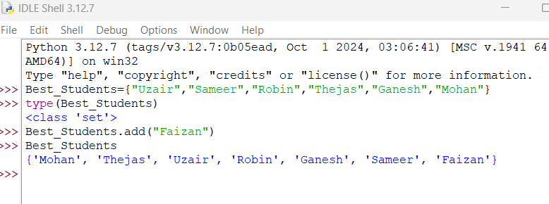

Slide 4
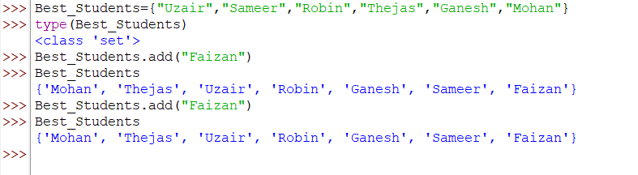
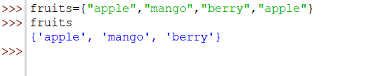
Duplicates not allowed

Slide 5
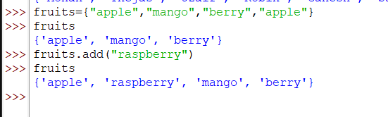
Add items
The order of elements is not same, the elements appear in arbitrary order , determined by hashing process.

Slide 6
Delete items
Use remove() if you want an error when the element is missing.
Use discard() if you want to avoid errors for missing elements.
Use pop() to remove a random element.
Use clear() to empty the entire set.

Slide 7
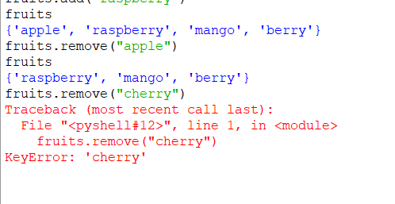
remove()
Removes a specified element from the set.
If the element is not present, it raises a KeyError

Slide 8
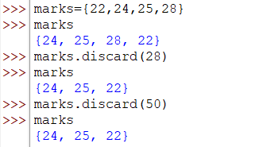
discard()
Removes a specified element from the set.
If the element is not present, it does not raise an error

Slide 9
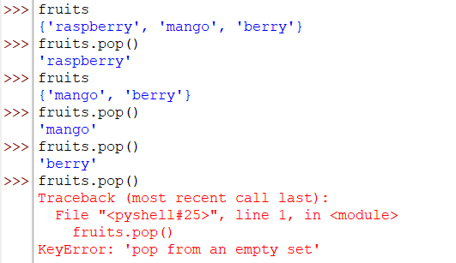
pop()
Removes and returns a random element from the set.
Raises a KeyError if the set is empty.

Slide 10
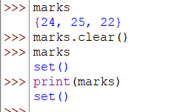
clear()
Removes all elements from the set leaving it empty.

Slide 11
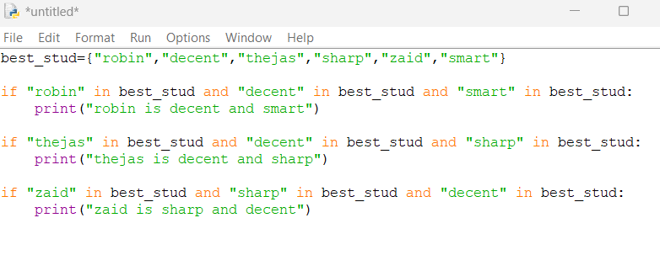

Display elements in a set

Slide 12
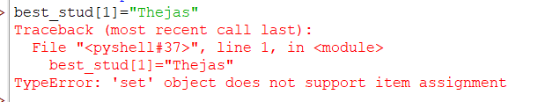
Cannot change already present individual elements

Slide 13
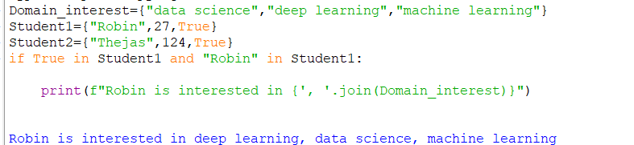
Heterogeneous elements

Slide 14
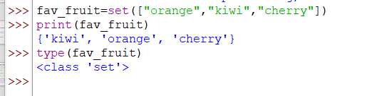
Typecasting with set()
Python set is an unordered datatype, which means we cannot know in which order the elements of the set are stored.

Slide 15
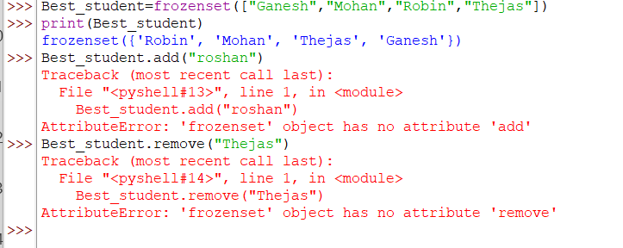
Frozen Sets
Frozen sets in Python are immutable objects that only support methods and operators that produce a result without affecting the frozen set or sets to which they are applied. It can be done with frozenset() method in Python.

Slide 16
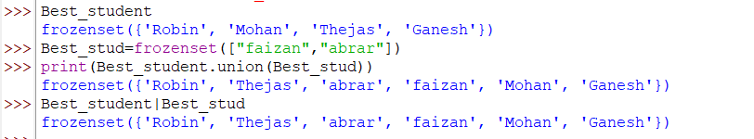
Union operation

Slide 17
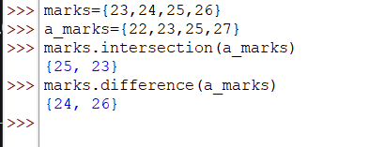
Intersection and difference operation

Slide 18
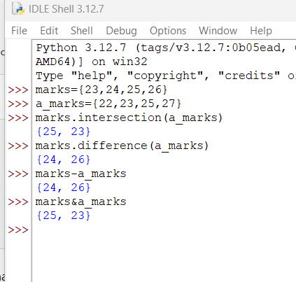
Intersection and difference operation

Slide 19
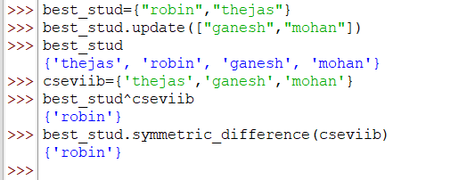
Symmetric difference
Elements in either set but not in both.

Slide 20
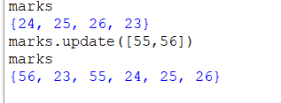
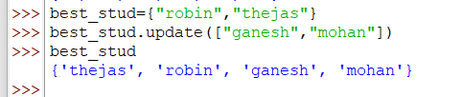
Updating the set
We can add multiple elements using the update() method:

Slide 21


issubset()
The issubset() method checks if all elements of one set are contained in another set. It returns True if it is a subset; otherwise, it returns False.

Slide 22

issuperset()
The issuperset() method checks if a set contains all elements of another set. It returns True if it is a superset; otherwise, it returns False.

