Slide 1
TUPLES
BY
Sana Mateen
Assistant Professor

Slide 2
Tuple
Tuple is a collection of objects separated by commas.
It allows indexing, nested objects and repetition.
It is immutable.
There are various ways of creating python tuples.
Using ()
With one item
Using tuple() constructor

Slide 3
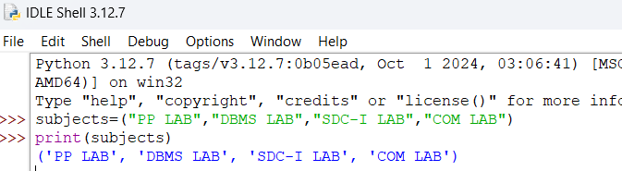
Creating tuples using ()

Slide 4

Create a tuple with one item
Tuple Definition: The tuple values is defined to include integers (int) and strings (str). The use of the pipe symbol (|) allows for multiple types, meaning each element in the tuple can either be an integer or a string.
…(ellipses) is a special object used to indicate that variable number of parameters are accepted.

Slide 5
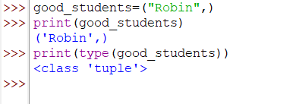
Create a tuple with one item
In case your generating a tuple with a single element, make sure to add a comma after the element.

Slide 6

Tuple constructor
To create a tuple with a Tuple constructor, we will pass the elements as its parameters.

Slide 7
Immutable
Tuples are immutable and ordered and allow duplicate values.
Rules:
No elements can be added.
No appending and extending of tuples.
We cannot remove items from tuple once it is created.

Slide 8
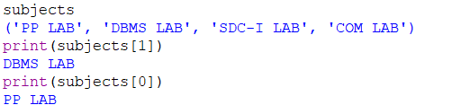
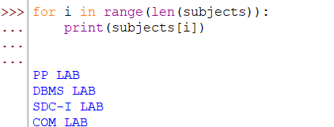
Finding elements in Tuples

Slide 9
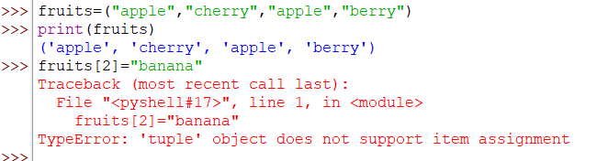
Duplicates in tuples

Slide 10
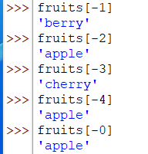

Negative index

Slide 11
Operations performed on Tuples
Concatenation
Nesting
Repetition
Slicing
Deleting
Finding the length
Multiple Data Types with tuples
Conversion of lists to tuples
Tuples in a Loop

Slide 12
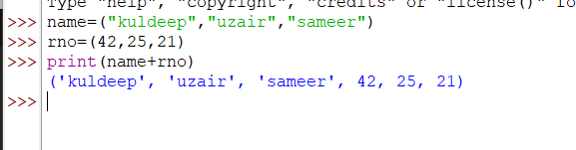
Concatenation

Slide 13
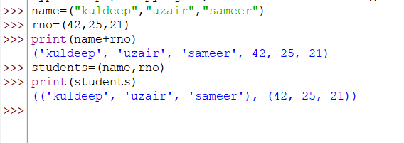
Nested tuples

Slide 14
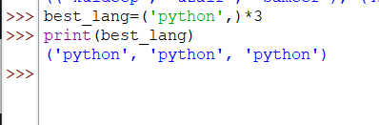
Repetition

Slide 15
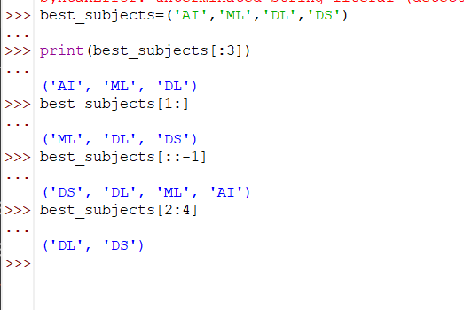

Slicing Tuples

Slide 16
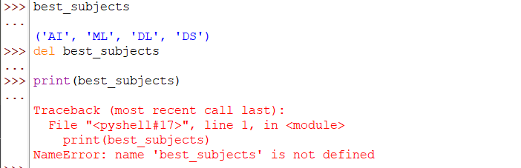
Deleting a tuple
delete a tuple using ‘del’ keyword

Slide 17
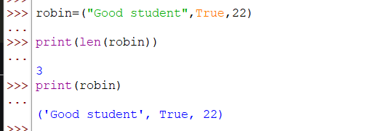
Find length and use multiple data types with tuple

Slide 18
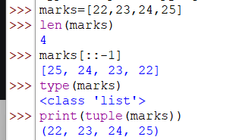
Converting a list to tuple
We can convert a list in Python to a tuple by using the tuple() constructor and passing the list as its parameters.

Slide 19
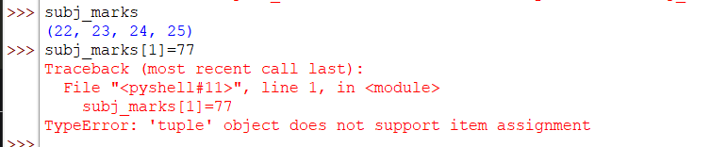

Slide 20
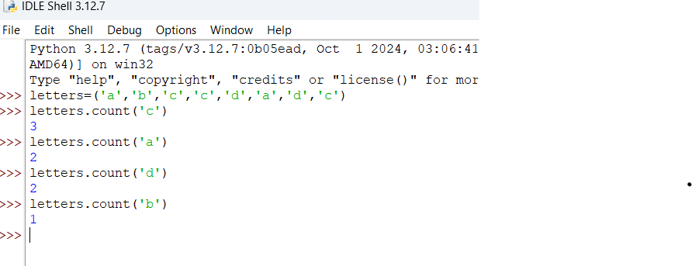
Count method

Slide 21
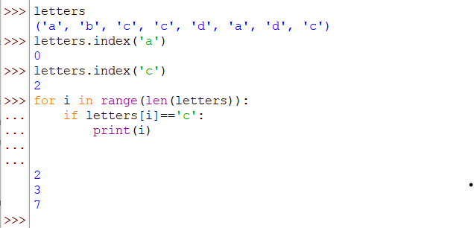
Index method

