Slide 1
Generalized Additive Models
Additive
Linear
Emily Corcoran & Kathryn Shore

Slide 2
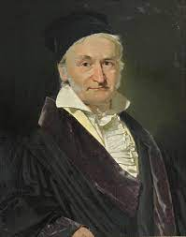
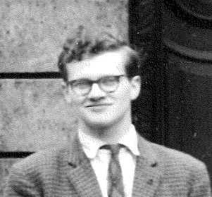
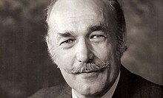
What are Generalized Linear Models?
Linear Models
Generalized Linear Models
Gauss 1809
Nelder & Wedderburn 1972

Slide 3
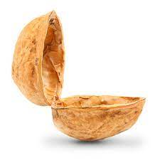
What are Generalized Linear Models?
A generalized linear model is a flexible generalization of ordinary linear regression
GLMs allow the extension of linear modelling ideas to more response types including count data or binary responses
Includes linear regression, logistic regression, and Poisson regression
Normally we assume residuals normally distributed; for GLM’s it does not have to be
GLMs

Slide 4
What are Generalized Linear Models?
A generalized linear model is a flexible generalization of ordinary linear regression
We can use GLM’s (instead of LMs or MLR) when…
residuals not normally distributed
data is heteroscedastic
data is non-linear
GLMs

Slide 5
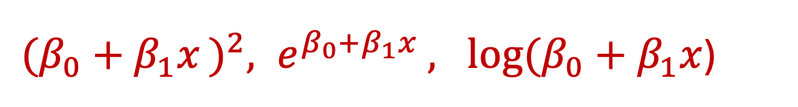

What are Generalized Linear Models?
A generalized linear model is a flexible generalization of ordinary linear regression
Systematic component (the function that links the predictor to the outcome)
Link function (function that “bends the line”)
Random component (epsilon does not have to be normally distributed)
$$β_{0}+β_{1}x$$
${(β_{0}+β_{1}x )}^{2}, e^{β_{0}+β_{1}x }, log⁡(β_{0}+β_{1}x$)
Normal, Poisson, Gamma, Binomial

Slide 6
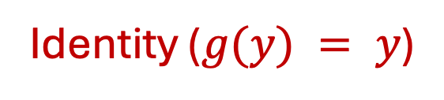
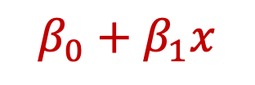
What are Generalized Linear Models?
An ordinary linear model is a special case of a GLM
Systematic component (the function that links the predictor to the outcome)
Link function (function that “bends the line”)
Random component (epsilon does not have to be normally distributed)
$$β_{0}+β_{1}x$$
Identity ($g(y) = y$)
Normally distributed

Slide 7
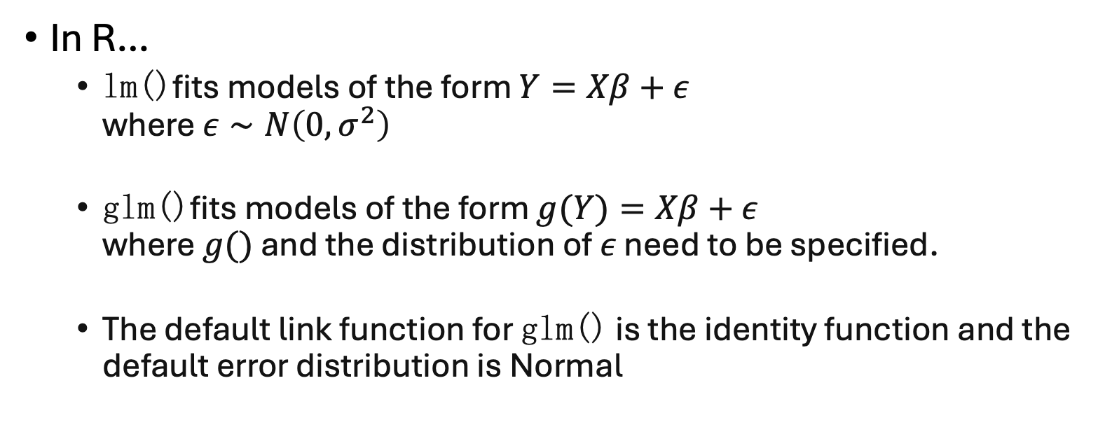
What are Generalized Linear Models?
An ordinary linear model is a special case of a GLM
In R…
lm()fits models of the form $Y=Xβ+ε$ where $ε∼N\left(0,σ^{2}\right)$
glm()fits models of the form $g(Y)=Xβ+ε$ where $g()$ and the distribution of $ε$ need to be specified.
The default link function for glm() is the identity function and the default error distribution is Normal (epsilon does not have to be normally distributed)
With these defaults, lm() and glm() fit the same model

Slide 8
Example Scenarios for GLMs
Predicting # of times people go to therapy (non-negative count data)
Predicting death from heart disease (binary data)
Predicting the grade someone will get in a class (ordinal data)

Slide 9
Pros and Cons of GLMS
The response does not have to be normally distributed
Able to deal with categorical predictors
Modelling is interpretable
Flexibility
Makes strict assumptions about shape
Can be prone to overfitting
Can be sensitive to outliers

Slide 10

CODE DEMO

Slide 11
Generalized Additive Models
Additive
Linear
Emily Corcoran & Kathryn Shore

Slide 12


What are Generalized Additive Models?
Linear Models
Generalized Linear Models
Generalized Additive Models
Gauss 1809
Nelder & Wedderburn 1972
Hastie & Tibshirani 1986

Slide 13
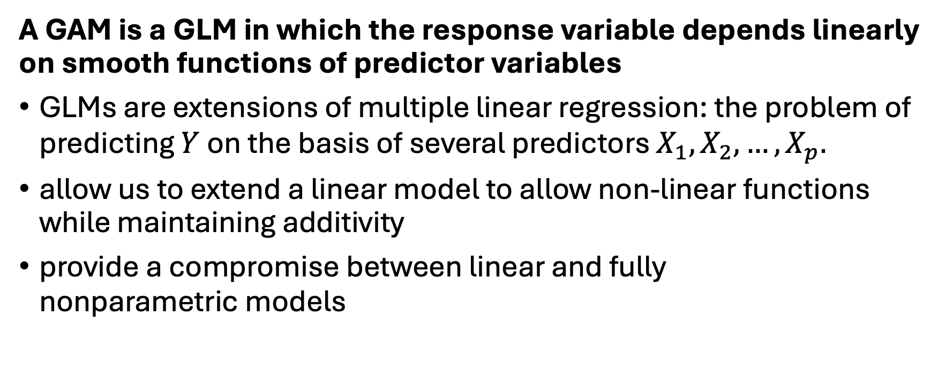
What are Generalized Additive Models?
A GAM is a GLM in which the response variable depends linearly on smooth functions of predictor variables
GLMs are extensions of multiple linear regression: the problem of predicting $Y$ on the basis of several predictors $X_{1},X_{2},…,X_{p}.$
allow us to extend a linear model to allow non-linear functions while maintaining additivity
provide a compromise between linear and fully nonparametric models
GAMs

Slide 14
What are Generalized Additive Models?
A GAM is a GLM in which the response variable depends linearly on smooth functions of predictor variables
The main difference is GLMs assume a fixed form of the relationship between the dependent variable and the covariates, but GAMs do not assume a specific form a priori
In GLMs we have a weighted sum of the covariates, in GAMs we have a sum of smooth functions
GAMs more flexible
GAMs

Slide 15
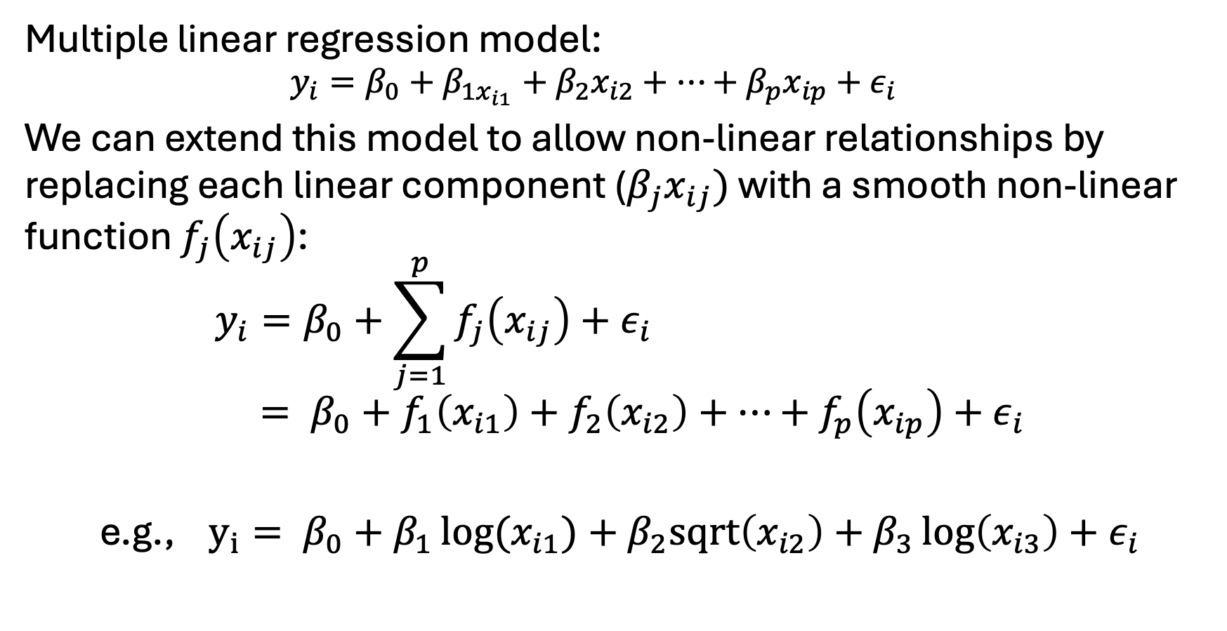
GAM Example
MLR is just a special case of a GAM
Multiple linear regression model:
$$y_{i}=β_{0}+β_{1x_{i1}}+β_{2}x_{i2}+…+β_{p}x_{ip}+ε_{i}$$
We can extend this model to allow non-linear relationships by replacing each linear component ($β_{j}x_{ij})$ with a smooth non-linear function $f_{j}\left(x_{ij}\right)$:
$$y_{i}=β_{0}+\sum_{j=1}^{p}{f_{j}\left(x_{ij}\right)+ε_{i}} \\ = β_{0}+f_{1}\left(x_{i1}\right)+f_{2}\left(x_{i2}\right)+…+f_{p}\left(x_{ip}\right)+ε_{i}$$
e.g., $y_{i}= β_{0}+β_{1}\log{(x_{i1})}+β_{2}sqrt\left(x_{i2}\right)+β_{3}\log\left(x_{i3}\right)+ε_{i}$

Slide 16
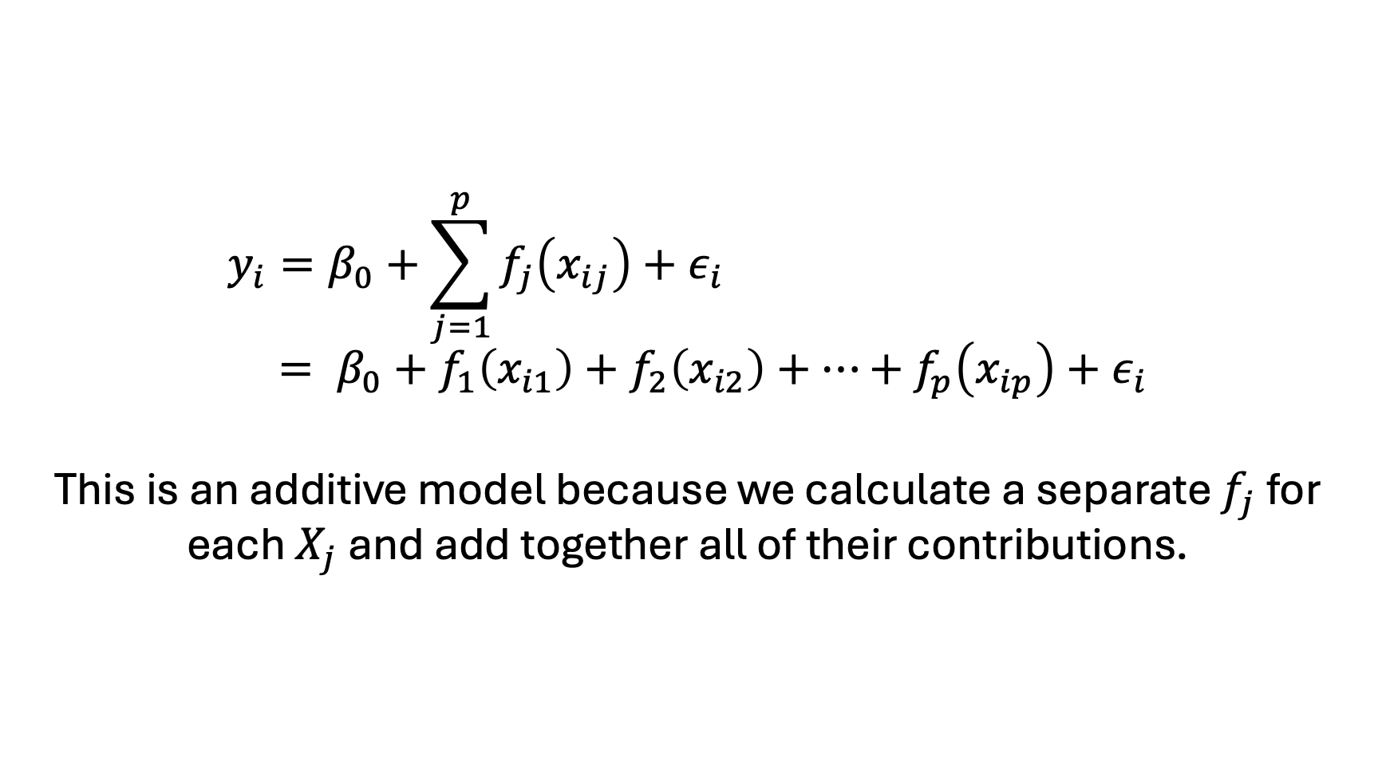
GAM Example
$$y_{i}=β_{0}+\sum_{j=1}^{p}{f_{j}\left(x_{ij}\right)+ε_{i}} \\ = β_{0}+f_{1}\left(x_{i1}\right)+f_{2}\left(x_{i2}\right)+…+f_{p}\left(x_{ip}\right)+ε_{i}$$
This is an additive model because we calculate a separate $f_{j}$ for each $X_{j}$ and add together all of their contributions.

Slide 17
GAM Example
CORIS survey – Coronary Risk Factor Study survey
Generalized Additive Models: Some Applications by Hastie and Tibshirani

Slide 18
GAM Example
CORIS survey
Investigating intensity of ischemic heart disease risk factors in rural areas of South Africa
Risk factors included
Systolic blood pressure
Cumulative tobacco
Cholesterol ratio
“Type A” (measure or psychosocial stress on Bortner Scale)
Age
Total energy
Family history (binary)
Fitted nonparametric logistic regression

Slide 19
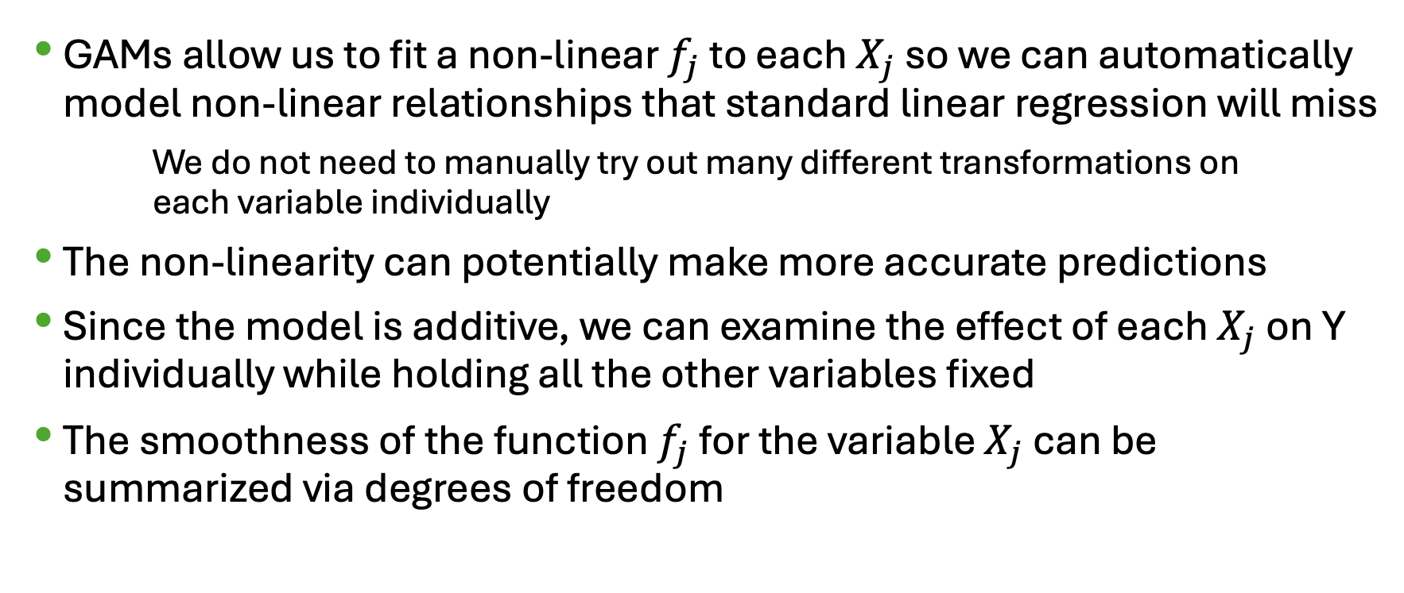
Pros and Cons of GAMS
GAMs allow us to fit a non-linear $f_{j}$ to each $X_{j}$ so we can automatically model non-linear relationships that standard linear regression will miss
We do not need to manually try out many different transformations on each variable individually
The non-linearity can potentially make more accurate predictions
Since the model is additive, we can examine the effect of each $X_{j}$ on Y individually while holding all the other variables fixed
The smoothness of the function $f_{j}$ for the variable $X_{j}$ can be summarized via degrees of freedom

Slide 20
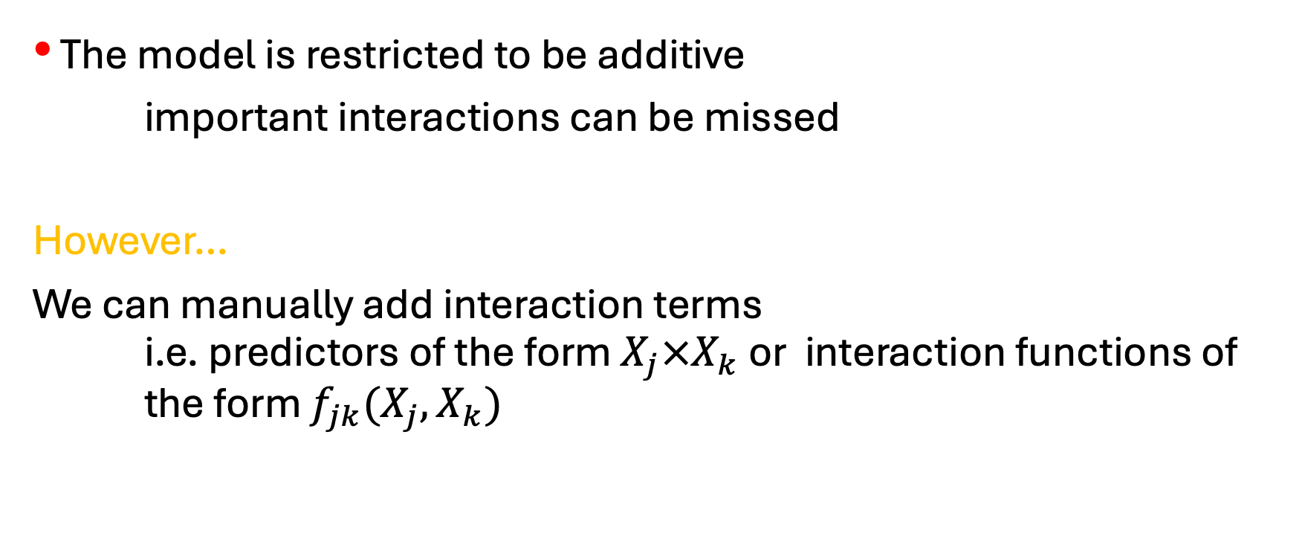
Pros and Cons of GAMs
The model is restricted to be additive
important interactions can be missed
However…
We can manually add interaction terms i.e. predictors of the form $X_{j}×X_{k}$ or interaction functions of the form $f_{jk}(X_{j}, X_{k})$

Slide 21
CODE DEMO

