Slide 1
Generalized Linear Models (GLMs)
&
Generalized Additive Models (GAMs)
MSSC 6250: Statistical Machine Learning
Edward Liu and Eimienwanlan (Jefferson) Ibhagui
March 7, 2024

Slide 2
Overview
A recap on linear regression
What are generalized linear models (GLMs)?
Special case
What are generalized additive models (GAMs)?
Special case
Properties of GAMs and GLMs
GAMs vs GLMs: differences and similarities
Why use these models?
Superiority of GAMs and GLMs over MLR
Code demo to run GAM and GLM
Model comparison
GAM
GLM
LM

Slide 3
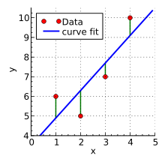
Linear Regression
Regressions are used to find the relationship between an outcome variable and a single explanatory variable or a set of explanatory variables.
In linear regression, modeling, certain assumptions must be complied with such as linearity, homogenization, independence, and normality of residuals.
However, these assumptions are considered restrictive and not all datasets conform to them.
So why do we still use linear regression? Ease of application, interpretability, and works well on small data.
But what happens when variables in the dataset are non-normal, not identically distributed, not independent/correlate, and non-linear?
E[y|x] = β_{o} + β₁*x₁ + … + β_{m}*x_{m} + ɛ
Enter GAMs and GLMs!

Slide 4

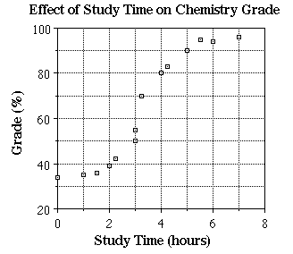

What is a Generalized Linear Model (GLM)?
Imagine you're trying to do a prediction based on some factors. For example, let's say you want to predict whether a student will pass or fail an exam based on factors like study hours, previous grades, and attendance.
In traditional linear regression, you assume that the relationship between these factors and the outcome (pass/fail) is straight and simple.
More study hours or higher previous grades mean a higher chance of passing. But this might not always be the case, especially when dealing with different kinds of outcomes like pass/fail or count data.

Slide 5
What is a Generalized Linear Model (GLM)?
A GLM is a flexible generalization of ordinary linear regression (LR). It relaxes the assumptions in LR (e.g., normality) and generalizes LR by allowing the linear model to be related to the response variable via a link function and by allowing the magnitude of the variance of each measurement to be a function of its predicted valued.
The link function also describes the distribution of y and how the latter is related to the x’s.
The distribution may be Binomial, Poisson, or any other type from the family of exponential distribution.
A special case when GLM becomes LM is when y is normally distributed with a constant variance and the link function equals the identity function i.e., g(E[y|x]) = E[y|x].
To fit a GLM model, a quantity called “deviance” must be minimized. This is like the sum of squares error that is minimized in linear regression modeling.
g(E[y|x]) = β_{o} + β₁*x₁ + … + β_{m}*x_{m} + ɛ

Slide 6

What is a Generalized Additive Model (GAM)?
GAMs further loosen the restrictive and rigid assumptions of linear regression modeling.
GAMs modify GLMs by allowing (1) non-linearity and (2) interaction of variables non-linearly
The function within GAMs can be non-linear and non-parametric but must be a smooth function.
GAMs use ‘smooth functions’ to capture the complex relationships between dependent and independent variables, fitting wiggly lines or curves to a dataset, and allowing for peaks, valleys, and everything in-between.
A special type of GAMs occurs when a single parameter β_{k} multiplies the function h_{k} and in that case GAMs become GLMs.
GAMs are like the Swiss Army knife of regression models.
g(E[y|x]) = β_{o} + h₁(x₁) + … + h_{m}(x_{m}) + ɛ

Slide 7
Properties of GAMs and GLMs
Generalizable – can handle many distributions e.g., nominal, binomial and count
Additive – terms in the model add together, but terms themselves are not linear
Data structure agnostic – no a priori assumptions and underlying distribution
Flexible and interpretable
Model non-linear relationships
Linear
Models
GLMs/GAMs
Black-Box ML

Slide 8
GAMs vs GLMs
Differences
GAMs wrap predictor variables inside a function - h_{k}(x_{k}).
The functions in GAMs require more convoluted fitting mechanism
Similarities
Both models loosen the ‘rigidity’ of the assumptions of linear models
Both have link functions that connect predictor and outcome variables
GAMs modify GLMs by allowing (1) non-linearity and (2) interaction of variables non-linearly

Slide 9
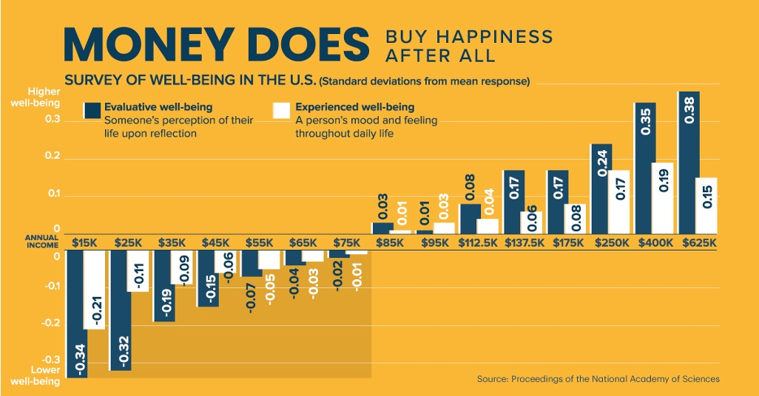
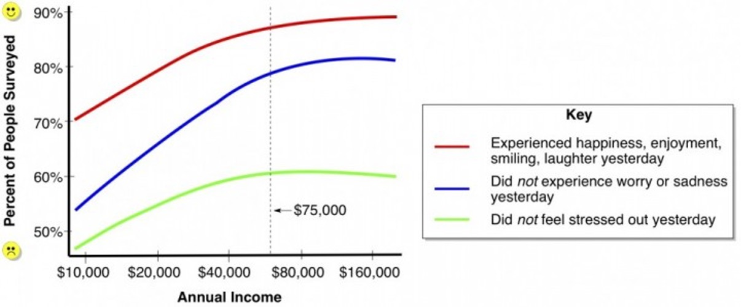
Why use GAMs and GLMs
Linear models have assumptions that are too restrictive, and most datasets do not conform to such assumptions.
Avoid back-transformation which can cause problems.
Make no assumptions of the forms of the relationships between response and predictor variables.
Flexibility.
Handle modeling of non-linear relationship effectively.

Slide 10
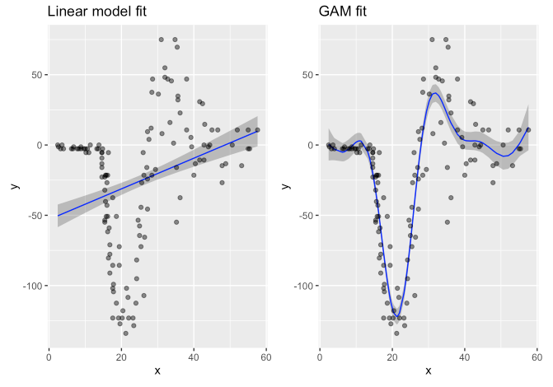
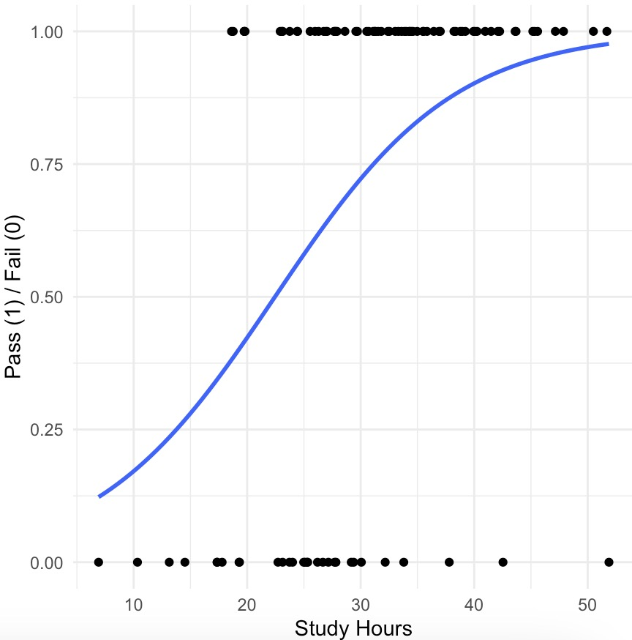
Superiority of GAMs and GLMs over MLR
A gaussian distribution is presumed when utilizing MLR whereas such presumption does not hold for GAMs and GLMs.
MLR may require some transformations before it can model complex interactions between dependent and independent but GAMs/GLMs do not need to transform data, hence it saves the time of the data analyst.
GLMs and GAMs can handle more complicated relationships and data types than MLR.
Linear model fit vs GAM fit. Source: https://ericrscott.com/posts/2021-01-13-dlnm/
SLR < MLR < GLM < GAM

Slide 11
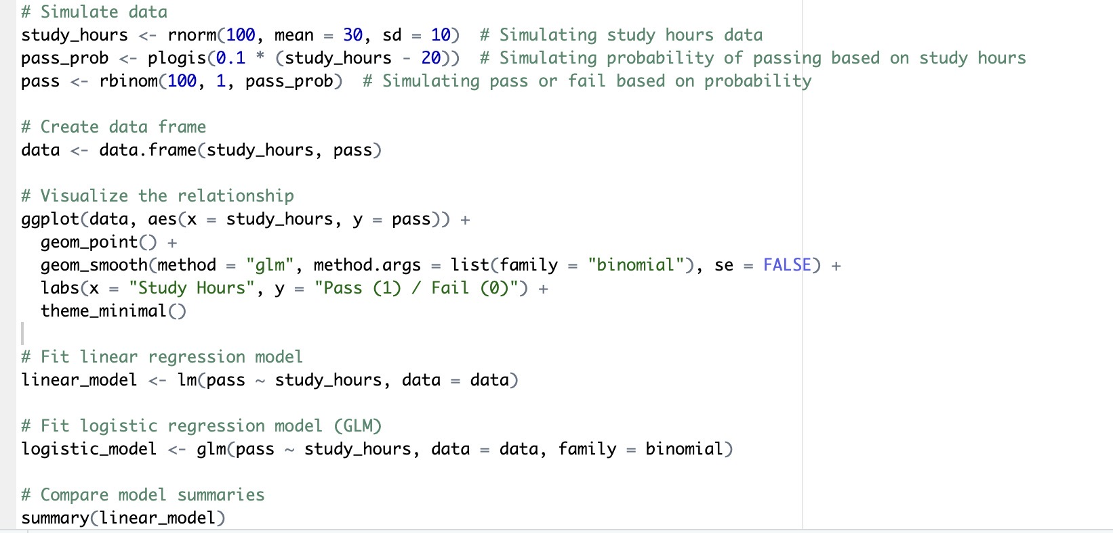
Model demo code – LM vs GLM
compare_performance(linear_model, logistic_model, verbose = FALSE) # tabular code for model indices plot(compare_performance(linear_model, logistic_model, rank = TRUE)) # visualization code of model indices

Slide 12
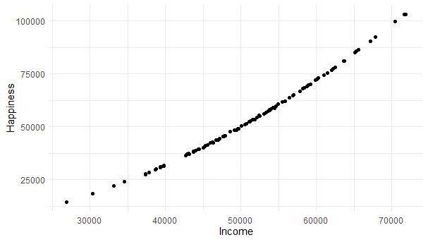
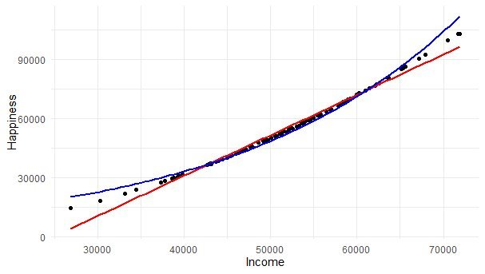
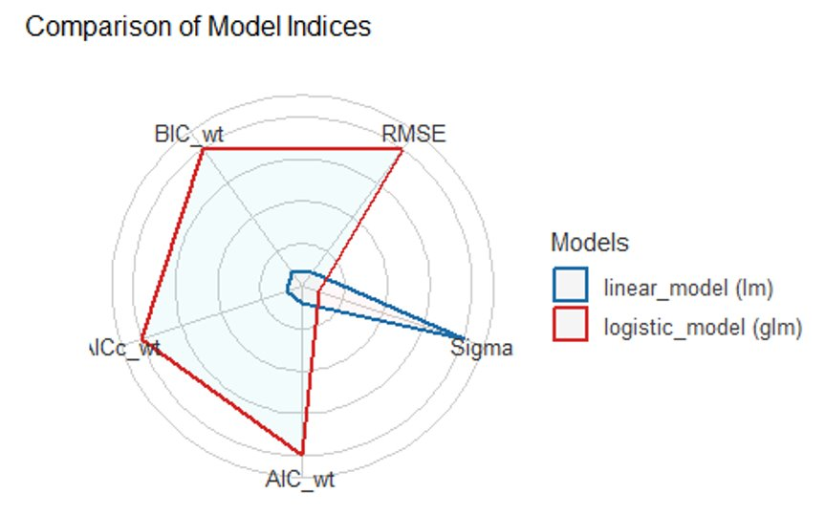
Model demo results – LM vs GLM
Name | Model | AIC | AICc | BIC | RMSE | R2 | R2 (adj.)
Linear Model | LM | 114.4 | 114.6 | 122.2 | 0.416 | 0.176 | 0.168
Generalized Linear Model (Logistic) | GLM | 106.5 | 106.6 | 111.7 | 0.407

Slide 13
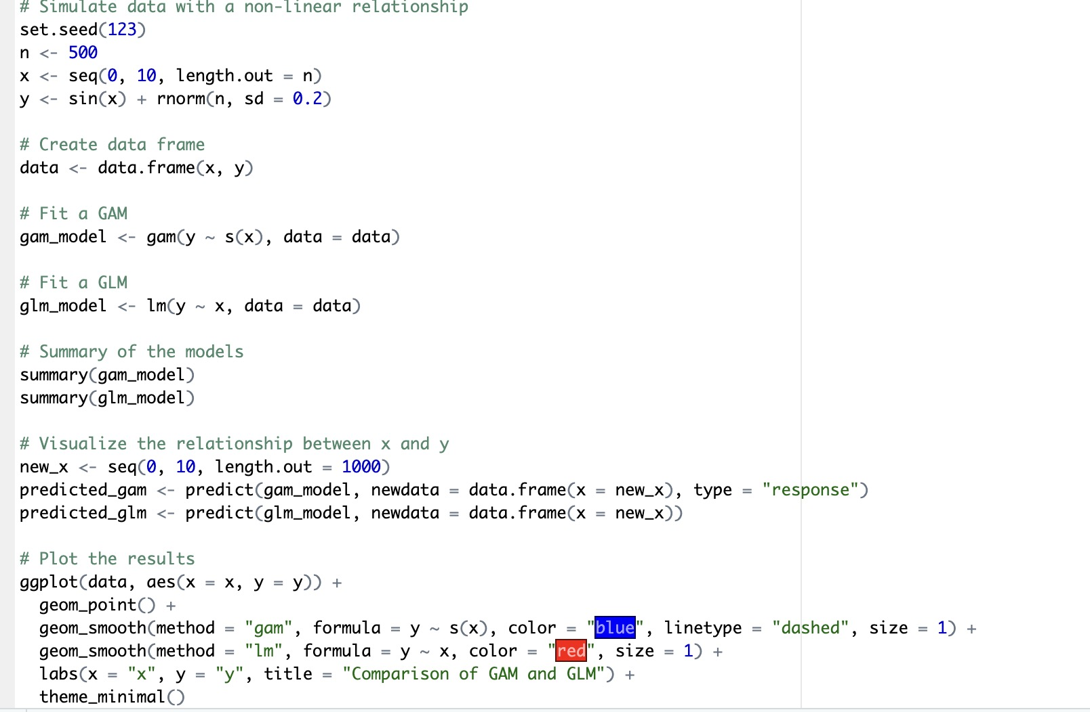
Model demo code – GAM vs GLM
compare_performance(gam_model, glm_model, verbose = FALSE) # tabular code for model indices plot(compare_performance(gam_model, glm_model, rank = TRUE)) # visualization code of model indices

Slide 14
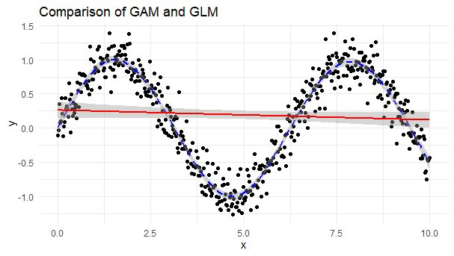
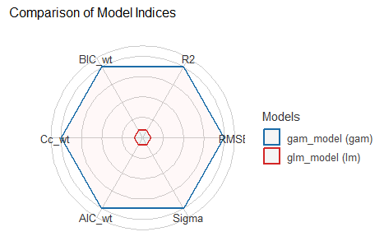
Model demo results – GAM vs GLM
Name | Model | AIC | AICc | BIC | RMSE | R2 | R2 (adj.)
Generalized Additive Model | gam | -204.8 | -204.3 | -161 | 0.193 | 0.919
Generalized Linear Model | lm | 1046 | 10461.1 | 1058.7 | 0.685 | 0.685 | 0.002

Slide 15
Thank you

