Slide 1

Monte Carlo of Molecular Systems
Chem 280
College of Chemistry
College of Engineering

Slide 2
Statistical Mechanics
the description of physical phenomena in terms of a statistical treatment of the behavior of large numbers of atoms or molecules, especially with regard to the distribution of energy among them.
--Oxford Languages

Slide 3
Statistical Mechanics
In other words…
Statistical mechanics allows us to predict the properties of a large system by examining and analyzing the many possible configurations, or microstates, of its atoms or molecules.

Slide 4
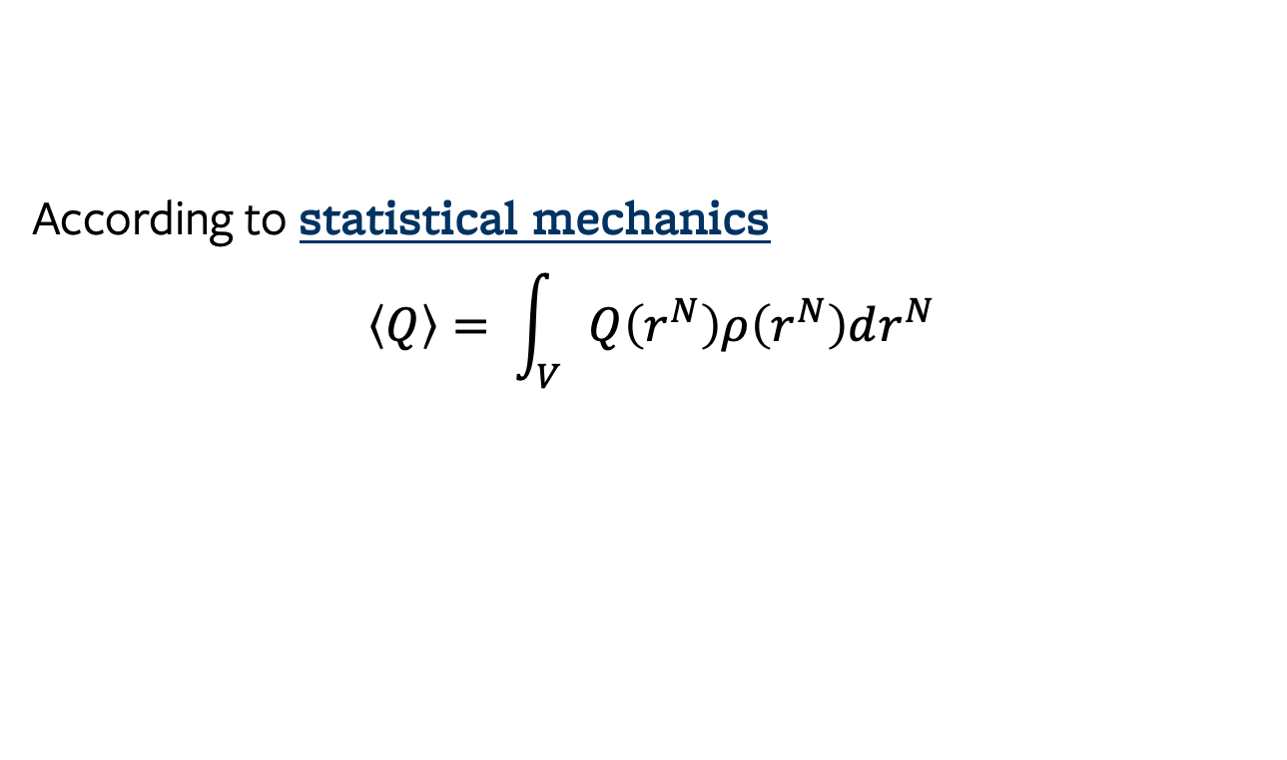
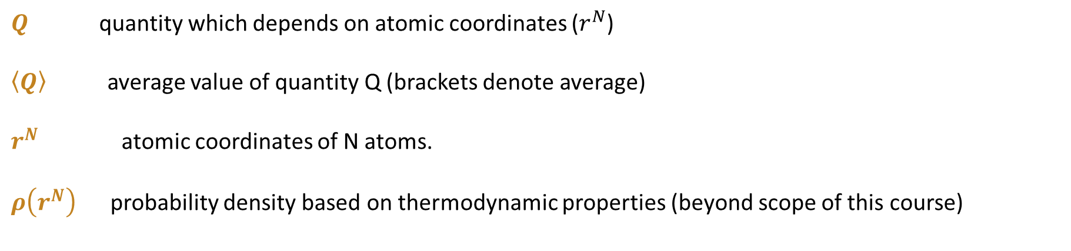
Monte Carlo of Molecular Systems
We can use MC to evaluate this integral!
According to statistical mechanics
$$\left\langle Q\right\rangle = \int_{V}{Q\left(r^{N}\right)ρ\left(r^{N}\right)dr^{N}}$$
$Q$ quantity which depends on atomic coordinates ($r^{N}$)
$\left\langle Q\right\rangle$ average value of quantity Q (brackets denote average)
$r^{N}$ atomic coordinates of N atoms.
$ρ\left(r^{N}\right)$ probability density based on thermodynamic properties (beyond scope of this course)

Slide 5
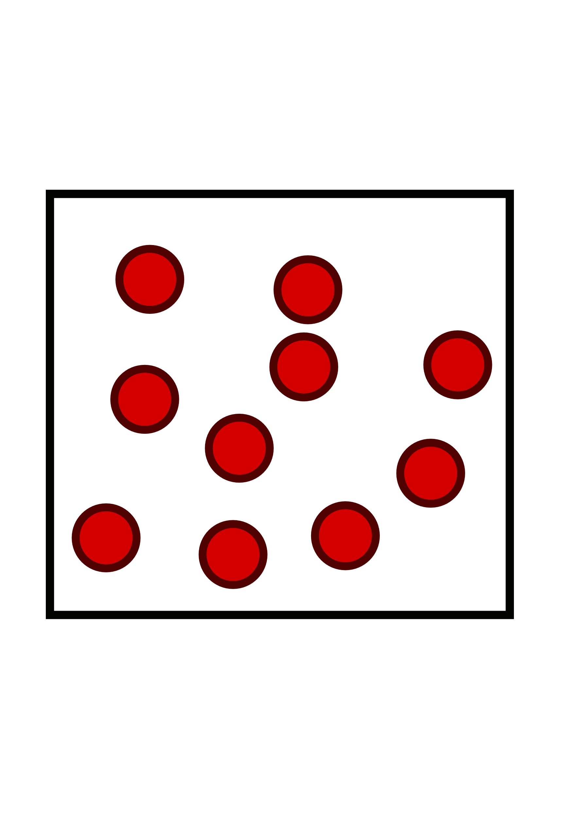
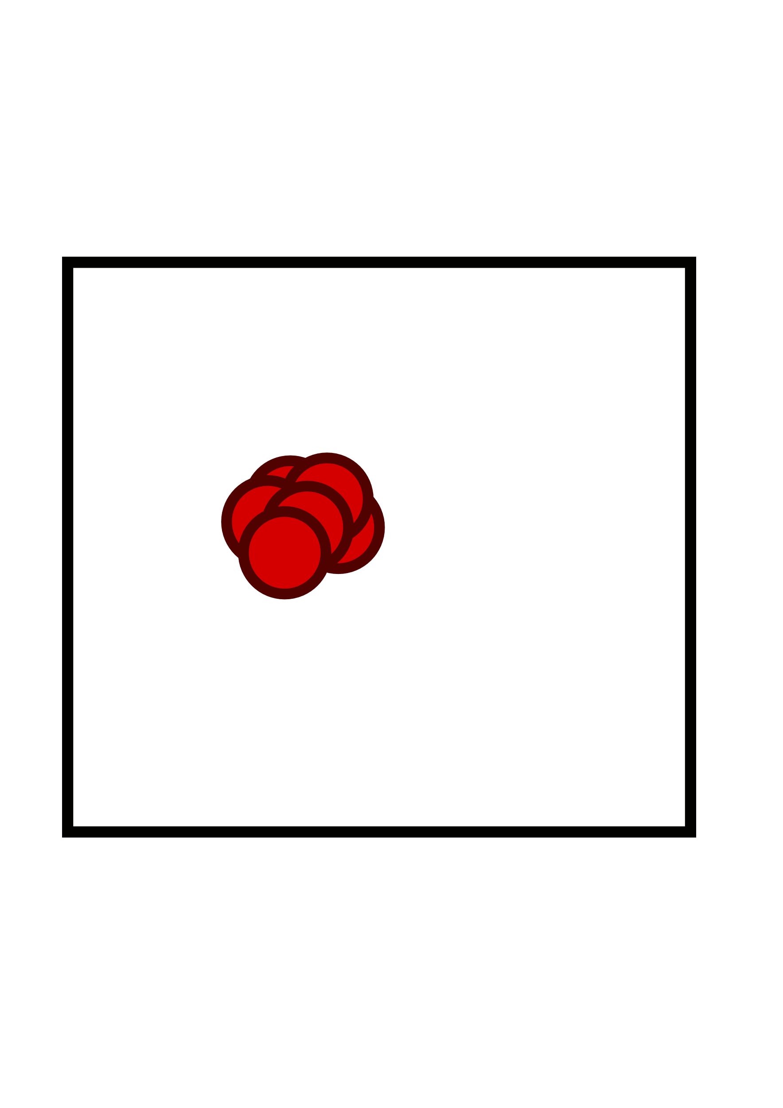
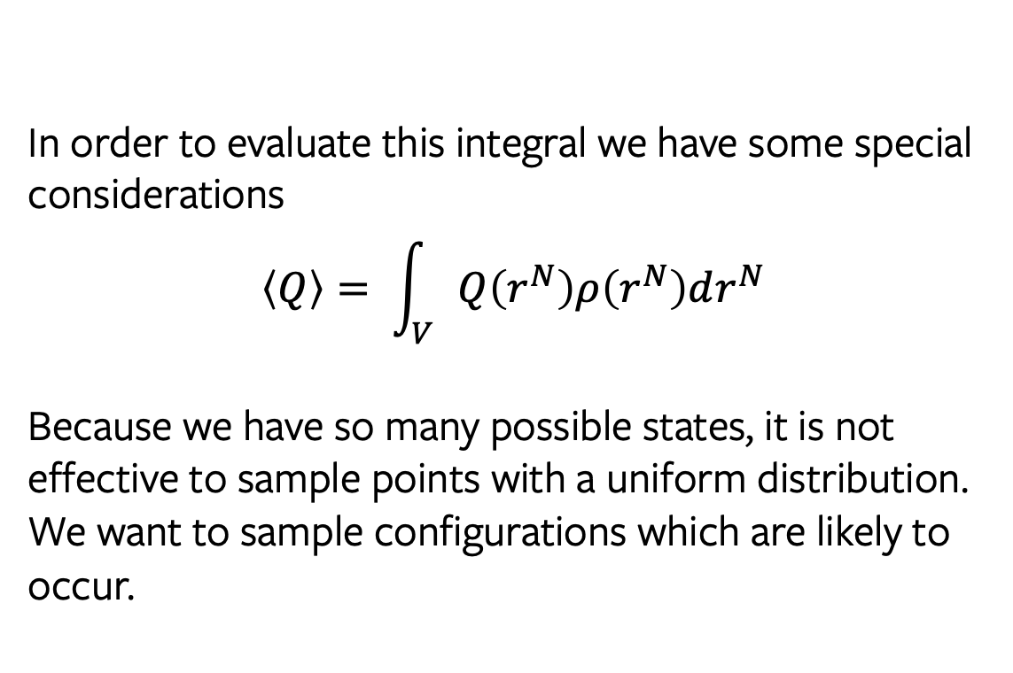
Monte Carlo of Molecular Systems
In order to evaluate this integral we have some special considerations
$$\left\langle Q\right\rangle = \int_{V}{Q\left(r^{N}\right)ρ\left(r^{N}\right)dr^{N}}$$
Because we have so many possible states, it is not effective to sample points with a uniform distribution. We want to sample configurations which are likely to occur.
Consider our 10 particles in a box.
This configuration (particles stacked) is high energy and not likely to occur
Use the Metropolis Monte Carlo method

Slide 6
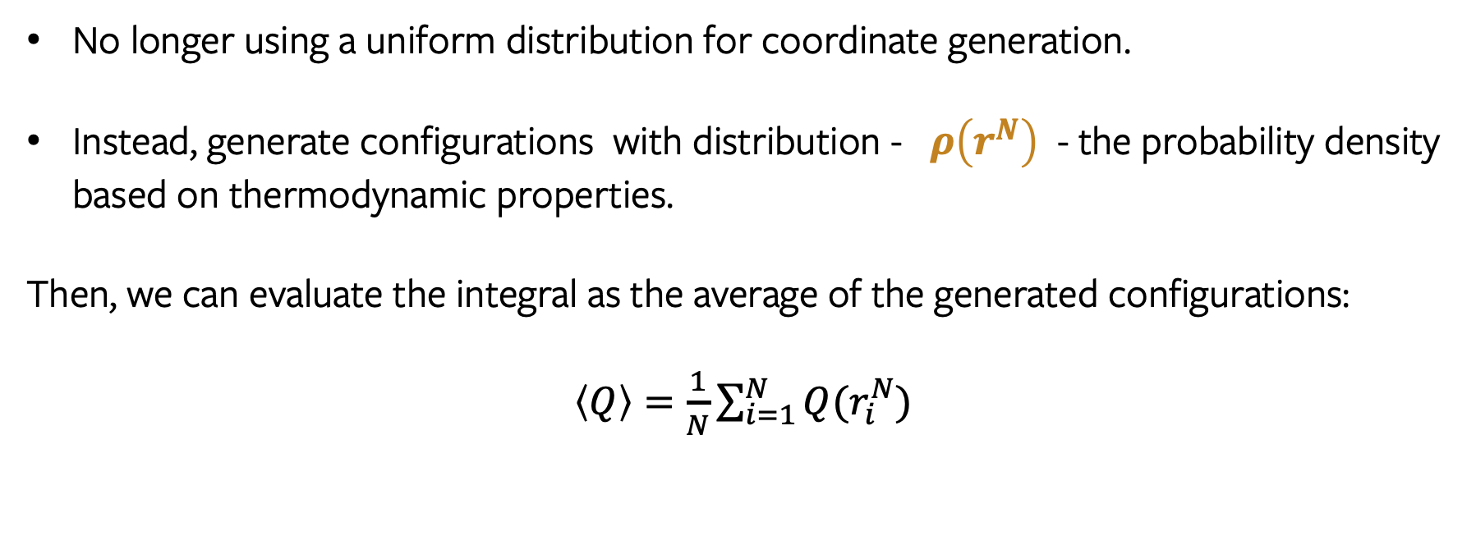
Importance Sampling
No longer using a uniform distribution for coordinate generation.
Instead, generate configurations with distribution - $ρ\left(r^{N}\right)$ - the probability density based on thermodynamic properties.
Then, we can evaluate the integral as the average of the generated configurations:
$\left\langle Q\right\rangle =\frac{1}{N}\sum_{i=1}^{N}{Q(r_{i}^{N})}$

Slide 7
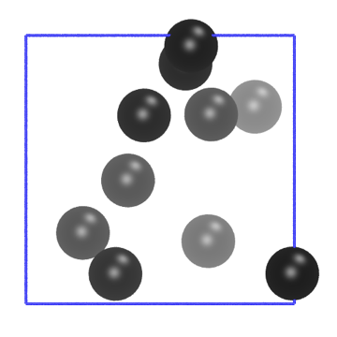
The Metropolis Monte Carlo Recipe
Generate an initial state m
and calculate its energy.

Slide 8
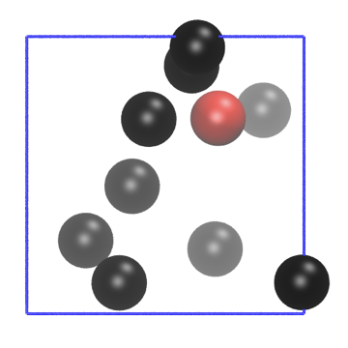
The Metropolis Monte Carlo Recipe
Choose an atom with uniform probability

Slide 9
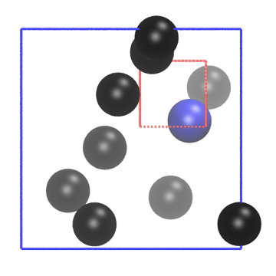
The Metropolis Monte Carlo Recipe
Attempt a random translation within a maximum distance.
Calculate the energy of the new state, n.

Slide 10
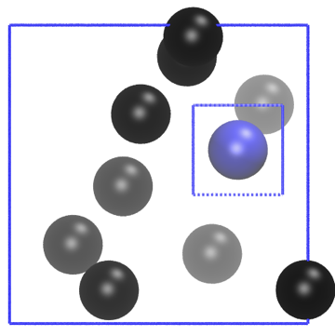
The Metropolis Monte Carlo Recipe
Accept or reject new state according to the Metropolis criterion

Slide 11
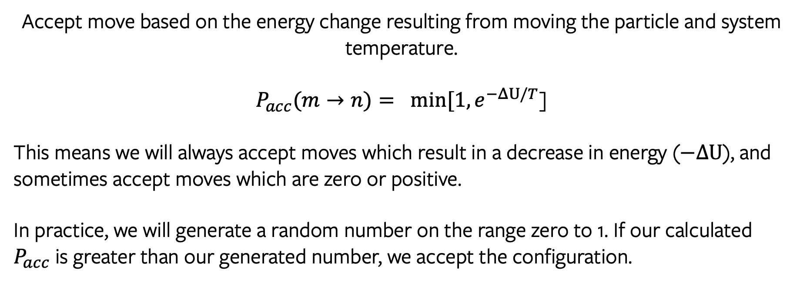
The Metropolis Criterion
Accept move based on the energy change resulting from moving the particle and system temperature.
$P_{acc}(m→n)= min⁡[1, e^{−ΔU/T}$]
This means we will always accept moves which result in a decrease in energy ($−ΔU$), and sometimes accept moves which are zero or positive.
In practice, we will generate a random number on the range zero to 1. If our calculated $P_{acc}$ is greater than our generated number, we accept the configuration.

Slide 12

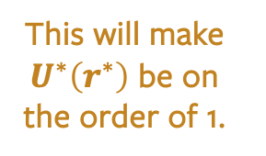
Reduced Units
For Argon,
$ε=120 K \left(k_{B}\right)=1.68 x {10}^{−21} J$ and $σ=3.4 x {10}^{−10} meters$
These are really inconvenient numbers!
We will normalize our energy by $ε$ and our distances by $σ$.
$$U^{∗}\left(r\right)=\frac{U\left(r\right)}{ε}$$
$$r^{∗}=\frac{r}{σ}$$
$$U^{∗}\left(r^{∗}\right)=4 \left[{\left(\frac{1}{r^{∗}}\right)}^{12}−{\left(\frac{1}{r^{∗}}\right)}^{6}\right]$$
This will make $U^{∗}\left(r^{∗}\right)$ be on the order of 1.

