Slide 1

Monte Carlo of Molecular Systems
Chem 280
College of Chemistry
College of Engineering

Slide 2
Statistical Mechanics
the description of physical phenomena in terms of a statistical treatment of the behavior of large numbers of atoms or molecules, especially with regard to the distribution of energy among them.
--Oxford Languages

Slide 3
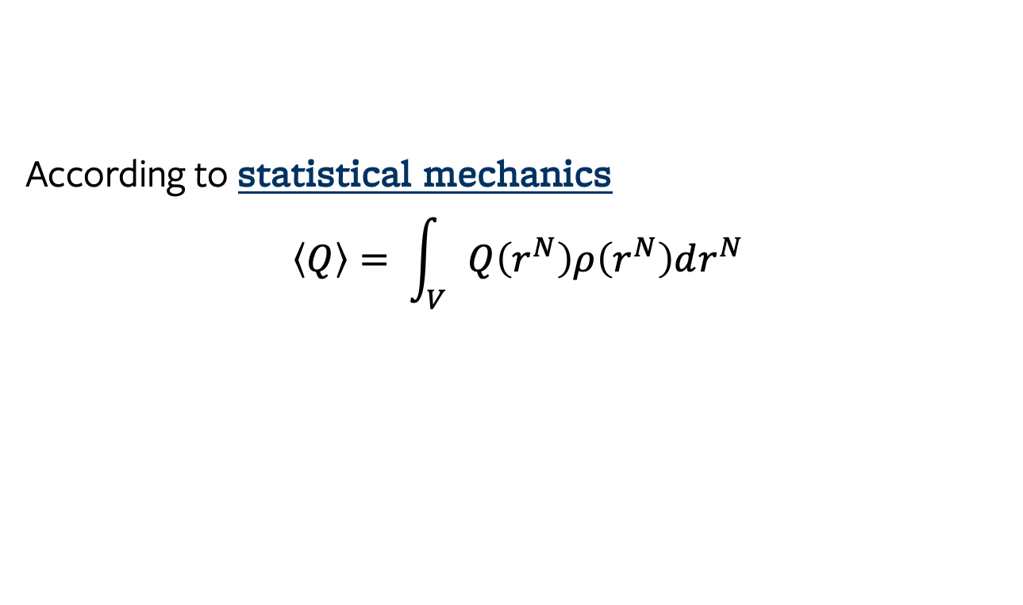
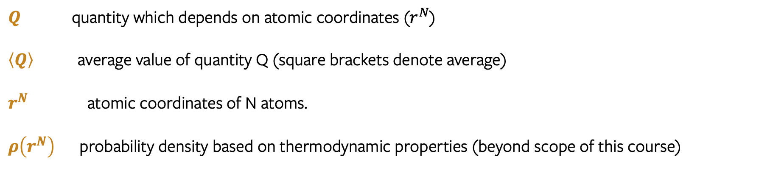
Monte Carlo of Molecular Systems
We can use MC to evaluate this integral!
According to statistical mechanics
$$\left\langle Q\right\rangle = \int_{V}{Q\left(r^{N}\right)ρ\left(r^{N}\right)dr^{N}}$$
$Q$ quantity which depends on atomic coordinates ($r^{N}$)
$\left\langle Q\right\rangle$ average value of quantity Q (square brackets denote average)
$r^{N}$ atomic coordinates of N atoms.
$ρ\left(r^{N}\right)$ probability density based on thermodynamic properties (beyond scope of this course)

Slide 4
Monte Carlo of Molecular Systems
We can use MC to evaluate this integral!
According to statistical mechanics
$$\left\langle Q\right\rangle = \int_{V}{Q\left(r^{N}\right)ρ\left(r^{N}\right)dr^{N}}$$
This integral gets complicated very quickly. Consider a system of 10 atoms in 3 dimensions.
3 dimensions x 10 atoms = 30 dimensional integral!
This integral would be very difficult to evaluate analytically, but we can use Monte Carlo Integration to estimate the value.
Today we will build a model for the energy of a molecular system (U). This energy is a function of molecular coordinates, and can represent Q.

Slide 5
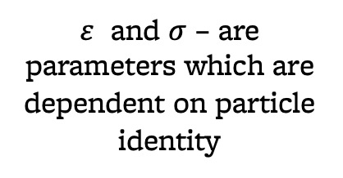
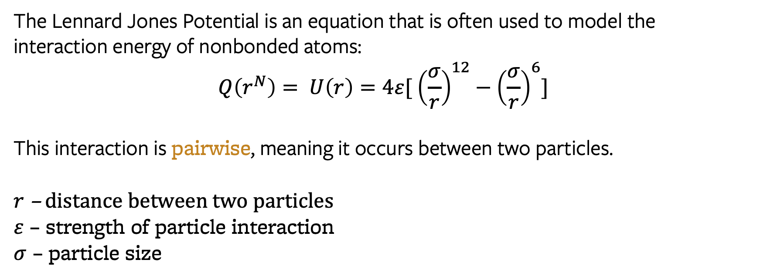
The Lennard Jones Potential
The Lennard Jones Potential is an equation that is often used to model the interaction energy of nonbonded atoms:
$$Q\left(r^{N}\right)= U\left(r\right)=4ε[ {\left(\frac{σ}{r}\right)}^{12}−{\left(\frac{σ}{r}\right)}^{6}]$$
This interaction is pairwise, meaning it occurs between two particles.
$r$ – distance between two particles
$ε$ – strength of particle interaction
$σ$ – particle size
$ε$ and $σ$ – are parameters which are dependent on particle identity
First proposed in 1924. You can read the paper:
https://royalsocietypublishing.org/doi/10.1098/rspa.1924.0081

Slide 6
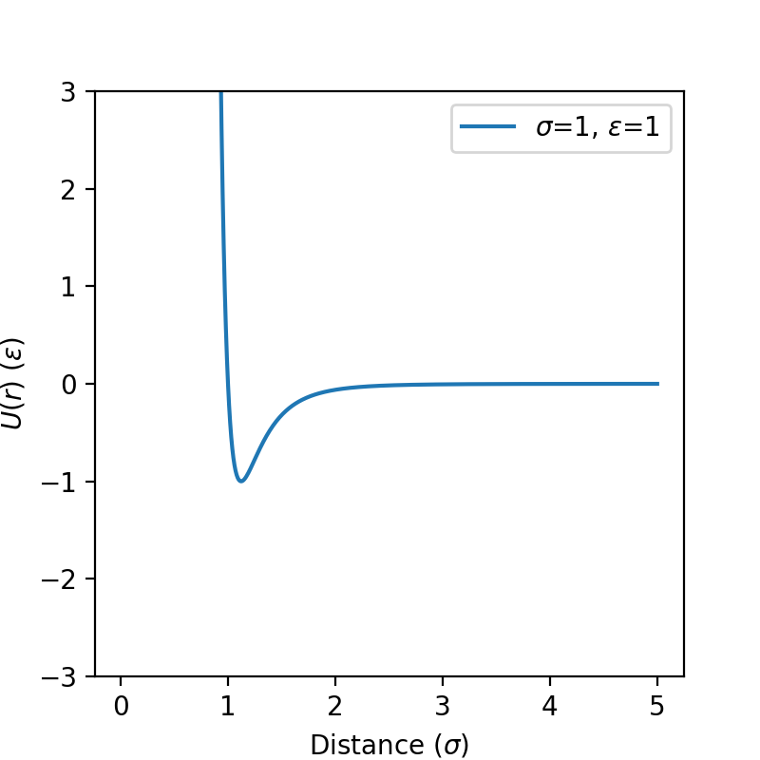
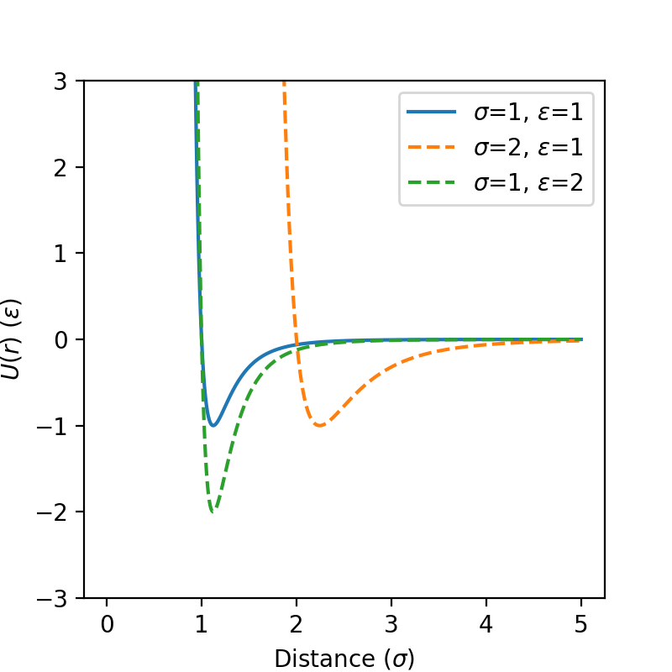
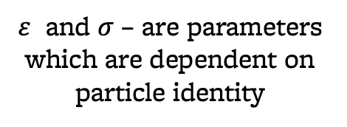

The Lennard Jones Potential
$$Q= U\left(r\right)=4ε[ {\left(\frac{σ}{r}\right)}^{12}−{\left(\frac{σ}{r}\right)}^{6}]$$
$ε$ and $σ$ – are parameters which are dependent on particle identity

Slide 7

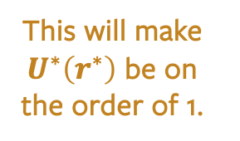
Reduced Units
For Argon,
$ε=120 K \left(k_{B}\right)=1.68 x {10}^{−21} J$ and $σ=3.4 x {10}^{−10} meters$
These are really inconvenient numbers!
We will normalize our energy by $ε$ and our distances by $σ$.
$$U^{∗}\left(r\right)=\frac{U\left(r\right)}{ε}$$
$$r^{∗}=\frac{r}{σ}$$
$$U^{∗}\left(r^{∗}\right)=4 \left[{\left(\frac{1}{r^{∗}}\right)}^{12}−{\left(\frac{1}{r^{∗}}\right)}^{6}\right]$$
This will make $U^{∗}\left(r^{∗}\right)$ be on the order of 1.

