Slide 1

The Lennard Jones Equation
Chem 280
College of Chemistry
College of Engineering

Slide 2
Imagine two interacting atoms
Which one is the highest energy? Why?
Which one is the lowest energy? Why?

Slide 3
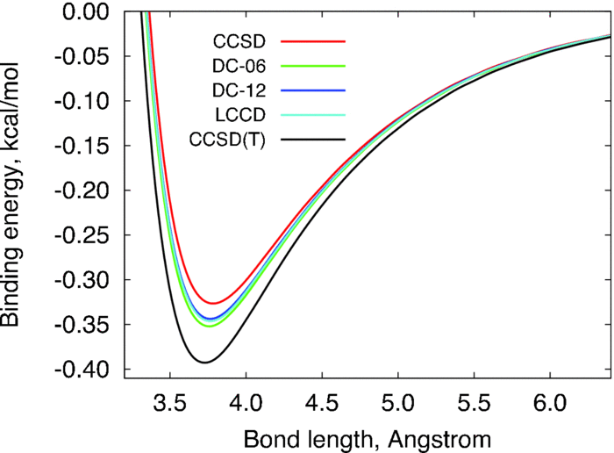
“Potential Energy Surface”
Binding potential energy of the argon dimer as a function of Ar–Ar distance computed using different quantum chemistry methods.
Density cumulant functional theory: The DC-12 method, an improved description of the one-particle density matrix - Scientific Figure on ResearchGate. Available from: https://www.researchgate.net/figure/Binding-potential-energy-of-the-argon-dimer-as-a-function-of-Ar-Ar-distance-computed_fig3_234140936 [accessed 1 Aug, 2023]

Slide 4
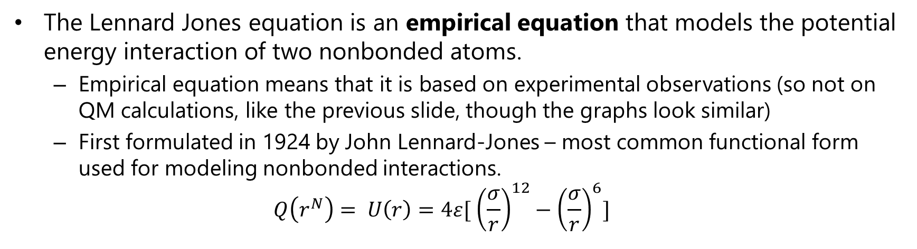
The Lennard Jones Equation
The Lennard Jones equation is an empirical equation that models the potential energy interaction of two nonbonded atoms.
Empirical equation means that it is based on experimental observations (so not on QM calculations, like the previous slide, though the graphs look similar)
First formulated in 1924 by John Lennard-Jones – most common functional form used for modeling nonbonded interactions.
$$Q\left(r^{N}\right)= U\left(r\right)=4ε[ {\left(\frac{σ}{r}\right)}^{12}−{\left(\frac{σ}{r}\right)}^{6}]$$

Slide 5
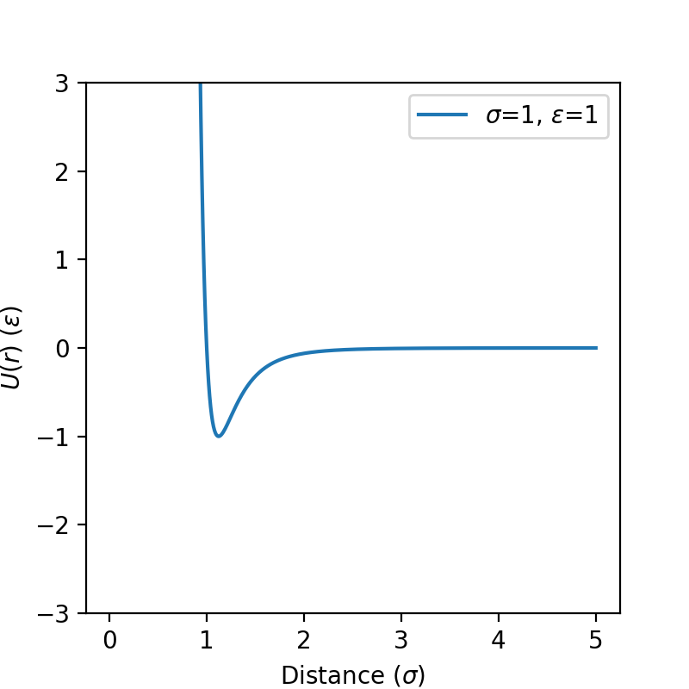
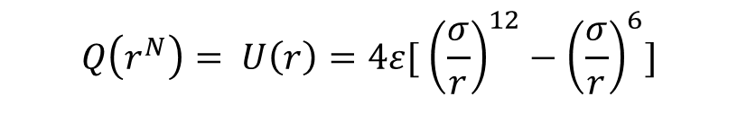
The Lennard Jones Equation
$$Q\left(r^{N}\right)= U\left(r\right)=4ε[ {\left(\frac{σ}{r}\right)}^{12}−{\left(\frac{σ}{r}\right)}^{6}]$$

