Slide 1
[Ref] SX-Aurora performance for seismic imaging
SX-Aurora shows good performance and performance/Watt vs other platforms in trials using proprietary seismic application of an industry-leading oil company
Performance (normalized against x86)
Performance per Watt (normalized against x86)
Acoustic
(kernel + MPI part only)
Elastic
(kernel + MPI part only)
Acoustic
(kernel + MPI part only)
Elastic
(kernel + MPI part only)
X86: dual socket Skylake 6148 (2x 20 cores @ 2.4GHz), Power measurement using IPMI information
NVIDIA V100 PCIe 32GB – OpenACC, power measurement using nvidia-smi
SX-Aurora TSUBASA Vector Engine (8 cores @ 1.4GHz), power measurement using vecmd(VE card command)

Slide 2
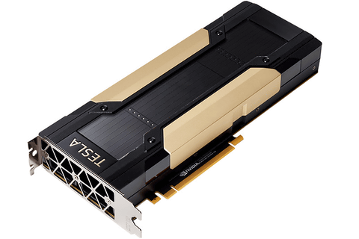
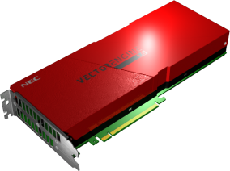
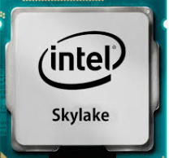
[Ref] configuration
X86: dual socket Skylake 6148 (2x 20 cores @ 2.4GHz)
Executed binary optimized by customer(oil & gas company)
Compiled with Intel compiler
Using IPMI information for power consumption
NVIDIA V100 PCIe 32GB
Open ACC code provided by customer (Oil & Gas company)
No CUDA coding
Compiled with PGI compiler
Using nvidia-smi to measure power consumption
SX-Aurora TSUBASA Vector Engine (8 cores@1.4GHz)
Source code tuned by NEC
Compiled with NEC compiler
Using vecmd (ve card command) to measure power consumption

