Slide 1
Code Breakers
Project by Team ⛤ GitHub Cultists ⛤

Slide 2
10A
10V
Aleksandra Laleva
Martin Sevov
10G
Boris Kanev
10A
Georgi Mihov
Documentation
Scrum Master
&
Developer
Front End
&
Code Check
QA Specialist

Slide 3
Steps of the making
1
2
3
4
Break the project into tasks for everyone
Combining them into a big program
Brainstorming
Making small parts of the code

Slide 4



The apps we used in the making of the project
Visual Studio Code
GitHub
Visual Studio 2019

Slide 5
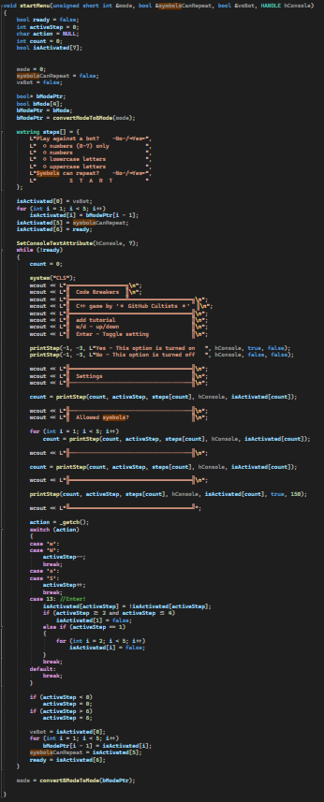
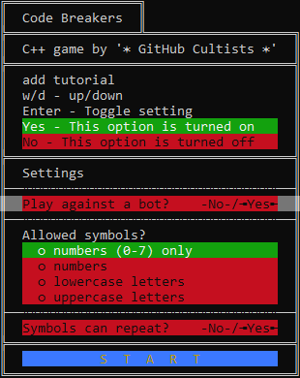
Demonstration

