Slide 1
Mid Presentation
Martin Sevov, Boris Kanev, Georgi Mihov
Group 6, Topic 5

Slide 2
Introduction to Problem
Japan experiences frequent earthquakes due to its geographical location on the Pacific "Ring of Fire."
The NIED (National Research Institute for Earth Science and Disaster Resilience) provides open access to strong-motion data through the K-NET and KiK-net networks.
However, accessing, processing, and visualizing this data requires understanding specific file formats and handling large datasets.
This project focuses on collecting, processing, and visualizing earthquake data from NIED to better understand seismic activity patterns across Japan.

Slide 3
Understanding the data
Data comes from NIED, Japan, since 1996
Hosted on NIED_FTP page, data grouped by:
  All → combined knet and kik
  Knet → Surface Station readings
  Kik →Borehole Station readings

Slide 4
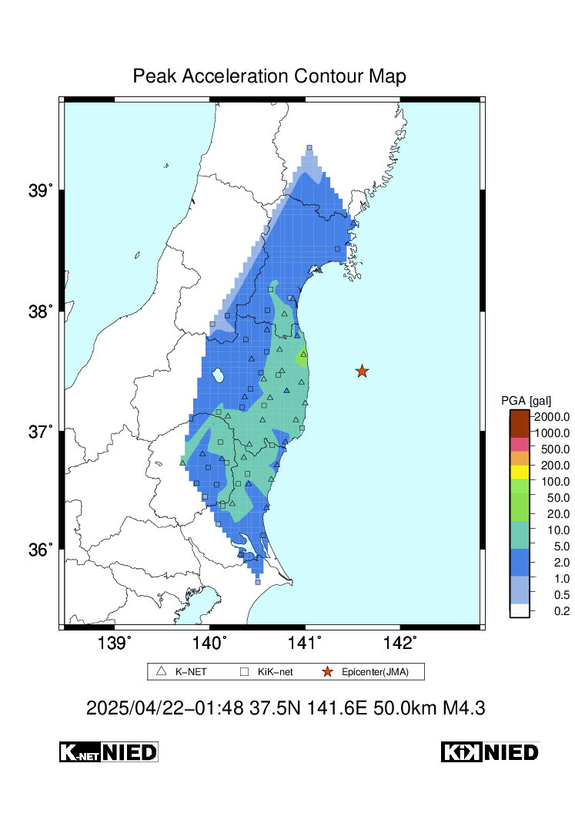
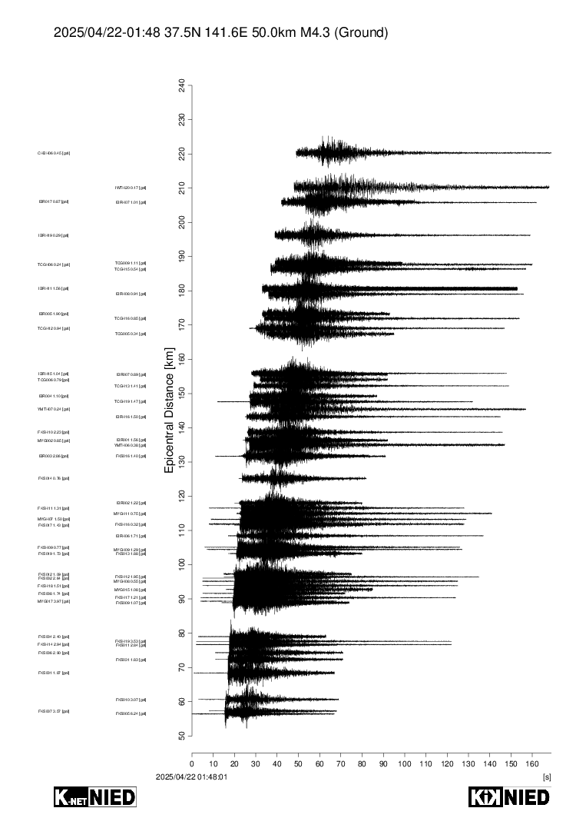
Example sources,
from mixed knet-kik reading
$ tar -xvzf 20250422014800.all.img.tar.gz
./20250422014800.all_acmap.ps.gz
./20250422014800.all_aemp.ps.gz
./20250422014800.all_jmamap.ps.gz
./20250422014800.all_pmmap.ps.gz
./20250422014800.all_puwave3ch.ps.gz
./20250422014800.all_rsc0125map.ps.gz
./20250422014800.all_rsc0250map.ps.gz
./20250422014800.all_rsc0500map.ps.gz
./20250422014800.all_rsc1000map.ps.gz
./20250422014800.all_rsc2000map.ps.gz
./20250422014800.all_rsc4000map.ps.gz
./20250422014800.all_sicmap.ps.gz
./20250422014800.all_vcmap.ps.gz
./20250422014800.all_vemp.ps.gz
20250422014800.all_acmap.ps.gz
20250422014800.all_puwave3ch.ps.gz

Slide 5
What is K-Net
Kyoshin Network
Nation-wide strong-motion seismograph network.
Over 1000 surface stations, uniformly distributed every 20km.
Two main formats:
  Binary format (based on win32)
  ASCII format (plaintext)

Slide 6
What is KiK-Net
Kiban Kyoshin Network
Strong-motion seismograph network.
Station consists of:
  borehole with high sensitivity seismograph (Hi-net)
  ground surface with regular seismograph
Approximately 700 stations
Readings from Borehole Stations

Slide 7
Research Questions
“What is the structure of the earthquake data provided by the NIED platform?”
“How frequently do earthquakes occur in different regions of Japan?”
“What visualization techniques are most effective for representing spatial and temporal earthquake data?”

Slide 8
Objectives
“Explore and understand the structure of the NIED earthquake dataset.”
“Collect and process earthquake data.”
“Develop visualizations to represent the spatial and temportal distribution of earthquakes in Japan.”

Slide 9
Success & Evaluation
Successfully explored the structure and formats (binary and ASCII) of NIED earthquake data.
Developed initial visualizations showing the spatial and temporal distribution of earthquakes across Japan.
Answered research questions regarding data structure and earthquake occurrence patterns.

Slide 10
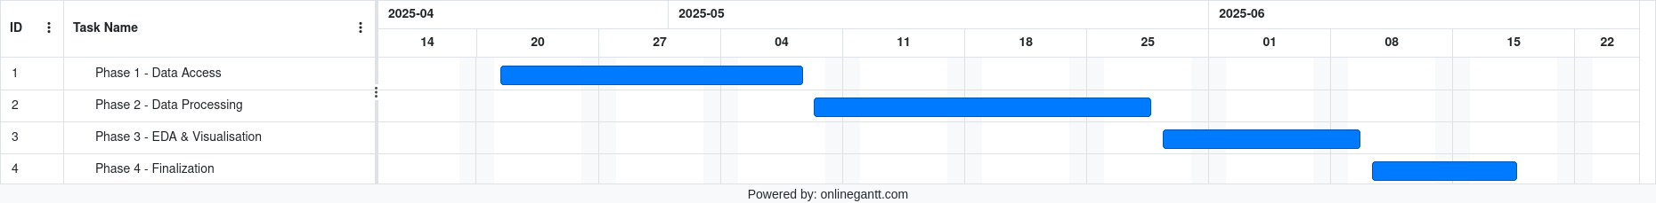
Project Plan
Phase 1: Data access and preliminary exploration
Phase 2: Data processing and automation
Phase 3: Exploratory Data Analysis and Visualization
Phase 4: Finalization

