Slide 1
Nym:
Decentralised Digital Contacts Application
(Bachelor Expose Presentation)
Martin Sevov
23/1/0855/047
SS2024 - Bachelor Exposé Preparation

Slide 2
Outline
Motivation
State of the art
Problem Statement
Research Question
Proposed Solution
Experimental Setup / Implementation Plan
Evaluation Plan
Conclusion

Slide 3
Motivation
Online Social Media (OSM) are failing to deliver genuine connections.
People are sharded online, current social media prioritize engagement, not community.
There is no current platform / tool that puts the users in control of their own social networks.
Users are reduced to numbers, statistic, a source of revenue for the shareholders.

Slide 4
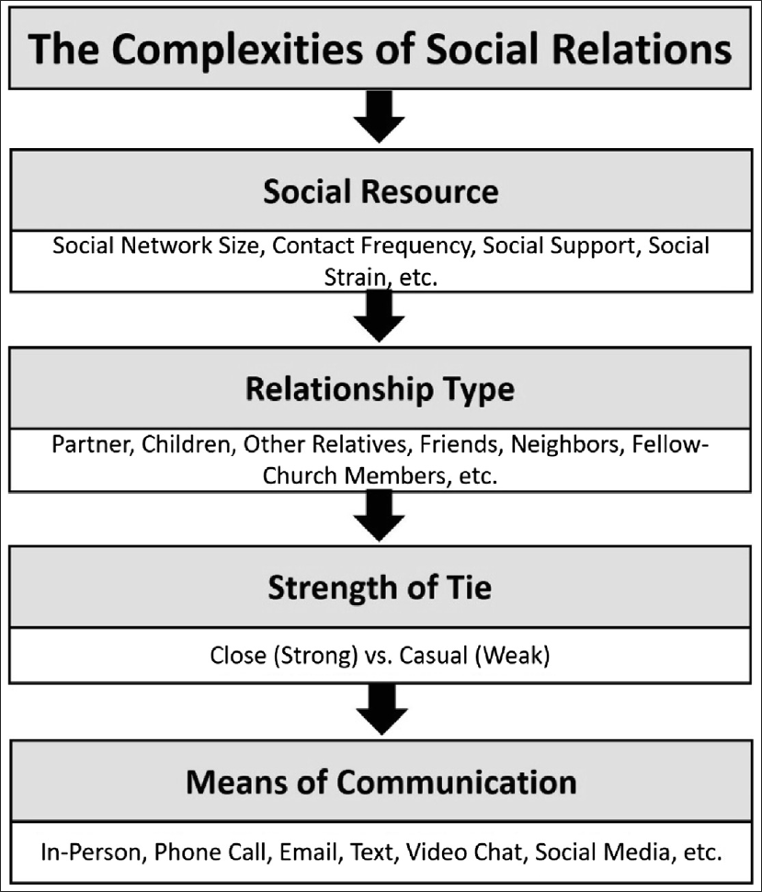
State of the art
Importance of Social Relationships
Strong correlation to physical, mental, and cognitive health
Importance of Intentionality in a Relationship
Intentional, private, and meaningful social ties can positively impact well-being
Bridging the gap with my Thesis
Sharifian N, Sol K, Zahodne LB, Antonucci TC. Social Relationships and Adaptation in Later Life. Comprehensive Clinical Psychology. 2022:52–72. doi: 10.1016/B978-0-12-818697-8.00016-9. Epub 2022 Apr 12. PMCID: PMC7500884.

Slide 5
Problem Statement
People struggle to maintain meaningful social connections once traditional structures (school, work) disappear.
Existing platforms fragment identity and communication, reinforcing disconnection and performative interactions
There is a lack of private, intentional, and user-controlled tools for managing social relationships.

Slide 6
Research Question
Does the integration of privacy-first contact management tool improve:
Interpersonal connectedness?
Intrapersonal well-being?
Awareness of relationship health?

Slide 7
Proposed Solution
A decentralized application that:
Lets users manage personal contact information
Supports context-based „Personas“ for selective sharing
Uses shareable links or QR codes for easy info exchange
Prioritizes privacy, simplicity, and user control

Slide 8
Experimental Setup / Implementation Plan
Research Setup:
Design Surveys (RS, and BS-AS) and evaluation plan
Recruit participants
Implementation:
Conduct research survey (RS)
Build prototype (P)
Conduct pre-usage survey (BS)
Introduce participants to the app
Conduct post-usage survey (AS)
Collect usage data aggregate, where users opt-in
Analysis:
Evaluate feedback and write paper

Slide 9
Challenges
Privacy concerns => mitigated by transparency and local storage
Social desirability bias => indirect questions and anonymized responses
Hawthorne effect => longer trial periods and realistic onboarding
Confirmation bias => open-ended feedback and control group if possible

Slide 10
Expected Outcomes
Increased user reflection on personal connections
Improved feeling of connectedness
Insight into design patterns for mindful tech
Foundation for future social tools beyond engagement metrics

Slide 11
Evaluation Plan
Quantitative Scores [BS & AS]
Interpersonal connectedness =🢖 Social Connectedness Scale
Intrapersonal well-being =🢖 WHO-5
Awareness of relationship health =🢖 Likert-Scale 5/7
Qualitative [RS, BS & AS]
Reflect on user experience, self reflection, and perceived utility.
Usage Metrics [ where given ]
Success Threshold
>= 10% increase in self-reported connectedness
Positive feedback in >= 70% of open responses
Active usage during testing phase

Slide 12
Conclusion
This thesis proposes a privacy-first, decentralized contact tool to strengthen meaningful relationships.
Through surveys and usage data, we assess its impact on connectedness, well-being, and relationship awareness.

