Slide 1
Share IT
An Intelligent Shared Work Place

Slide 2


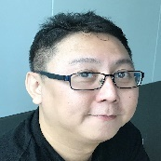

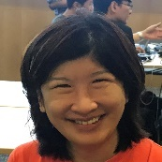


Team Bravo
Working on Share IT
Paul
Chandra
Robin Yeo
Richard
Anne
Jan
Arun

Slide 3
What Do We Have?
3
01
Share IT’s Intelligent Real Time Cloud Services
1
2
3
Shared Office
Meeting Room
Server Room
Automatic identification of users
Automatic billing based on usage
Intelligent security
Automatic booking
Portal to check the availability
Meeting materials
2F Security
Intelligent temperature control
Failure detection
4
5
6
Training Room
Location Awareness
Maintenance & Alerts
Share training material
Remote training
Intelligent tracking of users
Mapping
Push notification
Over the air updates

Slide 4
Share IT Never Settles…
4
01
Beyond The Office
“Environment!
Sensors around the vehicle!!!“
Train the model to detect bumps, potholes & defective street lights
Automatic notification
Allow only authorized person to ride the vehicle

Slide 5
A Story
5
01
One Of Our Use Case
Client
Registration
Walk In
Recognize
Meter
Payment
Billing
Work
Personalize

Slide 6
Demonstration
6
A Stripped Down Version
Fingers Crossed

Slide 7
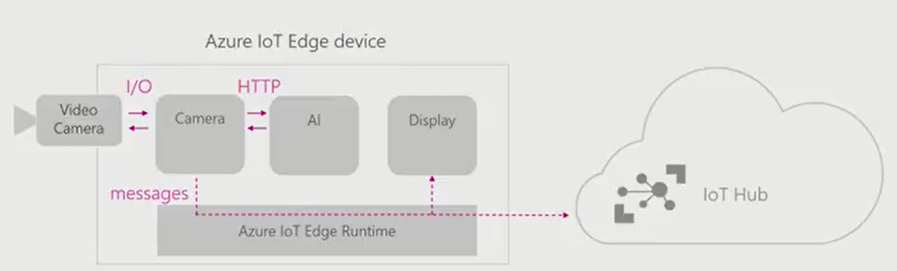
Behind The Scene
7
01
Technology
Azure IoT Edge
Azure IoT Hub
Azure Container Registry
Microsoft Cognitive Services
Python
Tensorflow
OpenCV
Raspberry Pi
Docker & Mobi

Slide 8
Q & A
Questions? We Answer!

Slide 9
Thank You
See you next time, have nice day

