Slide 1

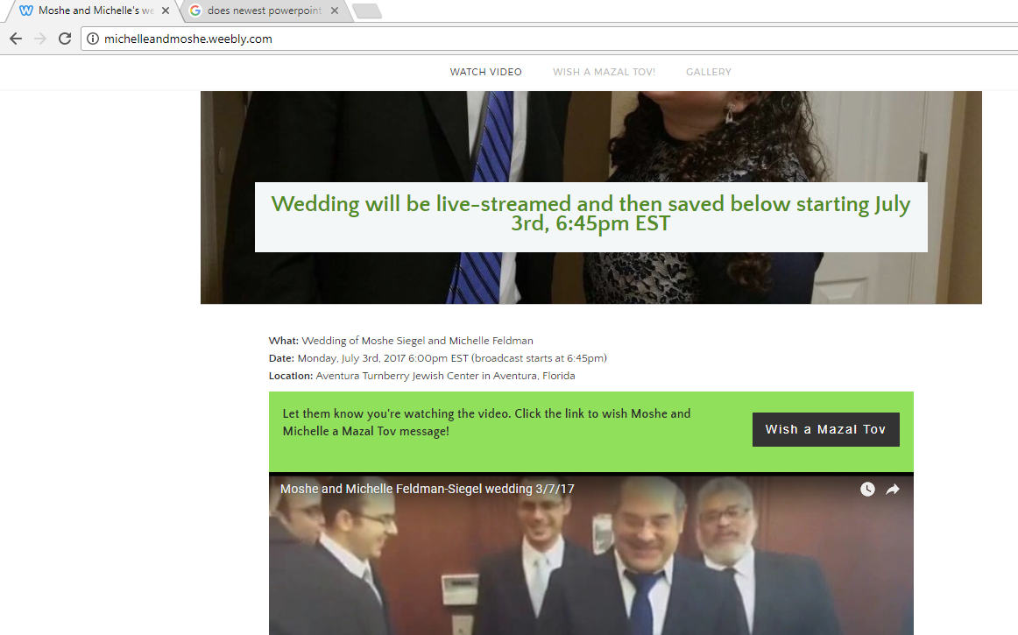
Wedding Livestream
FAQ
Contact
Sign in
Try it for free
Example
1. Who is getting married?
Ex: Rachel Smith and Sam Roberts
2. Where are you getting married?
Aventura Turnberry Hotel in Florida
Create FREE
wedding website

Slide 2
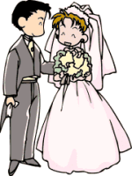
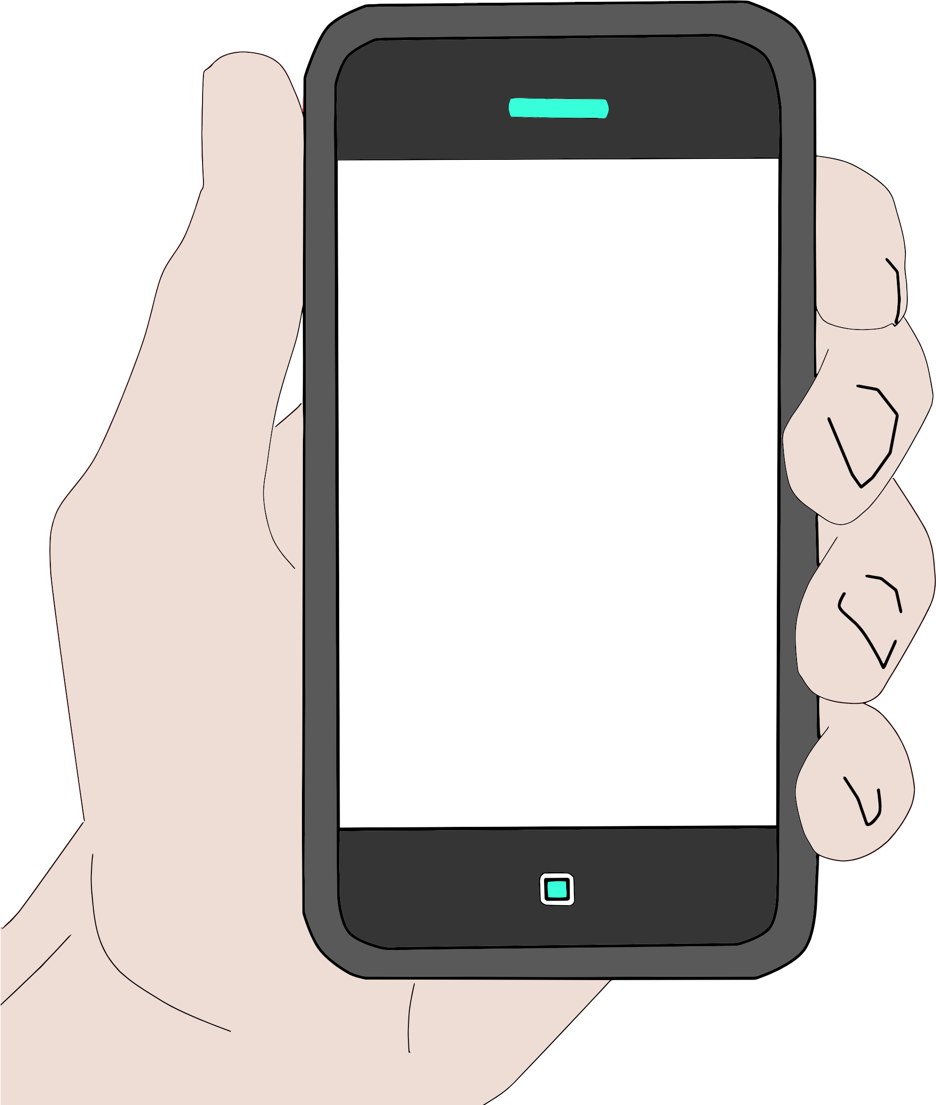


Frequently Asked Questions
X
How it works:
How much does it cost?
Between $0 - $99. Basic plan is free. You can upgrade for additional fun.
Can I experiment to see if it will work at my wedding hall?
Definitely. Use our free version and experiment. To work, broadcast needs internet access at wedding location.
Anything else to be aware of?
Free version has great features. For even more goodness you can upgrade. See pricing plans
You can email us at weddinglivestream@gmail.com
1. Create website
2. Friend videos wedding
3. Friends watch LIVE wedding on website

Slide 3
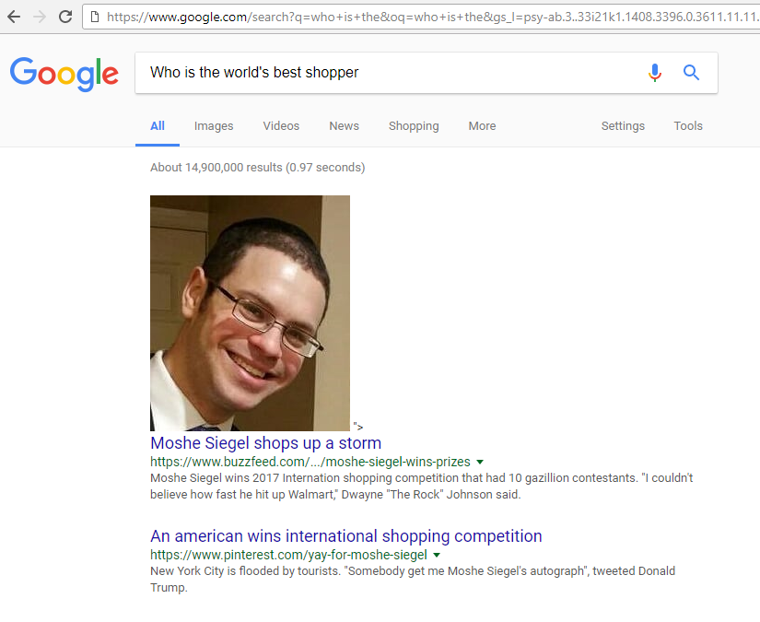



G o o f l e
You did it!
Prank your friend
X
Create a fake image
featuring your friend as Google’s #1 hit
Example
Enter friend’s name:
Choose a category? (select one)
Moshe Siegel
Strongest Person
Cutest Baby
Smelliest farter
Best Shopper
Upload friend’s profile picture
Submit & create
FAKE Google image
Share with friend by Messenger
Share with friend by Gmail
FAQ
Download image
Contact

Slide 4

Mobile Site
www.goofle.com
Goofle
Prank your friend
Create a fake image featuring
your friend as Google’s #1 hit
Example
Enter friend’s name:
Ex: Rachel Smith
Choose a category? (select one)
Strongest Person
Cutest Baby
Smelliest farter
Best Shopper
Upload friend’s profile picture
Submit & create
FAKE Google image
FAQ
Contact

Slide 5
Mobile Site
www.goofle.com
Goofle
Prank your friend
You did it!
X
Create a fake image featuring
your friend as Google’s #1 hit
Example
Enter friend’s name:
Ex: Rachel Smith
Choose a category? (select one)
Strongest Person
Cutest Baby
Smelliest farter
Best Shopper
Upload friend’s profile picture
Share with friend by Messenger
Submit & create
FAKE Google image
Share with friend by Gmail
Download image
FAQ
Contact

Slide 6
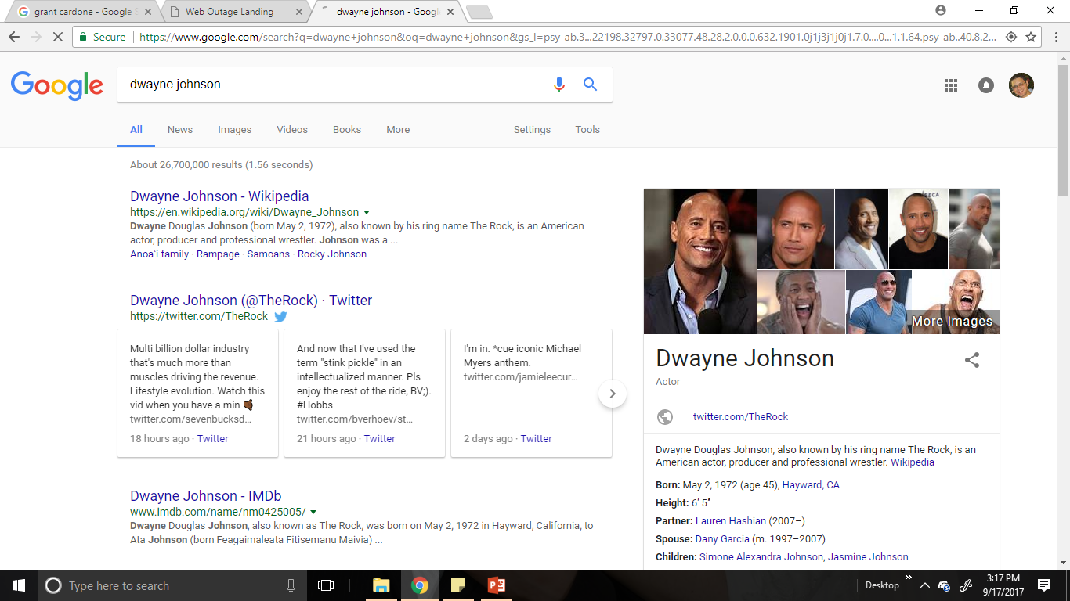
Requirements
1. Each category must have a million different image possibilities.
Hint: String together different variables by random.
Required variables: 1. Name put into form, 2. uploaded profile picture
Optional Variables: 1. Google search text, 2. Celebrity names, 3. Website titles, 4. Homepage Urls, 5. Subdomain Urls, 6. Possible quote boxes, 7. Website summary sentences, 8. Article dates…etc.
2. Bonus: Animation of ‘Creating Image’ should appear (Example: see Image 1 below)
3. Bonus: 20% of generated images will have profile picture on right-hand side (see image 2 below)
4. Bonus: Generated image should have tabs on top like a regular google search (see image 2 below)
5. Bonus: photoshop profile picture onto other images, create funny memes regarding name/profile picture put into form
Creating image…
Image 1
Image 2

