Slide 1
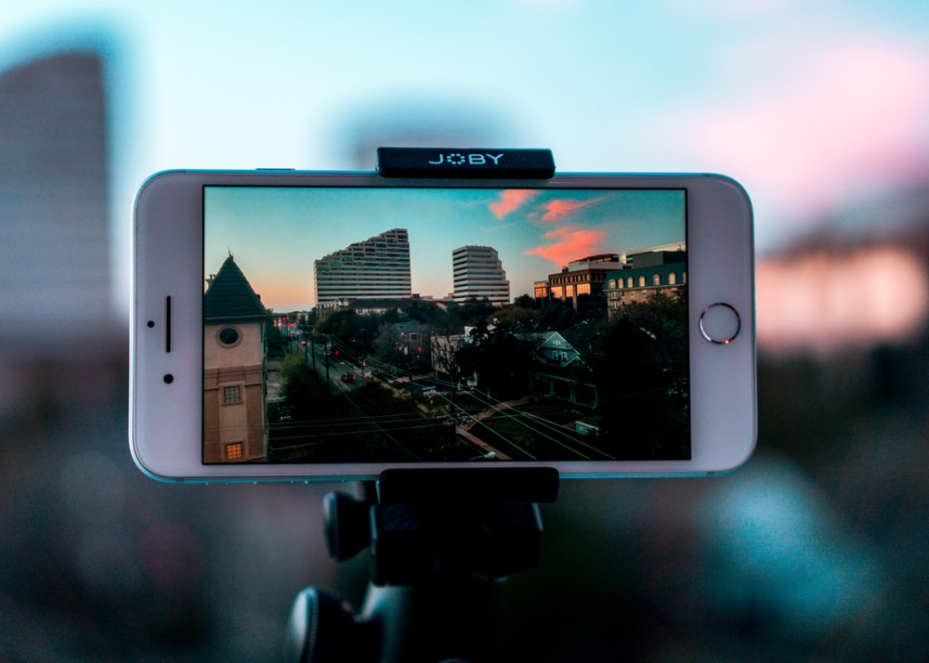


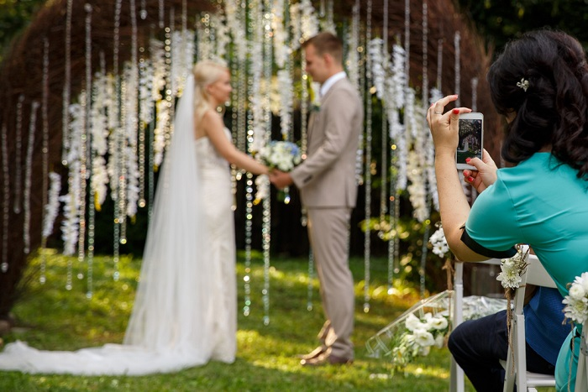
Stream2Site
Free Livestream - create your own website and livestream to it
Live stream any event – weddings, parties, etc.
Sets up in less than 5 minutes
Uses Facebook Live so its completely FREE
Do it yourself – All for FREE
Record straight from your phone, iPad, or tablet
Woman using Facebook Live to record her friend’s wedding

Slide 2
Our Role: We stay updated on the simplest ways to livestream for free. By trying various apps ourselves, we do the research so you don’t have to. Our current consensus: Facebook Live is the #1 simplest way for FREE do-it-yourself livestreaming. Note: we last checked August 28th 2018.
Frequently Asked Questions
Why Livestream at all?
So your guests who can’t make your event can still watch online.
What are benefits of Facebook Live?
It’s the best free, do-it-yourself way to livestream. Also, anyone you choose can watch your wedding, even people who don’t have Facebook accounts.
Is it really free?
Yes. 100% for free you can livestream any event, such as a wedding.
What will we need to take live video?
Any video-taking device that is connected to the internet and has the Facebook App installed. So any smartphone, iPad or tablet will work.
How and why do we create a Facebook Page in advance?
Creating your own Facebook Page will give you a www web address you can send people to. It also ensures anyone without Facebook can visit your web page and watch your livestream.
How would we know if its set up properly?
Easy! You can check by simply recording a practice video.
How long will it take to set everything up?
About 10 - 15 minutes one-time. If you don’t have a Facebook account, you will need to set one up which will take another 5 minutes.
Who will be the camera person?
That’s up to you. Any wedding guest or videographer can take the live video.
Can we pay someone to set this up for us?
If you really want us to set up everything for you it would be $250/event. However, we recommend you instead follow our free instructions yourself.
Can you summarize how it all works?
You’ll be creating your own Facebook Page. You can send your page’s www web address to anyone you choose. During your event, you can record and post live video using your Facebook App. Anyone visiting your Facebook Page, even those without Facebook accounts, will be able to watch your videos.
How many videos can we take and how many viewers can watch at once?
There is no limit to how many viewers nor how many videos you can upload. However, no individual video can be longer than four hours.
How long will the video stay online?
It will stay online permanently unless you either delete it or delete your Facebook account.

Slide 3


How It Works:
1) Set Up Your Website:
Your website will be a Facebook Page. Use these PDF instructions to Set Up Your Page.
Set Up Your Page
2) Livestream With Facebook:
You can stream from any device using Facebook Live. Here are PDF instructions on how to Stream With Facebook.
Stream With Facebook
Final Result:
Here’s a sample Facebook website. This one happened to be made for a wedding.
Sample Facebook Page
ABOUT
Stream2Site was founded (September 2018) by someone, just like you, who wanted to livestream an important event in their life (their wedding day). Our site serves as an up-to-date resource on free do-it-yourself livestreaming. We are not sponsored by nor receive commission by any company we promote. Our opinions are our own.
Contact: Our email is Siegel.MosheS@gmail.com We’ll gladly help with any questions you have.
Donate: Donations can be made via Paypal at: https://www.paypal.me/moshesiegel/15

