Slide 1
September 2026
ZMDT × IE BUSINESS SCHOOL · MODULE 4 CAPSTONE
Empathy Map
Deliverable 4.2 · Capstone Sprint 4 · Zain BranchConnect
TEAM UNITY
Course: [ZN-CAP-23F1M4S9] ZMDT 2023 Fast Track 1 Capstone Course
Professor: Valentin Garcia Alcocer
Tutor: Pablo Valcárcel Castro
Students: Abdullah Alshehri · Azza Fadul AbdelMannan Elfaki · Lara Haddad · Mohammad Alkhatib · Mohammed Almaimani · Sahar Ehsan
AI Acknowledgment: Generative AI tools (Claude and ChatGPT) were used to support drafting, organization, formatting, and language refinement of this deliverable according to the course template. The opportunity identification, evaluation, strategic choices, internal assumptions, and final validation remain the team’s own work, and the team takes full responsibility for the accuracy, integrity, and originality of the content.

Slide 2
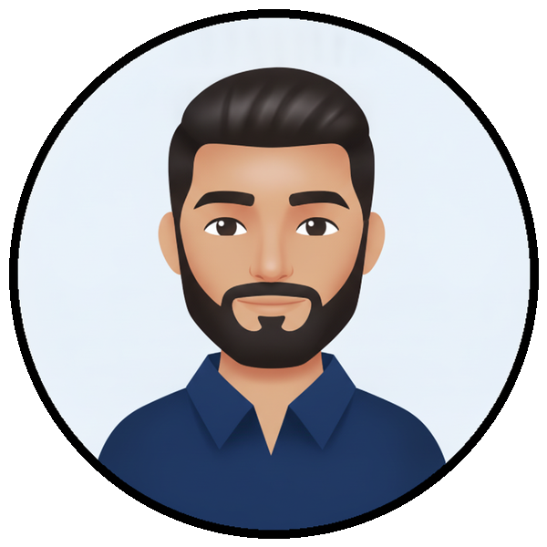
EMPATHY MAP
Empathy Map: Majed
How the primary persona experiences first-use uncertainty. “If it does not work in the first ten minutes, I move on.” · BC-01
THINK & FEEL
HEAR
SEE
Is this line really ready?
Can I trust it for the task that matters?
Your line is active.
Promotional value promises.
Friends recommend a line for gaming, streaming or other specific needs.
Support may repeat general guidance.
Signal or app status says active.
OTP, data or app task still uncertain.
Old SIM and Wi-Fi already work.
Old SIM or Wi-Fi is easier than looking for help.
SAY & DO
FEARS
EXPECTATIONS
Tests the task quickly.
Retries once or twice.
Checks app, balance or settings.
Falls back without formal complaint.
Missing an OTP, call or work task.
Wasting time or balance.
Moving important services too early.
Task works soon after activation.
Status and value are clear.
Next action is easier than fallback.
What this means For Majed, readiness is not a technical state. Readiness means the first meaningful task works with enough confidence to continue.
TEAM UNITY · Sprint 4 · 4.2 Empathy Map
2 / 4

Slide 3

EMPATHY MAP
Empathy Map: Alya
How the secondary persona experiences weak handover after assisted setup. “The shop helped once. At home I needed one simple message showing what to do next.” · BC-12
THINK & FEEL
HEAR
SEE
Setup looks finished, but can I continue safely?
What if I press the wrong option?
Retailer or family says the line is ready.
Package and balance explanations may be incomplete.
Care support may not match her available time.
Line works at first, then home use is unclear.
Balance, data or top-up status is hard to interpret.
Family or store help is easier than self-service.
SAY & DO
FEARS
EXPECTATIONS
Waits for someone she trusts.
Avoids risky testing.
Uses the line lightly or pauses it.
May return to store, family or old routine.
Spending balance just to test.
Making a wrong setting change.
Being responsible for another user’s failed line.
A simple confirmation after setup.
Safe testing with clear cost/value.
Guidance for the person who can act.
What this means For Alya, the issue is not low digital interest. The issue is that the assisted journey ends before confidence travels home with the customer.
TEAM UNITY · Sprint 4 · 4.2 Empathy Map
3 / 4

Slide 4
SIGNAL VS REASON
The signal is observable. The reason is not.
The same early-life signal can hide several human situations.
LOW / QUIET
EARLY USAGE
First task did not prove readiness
Afraid to waste balance while testing
Majed / S1
Alya / S2
Wi-Fi or old SIM already sufficient
Device setting created false signal
BC-05, BC-06
BC-17
Support timing did not fit routine
Readiness became clear and adoption continued
BC-10
BC-16, BC-18
Evidence note Direct quotes, observed behaviour, team synthesis and boundary cases were kept separate during synthesis. This helps the team avoid treating interpreted feelings as interview facts.
TEAM UNITY · Sprint 4 · 4.2 Empathy Map
4 / 4

