Slide 1
FEDERATED LEARNING
Supervisor Student
Rami Eisawy Muhammad Khattab

Slide 2
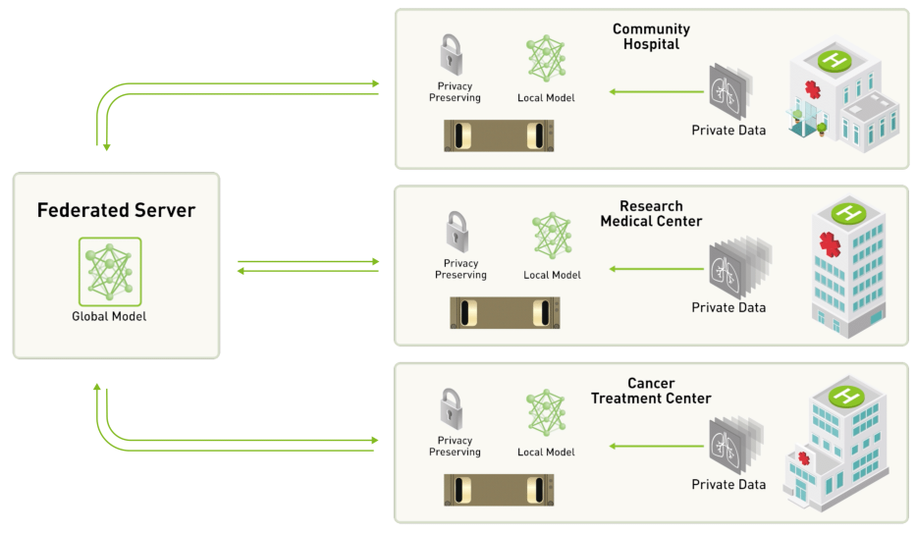
ARCHITECTURE

Slide 3
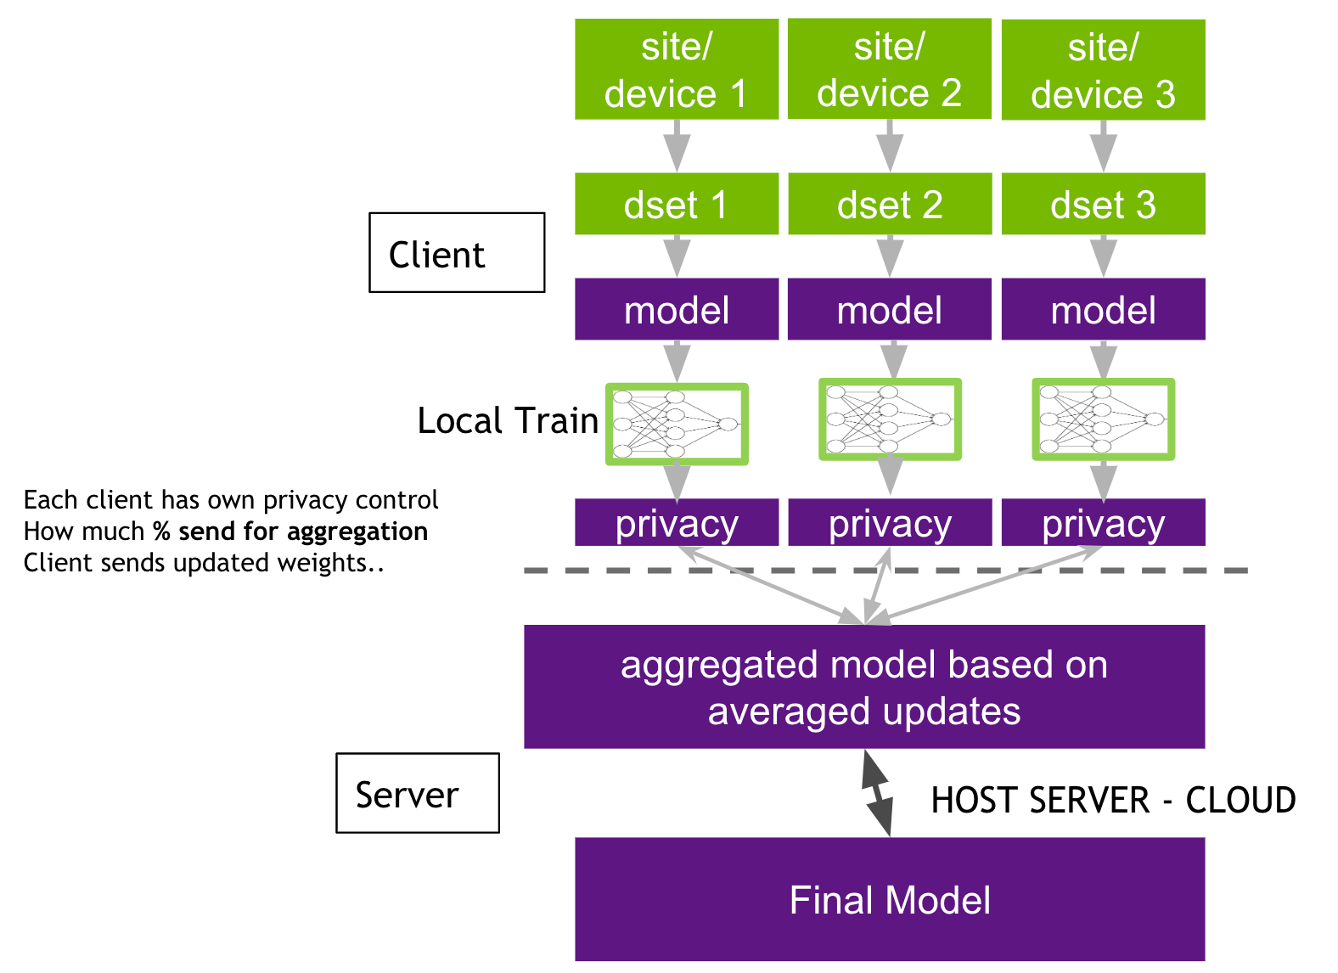
CLIENT-SERVER

Slide 4
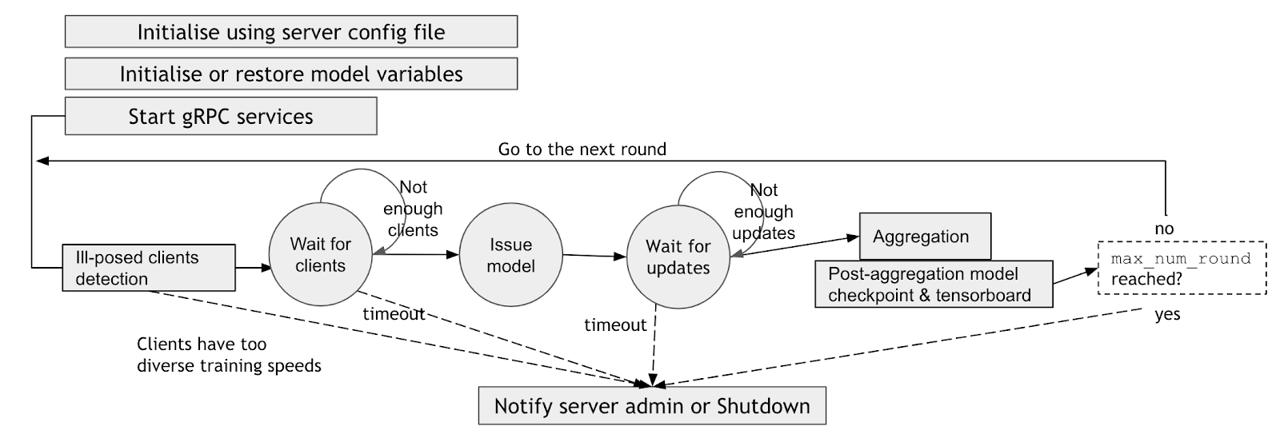
SERVER CYCLE
Computer Aided Medical Procedures
Slide <number>

Slide 5
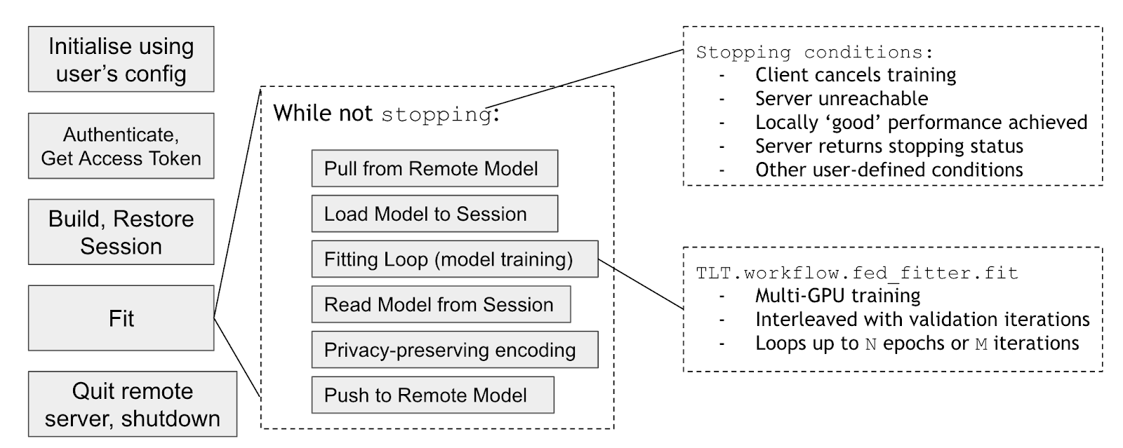
CLIENT CYCLE
Computer Aided Medical Procedures
Slide <number>

Slide 6
CHALLENGES – TASKS (DONE)
Switch from WSL to Ubuntu
Learn/Install Docker and containerization
Get a data-set
Install Clara SDK
Learn about framework architecture
Get a model
Provisioning Federated learning Tool
Computer Aided Medical Procedures
Slide <number>

Slide 7
CHALLENGES – TASKS (NEXT UP)
FL client Joining FL experiment
Running FL Admin to orchestrate an FL Experiment
Build a model using only one client part of data-set
Build Global model using FedAvg aggregation scheme on all data-set
Build global model using FedMA aggregation scheme on all data-set
Compare Performance
Bonus: suggest a new aggregation scheme
Computer Aided Medical Procedures
Slide <number>

Slide 8
DOCKER
Computer Aided Medical Procedures
Slide <number>

Slide 9
DATA-SET
Computer Aided Medical Procedures
Slide <number>

Slide 10
CLARA SDK
Computer Aided Medical Procedures
Slide <number>

Slide 11
MODEL
Computer Aided Medical Procedures
Slide <number>

Slide 12
PROVISIONING FEDERATED LEARNING TOOL
Computer Aided Medical Procedures
Slide <number>

Slide 13
NEXT
Computer Aided Medical Procedures
Slide <number>

Slide 14
QUESTIONS?

Slide 15
THANK YOU!

