Slide 1

FEDERATED LEARNING

Slide 2
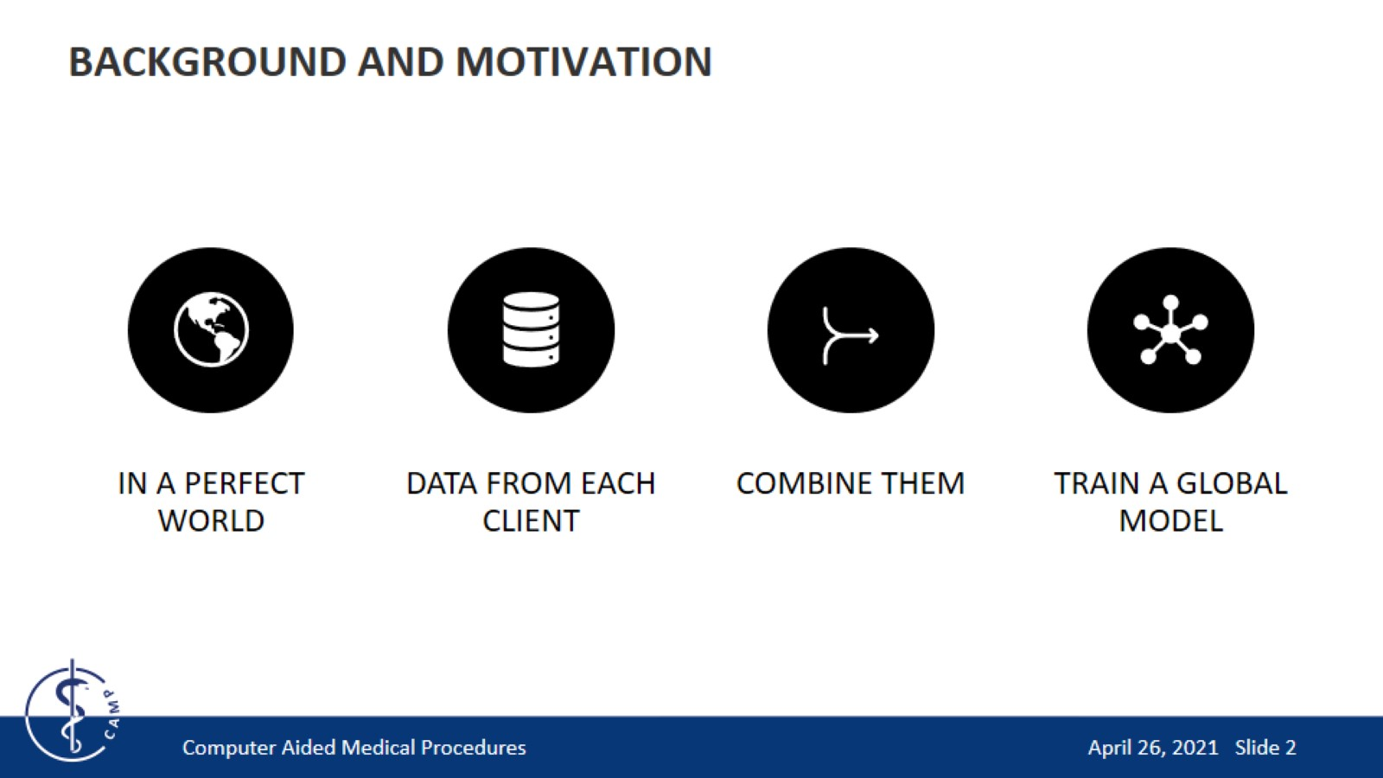
BACKGROUND AND MOTIVATION

Slide 3
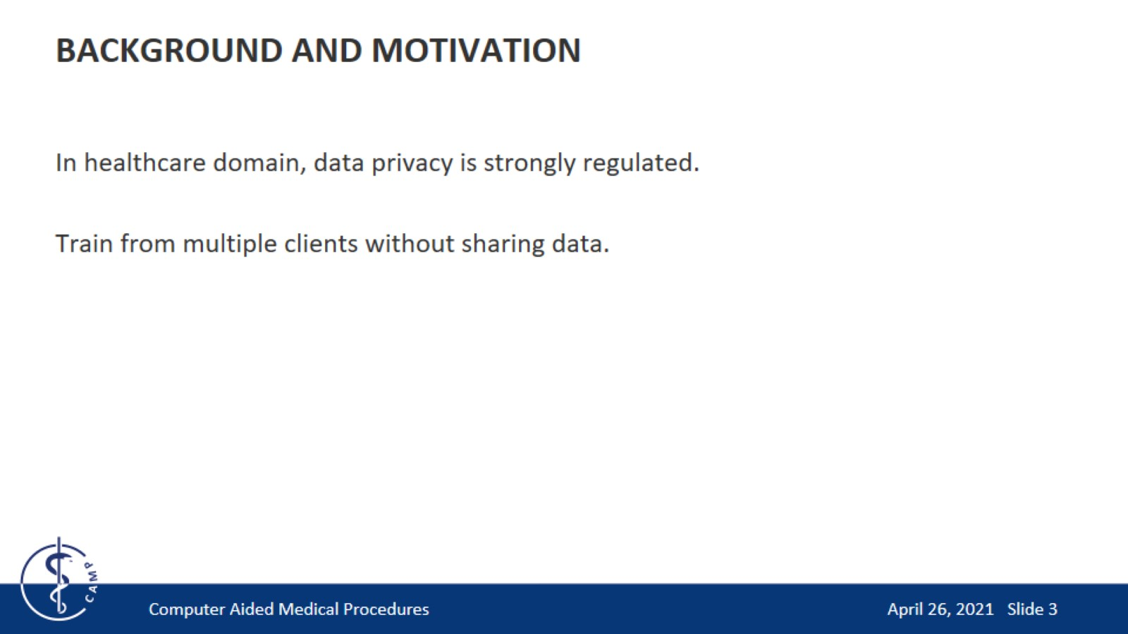
BACKGROUND AND MOTIVATION

Slide 4
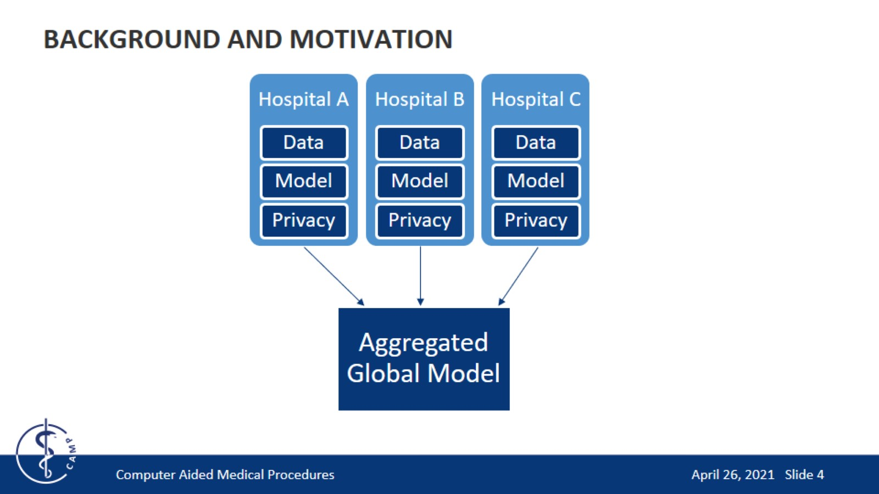
BACKGROUND AND MOTIVATION

Slide 5
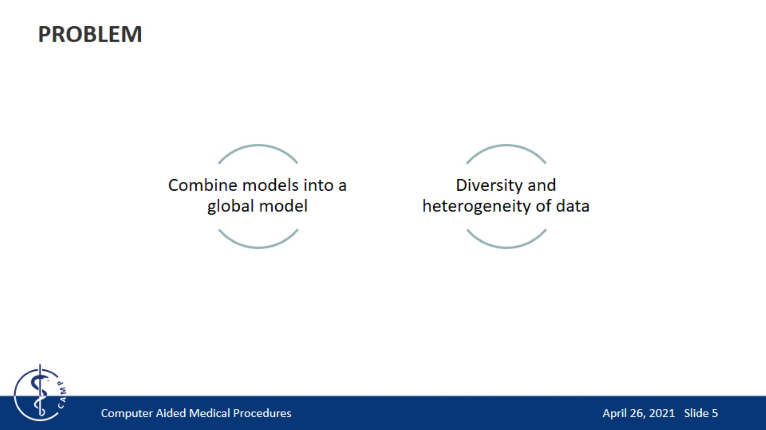
PROBLEM

Slide 6
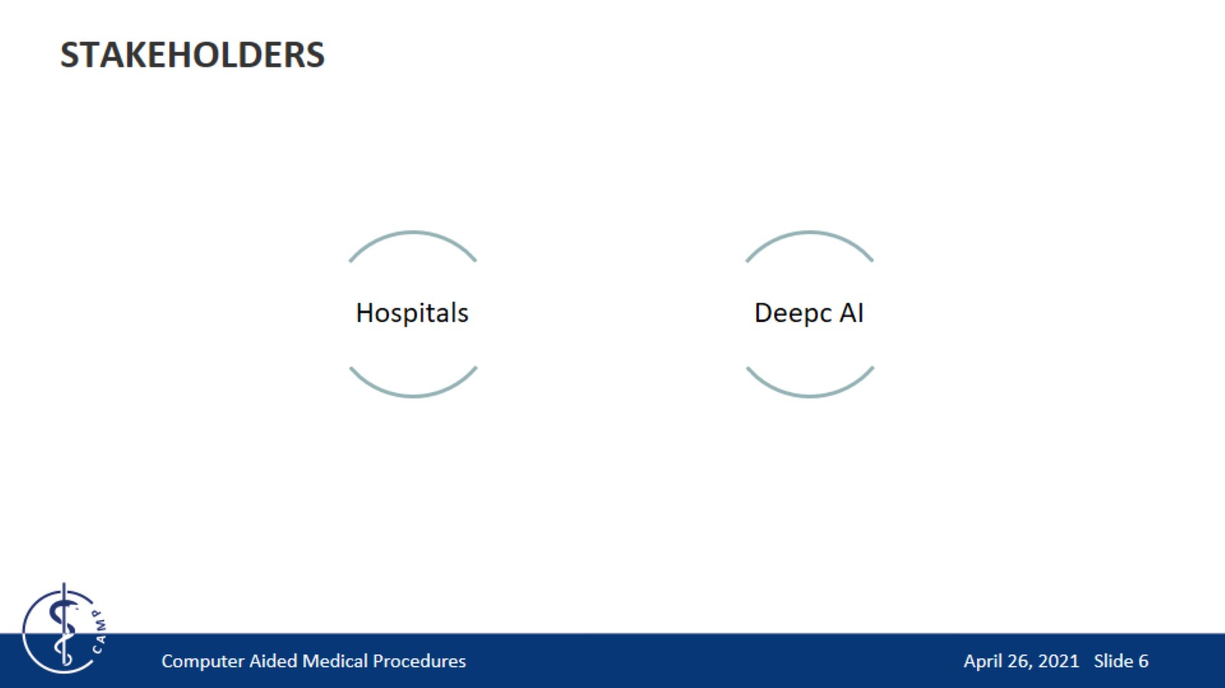
STAKEHOLDERS

Slide 7
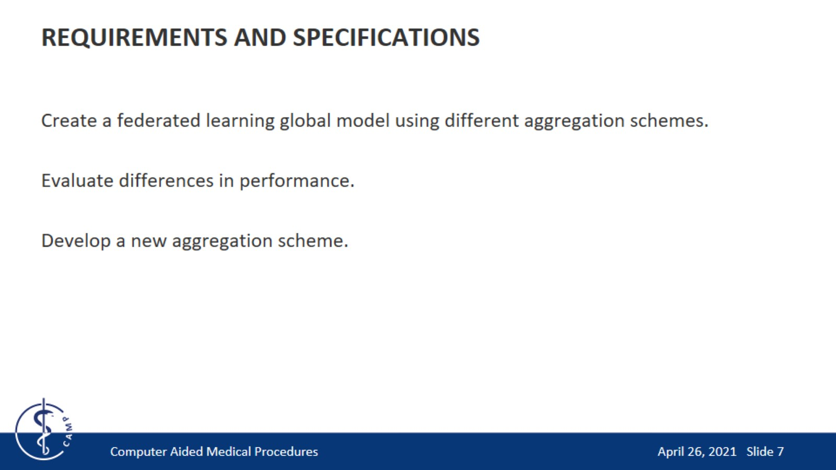
REQUIREMENTS AND SPECIFICATIONS

Slide 8
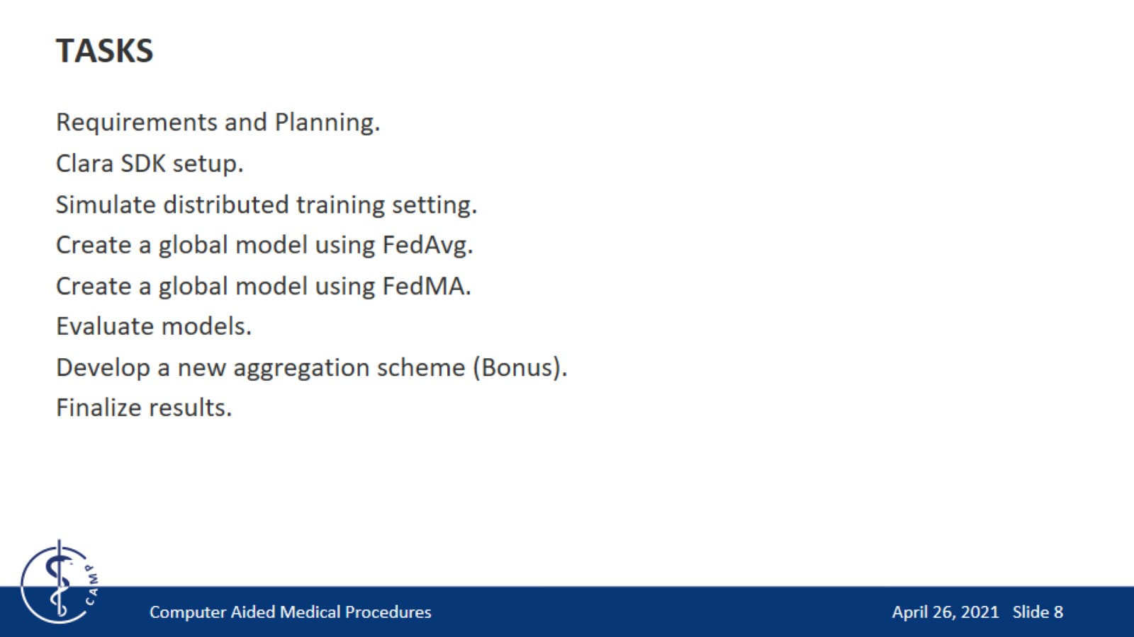
TASKS

Slide 9
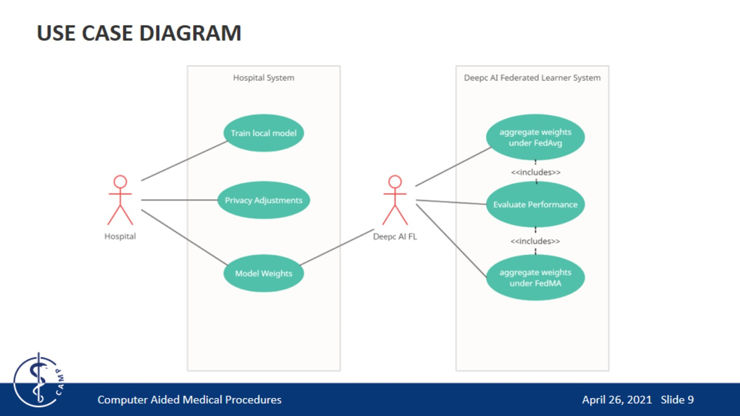
USE CASE DIAGRAM

Slide 10
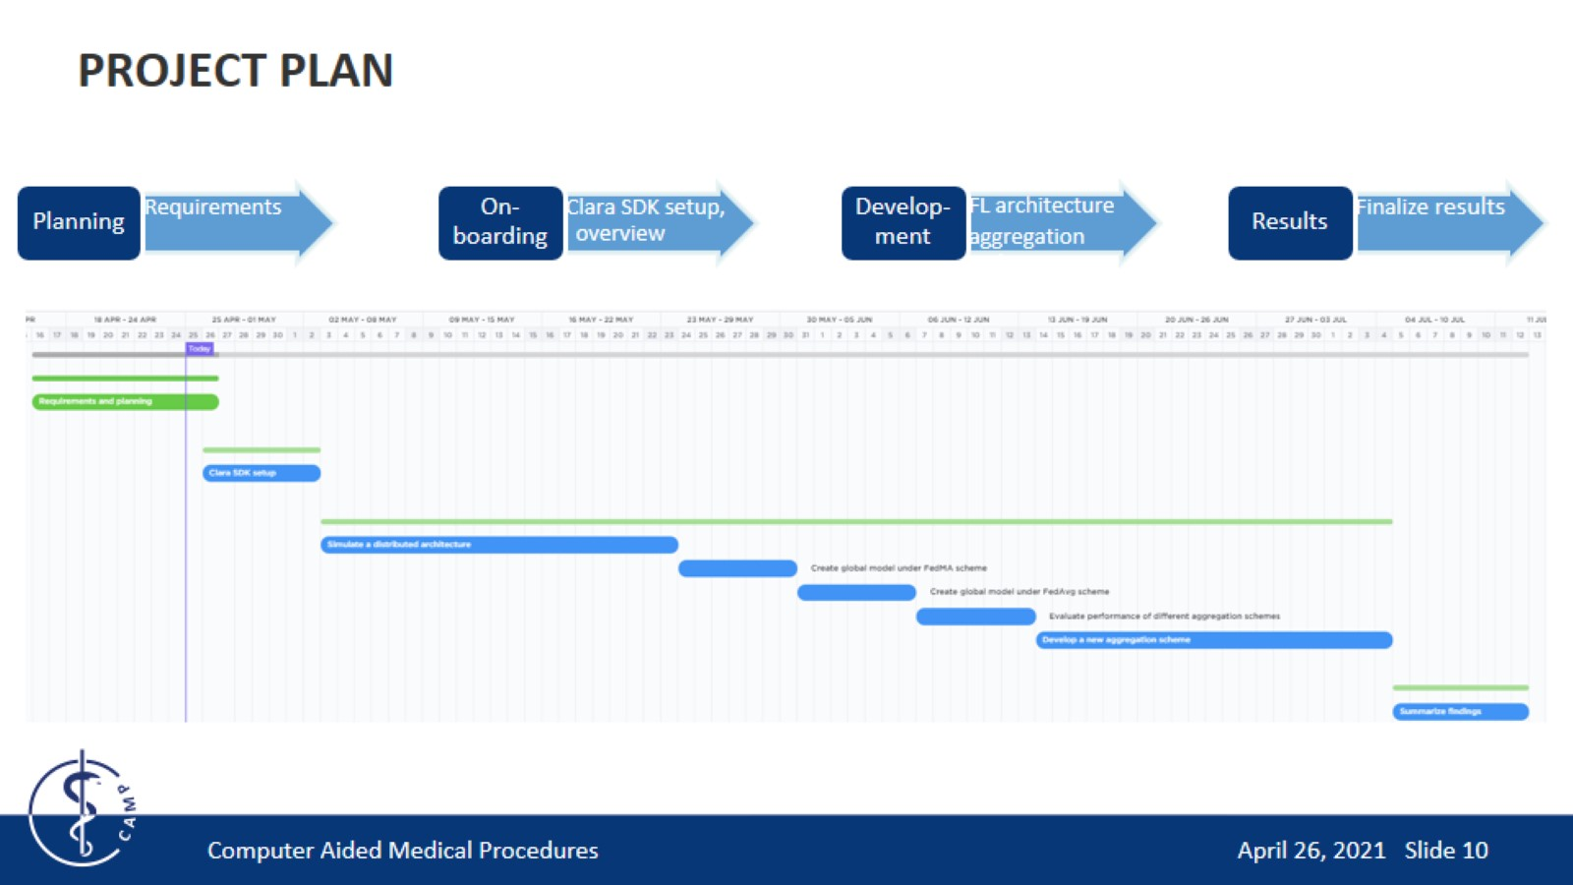
PROJECT PLAN

Slide 11
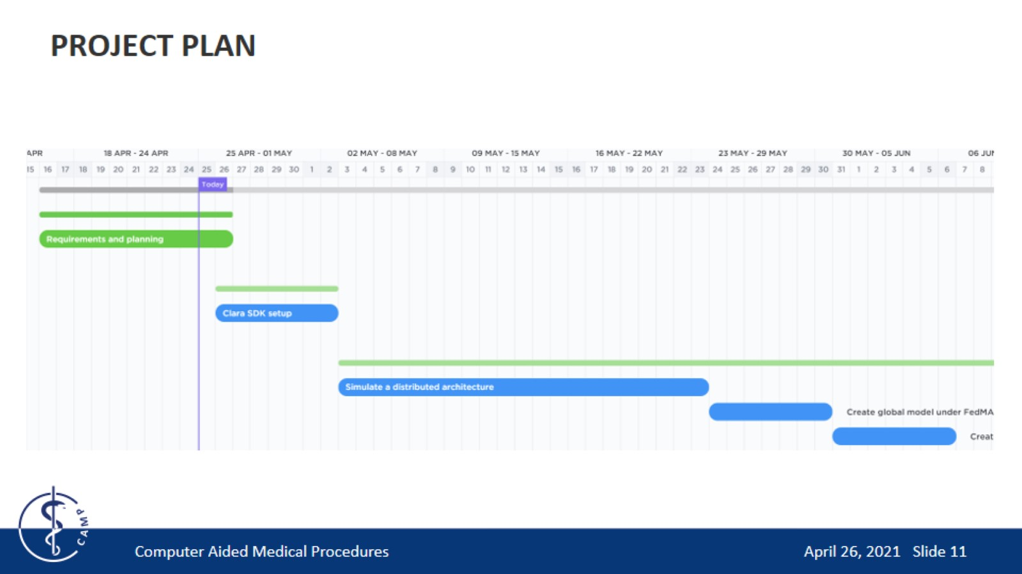
PROJECT PLAN

Slide 12
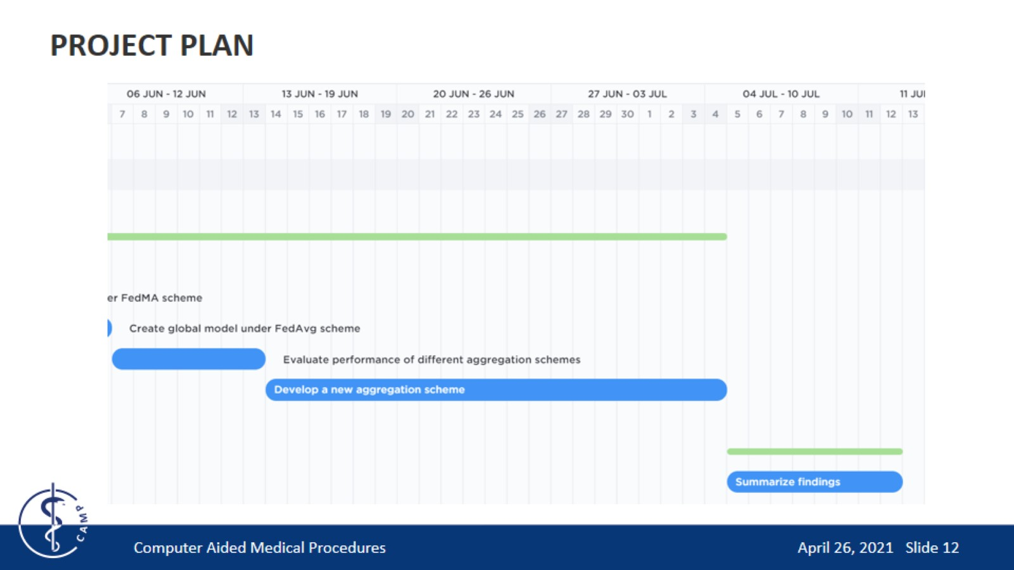
PROJECT PLAN

Slide 13

THANK YOU!

Slide 14
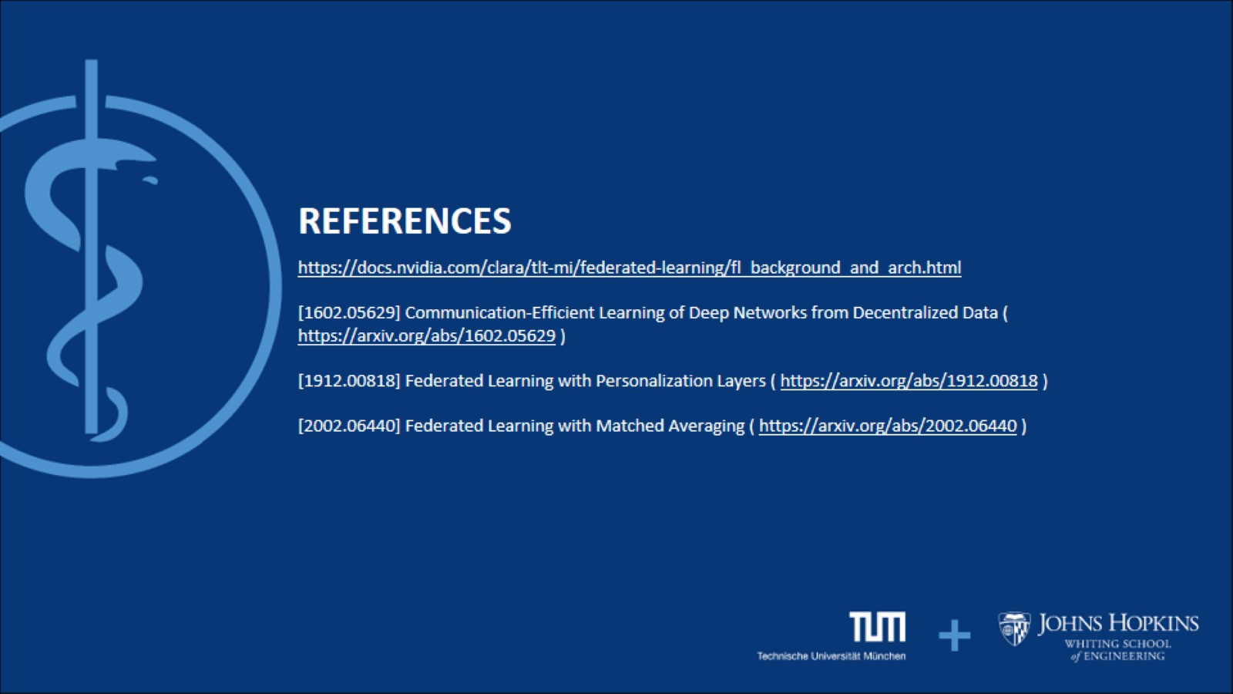
https://docs.nvidia.com/clara/tlt-mi/federated-learning/fl_background_and_arch.html [1602.05629] Communication-Efficient Learning of Deep Networks from Decentralized Data ( https://arxiv.org/abs/1602.05629 ) [1912.00818] Federated Learning with Personalization Layers ( https://arxiv.org/abs/1912.00818 ) [2002.06440] Federated Learning with Matched Averaging ( https://arxiv.org/abs/2002.06440 )

Slide 15

QUESTIONS?

