Slide 1
FEDERATED LEARNING
Supervisor Student
Rami Eisawy Muhammad Khattab

Slide 2
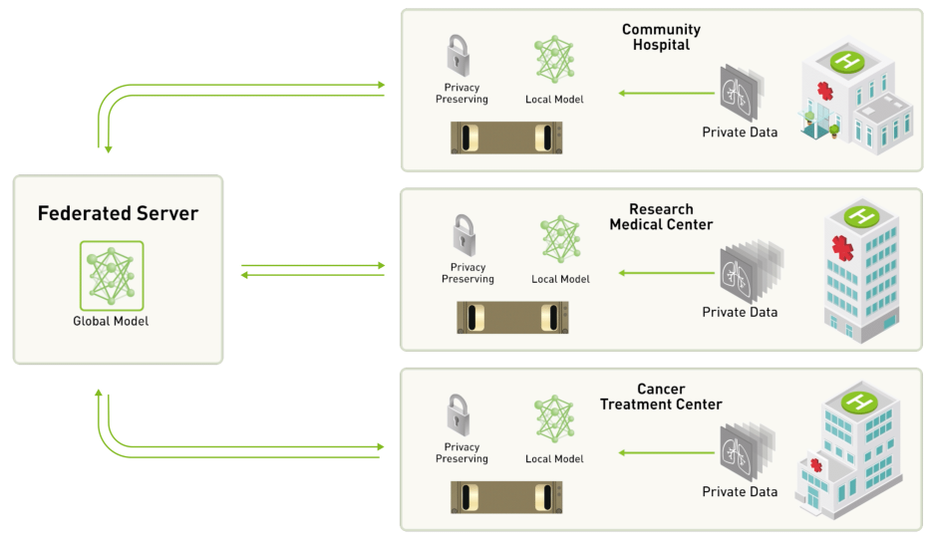
ARCHITECTURE
https://github.com/NVIDIA/clara-train-examples/blob/master/PyTorch/NoteBooks/FL/FederatedLearning.ipynb

Slide 3
TASKS - DONE
Connect to remote machine
Change model, data-set
Provisioning federated learning tool
Run admin to orchestrate the FL experiment
Clients join the FL experiment
Build Global model using FedAvg, FedMA aggregation schemes
Compare performance
Computer Aided Medical Procedures
Slide 15

Slide 4
REMOTE MACHINE
Install zerotier
Join remote network
Connect to remote machine
Computer Aided Medical Procedures
Slide 15

Slide 5

REMOTE MACHINE – Install zerotier
ZeroTier creates secure networks between on-premise, cloud, desktop, and mobile devices.
combines the capabilities of VPN and SD-WAN, simplifying network management.
Computer Aided Medical Procedures
Slide 15

Slide 6
REMOTE MACHINE – Join Network
Join the network using the pre-shared ID
Computer Aided Medical Procedures
Slide 15

Slide 7
REMOTE MACHINE – Connect to Machine
After join approval, and sharing the SSH public key
Connect to machine using private SSH key
Computer Aided Medical Procedures
Slide 15

Slide 8
DATA-SET
The data-set was replaced as it had missing config files.
Split the data-set over 3 clients (50%, 25%, 25%)
Computer Aided Medical Procedures
Slide 15

Slide 9
MODEL
Model was replaced with a compatible spleen model to match the data-set
Computer Aided Medical Procedures
Slide 15

Slide 10
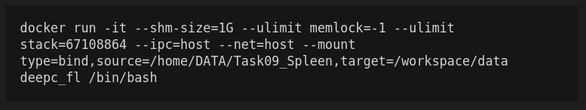
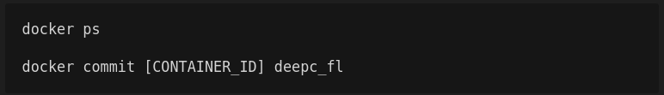
IMAGE
In case of changes to the image, commit changes
Computer Aided Medical Procedures
Slide 15

Slide 11
PROVISIONING
Setup starting packages for
  Server
  Admin
  Client1
  Client2
  Client3
Edit config files:
  `opt/nvidia/medical/tools/project.yml`
Computer Aided Medical Procedures
Slide 15

Slide 12
RUN PARTICIPANTS
For each of the participants run a new docker image in a new terminal
Go to the corresponding `startup` folder
Run `sh start.sh` in order to run their service
Computer Aided Medical Procedures
Slide 15

Slide 13
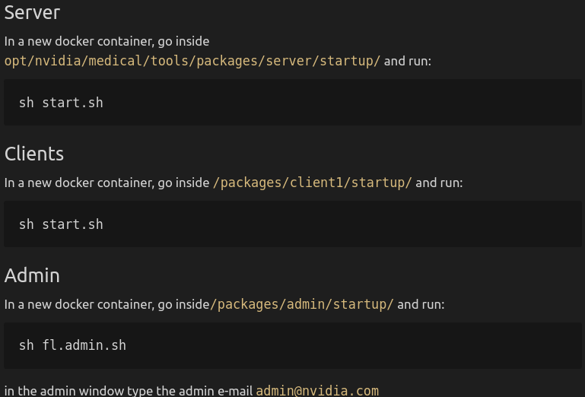
RUN PARTICIPANTS
Computer Aided Medical Procedures
Slide 15

Slide 14
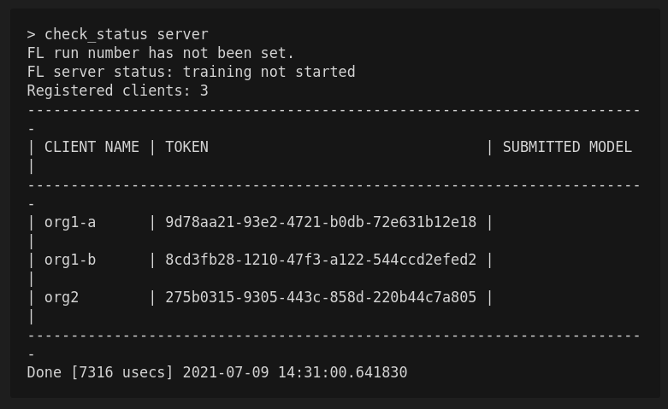
ADMIN CLIENT
Computer Aided Medical Procedures
Slide 15

Slide 15
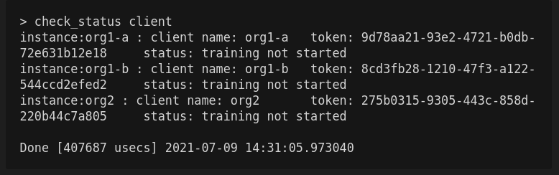
ADMIN CLIENT
Computer Aided Medical Procedures
Slide 15

Slide 16
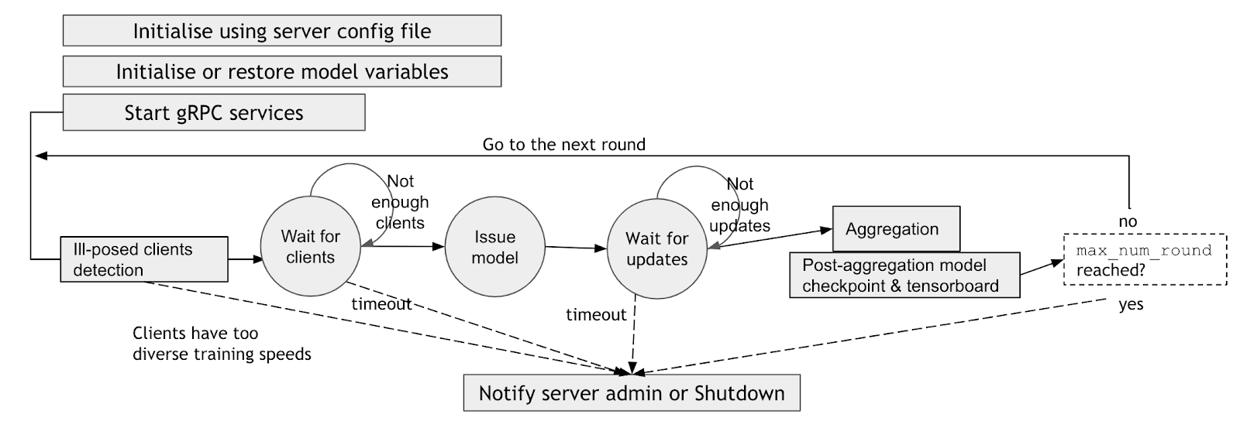
SERVER CYCLE
https://github.com/NVIDIA/clara-train-examples/blob/master/PyTorch/NoteBooks/FL/FederatedLearning.ipynb
Computer Aided Medical Procedures
Slide 15

Slide 17
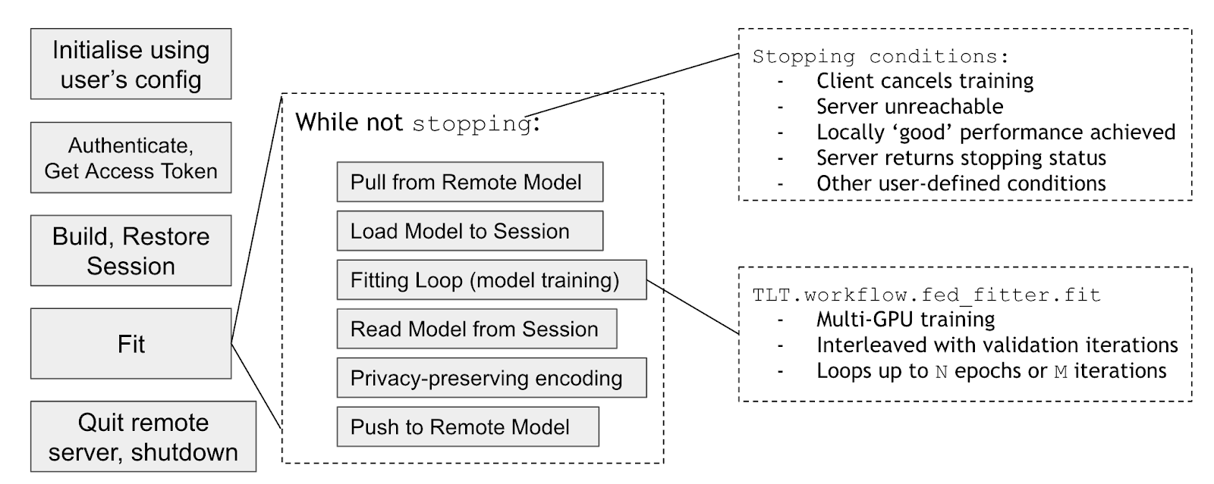
CLIENT CYCLE
https://github.com/NVIDIA/clara-train-examples/blob/master/PyTorch/NoteBooks/FL/FederatedLearning.ipynb
Computer Aided Medical Procedures
Slide 15

Slide 18
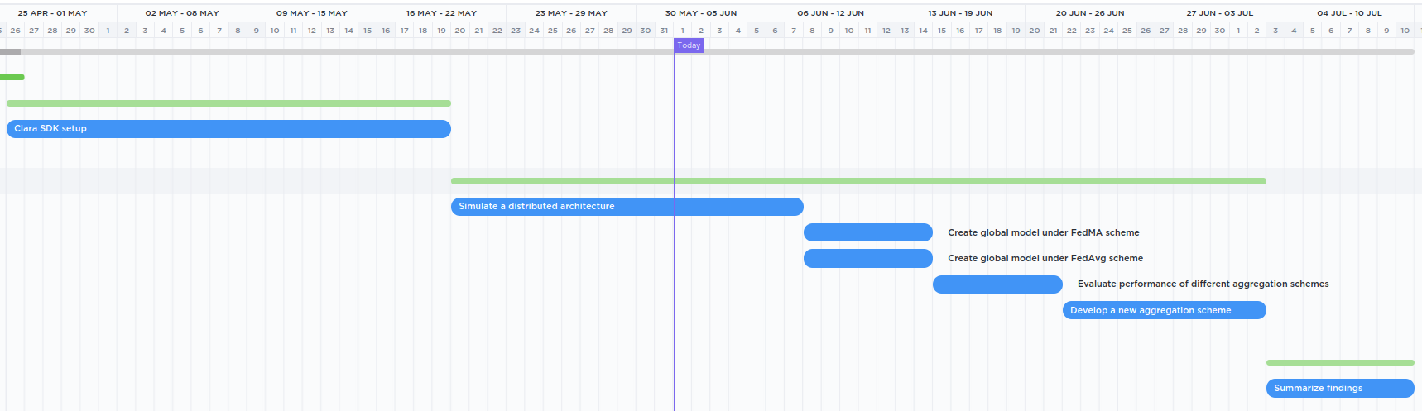
GANTT CHART
Computer Aided Medical Procedures
Slide 15

Slide 19
QUESTIONS?

Slide 20
THANK YOU!

Slide 21
REFERENCES
https://www.digitalocean.com/community/tutorials/how-to-install-and-use-docker-on-ubuntu-20-04
https://github.com/NVIDIA/clara-train-examples/blob/master/PyTorch/NoteBooks/FL/FederatedLearning.ipynb
Computer Aided Medical Procedures
Slide 15

