Slide 1
FEDERATED LEARNING
Supervisor Student
Rami Eisawy Muhammad Khattab

Slide 2
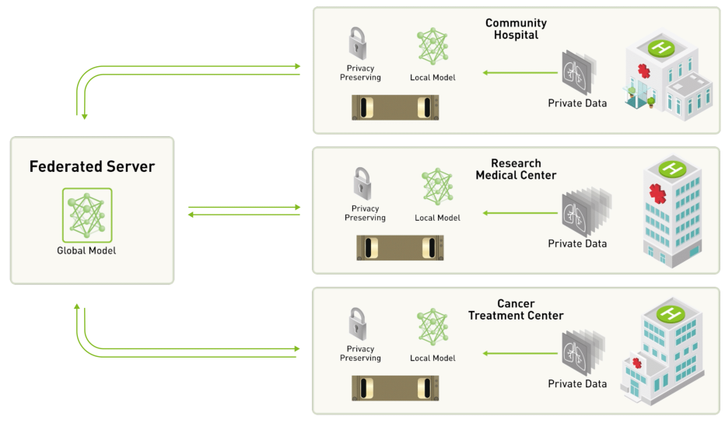
ARCHITECTURE
https://github.com/NVIDIA/clara-train-examples/blob/master/PyTorch/NoteBooks/FL/FederatedLearning.ipynb

Slide 3
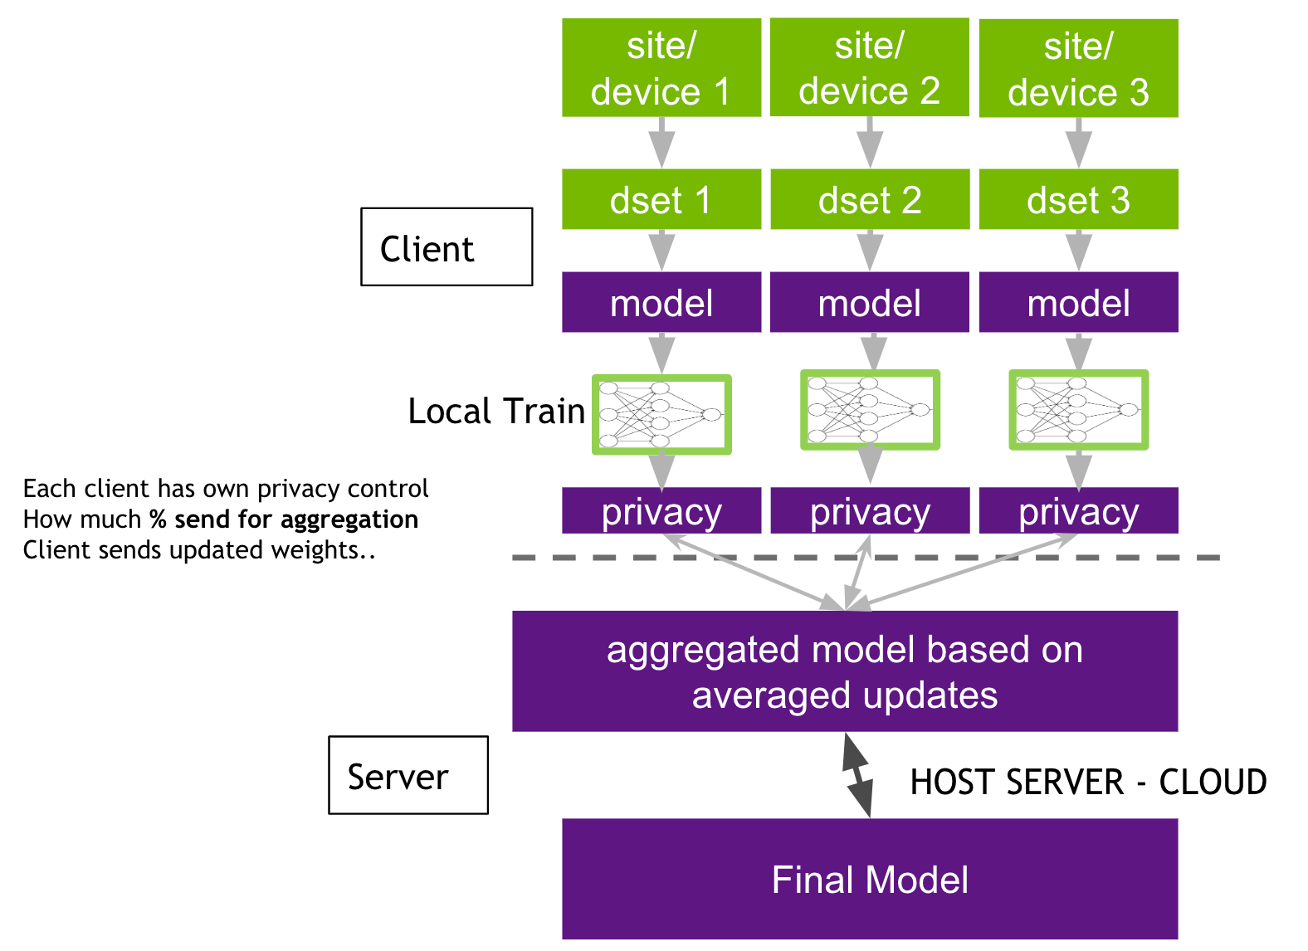
CLIENT-SERVER
https://github.com/NVIDIA/clara-train-examples/blob/master/PyTorch/NoteBooks/FL/FederatedLearning.ipynb

Slide 4
CHALLENGES – TASKS (DONE)
Switch from WSL to Ubuntu
Install Docker – Docker Compose
Learn about containerization
Get a data-set
Install Clara SDK
Learn about framework architecture
Get a model
Computer Aided Medical Procedures
Slide <number>

Slide 5
CHALLENGES – TASKS (NEXT UP)
Provisioning Federated learning Tool
FL client Joining FL experiment
Running FL Admin to orchestrate an FL Experiment
Build a global model using only one client’s part of data-set
Build Global model using FedAvg aggregation scheme on all data-set
Build global model using FedMA aggregation scheme on all data-set
Compare Performance
Bonus: suggest a new aggregation scheme
Computer Aided Medical Procedures
Slide <number>

Slide 6
Ubuntu
Windows 10 with Windows Subsystem for Linux (WSL)
Had problems with windows updates resetting WSL
Switched to Ubuntu 20.04
Computer Aided Medical Procedures
Slide <number>

Slide 7
DOCKER
managing application processes in containers
resource-isolated processes
similar to virtual machines
more portable
more resource-friendly
more dependent on the host operating system
Computer Aided Medical Procedures
Slide <number>

Slide 8
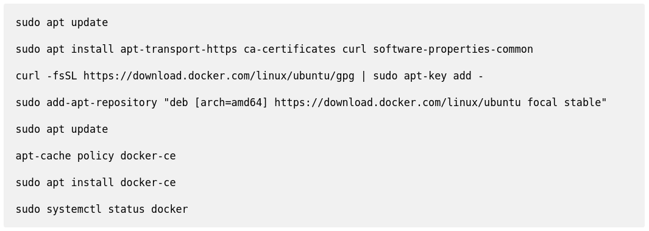
DOCKER - INSTALLATION
Computer Aided Medical Procedures
Slide <number>

Slide 9
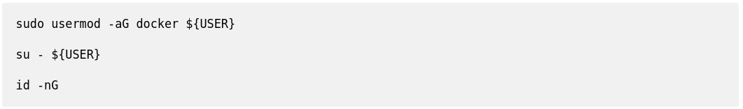
DOCKER - INSTALLATION
Optionl: to use docker without `sudo`
Computer Aided Medical Procedures
Slide <number>

Slide 10
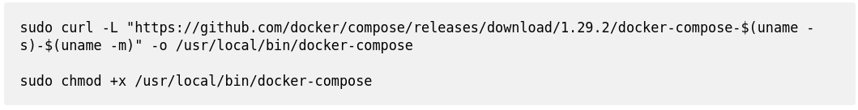
DOCKER COMPOSE - INSTALLATION
defining and running multi-container Docker applications
use a `YAML` file to configure your application’s services
single command, you create and start all the services
Computer Aided Medical Procedures
Slide <number>

Slide 11
DATA-SET
From Multimodal Brain Tumor Segmentation Challenge 2018 (BraTS)
Ground truth labels, manually-revised by expert board-certified neuroradiologists
Training, Validation, Testing:
  Ample multi-institutional routine clinically-acquired pre-operative multimodal MRI scans of glioblastoma (GBM/HGG)
  Lower grade glioma (LGG), with pathologically confirmed diagnosis and available OS
Computer Aided Medical Procedures
Slide <number>

Slide 12
DATA-SET
available as NIfTI files (.nii.gz)
Describe:
  native (T1)
  post-contrast T1-weighted (T1Gd)
  T2-weighted (T2)
  T2 Fluid Attenuated Inversion Recovery (FLAIR)
The overall survival (OS) data (.csv)
  Defined in days, include the age of patients, as well as the resection status
  only subjects with resection status of GTR (i.e., Gross Total Resection) will be evaluated
Split the data-set over 3 clients (50%, 25%, 25%)
Computer Aided Medical Procedures
Slide <number>

Slide 13
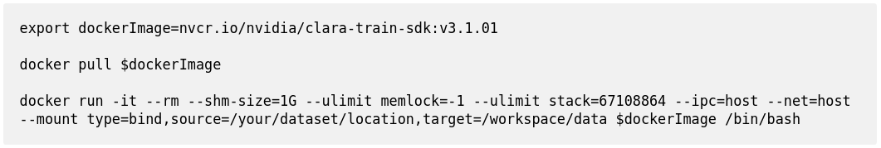
CLARA SDK - SETUP
Computer Aided Medical Procedures
Slide <number>

Slide 14
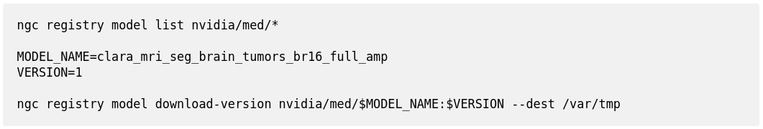
MODEL - SETUP
Computer Aided Medical Procedures
Slide <number>

Slide 15
MODEL - DATA
The model is trained to segment 3 nested subregions of primary (gliomas) brain tumors
  enhancing tumor (ET)
  tumor core (TC)
  whole tumor (WT)
based on 4 input MRI scans (T1c, T1, T2, FLAIR)
Computer Aided Medical Procedures
Slide <number>

Slide 16
MODEL – DATA
The ET is described by areas that show hyper intensity in T1c when compared to T1, but also when compared to "healthy" white matter in T1c
The TC describes the bulk of the tumor, which is what is typically resected
The TC entails the ET, as well as the necrotic (fluid-filled) and the non-enhancing (solid) parts of the tumor
The WT describes the complete extent of the disease, as it entails the TC and the peritumoral edema (ED), which is typically depicted by hyper-intense signal in FLAIR
Computer Aided Medical Procedures
Slide <number>

Slide 17
MODEL – TRAINING CONFIGURATION
This model utilized a similar approach described in 3D MRI brain tumor segmentation using autoencoder regularization, which was a winning method in BraTS2018
The provided training configuration required 16GB GPU memory.
Model Input Shape: 224 x 224 x 128
Training Script: train.sh
The training task uses Automatic Mixed Precision (AMP) for speed improvements.
Computer Aided Medical Procedures
Slide <number>

Slide 18
MODEL – INPUT, OUTPUT, SCORES
Input: 4 channel 3D MRIs (T1c, T1, T2, FLAIR)
Output: 3 channels of tumor subregion 3D masks
Dice scores on the validation data are:
  Tumor core (TC): 0.859
  Whole tumor (WT): 0.904
  Enhancing tumor (ET): 0.786
Computer Aided Medical Procedures
Slide <number>

Slide 19
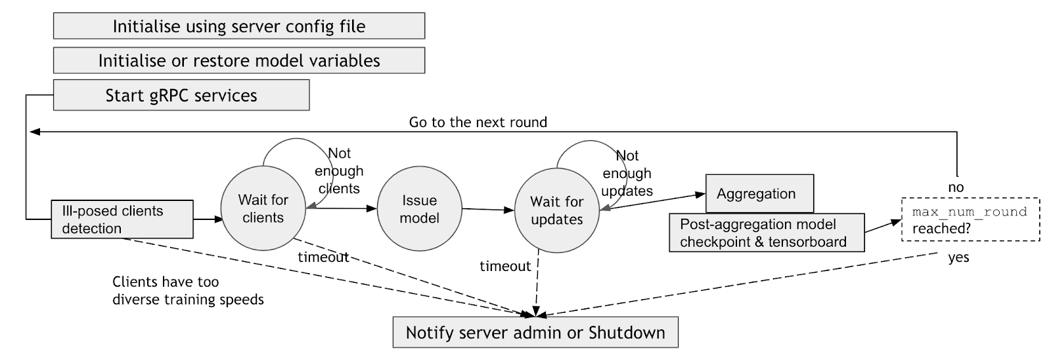
SERVER CYCLE
https://github.com/NVIDIA/clara-train-examples/blob/master/PyTorch/NoteBooks/FL/FederatedLearning.ipynb
Computer Aided Medical Procedures
Slide <number>

Slide 20
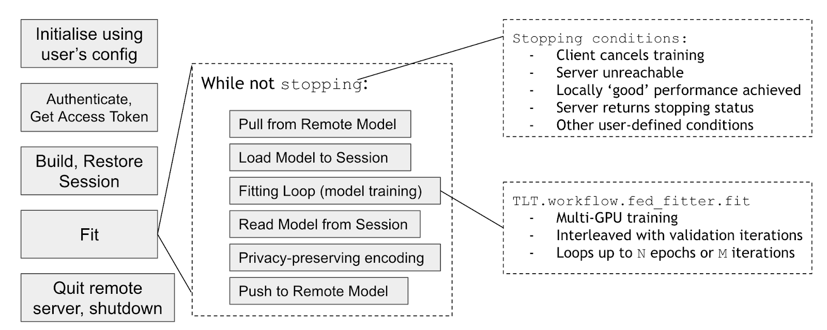
CLIENT CYCLE
https://github.com/NVIDIA/clara-train-examples/blob/master/PyTorch/NoteBooks/FL/FederatedLearning.ipynb
Computer Aided Medical Procedures
Slide <number>

Slide 21
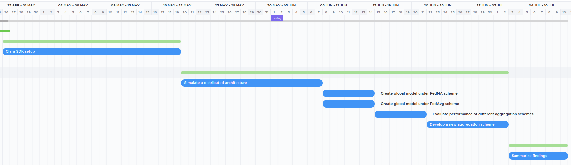
GANTT CHART
Computer Aided Medical Procedures
Slide <number>

Slide 22
QUESTIONS?

Slide 23
THANK YOU!

Slide 24
REFERENCES
https://www.digitalocean.com/community/tutorials/how-to-install-and-use-docker-on-ubuntu-20-04
https://docs.docker.com/compose/
https://ngc.nvidia.com/catalog/models/nvidia:med:clara_mri_seg_brain_tumors_br16_full_amp
https://www.med.upenn.edu/sbia/brats2018/data.html
https://github.com/NVIDIA/clara-train-examples/blob/master/PyTorch/NoteBooks/FL/FederatedLearning.ipynb
Computer Aided Medical Procedures
Slide <number>

