Slide 1
Exploration of Iceland
Presenter: Suheng Yao

Slide 2
Introduction to Iceland
Iceland is a Nordic island country between the North Atlantic and Arctic Oceans.
Its capital and largest city is Reykjavík, which is home to about 36% of the country’s roughly 380,000 residents. 86% of the residents are Icelanders. The official language of the country is Icelandic.
Iceland is on a rift between tectonic plates, and its geologic activity includes geysers and frequent volcanic eruptions. The interior consists of a volcanic plateau with sand and lava fields, mountains and glaciers, and many glacial rivers flow to the sea through the lowlands.
In 2022, Iceland was the eighth-most productive country in the world per capita (US$78,837). About 85 percent of the total primary energy supply in Iceland is derived from domestically produced renewable energy sources. The economy now in Iceland is more dependent on tourism.

Slide 3
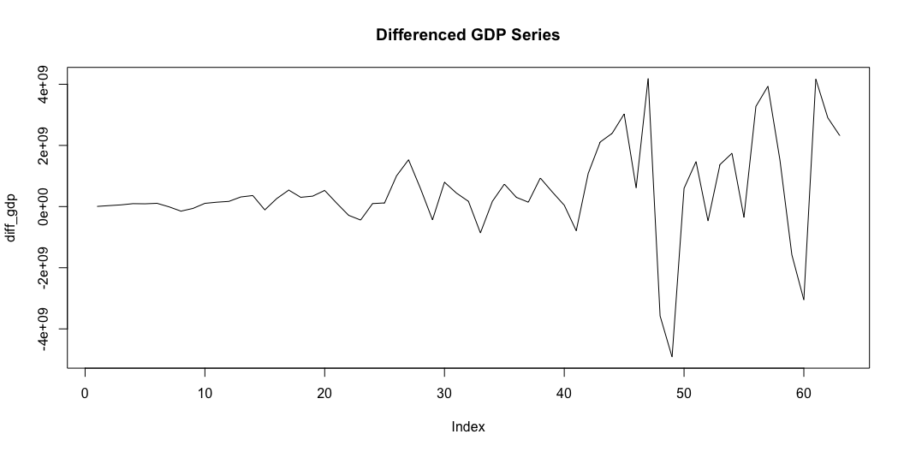
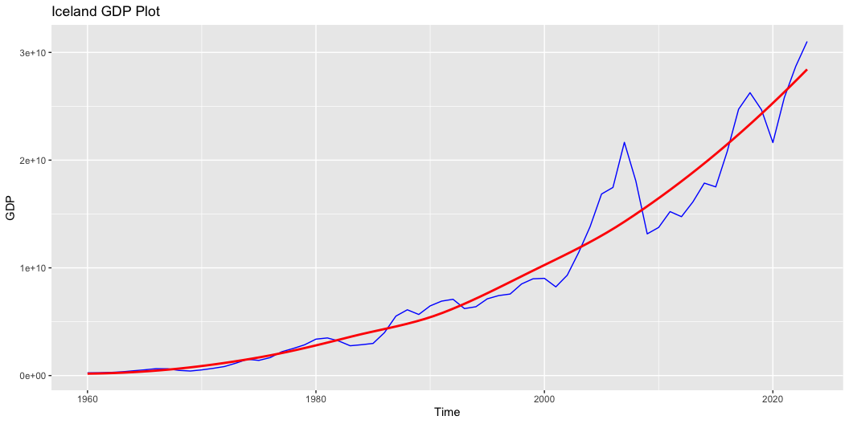
Modeling and Projection of GDP

Slide 4
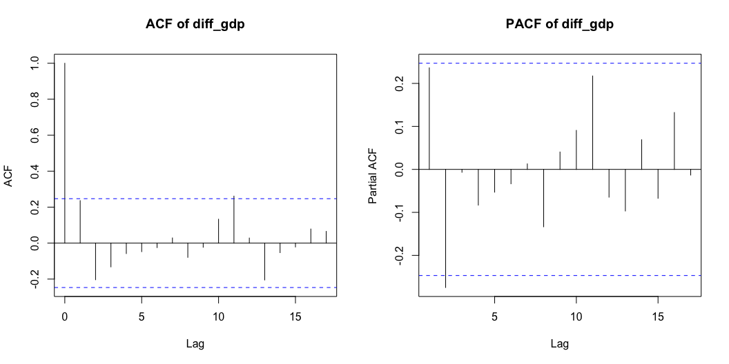
Plot ACF and PACF for GDP
Based on the plot on the right, both ACF and PACF have significant spike at lag order 1, and since there is first order differencing performed on GDP data, the first model to try is ARIMA(1, 1, 1).

Slide 5
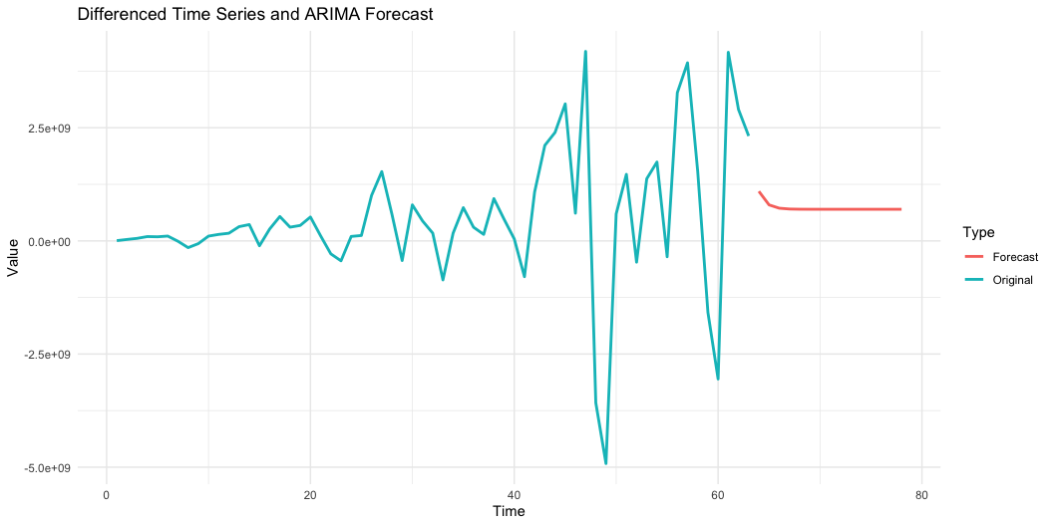
Forecast the GDP for Next 15 Years Based on ARIMA(1, 1, 1)
Based on the forecast values above, the GDP is predicted to decrease and become gradually
stable at around $700,000,000 per year.

Slide 6
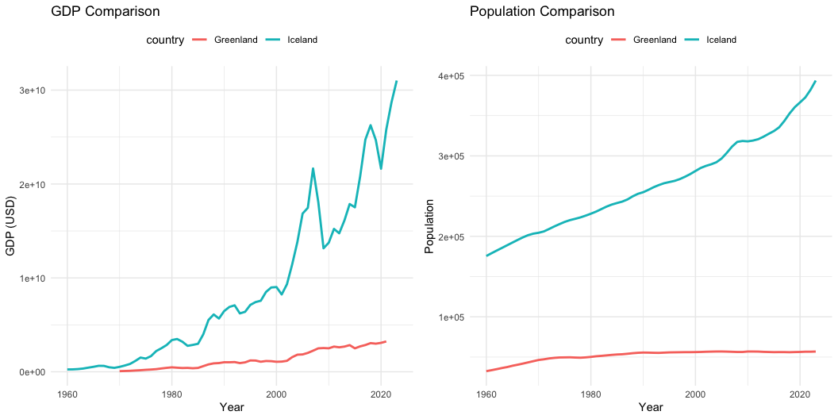
Comparison with Greenland

Slide 7
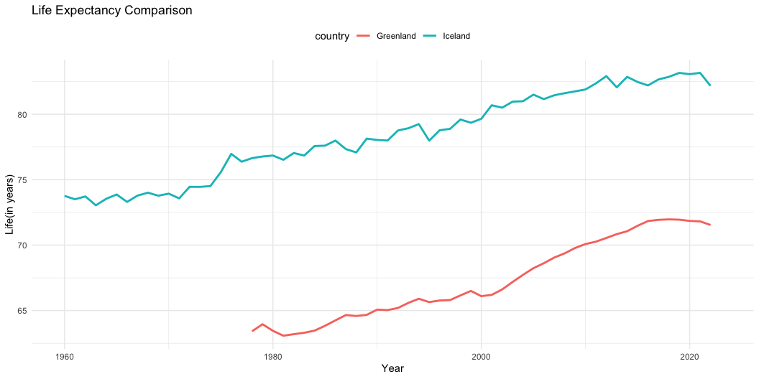
Comparison of Life Expectancy

Slide 8
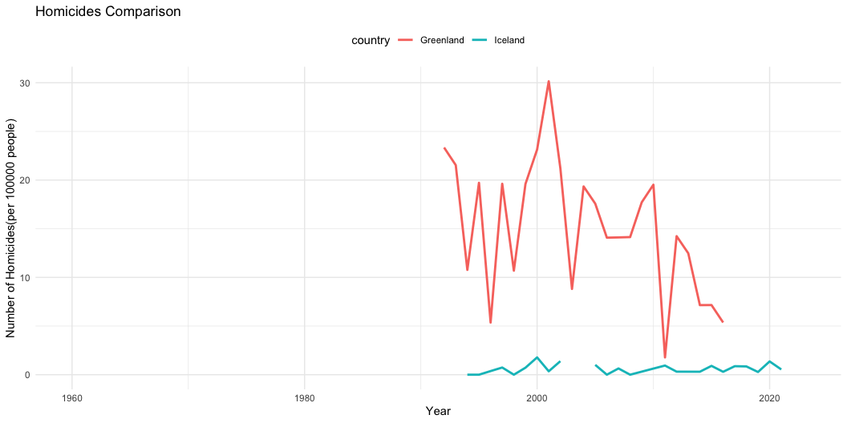
Comparison of Intentional Homicide

Slide 9
SWOT Analysis
Strength
Iceland GDP continues increasing, suggesting the economic prosperity.
The mean life expectancy suggests the overall better life quality and healthcare for old people.
Iceland is a global leader in sustainable development.
Weakness
Iceland’s economy is vulnerable to demand swings and volcanic activity.
Iceland is expected to have an aging population, leading to shrinkage of labor force and more expenditure on healthcare
Opportunities
Iceland relies heavily on tourism, the visitors in Iceland will increase after pandemic and further boost its economy
Data centers can stimulate the economic growth and rapid development of Iceland
Threat
Global warming and melting of glaciers in Iceland
Data Centers may lead to shortage in energy generation

Slide 10
Reference
[1] Central Intelligence Agency. (2024, December 3). Iceland. In The World Factbook. https://www.cia.gov/the-world-factbook/countries/iceland/
[2] ClimateChangePost. (n.d.). Climate change. ClimateChangePost. Retrieved December 12, 2024, from https://www.climatechangepost.com/countries/iceland/climate-change/
[3] Reynolds, M. (2019, June 18). Iceland’s data centers are booming—here’s why that’s a problem. MIT Technology Review. https://www.technologyreview.com/2019/06/18/134902/icelands-data-centers-are-booming-heres-why-thats-a-problem/
[4] Statista. (2024). Iceland: Average age of the population from 1950 to 2100 (median age in years) [Graph]. Statista. https://www.statista.com/statistics/398566/average-age-of-the-population-in-iceland/

