Slide 1
615finalproject

Slide 2
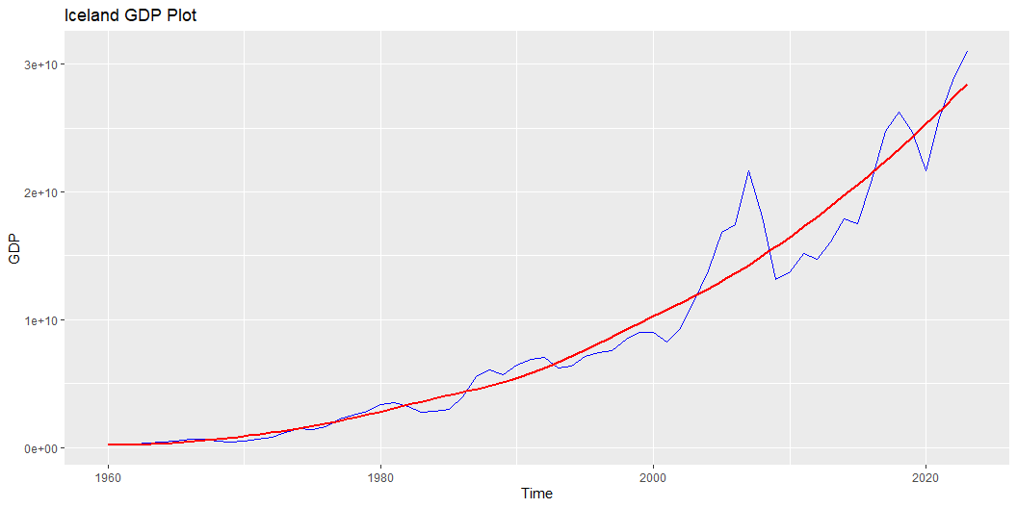
Modeling and Projection
Graphing and Test for Stationarity for Iceland GDP

Slide 3
Result of ADF test for GDP
Augmented Dickey-Fuller Test data: icelanddata$GDP Dickey-Fuller = -1.1721, Lag order = 3, p-value = 0.904 alternative hypothesis: stationary
Based on the result shown above, the series is not stationary, some transformations need to be done to make the series stationary so it satisfies the assumption of time series model.

Slide 4
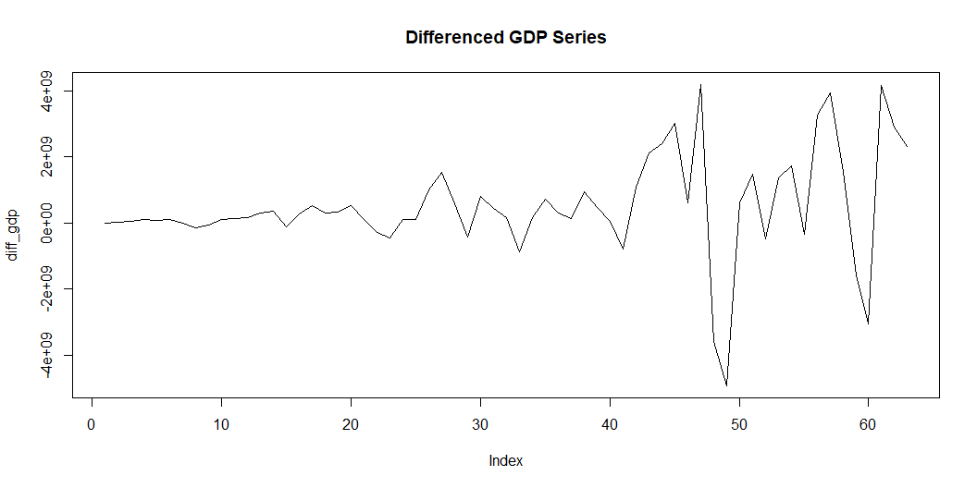
Perform Differencing and Check Stationarity
Augmented Dickey-Fuller Test data: diff_gdp Dickey-Fuller = -4.8151, Lag order = 3, p-value = 0.01 alternative hypothesis: stationary

Slide 5
Based on the ADF test result above, the p-value is 0.01, so we can reject the null hypothesis, showing that the series is stationary.

Slide 6
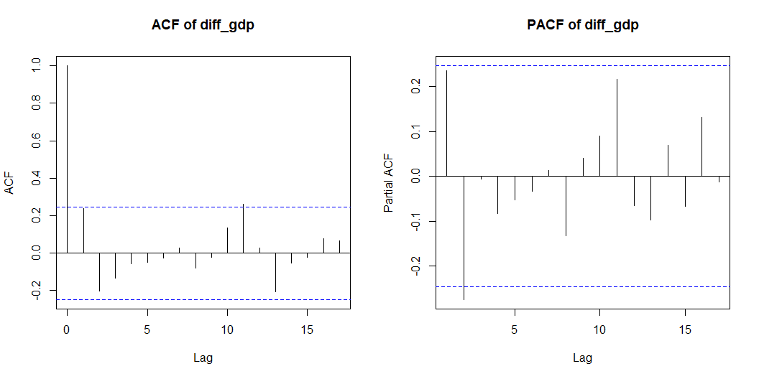
Plot ACF and PACF for GDP

Slide 7
Based on the plot above, both ACF and PACF have significant spike at lag order 1, and since there is first order differencing performed on GDP data, the first model to try is ARIMA(1, 1, 1).

Slide 8
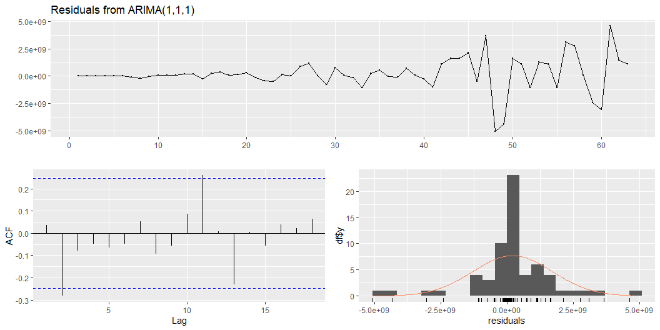
Fit ARIMA(1, 1, 1) Model

Slide 9
Ljung-Box test data: Residuals from ARIMA(1,1,1) Q* = 8.131, df = 8, p-value = 0.4208 Model df: 2. Total lags used: 10
Based on the Ljung-Box test result, p-value is greater than 0.05, indicating that there is no significant autocorrelation between residuals, and the residuals behave like white noise. Based on the ACF plot in the lower left part, most of the spikes are not statistically significant, suggesting again no autocorrelation between residuals. The histogram on the lower right shows the normality of residuals. Based on the model diagnostics above, ARIMA(1, 1, 1) model can be used to predict the GDP in Iceland.

Slide 10
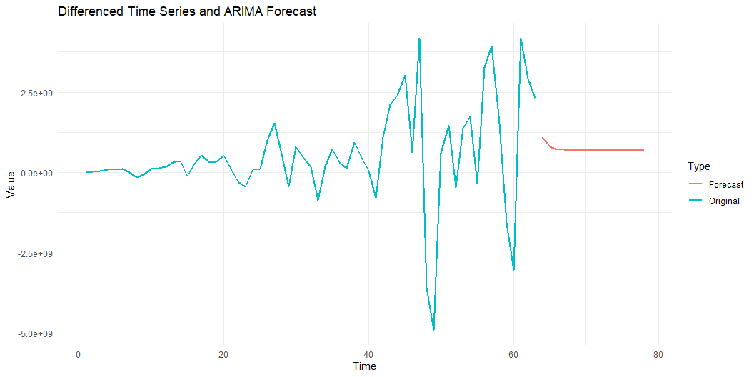
Forecast the GDP for Next 15 Years Based on ARIMA(1, 1, 1)

Slide 11
Based on the forecast values above, the GDP is predicted to decrease and become gradually stable at around $700,000,000 per year.

