Slide 1
POWER SYSTEM
By,
Sreerag M S
S3 CSE

Slide 2
What is power system of a satellite?
Every tech needs power to run.
Includes generating storing and managing all the power required for a satellite.
Power Control Unit
Battery budgeting
Types of batteries
Power generation
Maximum Power Point Tracking(MPPT)

Slide 3
Battery Budgeting
Battery budgeting is the efficient usage of energy stored in the battery.
A challenge for small satellites

Slide 4
Importance of Battery Budgeting
During Eclipse (night) of satellite.
reduce the cost of manufacturing.
Avoid accidential Turnoff of the satellite

Slide 5
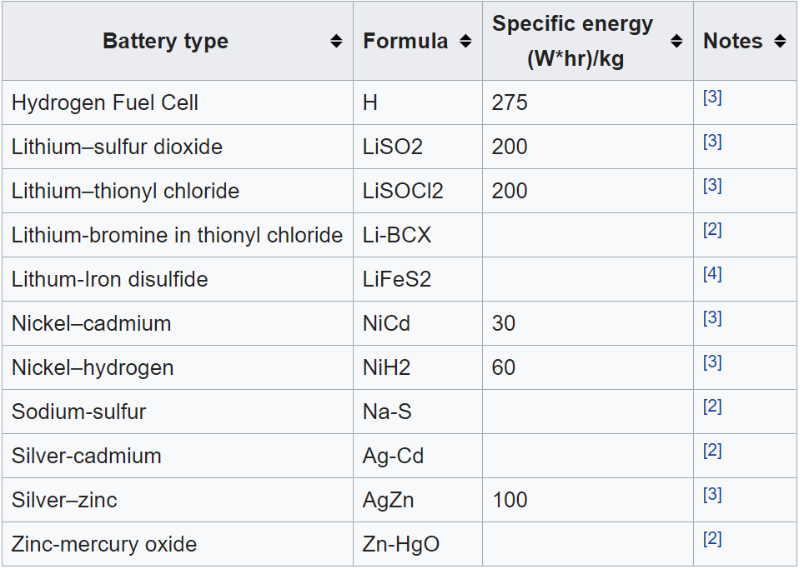
Types of batteries in Satellite

Slide 6

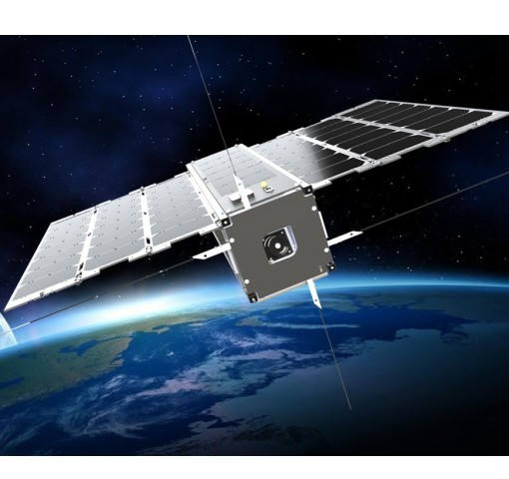
Power generation in Satellites

Slide 7
Maximum Power Point Tracking Algorithm
Method of yielding maximum power from the PV cell
Implemented in photovoltaic (PV) inverters
The algorithms account for factors such as variable irradiance (sunlight) and temperature
Ensures that the PV system generates maximum power at all times

Slide 8
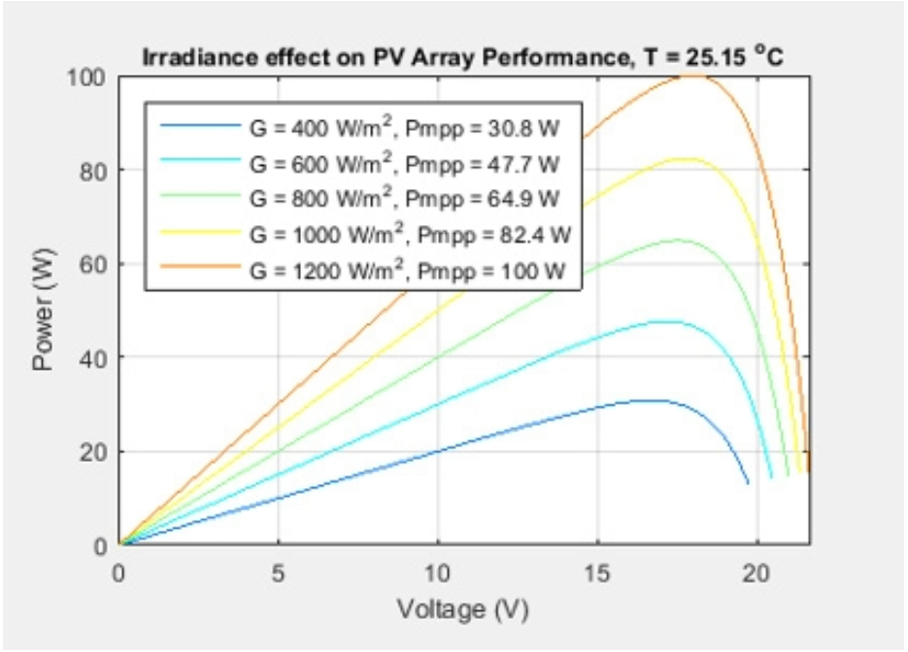
Voltage Power graph for different intensities of light

Slide 9
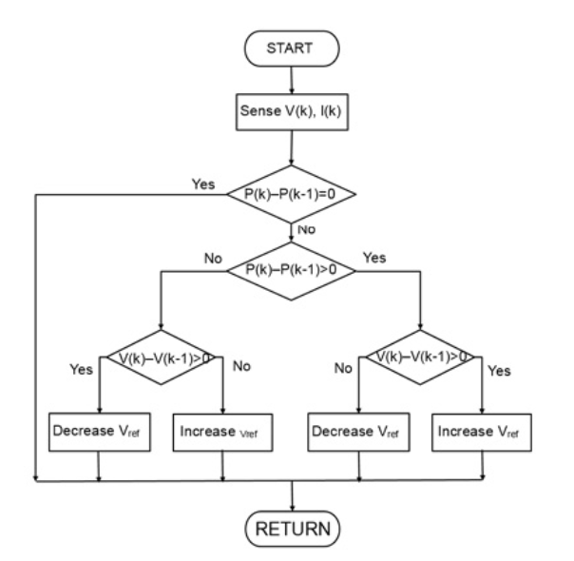
Perturbation and observation (P&O) algorithm

Slide 10
THANK YOU

