Slide 1
NHTS Travel Data
Technical Specifications of Tesla Model S
Speed
Location
SOC
Stop: no change in SOC
(2) Driving: decrease in SOC
- City mileage (if speed < 60 mph)
- Highway mileage if speed ≥ 60 mph)
(3) Home: charging starts upon arrival at home

Slide 2
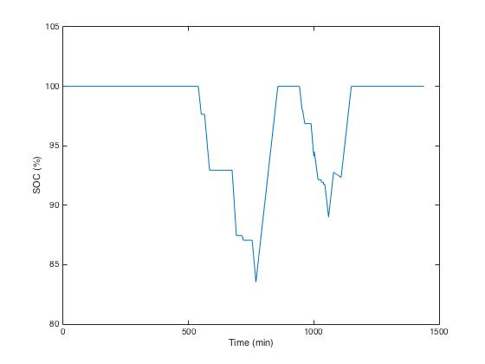

Slide 3
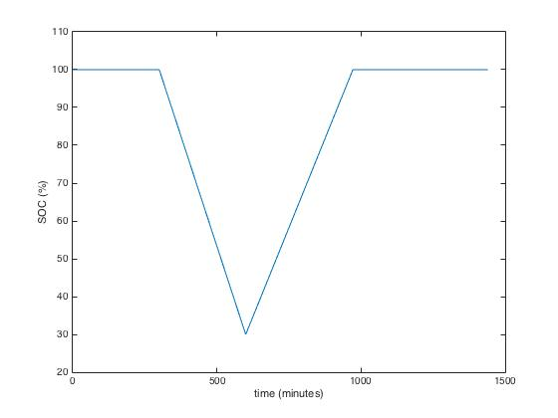
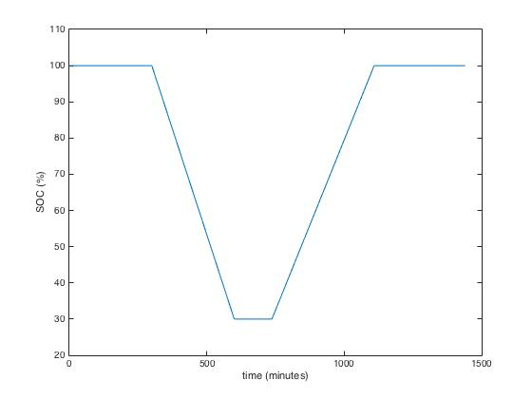
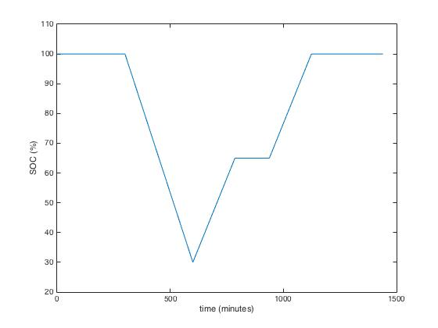
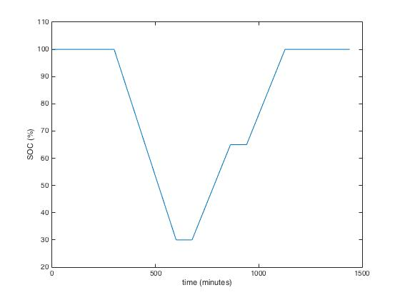
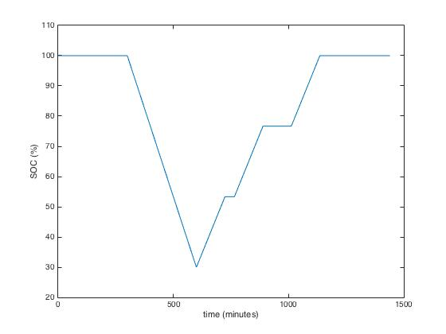
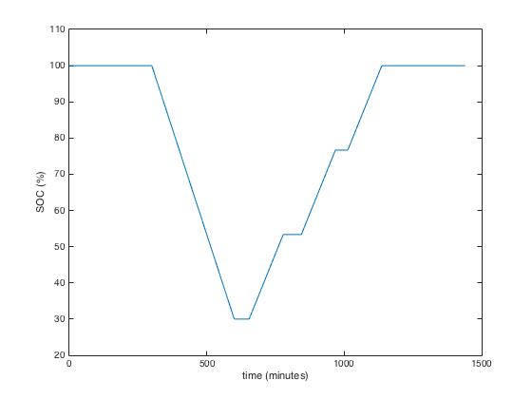
(a)
(b)
t_{leave}
t_{home}
R
(c)
(d)
R
R
R
R
R
(e)
(f)
R
R
R
R
R
R
R

