Slide 1
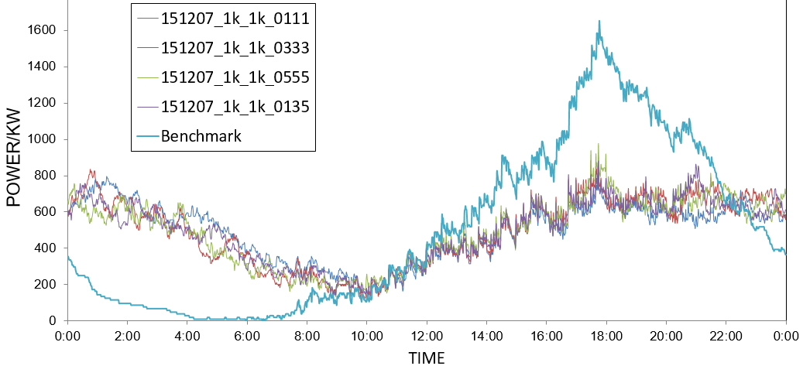
RESULTS AND DISCUSSION – Robustness as goal
 | Start | Steps
Benchmark | Immediate | 1
Alternative Plan 1 | Random | 1
Alternative Plan 3 | Random | 2
Alternative Plan 5 | Random | 3
All four schemes with alternative plans can significantly reach a more stable electricity consumption along the whole day.
The charging steps in random charging plans do not make significant differences on the robustness of the grid.
Benchmark
With different scheme of alternative plans

Slide 2
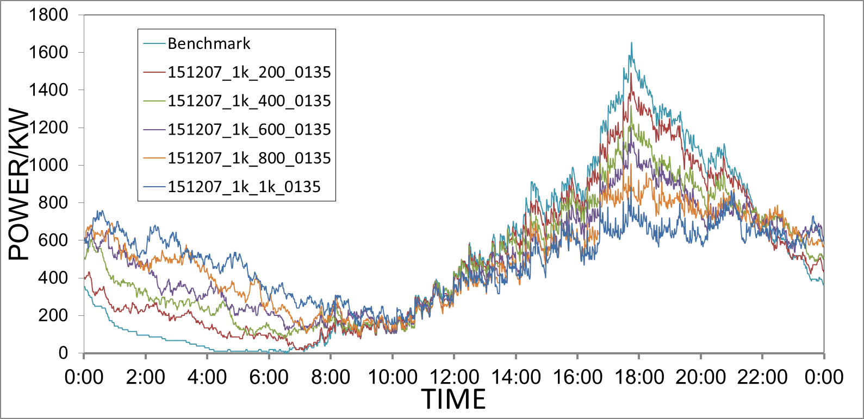
RESULTS AND DISCUSSION – Robustness as goal
Experiment Variables | Values
percentage of Households with alternative plans | 0% 20% 40% 60% 80% 100%
Scheme | [0, 1, 3, 5]
(c) All four schemes with alternative plans can significantly reach a more stable electricity consumption along the whole day.

Slide 3
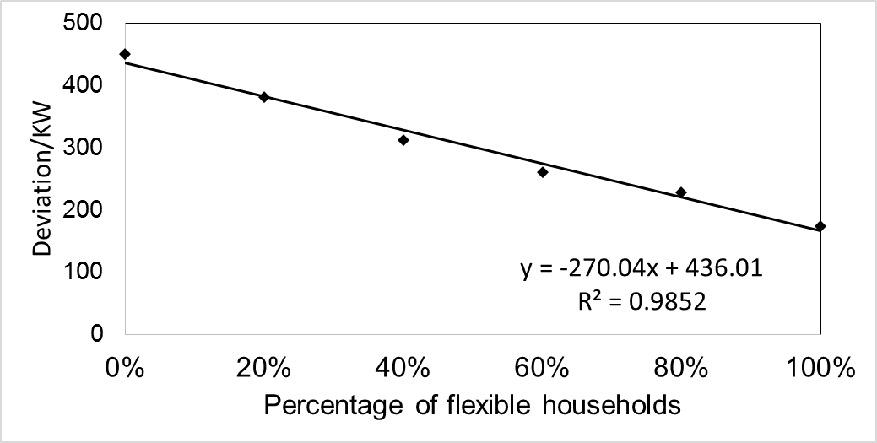
RESULTS AND DISCUSSION – Robustness as goal
(d) The grid robustness, measure in standard deviation, has negative near-linear relationship with the percentage of flexible households.

Slide 4
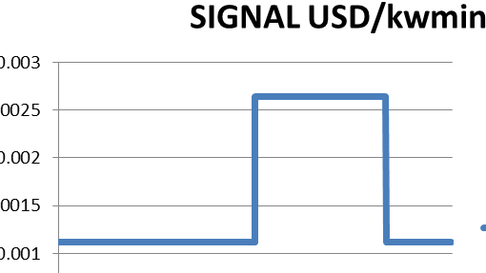
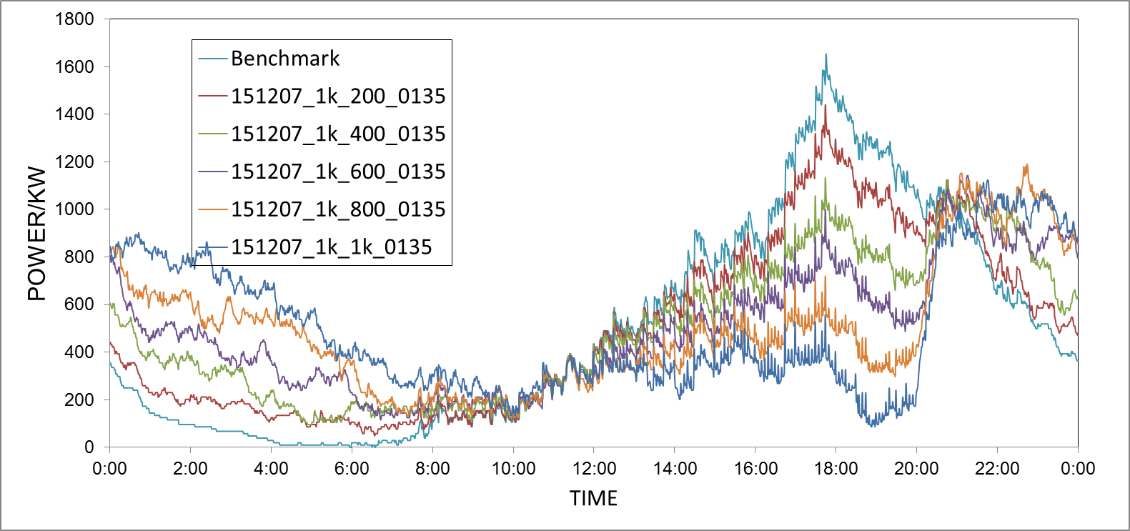
RESULTS AND DISCUSSION – Total cost as goal
Cost decreases as optimization is performed. (32.6% cost saving, comparing between best and worse case)
Higher the percentage of flexible households, lower the total cost.
0 | ($ 1,494.42)
0.2 | ($ 1,406.21)
0.4 | ($ 1,301.65)
0.6 | ($ 1,215.60)
0.8 | ($ 1,112.46)
1 | ($ 1,022.35)
1494.42 USD
1022.35 USD

Slide 5
RESULTS AND DISCUSSION – Total cost as goal
(b) Cost Minimization has an impact on the robustness of the grid.
! Can be positive effect
! Can be negative effect (when flexibility is too high)
Percentage of Household with alternative plans | 0% (benchmark) | 20% | 40% | 60% | 80% | 100%
Average/KW | 496.037804 | 495.924392 | 495.804309 | 495.644197 | 495.597498 | 495.55747
Deviation/KW | 450.0195038 | 366.037821 | 295.897607 | 255.979446 | 259.316847 | 277.148421

Slide 6
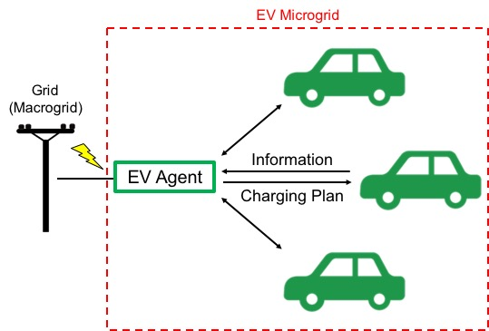

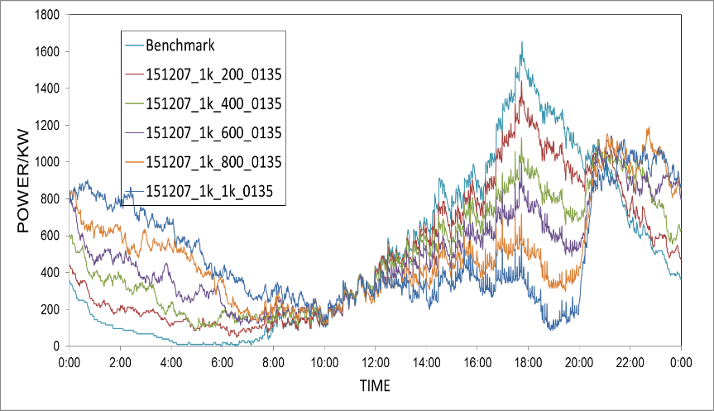
SUMMARY AND OUTLOOK
NTHS
EPOS
Conclusion
In smart microgrid, households who has alternative plans with random charging plans will increase the grid robustness significantly
Robustness as goal: When flexibility ↑, robustness ↑ near-linearly (std. dev.)
Cost at goal: When flexibility ↑, total energy cost ↓, but robustness ↑ or ↓
OUTLOOK
The Infrastructure deployment in real life
Optimization of combined objective in cost and robustness

