Slide 1
NHTS Travel Data
Technical Specifications of Tesla Model S
Speed
Location
SOC
Stop: no change in SOC
(2) Driving: decrease in SOC
- City mileage (if speed < 60 mph)
- Highway mileage if speed ≥ 60 mph)
(3) Home: charging starts upon arrival at home

Slide 2
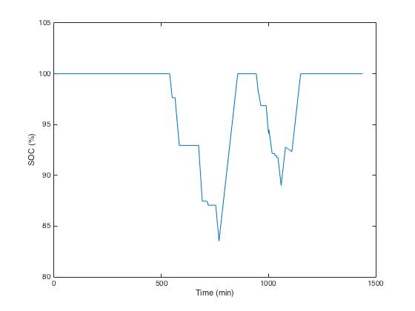

Slide 3
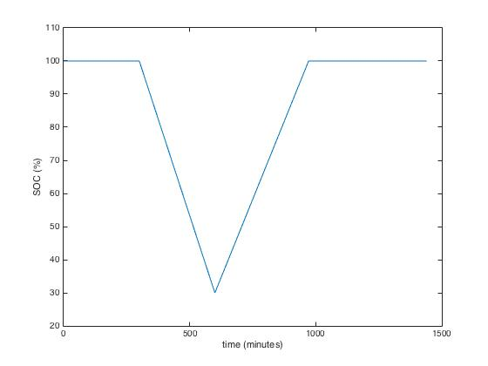
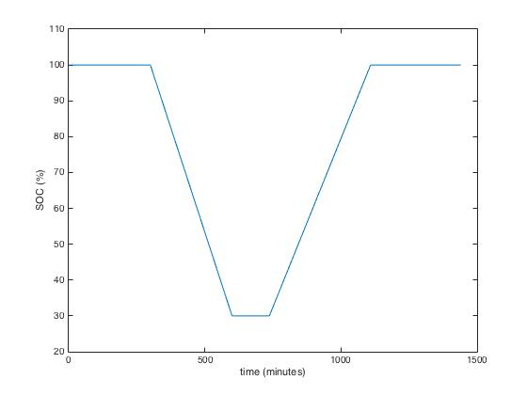
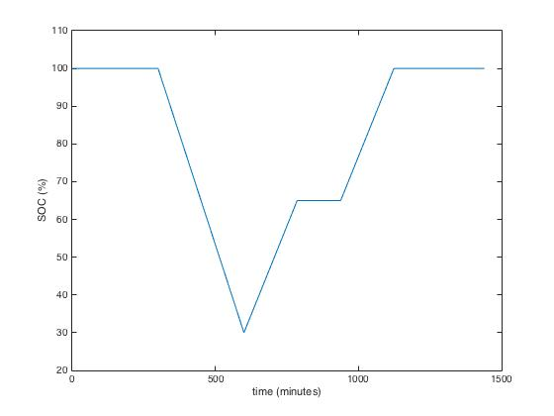
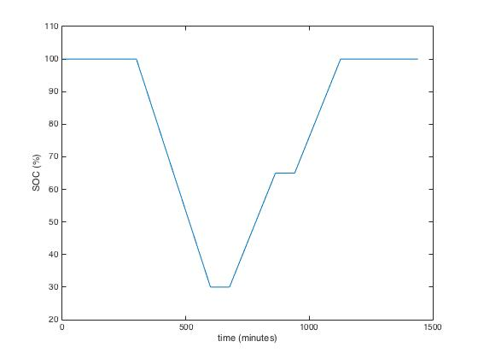
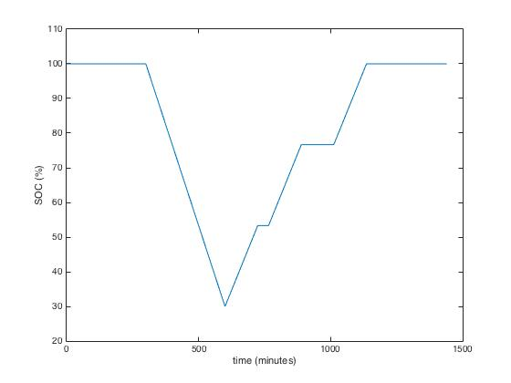
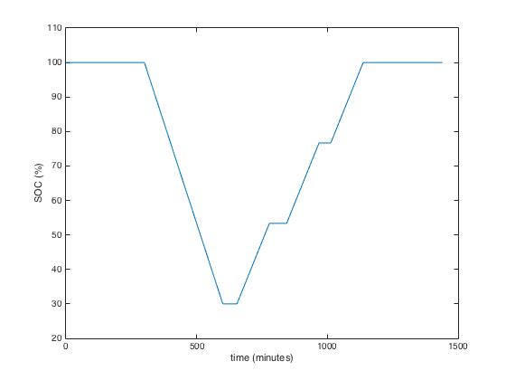
(a)
(b)
t_{leave}
t_{home}
R
(c)
(d)
R
R
R
R
R
(e)
(f)
R
R
R
R
R
R
R

Slide 4
NHTS Travel Data
Technical Specifications of Tesla Model S
Speed
Location
SOC
Stop: no change in SOC
(2) Driving: decrease in SOC
- City mileage (if speed < 60 mph)
- Highway mileage if speed ≥ 60 mph)
(3) Home: charging starts upon arrival at home

Slide 5
Modeling
- Driving Profile
: based on NHTS Travel Data
- Vehicle Specifications
- SOC
Simulation
- Alternative Plans
- Schemes
- Electricity Consumption
- Total Cost
Optimization
- EPOS
- Objective Function
(1) Minimize σ/avg
(2) Minimize Cost
Feedback

Slide 6


EV Microgrid
Grid
(Macrogrid)
EV Agent
EV Agent
Information
EV Agent
Charging Plan
EV Agent
EV Agent
EV Agent
EV Agent

