Slide 1





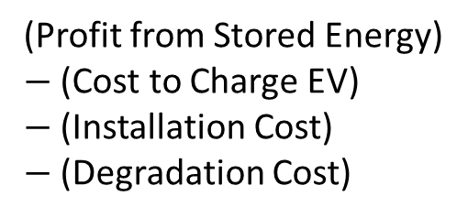
Microgrid with EVs
Xingliang Fang | Seoho Jung | Huiting Zhang
Flexible demand consumption
Store off-peak (cheaper) energy
Avoid peak (costly) prices or sell back to the grid
EV Agent
$$maximize\sum_{Car=1}^{N}{\left(Net Revenue\right)}$$
“Is joining the microgrid a rational decision for an EV owner?”
(Profit from Stored Energy)
$−$ (Cost to Charge EV)
$−$ (Installation Cost)
$−$ (Degradation Cost)
EV Capacity,
Driving Pattern
Break-even,
Total Profit

