Slide 1
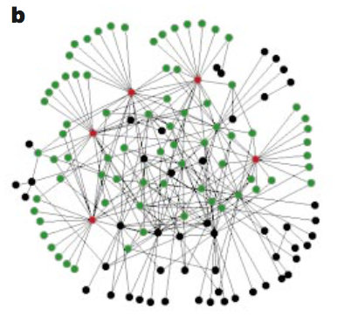
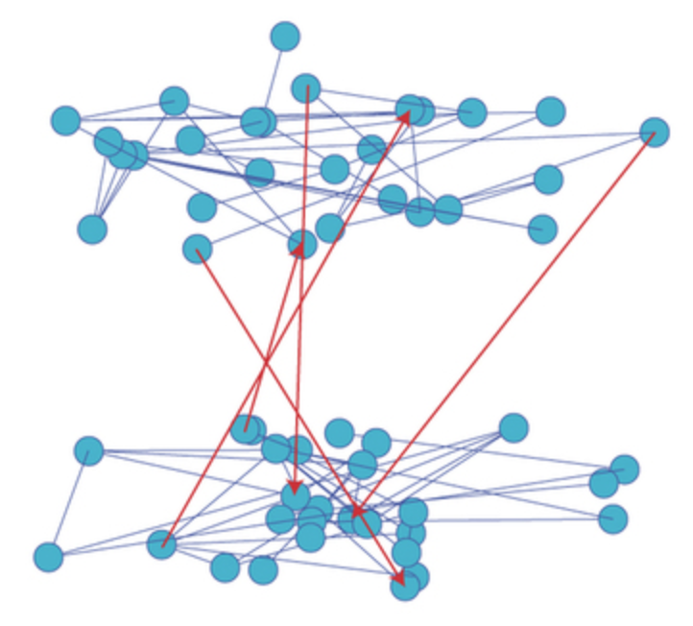
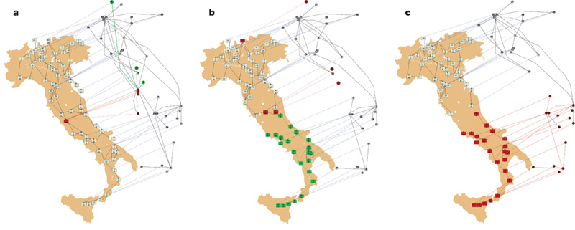
Analyzing Resilience of Interdependent Networks
network
Interdependent network
Interdependent network under failure
Interesting Questions:
How interdepent networks react under failure of nodes or edges?
How to improve the resilience of these networks?
How can we apply the model to real life?
Group Members: Thierry Backes, Sichen Li, Peng Zhou

