Slide 1
System Memories
To make fast and reduce price

Slide 2
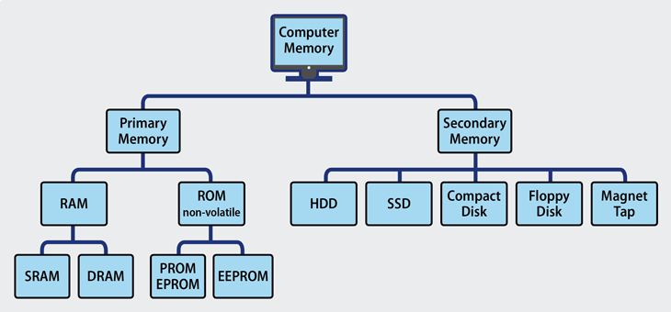
Types of storages

Slide 3
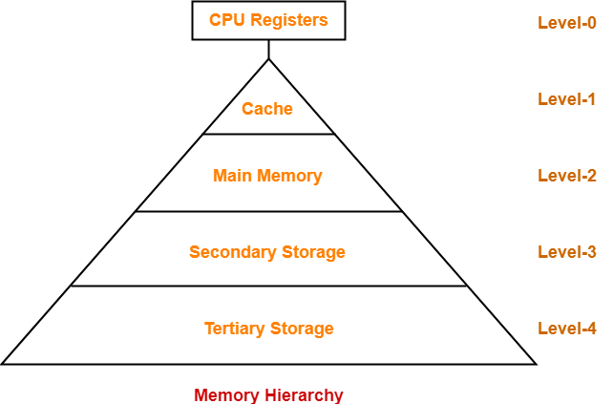
Hierarchy

Slide 4
CPU Registers
Inside CPU
Least access time
These are like Flip flops
Expensive

Slide 5
Cache
Inside CPU, Direct CPU access.
For Memory segments accessing frequently.
Implemented by Static RAM, No need refresh.
Expensive
For Optimzation

Slide 6
Main Memory
Direct CPU Access.
In general system RAM
Implemented by Dynamic RAM, Keep on Refreshing.

Slide 7
Secondary memory
No Direct access with CPU.
System HDD.
For files storage.
Cheaper in price.

Slide 8
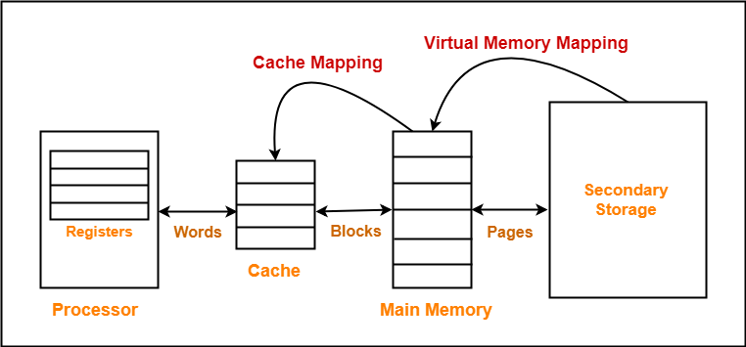
How memory arranged

Slide 9
Assignments
Collect X86 CPU Registers
Collect your Processor Cache capacity(Refer specification in online)
Your PC RAM
Your PC HDD Size

