Slide 1
Introduction to C
Characteristics & Basics

Slide 2
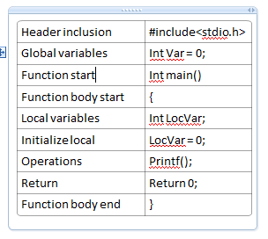
How it should look
Structured Language

Slide 3
Important terminologies
What it is …
Keywords
Identifiers
Code section
Data section
Declaration
Definition

Slide 4
Executable as file
When we write c file, it is on secondary memory.
After compilation also it is on secondary.
Nm command – To examine binaries
Data Section
Code or Text section

Slide 5
Run time Memory map of C
When you start executing program, placed into primary memory.
Code or text section
Data section
Stack
Heap

Slide 6
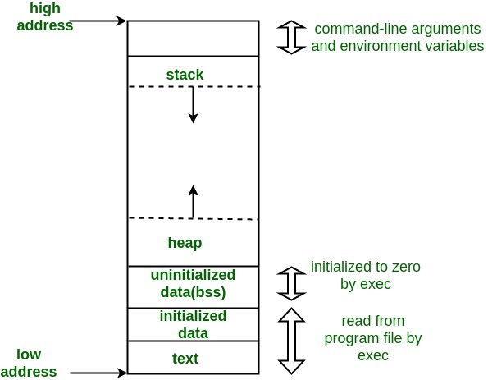
Memory Map(Process Area)

Slide 7
Conditional Statements
If
If, else
If, else if, else
Switch, case
Ternary operator (True)?PASS:FAIL;

Slide 8
Loops
for
While
Do, While – Run at least once

Slide 9
Functions
To get modularity.
To reduce code section size.
Call when required.
Types:
Library functions
User defined functions

Slide 10
User defined functions
Based on requirement user has to declare and define function.
How important is declaration.?

Slide 11
Library Functions
Most frequently used functions are printf scanf
To save user time
Examples:
atoi
sqrt

Slide 12
Assignments(try multiple methods)
Maintain document with Linux commands
Don’t by heart, Collect keywords covered here
Write code to for below
find max number among 3 numbers.
To check input character is alphabet, digit, or special character.(Refer ASCII table)
Calculate profit or loss and how much by taking inputs cost price and sold price.

