Slide 1
How I Used Clojure to Appear on the NPR Sunday Puzzle
by Mitchell Szczepanczyk
Chicago Clojure Meetup
May 27, 2026
https://www.meetup.com/chicagoclj/events/314769365/

Slide 2
How I Used Clojure to Appear on the NPR Sunday Puzzle
NPR Sunday Puzzle Review
Old Code
Older Reference
Solution in Clojure
NPR Appearance

Slide 3
How I Used Clojure to Appear on the NPR Sunday Puzzle
<advertisement>
1. I pay for this Clojure Meetup out of my own pocket. Donations very much appreciated.
Venmo: @Mitchell-Szczepanczyk
2. I’m currently looking for a new job. New job leads very much appreciated. Email: mitchell@szcz.org
</advertisement>

Slide 4
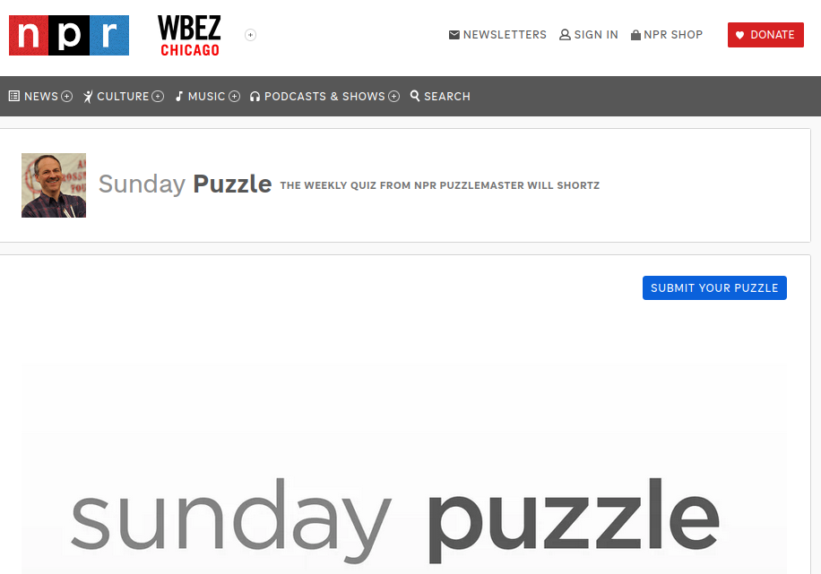
How I Used Clojure to Appear on the NPR Sunday Puzzle: NPR Sunday Puzzle Review

Slide 5
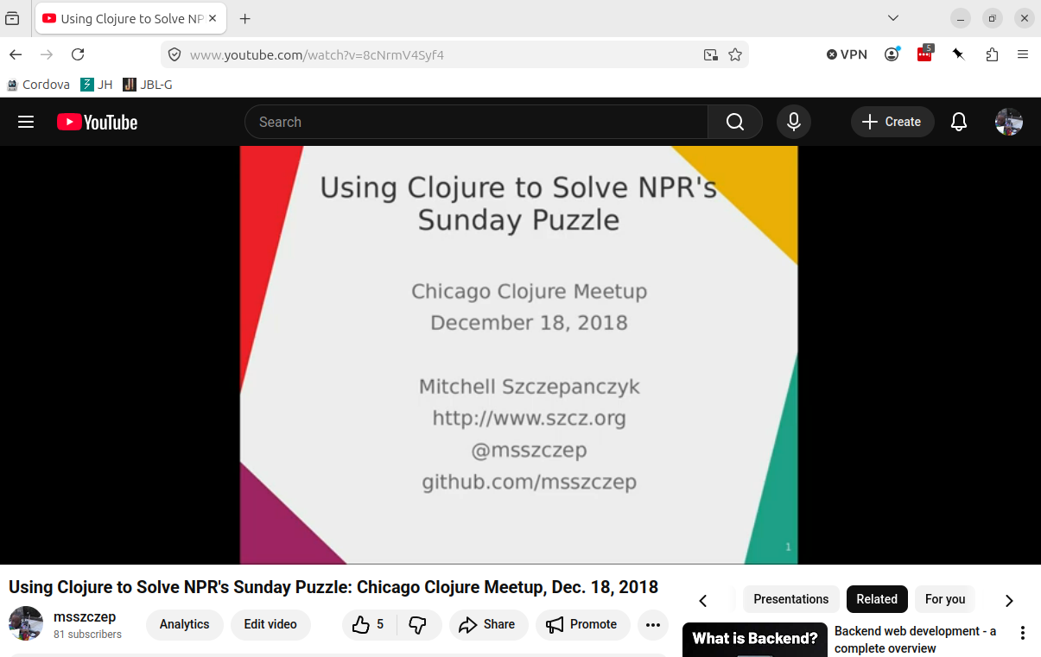
How I Used Clojure to Appear on the NPR Sunday Puzzle: NPR Sunday Puzzle Review

Slide 6
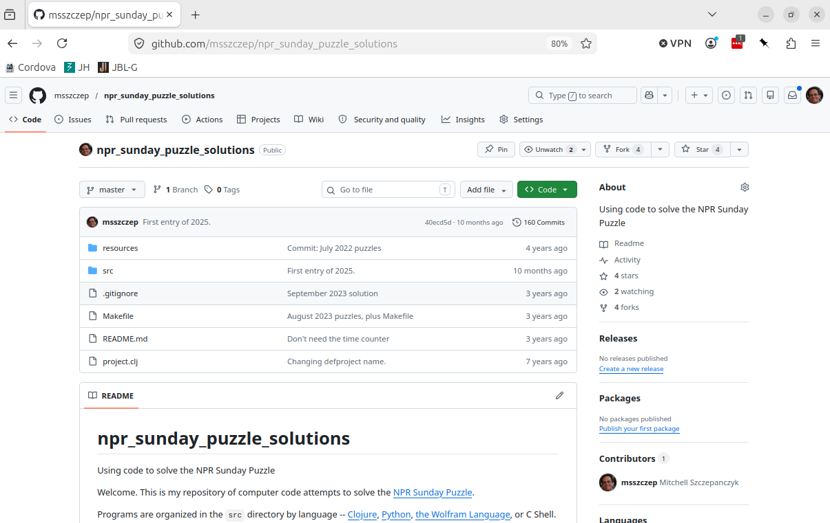
How I Used Clojure to Appear on the NPR Sunday Puzzle: NPR Sunday Puzzle Review

Slide 7
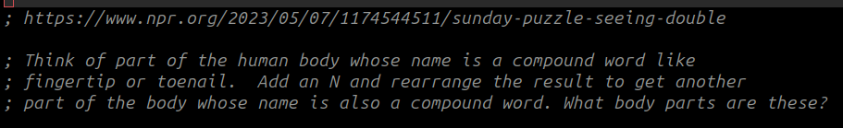
How I Used Clojure to Appear on the NPR Sunday Puzzle: NPR Sunday Puzzle Review

Slide 8
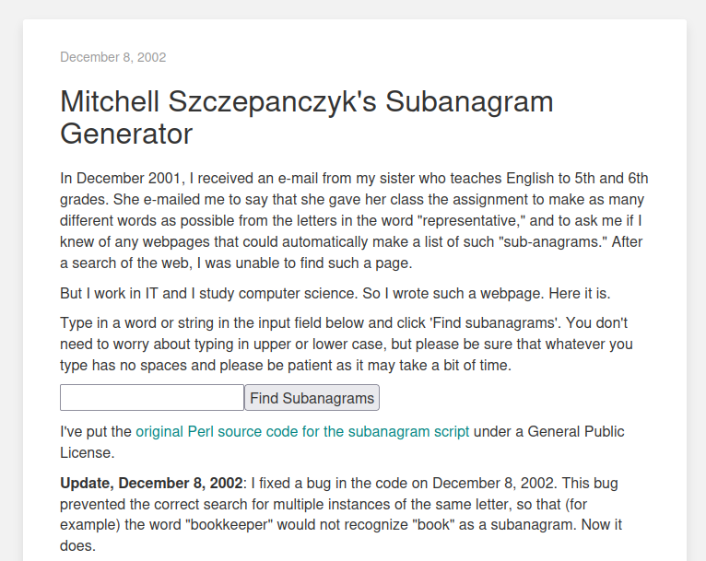
How I Used Clojure to Appear on the NPR Sunday Puzzle: Old Code

Slide 9
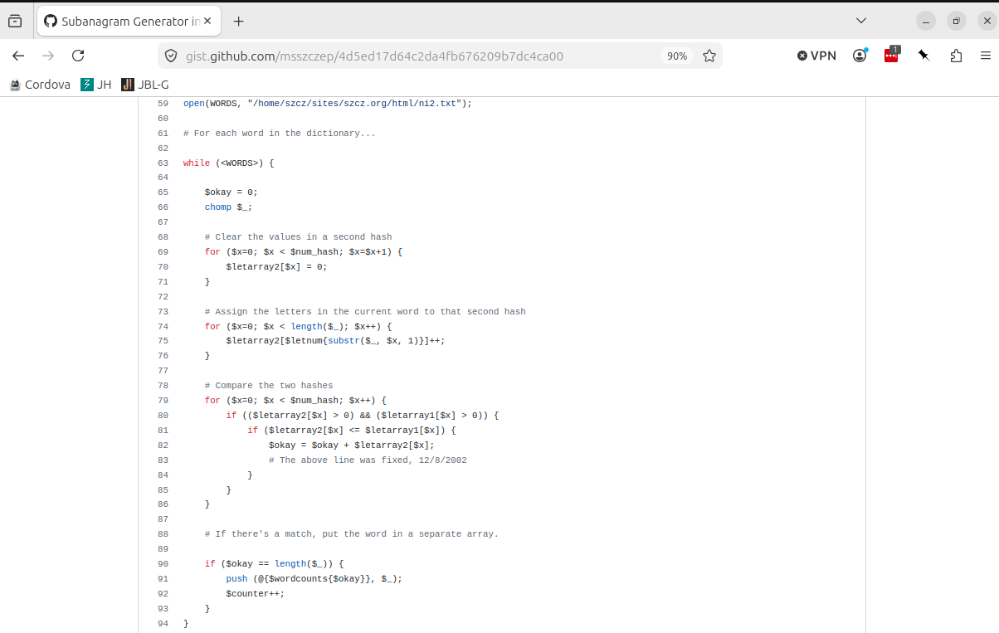
How I Used Clojure to Appear on the NPR Sunday Puzzle: Old Code

Slide 10
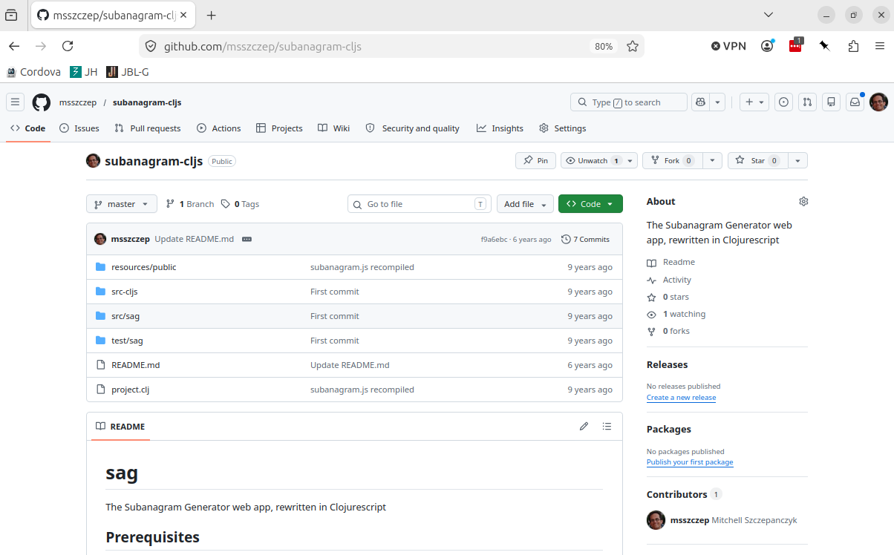
How I Used Clojure to Appear on the NPR Sunday Puzzle: Old Code

Slide 11
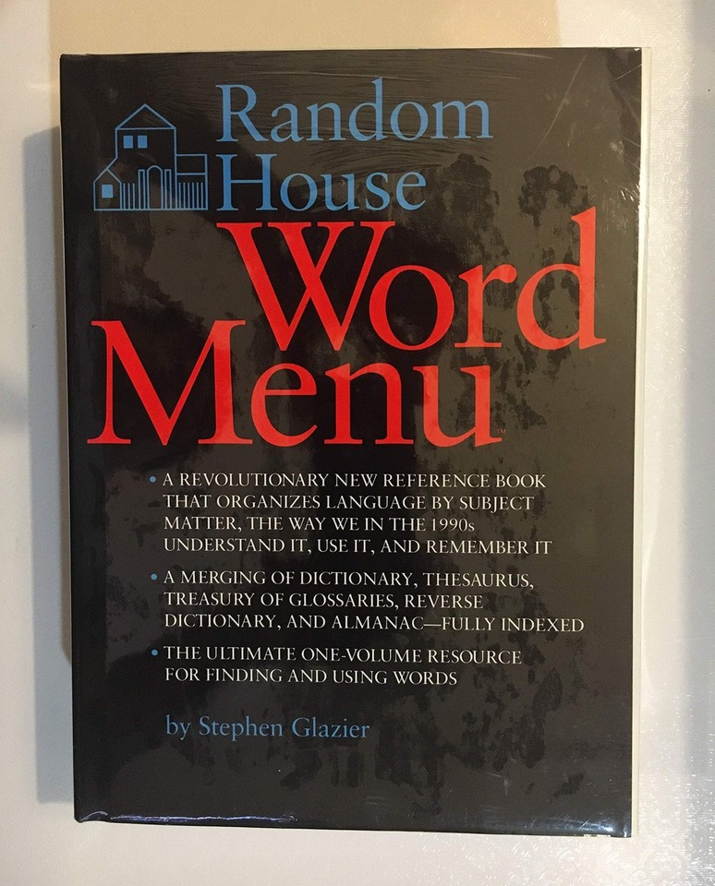
How I Used Clojure to Appear on the NPR Sunday Puzzle: Older Reference

Slide 12
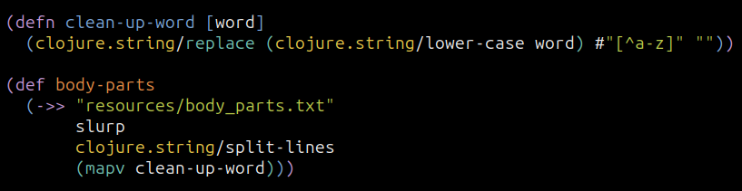
How I Used Clojure to Appear on the NPR Sunday Puzzle: Solution in Clojure

Slide 13
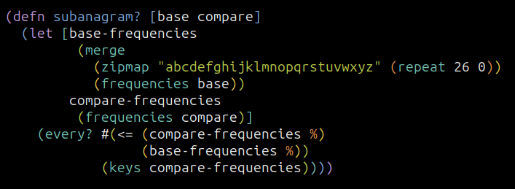
How I Used Clojure to Appear on the NPR Sunday Puzzle: Solution in Clojure

Slide 14
How I Used Clojure to Appear on the NPR Sunday Puzzle: Solution in Clojure

Slide 15
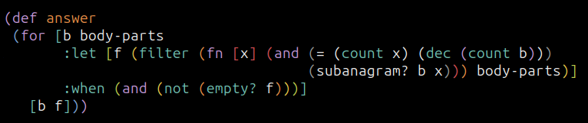
How I Used Clojure to Appear on the NPR Sunday Puzzle: Solution in Clojure

Slide 16
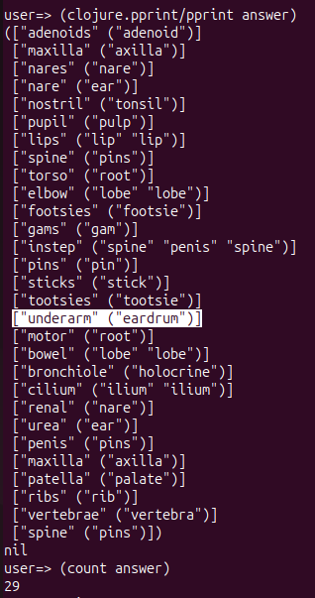
How I Used Clojure to Appear on the NPR Sunday Puzzle: Solution in Clojure

Slide 17
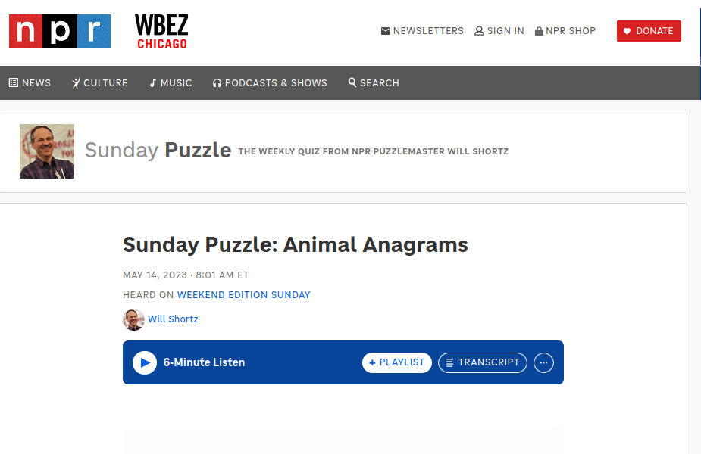
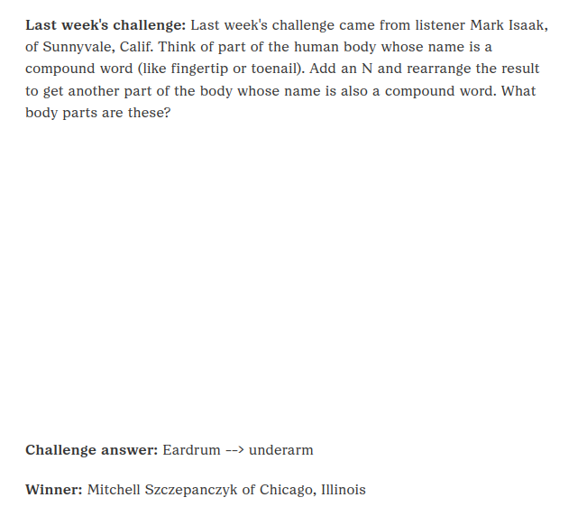
How I Used Clojure to Appear on the NPR Sunday Puzzle: NPR Appearance

Slide 18
How I Used Clojure to Appear on the NPR Sunday Puzzle: NPR Appearance
https://www.szcz.org/posts/2023-07-29-my-npr-sunday-puzzle-appearance
https://github.com/msszczep/npr_sunday_puzzle_solutions
https://github.com/msszczep/subanagram-cljs
https://www.npr.org/2023/05/14/1176014675/sunday-puzzle-animal-anagrams

