Slide 1
Using Clojure to Solve NPR's Sunday Puzzle
Chicago Clojure Meetup
December 18, 2018
Mitchell Szczepanczyk
http://www.szcz.org
@msszczep
github.com/msszczep

Slide 2
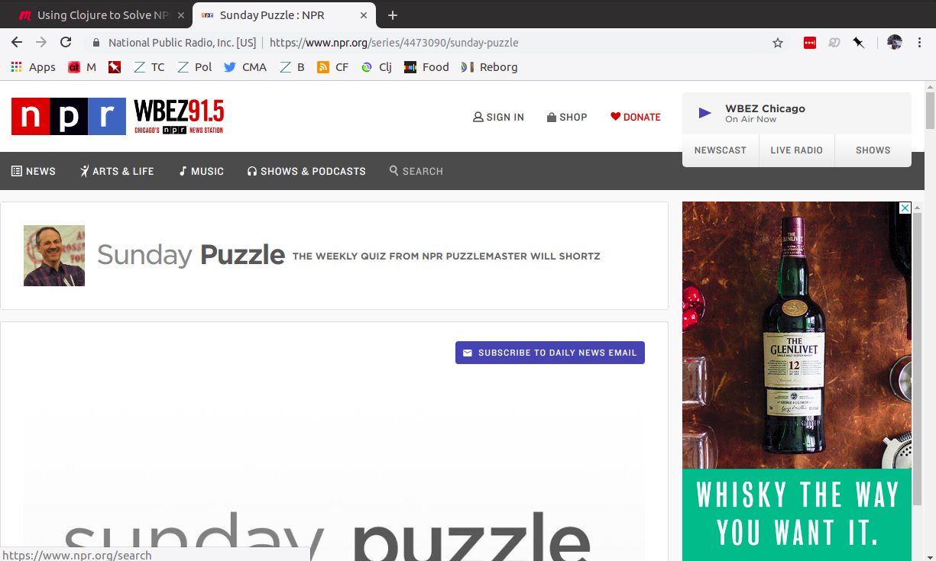

Slide 3
Puzzle #1
From December 2, 2018:
Think of a common 7-letter word. Drop its second letter, and you'll get a 6-letter word that does not rhyme with the first. Alternatively, you can drop the third letter from the 7-letter word to get a 6-letter word that doesn't rhyme with either of the first two. Further, you can drop both the second and third letters from the 7-letter word to get a 5-letter word that doesn't rhyme with any of the others. What words are these?

Slide 4
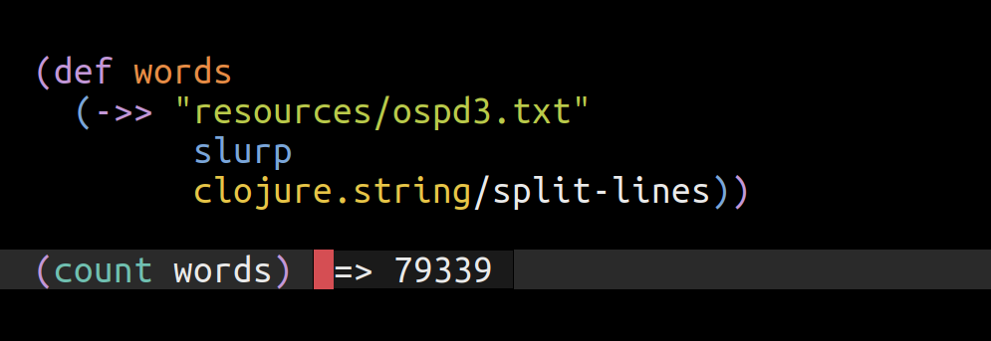
Puzzle #1

Slide 5
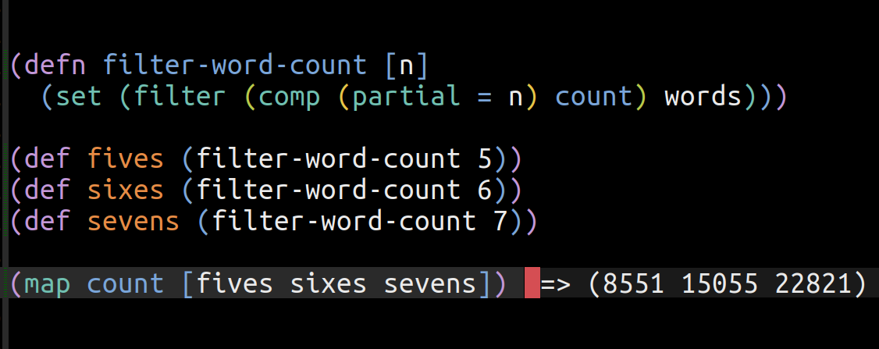
Puzzle #1

Slide 6
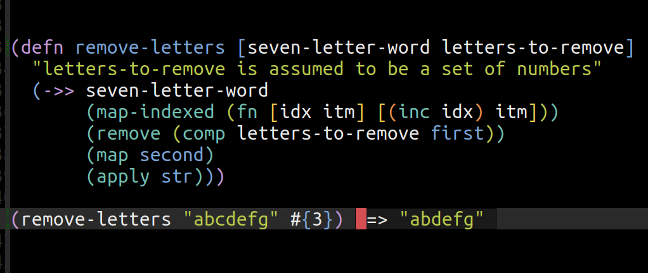
Puzzle #1

Slide 7
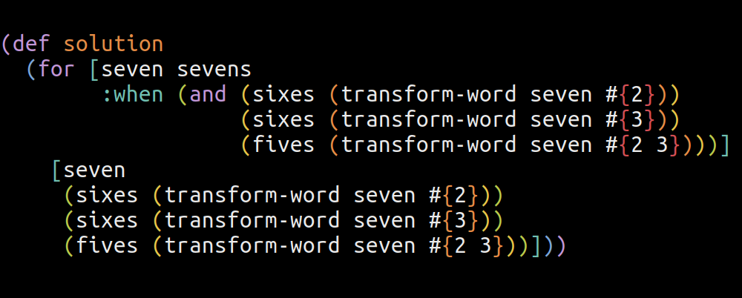
Puzzle #1

Slide 8
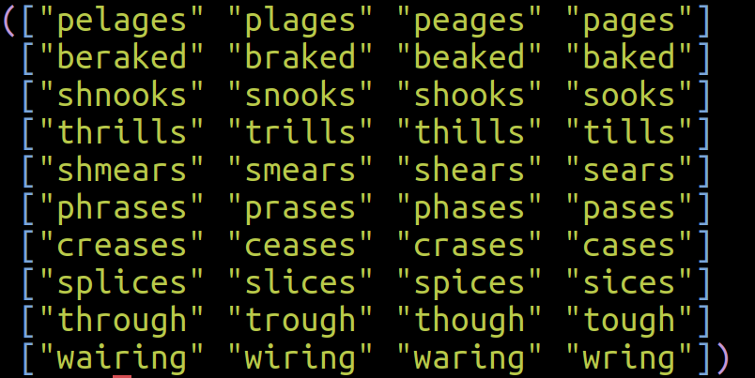
Puzzle #1

Slide 9
Puzzle #2
From October 28, 2018:
Think of a famous Broadway musical in two words. Change one letter in it to the preceding letter of the alphabet — so B would become A, C would become B, etc. Remove the space so you have a solid word. The result will name something that all of us are part of. What is it?

Slide 10
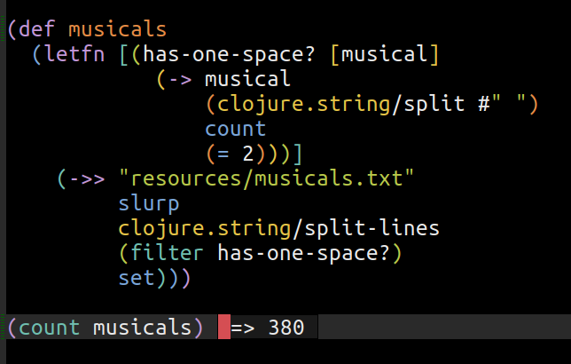
Puzzle #2

Slide 11
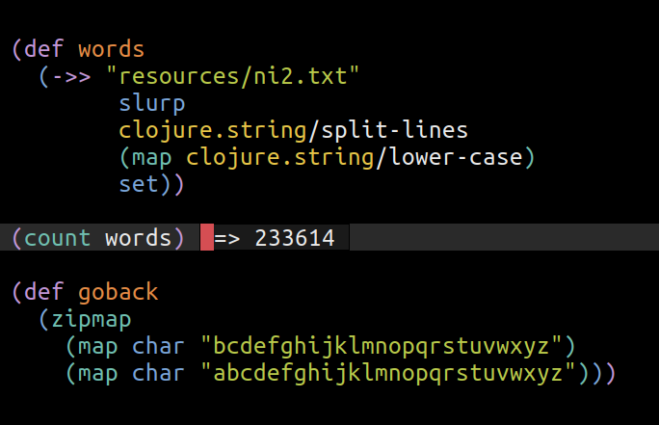
Puzzle #2

Slide 12
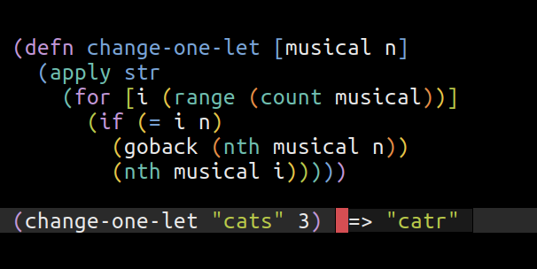
Puzzle #2

Slide 13
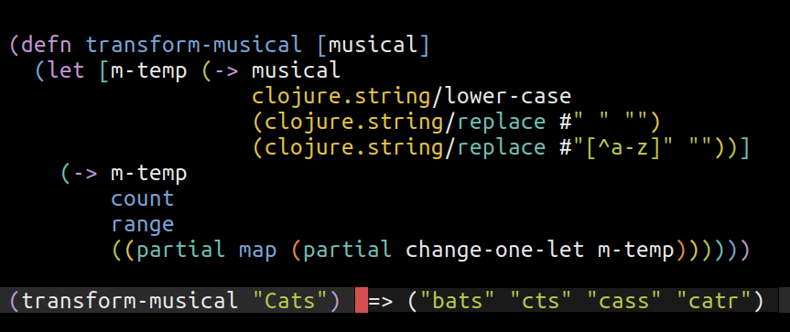
Puzzle #2

Slide 14
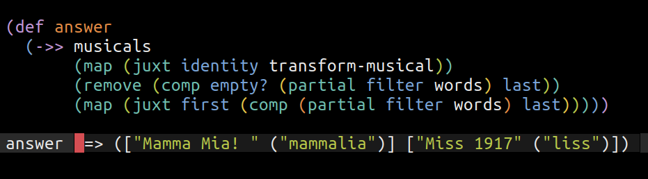
Puzzle #2

Slide 15
Puzzle #3
From May 8, 2018:
Name something in 11 letters that's a common household item. You can rearrange the first six letters to form a synonym of a word spelled by the middle three letters. What is the item, and what are the words?

Slide 16
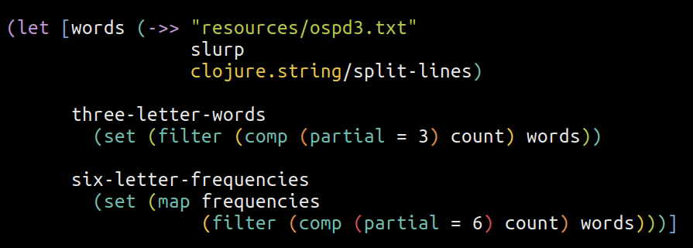
Puzzle #3

Slide 17
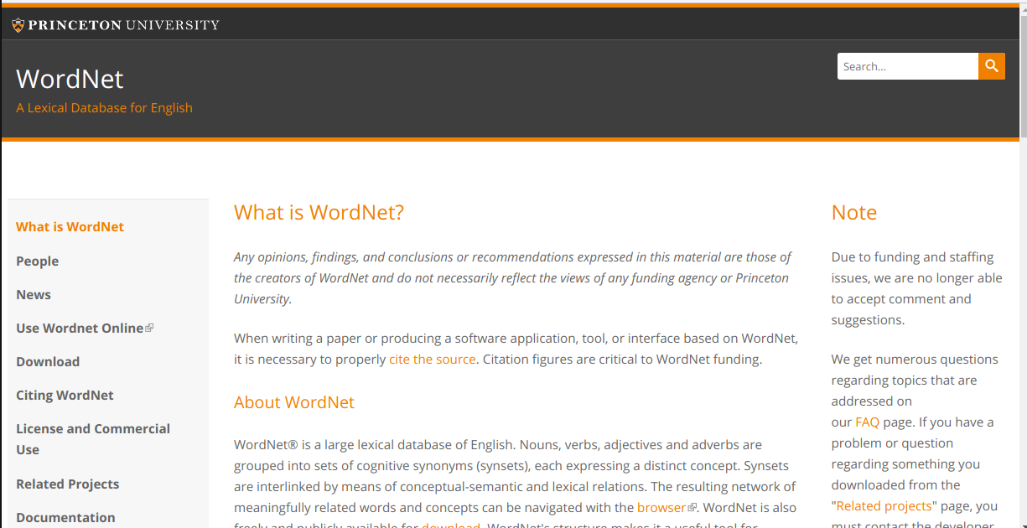
Puzzle #3

Slide 18
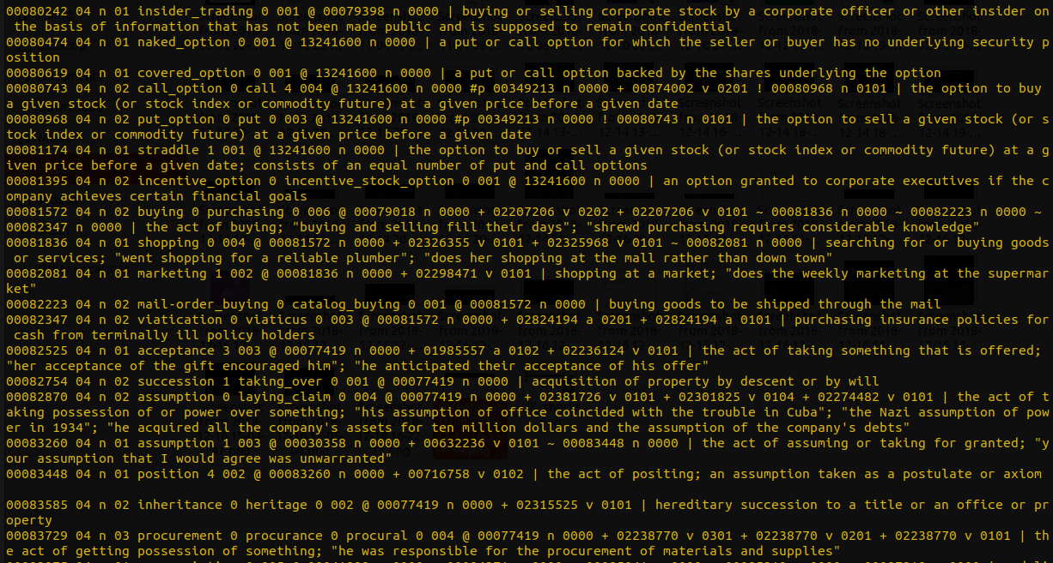
Puzzle #3

Slide 19
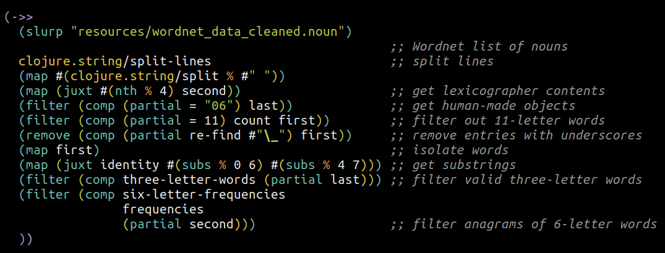
Puzzle #3

Slide 20
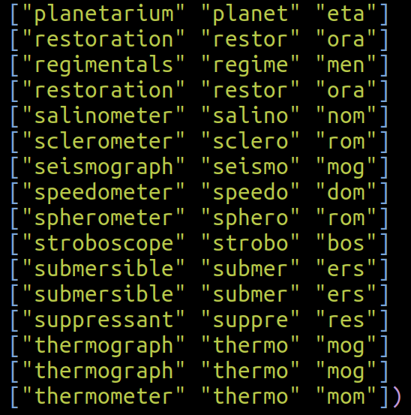
Puzzle #3

Slide 21
Puzzle #4
From August 16, 2016:
Take the word EASILY. You can rearrange its letters to spell SAY and LEI. These two words rhyme even though they have no letters in common.
What is the longest familiar word you can find that can be anagrammed into two shorter words that rhyme but have no letters in common? The two shorter words must have only one syllable.

Slide 22
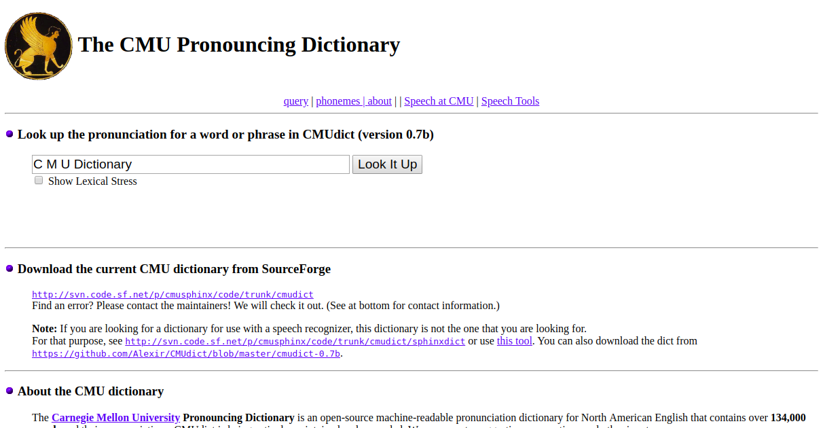
Puzzle #4

Slide 23
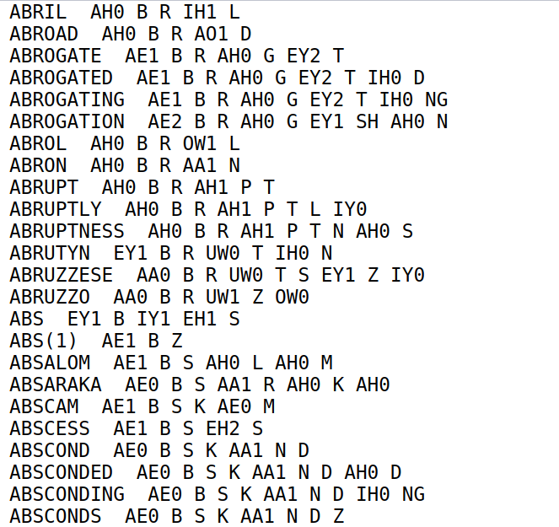
Puzzle #4

Slide 24
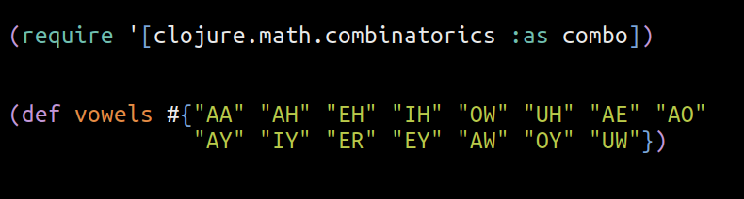
Puzzle #4

Slide 25
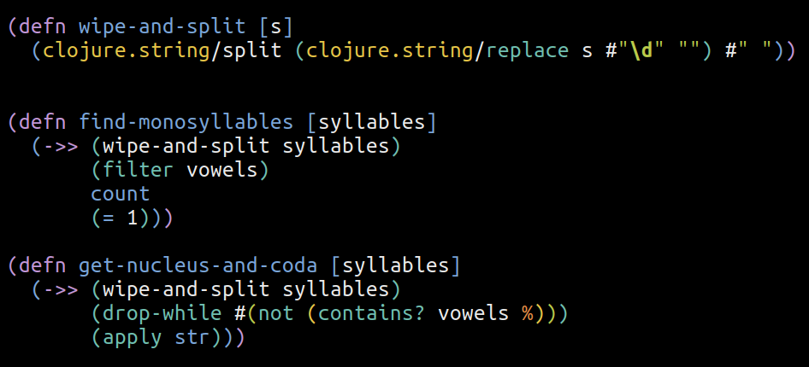
Puzzle #4

Slide 26
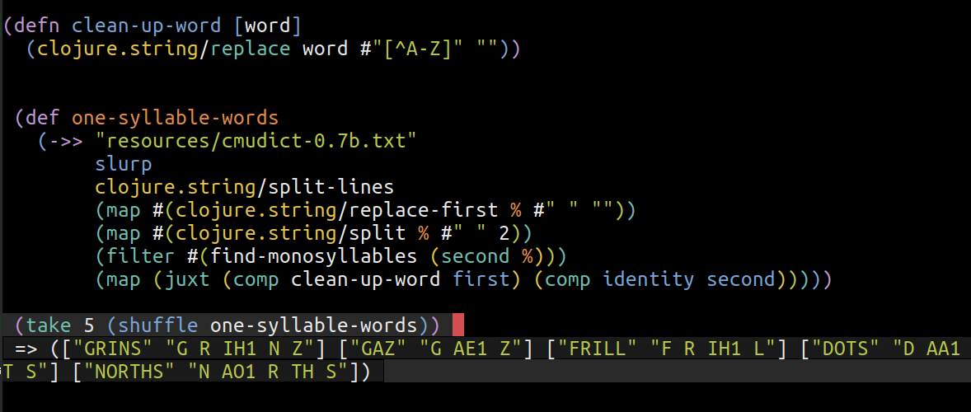
Puzzle #4

Slide 27
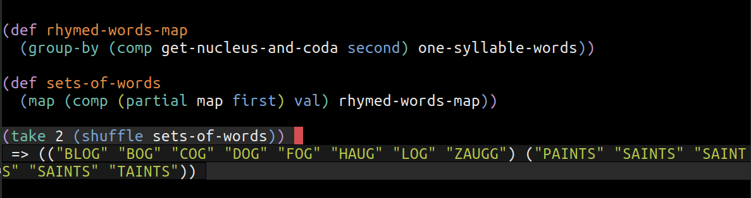
Puzzle #4

Slide 28
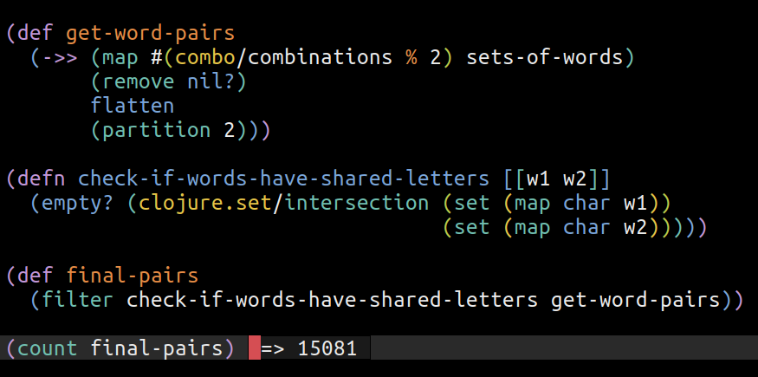
Puzzle #4

Slide 29
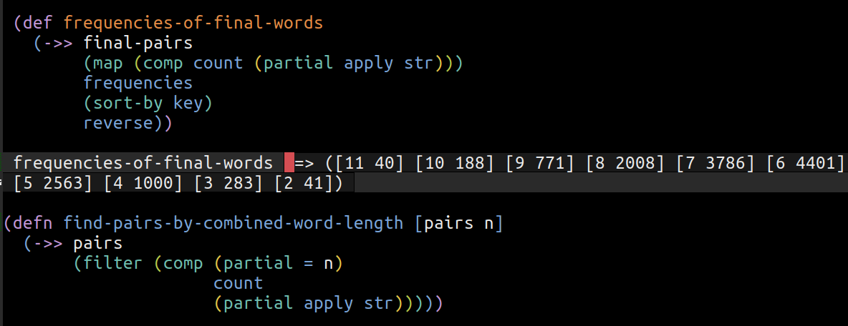
Puzzle #4

Slide 30
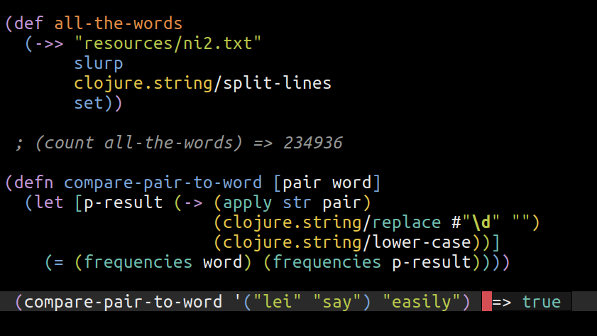
Puzzle #4

Slide 31
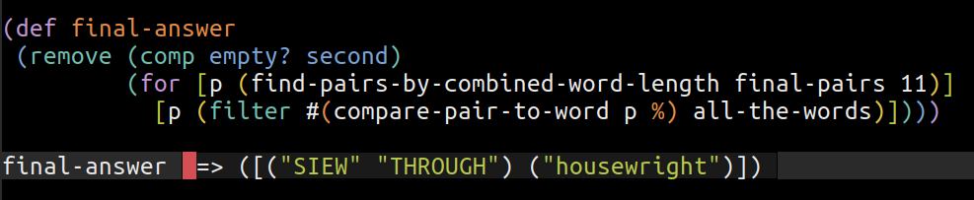
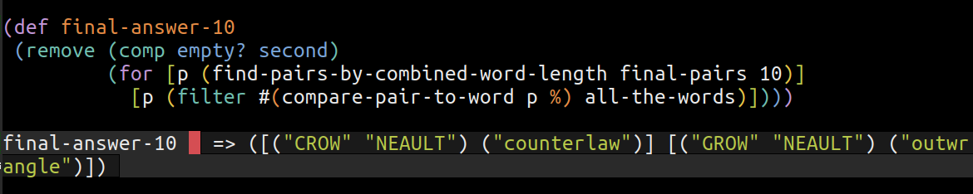
Puzzle #4

Slide 32
Puzzle #5
Take the four four-letter words LIMB, AREA, CORK and KNEE.
Write them one under the other, and the four columns will
spell four new words LACK, IRON, MERE, and BAKE.
This is called a double word square. I'd like you to find a
double word square with 6-letter words. Specifically, your
square must include the words PONIES, ACCEPT, SEARED and CAVIAR.
These four words must be among the 12 common, uncapitalized
six-letter words in the square. Can you do it?
L | I | M | B
A | R | E | A
C | O | R | K
K | N | E | E

Slide 33
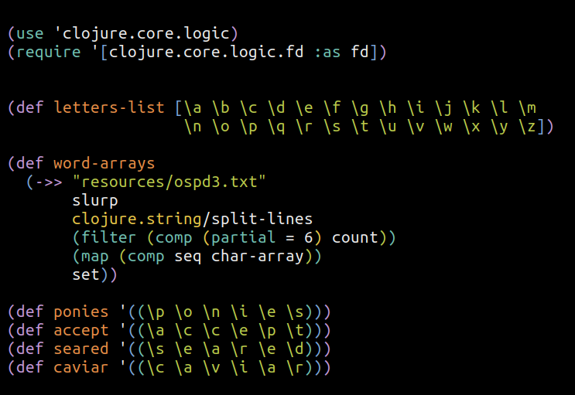
Puzzle #5

Slide 34
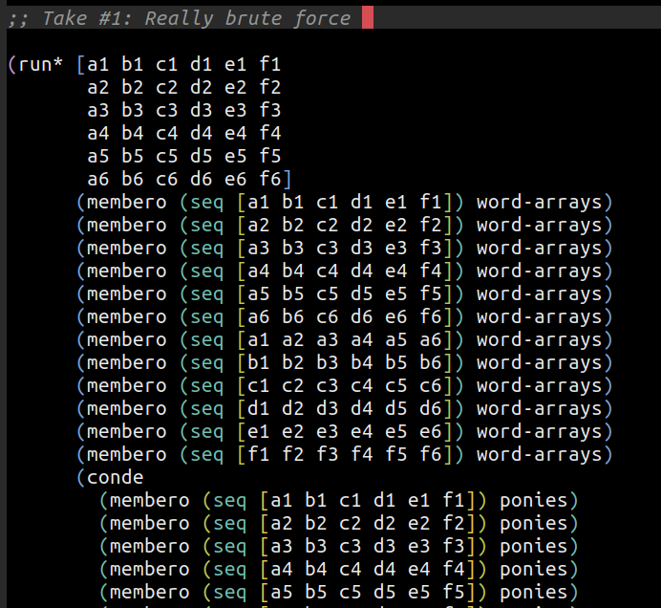
Puzzle #5

Slide 35
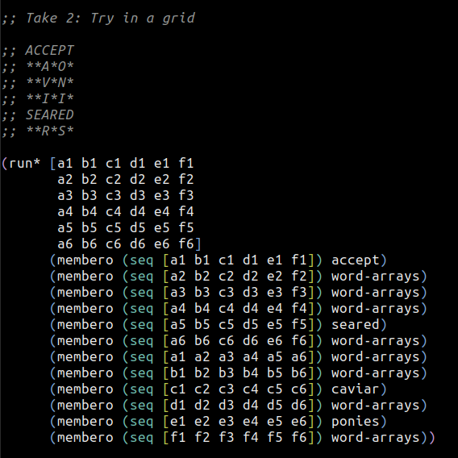
Puzzle #5

Slide 36
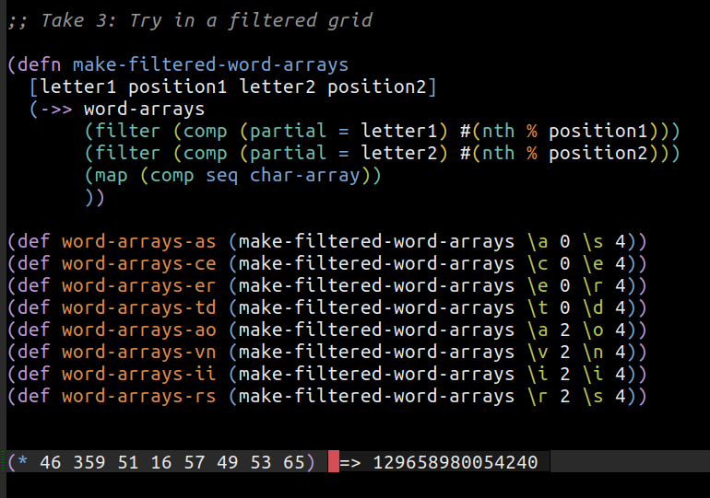
Puzzle #5

Slide 37
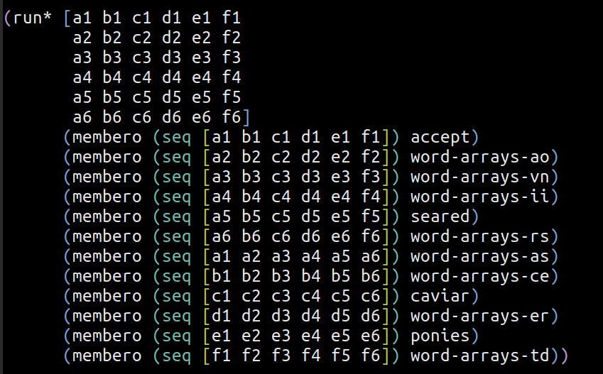
Puzzle #5

Slide 38
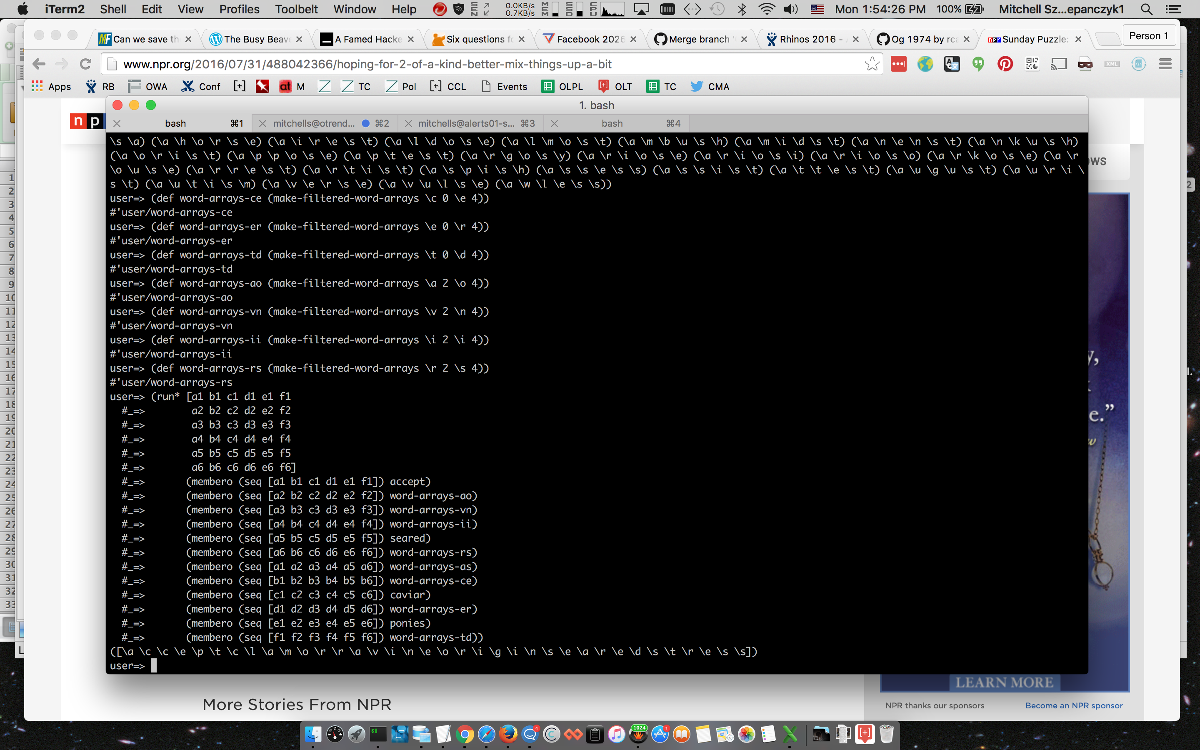
Puzzle #5

Slide 39
Puzzle #5
A | C | C | E | P | T
C | L | A | M | O | R
R | A | V | I | N | E
O | R | I | G | I | N
S | E | A | R | E | D
S | T | R | E | S | S

Slide 40
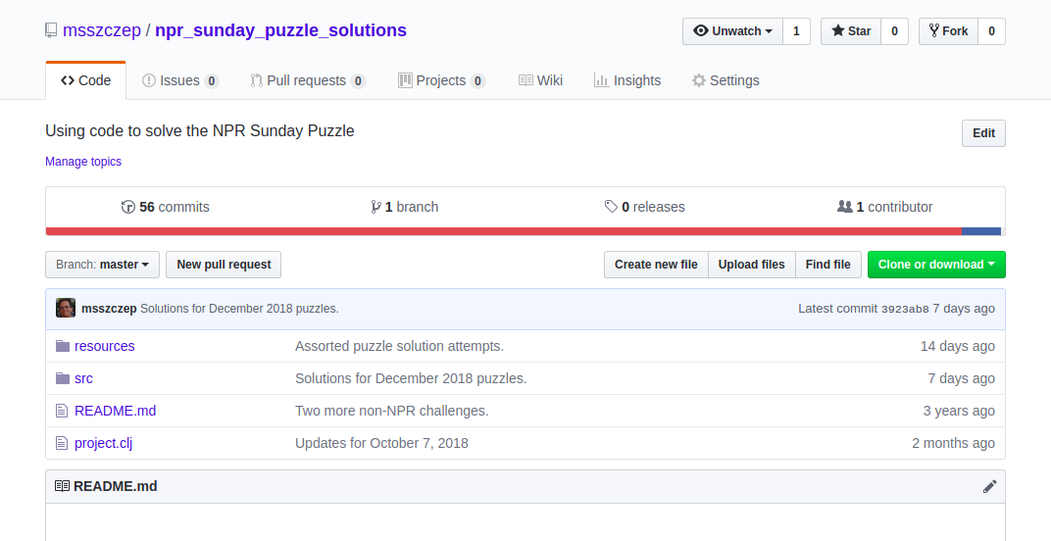
github.com/msszczep/npr_sunday_puzzle_solutions

