Slide 1

CAPSTONE
Madeleine Tourelle

Slide 2



OUTLINE
Executive Summary
Introduction
Methodology
Results
Visualization – Charts
Dashboard
Discussion
Findings & Implications
Conclusion
Appendix

Slide 3

EXECUTIVE SUMMARY
This capstone project explores trends in programming languages, database technologies, and their implications for developers and organizations. Using API collection, web scraping, and exploratory data analysis, the study identifies key insights about the technology landscape:
Programming Language Trends: JavaScript continues to dominate, highlighting the critical role of web development. Emerging languages like TypeScript and SQL emphasize the shift towards scalable, modern technologies.
Database Preferences: PostgreSQL leads as the most desired database, reflecting the growing preference for feature-rich, scalable, open-source systems. A strong interest in NoSQL databases suggests a diversification in data storage needs.
Job Market Insights: Skills in cloud platforms like AWS, Azure, and Google Cloud are highly sought after, aligning with the rising importance of cloud computing. Web development and full-stack development remain crucial for industry demands.
Demographic Highlights: The majority of respondents are well-educated, mid-career professionals, underscoring the need for advanced skills and qualifications in the job market.

Slide 4

INTRODUCTION
Identifying Programming Language Trends
Findings & Implications
Identifying Database Trends
Findings & Implications
Exploring Relationships
Jobs vs. Skills
Languages vs. Salary
Cognos Analytics Dashboard
Current Technology
Future Technology
Demographics

Slide 5

METHODOLOGY
API Collection and Web Scraping
Data Wrangling
Identify missing values
Removal of duplicates
Impute missing values
Normalize the data
Exploratory Data Analysis (EDA)
Data Visualization
Identify correlations/patterns/trends in data
Present Data
Results

Slide 6
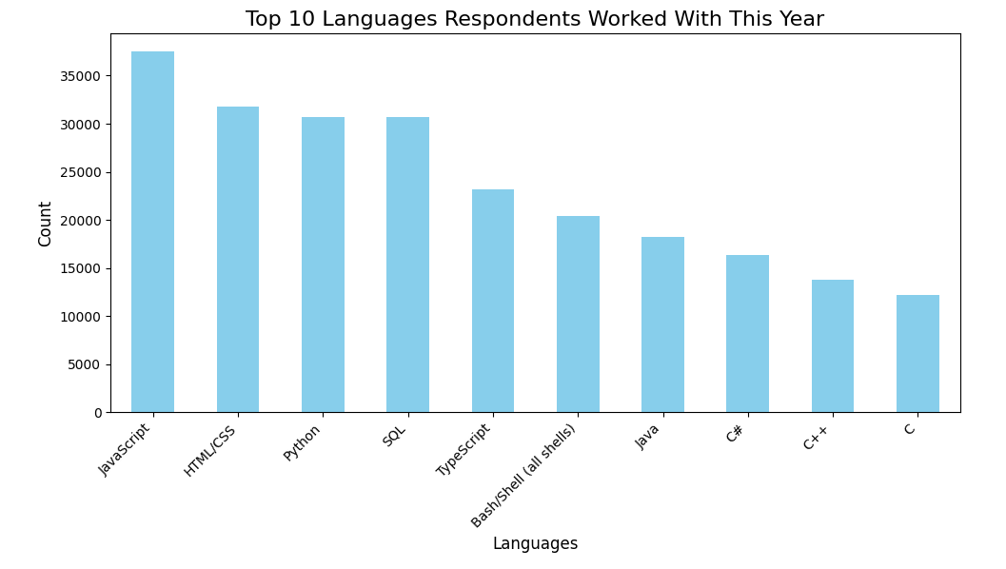
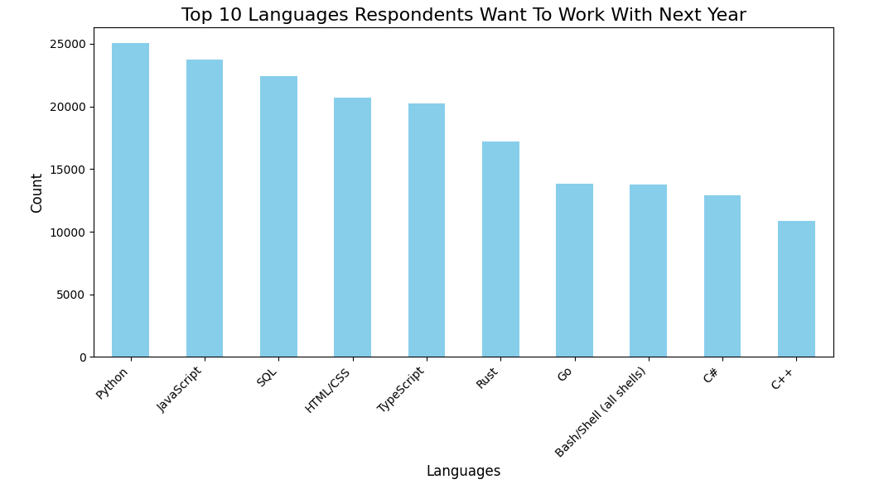
PROGRAMMING LANGUAGE TRENDS
Current Year
Next Year

Slide 7
PROGRAMMING LANGUAGE TRENDS - FINDINGS & IMPLICATIONS
IMPLICATIONS:
FINDINGS:
JavaScript Dominates:
Implication: JavaScript's dominance suggests that web development remains a primary area of focus for developers. Organizations focusing on web technologies might prioritize JavaScript-related frameworks and tools.
Diverse Language Usage:
Implication: A broad distribution of programming languages suggests that the development community is diversifying its skill sets. Companies and educators may want to focus on a wider array of programming languages to meet the diverse needs of the industry.
Emerging Technologies:
Implication: The growth of TypeScript and SQL may signal a shift towards strongly-typed, scalable languages and database technologies. Developers and companies investing in modern languages and databases will likely see better adaptability and performance in large-scale applications.
JavaScript Dominates:
JavaScript is the most popular language both in terms of percentage (16%) and count. This indicates that a significant portion of developers are working with JavaScript.
Diverse Language Usage:
The spread of languages like Python, HTML/CSS, SQL, and TypeScript reveals a wide range of technologies that developers are engaging with.
Emerging Technologies:
Languages like TypeScript and SQL have strong representation, while more traditional languages like C, C++, and Java remain relevant.

Slide 8
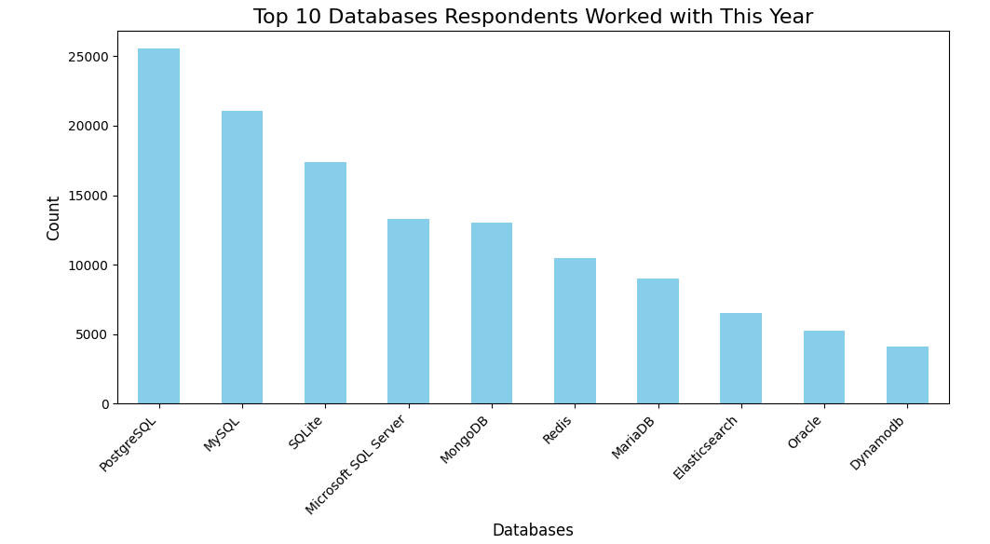
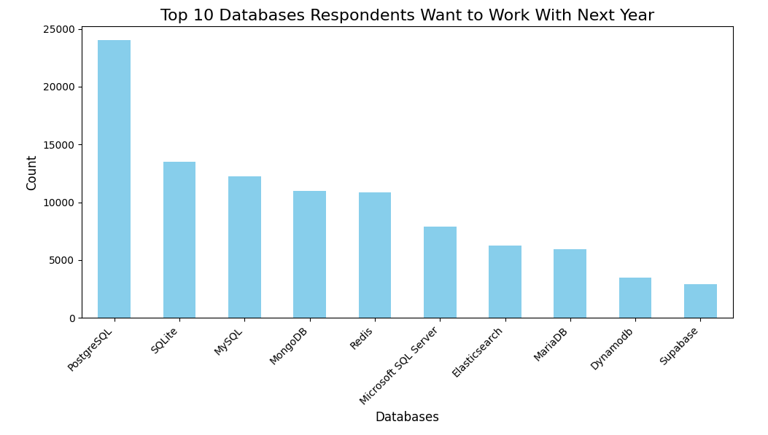
DATABASE TRENDS
Lab Data Visualization notebook
Current Year
Next Year

Slide 9
DATABASE TRENDS - FINDINGS & IMPLICATIONS
FINDINGS:
IMPLICATIONS:
PostgreSQL Leads:
PostgreSQL is the most desired database both in percentage (24.5%) and count, followed by SQLite and MySQL. This suggests PostgreSQL's growing popularity.
Strong Preference for Relational Databases:
Traditional relational databases like MySQL, SQLite, and Microsoft SQL Server show consistent interest, which indicates that relational database management systems (RDBMS) are still fundamental to the industry.
Rising Interest in NoSQL Databases:
Databases like MongoDB and Redis, which are part of the NoSQL family, also rank highly.
PostgreSQL Leads:
Implication: PostgreSQL's popularity could mean an increasing preference for open-source, highly scalable, and feature-rich databases. Organizations may look to invest in PostgreSQL for better performance and long-term viability.
Strong Preference for Relational Databases:
Implication: RDBMS technologies will remain a core skill for developers and companies, especially for applications requiring robust data integrity and structured storage.
Rising Interest in NoSQL Databases:
Implication: The increasing preference for NoSQL databases suggests that developers are leaning towards more flexible data models for certain use cases (e.g., big data, real-time applications). Companies should consider diversifying their database choices to handle a wider variety of workloads.

Slide 10
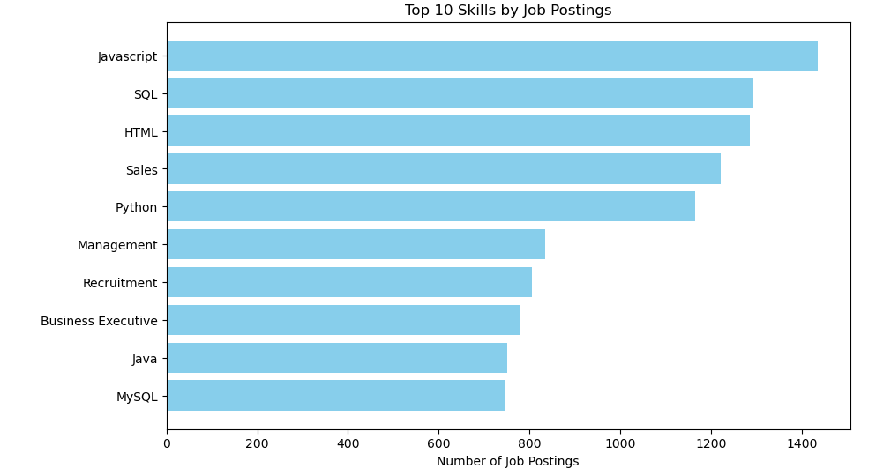
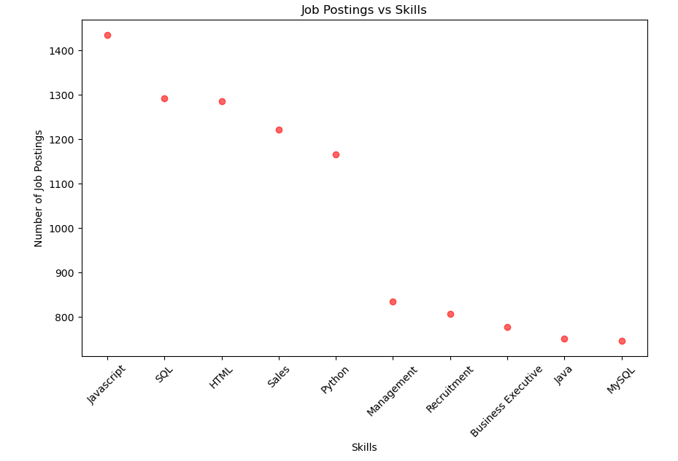
JOB POSTINGS: Jobs vs. Skills

Slide 11
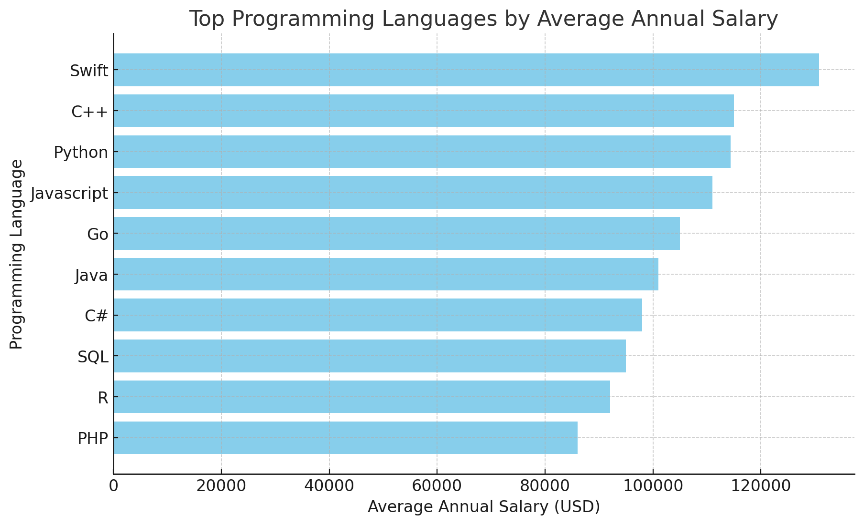
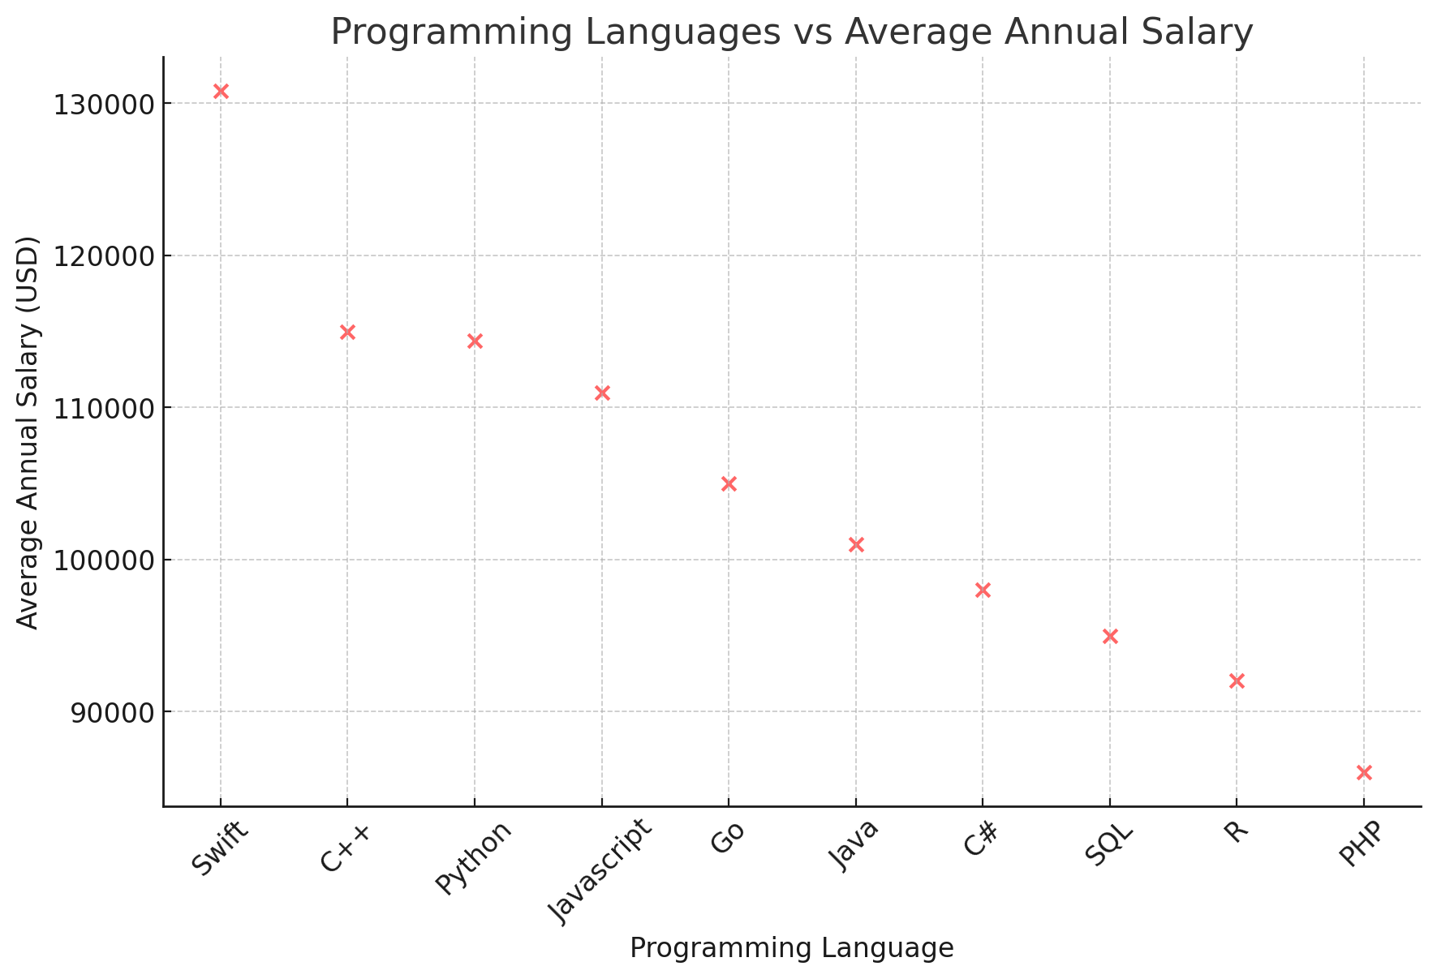
POPULAR LANGUAGES: Language vs. Salary

Slide 12
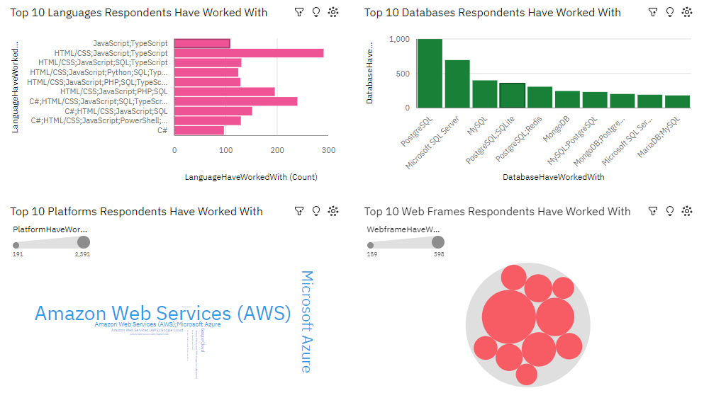
DASHBOARD TAB 1: Current Technology
CAPSTONE DASHBOARD.pdf
GitHub: https://github.com/mst141umiami/CAPSTONE_DATA_ANALYST.git

Slide 13

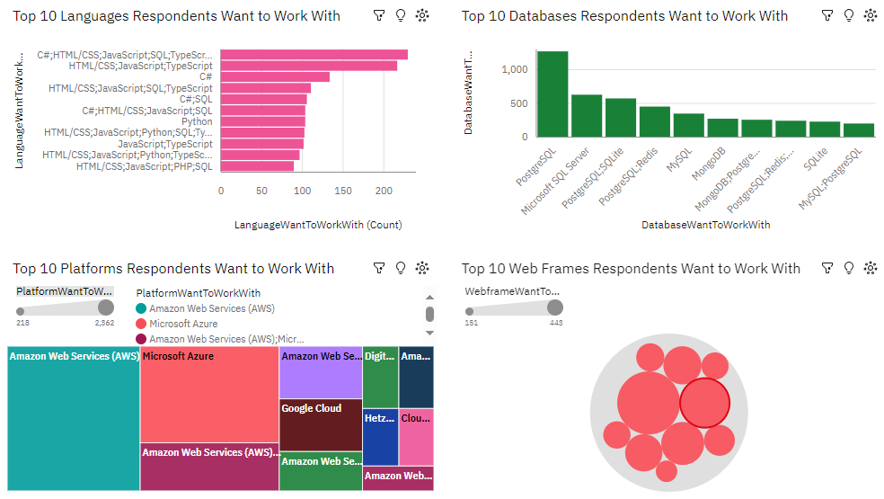
DASHBOARD TAB 2: Future Technology

Slide 14
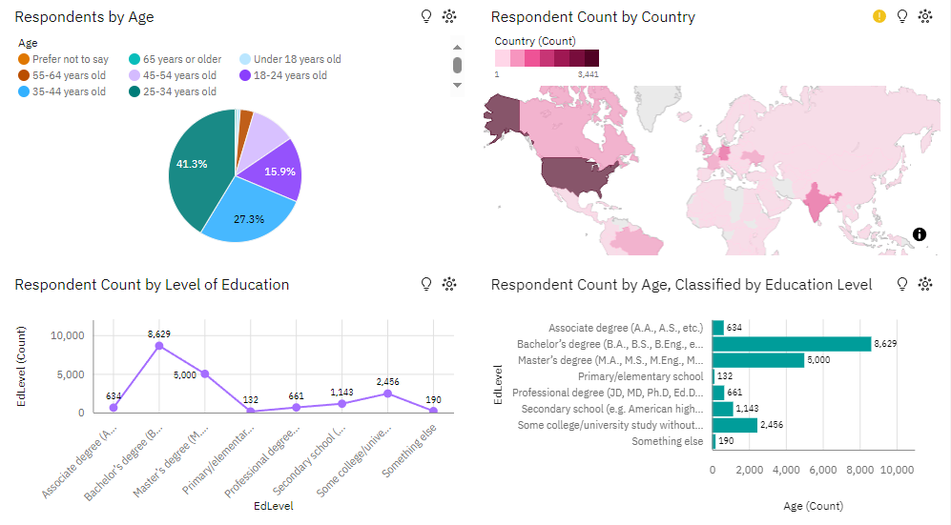
DASHBOARD TAB 3: Demographics

Slide 15

DISCUSSION
Focus on Cloud Computing: The preference for AWS, Microsoft Azure, and Google Cloud shows that cloud skills are highly sought after. Training and certifications in these platforms will be valuable for professionals and organizations looking to stay competitive.
Web Development Technologies: The dominance of JavaScript, HTML/CSS, and frameworks like React and Angular highlights the ongoing importance of web development skills. Professionals should continue to sharpen their front-end and full-stack development expertise.
Educational Trends: The high level of education among respondents suggests that employers may prioritize candidates with formal academic qualifications and advanced degrees. Additionally, there’s a clear interest in professionals with a diverse set of skills, particularly those that bridge front-end and back-end technologies.

Slide 16
OVERALL FINDINGS & IMPLICATIONS
FINDINGS:
IMPLICATIONS:
Top 10 Languages Respondents Have Worked With
Implications: This suggests that there is a high demand for web development and front-end skills (JavaScript, HTML/CSS), with a focus on data-related skills (SQL, Python) as well. It could indicate a strong market for web developers with proficiency in both front-end and back-end technologies.
Top 10 Platforms Respondents Want to Work With
Implications: The preference for cloud platforms like AWS highlights the increasing adoption of cloud computing. Professionals are likely preparing for roles that involve cloud services, which are integral to modern infrastructure and development practices. Organizations investing in cloud technology will prioritize skills in AWS, Azure, and Google Cloud.
Respondents by Age and Education Level
Implications: This demographic suggests a well-educated, mid-career group actively engaged in development and coding. Employers might target this group for higher-level roles, such as software development, architecture, and project management, as they likely have significant experience in their fields.
Top 10 Languages Respondents Have Worked With
Finding: JavaScript and HTML/CSS are the most commonly used languages among respondents. Other popular languages include SQL, Python, and TypeScript.
Respondents Want to Work With
Finding: Amazon Web Services (AWS) is by far the most preferred platform, followed by Microsoft Azure and Google Cloud.
Respondents by Age and Education Level
Finding: The majority of respondents fall within the age range of 25-44 years old, with a strong representation of individuals holding a bachelor's or master's degree.

Slide 17

CONCLUSION
This project underscores the dynamic nature of the tech industry and the critical need for adaptability in skill development. Key takeaways include:
The Dominance of Web and Cloud Technologies: JavaScript's ubiquity and the rise of cloud platforms affirm their central role in modern infrastructure and development.
Evolving Database Preferences: The shift towards PostgreSQL and NoSQL databases highlights the need for flexibility and scalability in data management.
Implications for Education and Employment: The findings emphasize the importance of bridging diverse skill sets, with a focus on full-stack development and cloud certifications.
Future Outlook: Organizations and professionals must prioritize investment in emerging technologies to sustain growth and innovation.

Slide 18
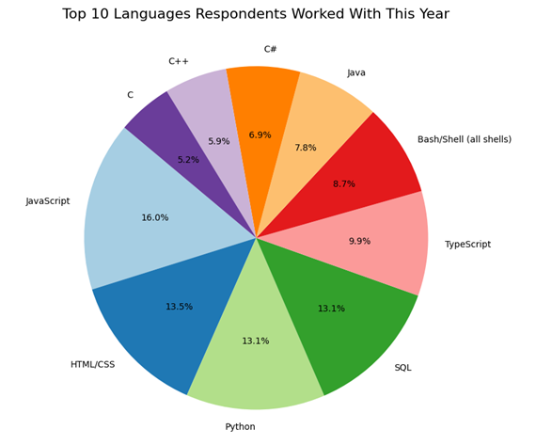
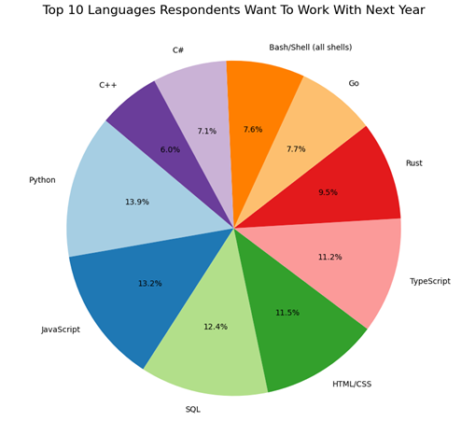
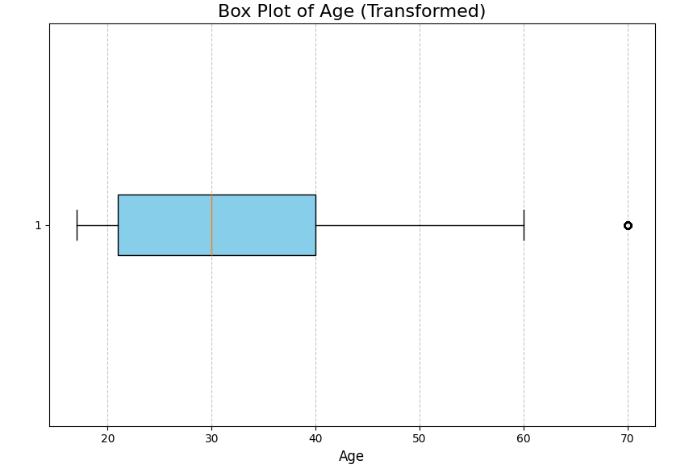
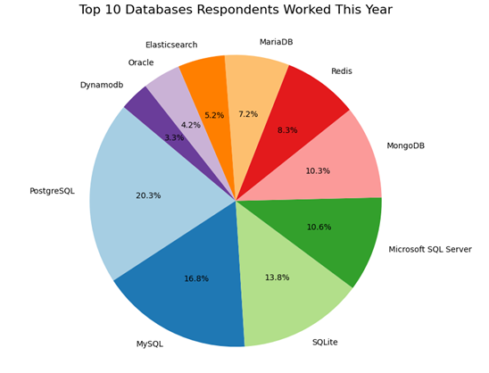
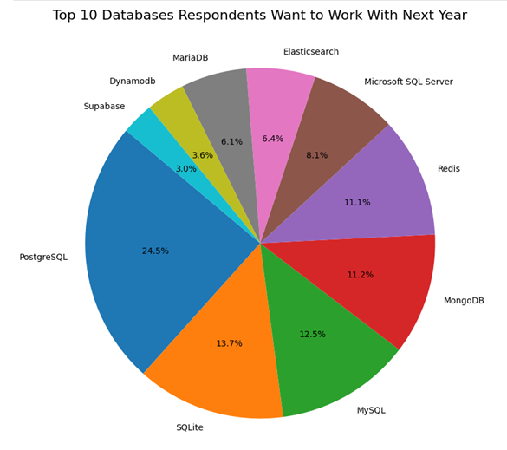
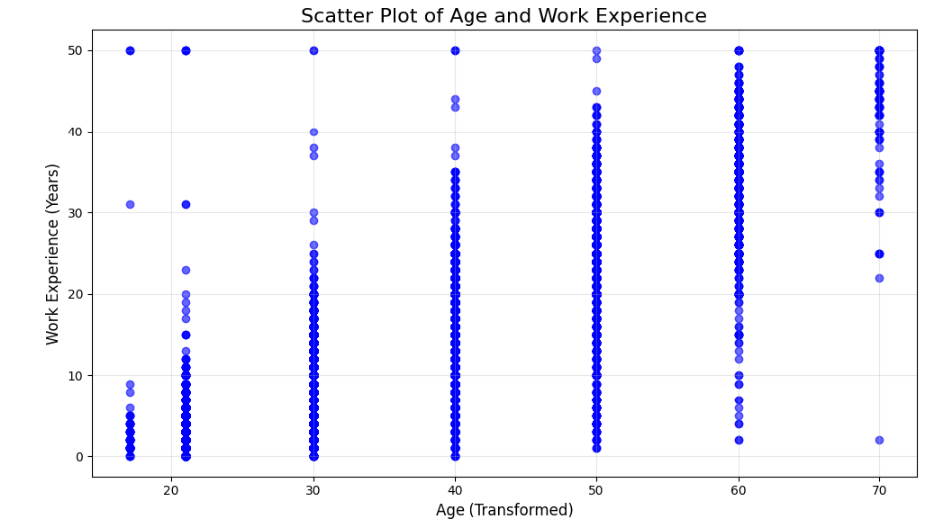
APPENDIX: survey-data.csv

