Slide 1
Birthday Hoax
Source
Presented By: Matthew Stevenson
Course: CS895, Date: 2019-04-3

Slide 2
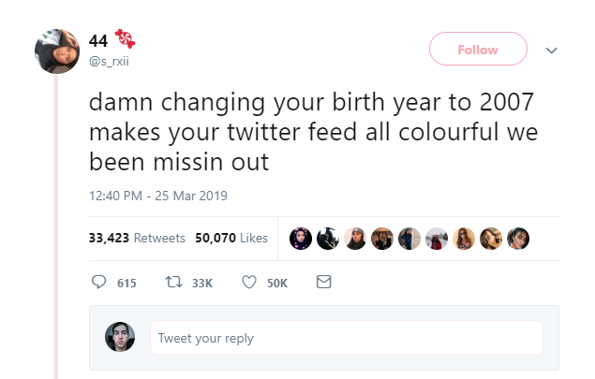
Original Tweet
https://twitter.com/s_rxii/status/1110265095702097920

Slide 3
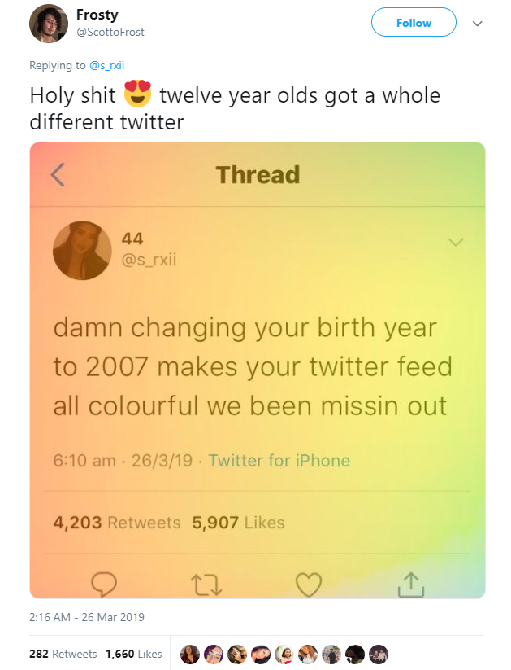
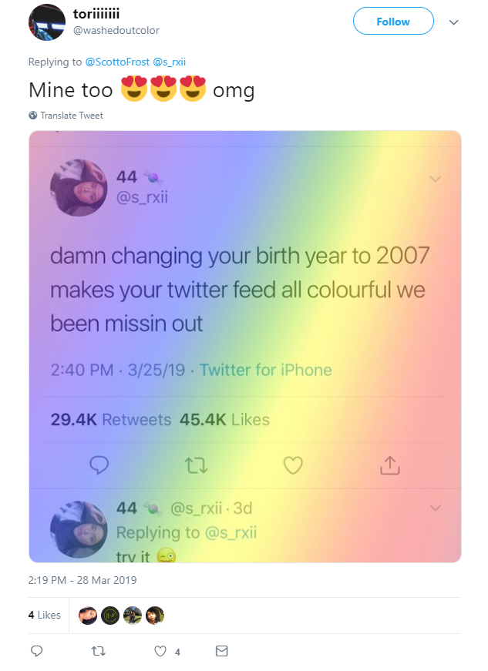
Responses To Original Tweet
Reply In Thread To @ScottoFrost
https://twitter.com/ScottoFrost/status/1110470509446090752

Slide 4
That Seems Quite Convincing…
Who Doesn’t Enjoy New Themes

Slide 5
Did Users Themes Actually Change?
Let’s Have A Look

Slide 6
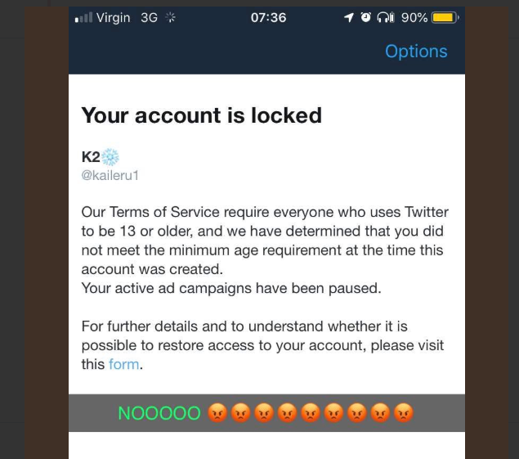
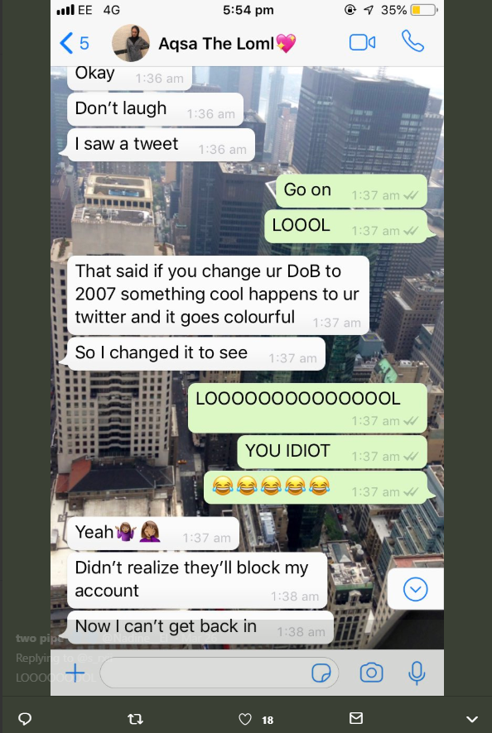
User Responses
https://twitter.com/s_rxii/status/1110265095702097920
https://twitter.com/s_rxii/status/1110265095702097920

Slide 7
Twitter Must Have A Response
Let’s See What They Say

Slide 8
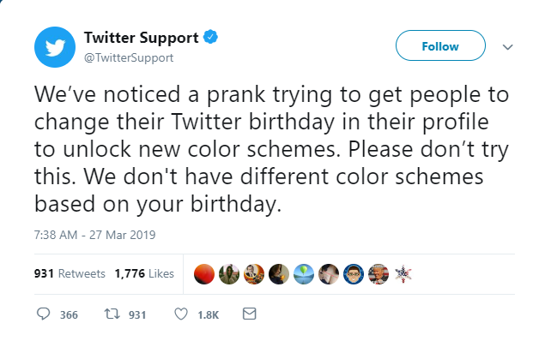
Twitter Response
https://twitter.com/TwitterSupport/status/1110913960230948864

Slide 9
The Twitter Age Requirement Enforcement
What Does The Policy State?

Slide 10
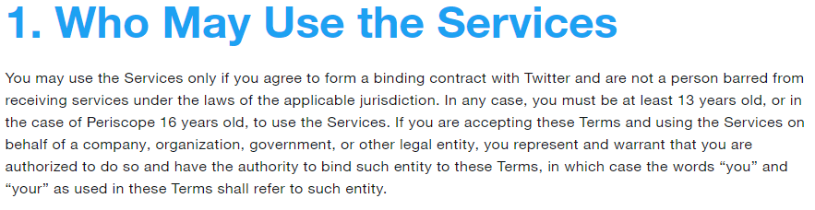
Twitter Terms Of Service
https://twitter.com/en/tos

Slide 11
Why Did Twitter Decide To Begin Enforcing Age Requirements?
Let’s Have A Look

Slide 12
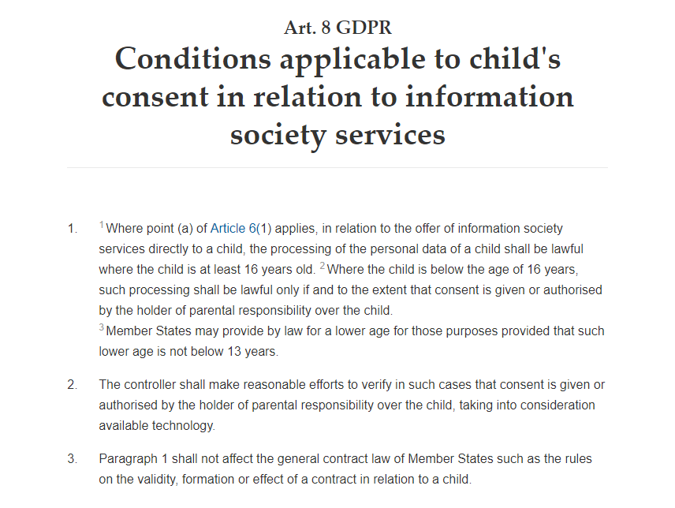
Twitter Enforces Terms Of Service On Age Restriction
https://gdpr-info.eu/art-8-gdpr/

Slide 13
Did Twitter Users Have Problems When The Policy Was First Enacted?
It Turns Out Twitter Caused A Bunch Of Problems

Slide 14
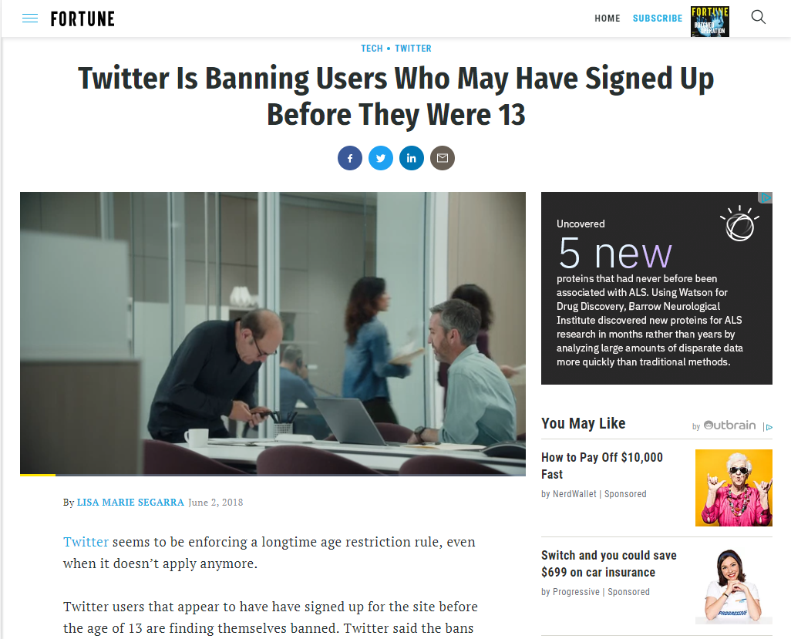
Twitter Enforces Terms Of Service Based On Age Restriction
http://fortune.com/2018/06/02/twitter-banning-users-13/

Slide 15
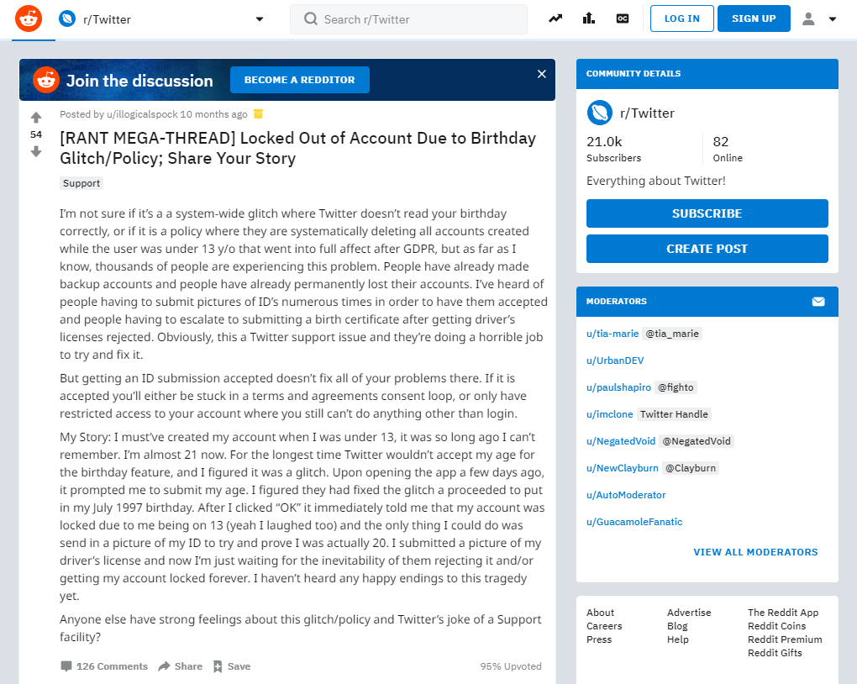
Twitter Age Enforcement Causes An Unexpected Glitch
https://www.reddit.com/r/Twitter/comments/8mzd4i/rant_megathread_locked_out_of_account_due_to/

Slide 16
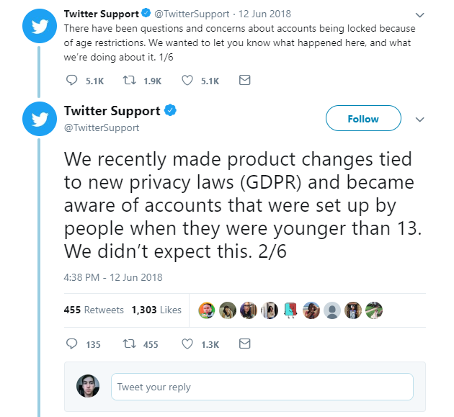
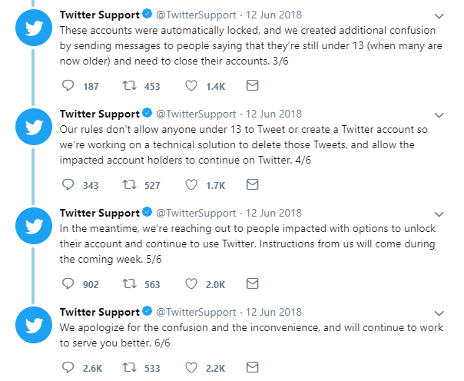
Twitter Responds
https://twitter.com/TwitterSupport/status/1006682102513848320

Slide 17
Twitter Enforcement Mishap
In many cases, Twitter algorithms mistakenly locked users out of their account even though they were above 13 years old requirement
This was based on the entered information for the birthdate from when a user’s account was first created
Meaning: The user signed up underage, but is now of age.

Slide 18
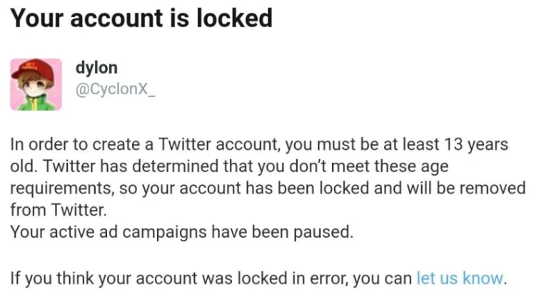
A Message From Twitter
https://twitter.com/TwitterSupport/status/1006682102513848320

Slide 19
So What Did Twitter Offering Its Users To Reclaim Their Accounts?
Let’s Have A Look

Slide 20
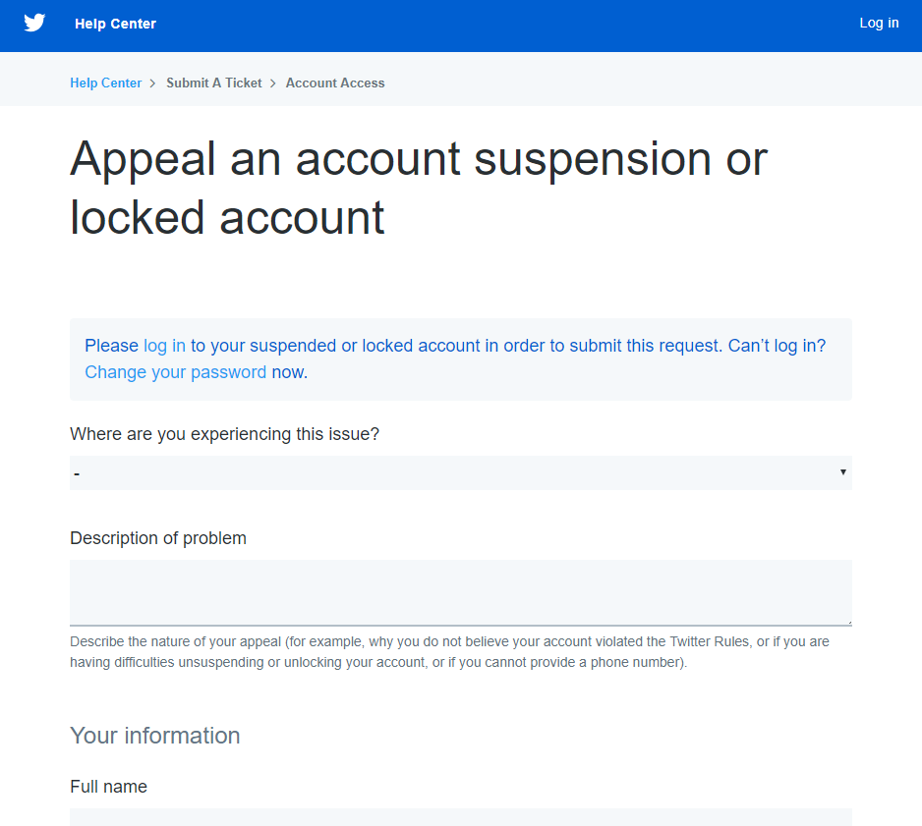
Twitter Account Appeal
https://help.twitter.com/forms/general?subtopic=suspended

Slide 21
Account Restoration
Requires proof of age
if user is under the age of 18, the user must provide parental consent including parental identification alongside with initial appeal

Slide 22
Now Back To The Birthday Hoax
What Is Twitter Offering Its Users?

Slide 23
Twitter Account Appeal
https://help.twitter.com/forms/general?subtopic=suspended

Slide 24
The Age Enforcement Began In Mid-2018
One Would Think Users Would Be Aware Of The Dangers Of Changing Their Age

Slide 25
The Hoax Was Successful Based On The Criteria
Twitter users wanted new themes
Influence was strong based on widespread social media interaction
Users affected by hoax were unaware of Twitter’s age enforcement policy that took place last year
Dynamics of human behavior while on social media exploited
Psychological factors of users wanting to receive satisfaction based on interacting with trending content was also exploited

