Slide 1
Gaussian Progression for next measurement prediction

Slide 2
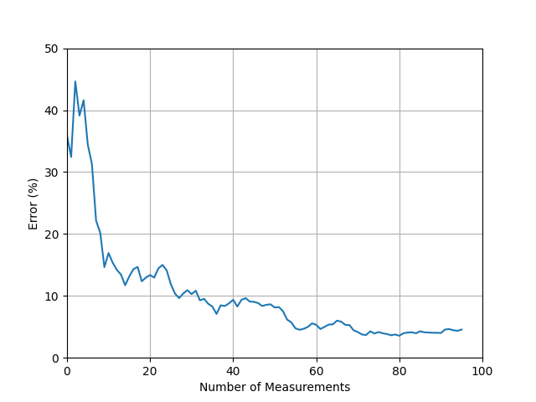

Slide 4
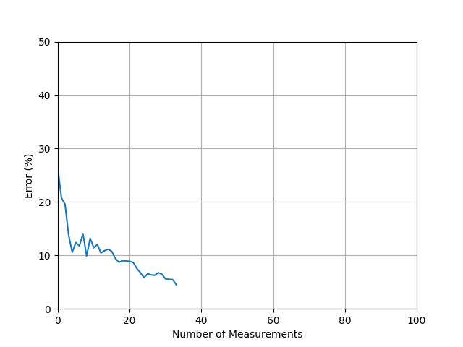

Slide 5
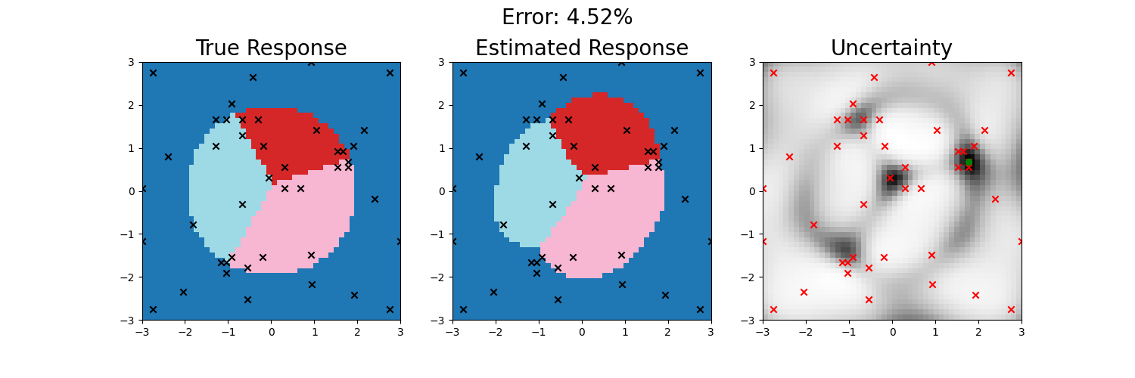
44/2500 = 1.76% points sampled
2387/2500 = 95.48% points correctly classified

