Slide 1



SEARCHING ALGORITHM
-220049
SHADIP KUMAR JOSHI
BATCH 32 A (COM)

Slide 2


SEARCHING ALGORITHM
TABLE OF CONTENTS?
1.What is searching algorithm?
2.How searching algorithm works?
3.Example of searching algorithm?
4.Types of searching algorithm?
5.What is Linear Search?
6.How Linear Search operates?
7.Linear Search in Python3?
8.What is Binary Search?
9.How Binary Search operates?
10.Binary Search in Python3?
11.Time complexity ?
13.Linear Search vs Binary Search?
14.WHY? , WHICH?
15.REFERENCES USED?
16.END!

Slide 3
SEARCHING ALGORITHM
What is searching algorithm?
- algorithm is a set of well-defined instructions to solve a particular problem.
- Searching algorithms is a basic, fundamental step in computing done via step-by-step method to locate and retrieve a specific data among a collection of data.
- Wikipedia: Searching algorithm is any algorithm which solves the search problem, namely, to retrieve information stored within some data structure, or calculated in the search space of a problem domain.
- Input a search key
2 possible outcomes- Success or Failure ( in boolean true or false value),
i.e- ‘Success’ when target is found &
‘Failure’ when target is not found.
- If it does exist, a search algorithm will locate it and retrieve the information.
How searching algorithm works?

Slide 4
SEARCHING ALGORITHM
Example of searching algorithm?
Searching Algorithms are used in lots of programs to make data easier to access and understand.
Computer game leader boards are sorted from the highest score to the lowest score to make it easy to find the winner and your position in the list.
Search engines like Google use special algorithms to help us find the most useful search results.
Online shopping websites order their products by type, so that you can click straight to the department that you're looking for, rather than searching through the whole site.

Slide 5
SEARCHING ALGORITHM
Types of searching algorithm?
Linear Search
Binary Search
Jump Search
Interpolation Search
Exponential Search
Sublist Search
Fibonacci Search
The Ubiquitous Binary Search

Slide 6
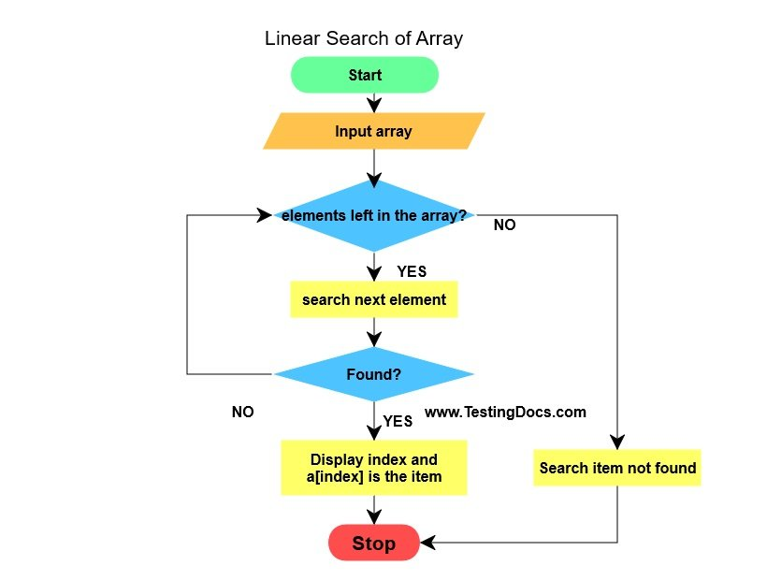
SEARCHING ALGORITHM
What is Linear Search? How Linear Search operates?
- the most basic of all search algorithms
- criteria: None
aka Sequential Search
sequentially checks each element of the list
until a match is found or
the whole list has been searched

Slide 7
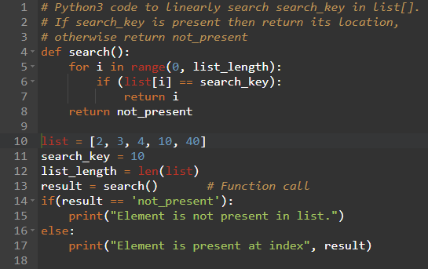
SEARCHING ALGORITHM
Linear Search in Python3?
Output: Element is present at index 3

Slide 8
SEARCHING ALGORITHM
What is Binary Search? How Binary Search operates?
Criteria: sorted data sequence
aka half-interval search or logarithmic search
works on the principle of divide & conquer
divides in the middle of a data structure, eliminating half of the remaining data with each pass
starts by searching in the middle of the array and going down the first lower or upper half of the sequence. If the median value is lower than the target value, that means that the search needs to go higher, if not, then it needs to look on the descending portion of the array
- continues until there is only one item in the list you are examining
- FAST. A list of one billion items would only require 30 iterations to find a particular piece of data or discover that the data is not in the list.

Slide 9
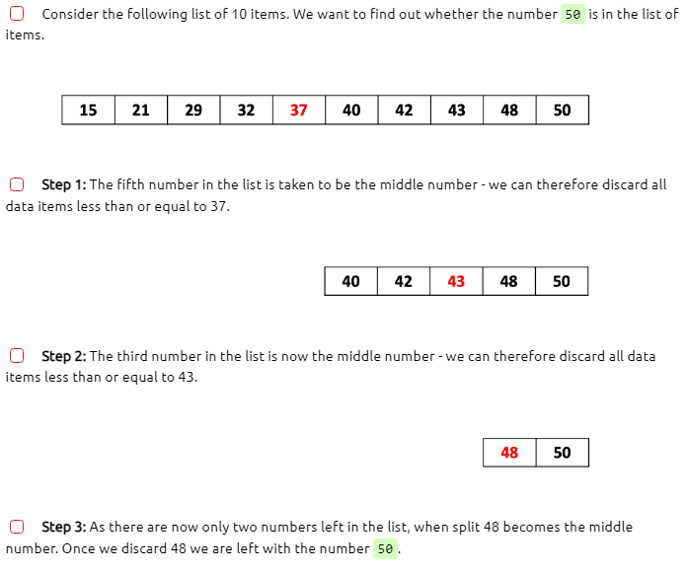
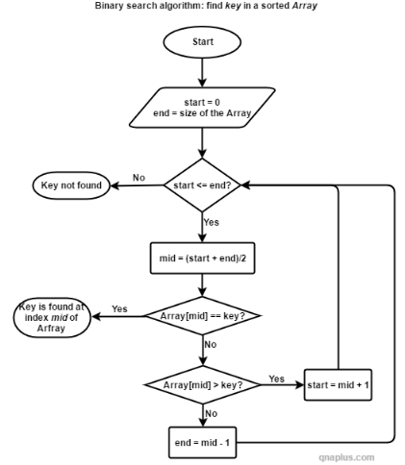
SEARCHING ALGORITHM
How Binary Search operates?

Slide 10
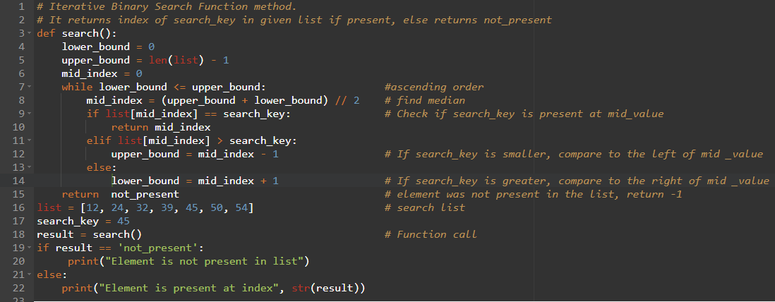
SEARCHING ALGORITHM
Binary Search in Python3?
Output: Element is present at index 4

Slide 11
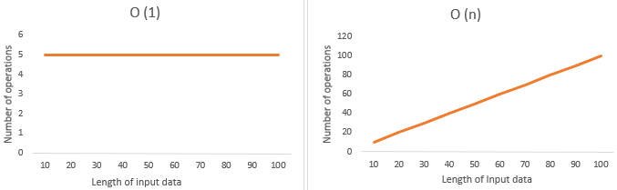
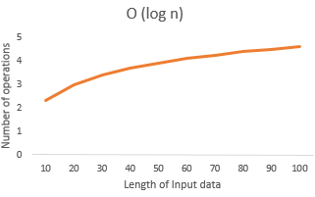
SEARCHING ALGORITHM
Time complexity?
the amount of time taken by an algorithm to run, as a function of the length of the input. Here, the length of input indicates the number of operations to be performed by the algorithm
give information about the variation (increase or decrease) in execution time when the number of operations (increase or decrease) in an algorithm.
Constant time – O (1): runtime is always same irrespective of the length of input
Linear time – O(n): the runtime increases linearly with the increase in length of the input
Logarithmic time – O (log n): number of operations gets reduced as the input size increases
Time Complexity | Linear Search | Binary Search
Best case | O(1) | O(1)
Worst case | O(n) | O(log n)

Slide 12
SEARCHING ALGORITHM
Linear Search vs Binary Search?
Linear Search | Binary Search
In linear search input data need not to be in sorted. | In binary search input data need to be in sorted order.
It is also called sequential search. | It is also called half-interval search.
Multidimensional array can be used. | Only single dimensional array is used.
Linear search performs equality comparisons | Binary search performs ordering comparisons
It is simple. | It is more complex.
The time complexity of linear search O(n). | The time complexity of binary search O(log n).
It is very slow process. | It is very fast process.

Slide 13
SEARCHING ALGORITHM
WHY? , WHICH?
WHY?
– for efficiency
WHICH?
– it depends!!!
-type of data sequence
-length of data sequence

Slide 14
SEARCHING ALGORITHM
REFERENCES USED?
https://codersera.com/blog/let-us-understand-searching-algorithms/
https://bournetocode.com/projects/GCSE_Computing_Fundamentals/pages/3-1-3-searc_alg.html
https://www.geeksforgeeks.org/searching-algorithms/?ref=lbp
https://thenounproject.com/icon/search-bar-2775997/
https://www.quora.com/What-is-the-flowchart-of-binary-search
https://www.clickcease.com/blog/how-to-do-keyword-research-for-ppc-ads/
https://www.mygreatlearning.com/blog/why-is-time-complexity-essential/#:~:text=Time%20complexity%20is%20the%20amount,you%20understand%20time%20complexity%20clearly.

Slide 15

SEARCHING ALGORITHM
END!

