Slide 1



Slide 2


Cisco Networking Academy
CCNP TShoot
Cisco CCNP
Cisco CCNP Security
CCNP Route
Advanced
CCNP Switch
CCNA R&S 4 Connecting Networks
Cisco CCNA R&S
CCNA Security
Cisco CCNA Security
CCNA R&S 3 Scaling Networks
CCNA R&S 2 Routing and Switching Essentials
Cisco CCENT
Introductory
CCNA R&S 1 Introducing to Networks
Networking

Slide 3
Mod de desfasurare
Sedinta: Teorie + Laborator
CCNA R&S 1: 50% + 50%
CCNA R&S 2: 20% + 80%
CCNA R&S 3: 20% + 80%
...
CCNP TShoot
10 sedinte de 4 ore
CCNP Route
10 sedinte de 4 ore
Advanced
CCNP Switch
10 sedinte de 4 ore
CCNA R&S 4 Connecting Networks
8 sedinte de 4 ore
CCNA Security
10 sedinte de 4 ore
CCNA R&S 3 Scaling Networks
10 sedinte de 4 ore
CCNA R&S 2 Routing and Switching Essentials
10 sedinte de 4 ore
Introductory
CCNA R&S 1 Introducing to Networks
11 sedinte de 4 ore
Networking

Slide 4
Reguli de promovare CCNA 1
Examene la capitole
Prezenta 7 din 11
Evaluare practica
Examen final

Slide 5
Adresare IP
10 . 1 . 0 .100
255.255. 0 . 0
IP uri in total : 10.1.0.0 – 10.1.255.255
IP uri folosibile: 10.1.0.1 – 10.1.255.254

Slide 6
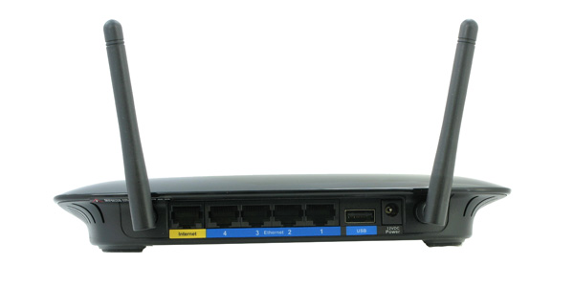
SOHO Router AP
Route+Switch+Access Point

Slide 7
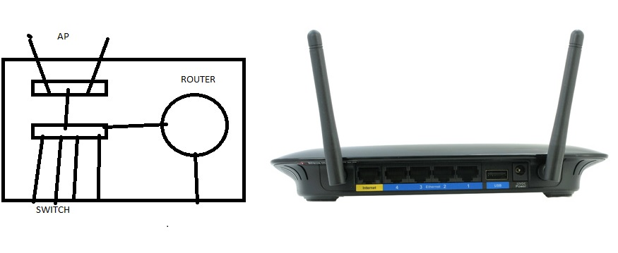
SOHO Router AP
Route+Switch+Access Point

Slide 8
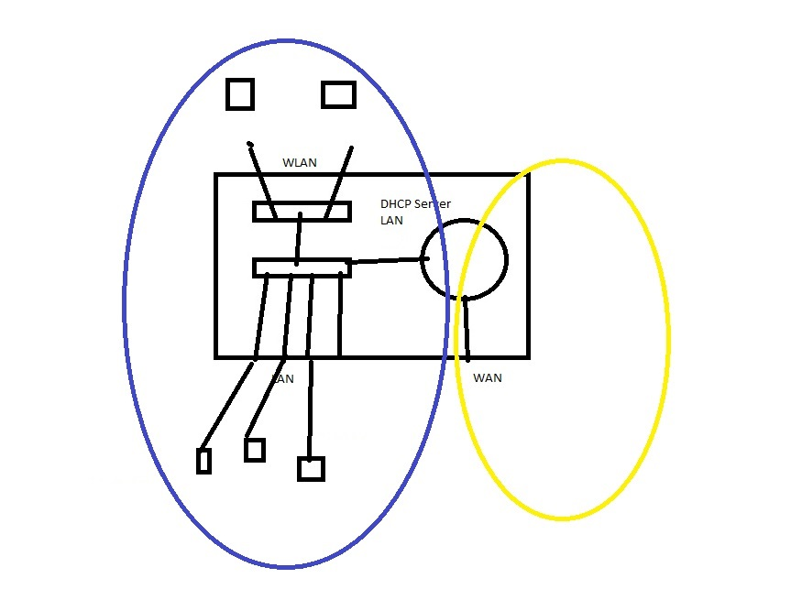
Routerul Separa Retelele si Ofera Servicii

Slide 9
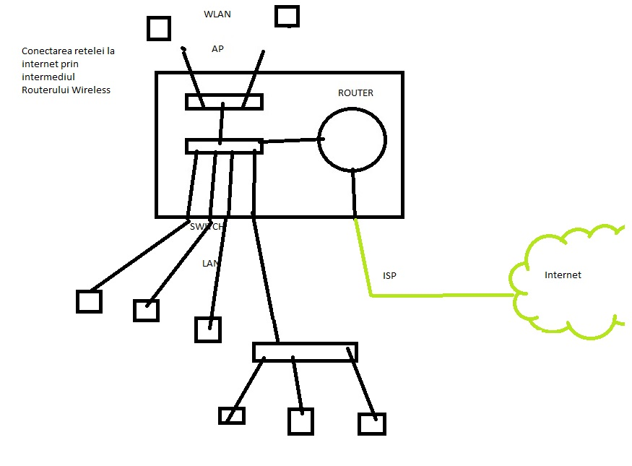
Scenariul 1. Home Office

Slide 10
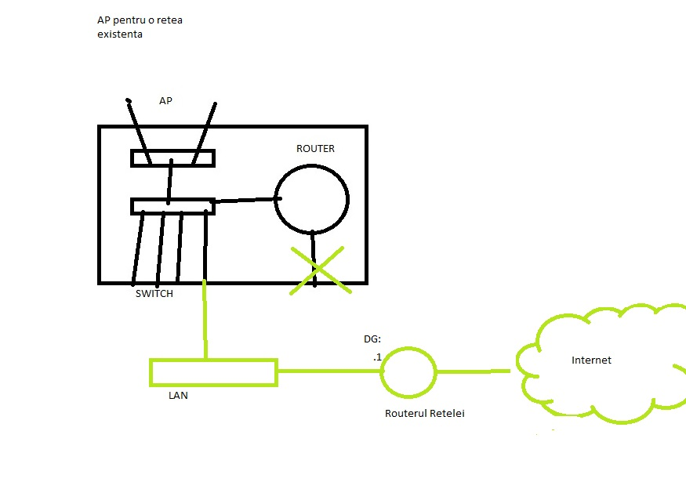
Scenariul 2. Small Office

Slide 11
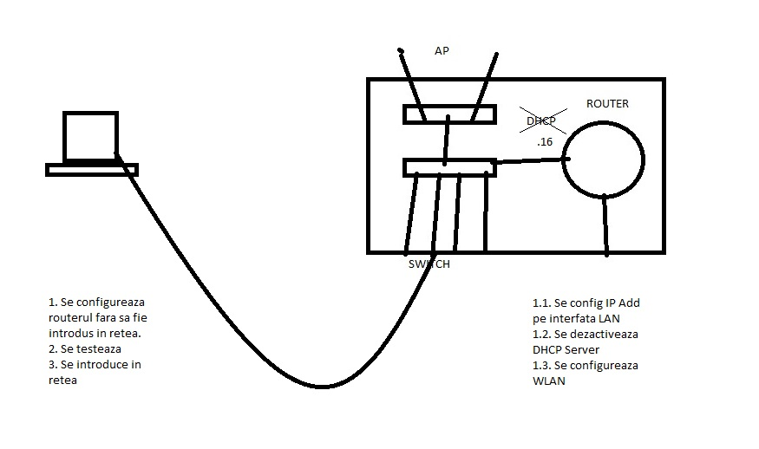
Configurare Scenariu AP

Slide 12
Transformari Binar-Zecimal-Hexazecimal
Binar > Zecimal
___ ___ ___ ___ ___ ___ ___ ___
2^7 2^6 2^5 2^4 2^3 2^2 2^1 2^0
128 64 32 16 8 4 2 1

Slide 13
Transformari Binar-Zecimal-Hexazecimal
Binar > Zecimal
1 1 1 0 0 0 1 1
___ ___ ___ ___ ___ ___ ___ ___
2^7 2^6 2^5 2^4 2^3 2^2 2^1 2^0
128 64 32 16 8 4 2 1

Slide 14
Transformari Binar-Zecimal-Hexazecimal
Binar > Zecimal
1 1 1 0 0 0 1 1
___ ___ ___ ___ ___ ___ ___ ___
2^7 2^6 2^5 2^4 2^3 2^2 2^1 2^0
128 64 32 16 8 4 2 1
225

Slide 15
Transformari Binar-Zecimal-Hexazecimal
Binar > Zecimal
0 1 0 1 0 1 1 0
___ ___ ___ ___ ___ ___ ___ ___
2^7 2^6 2^5 2^4 2^3 2^2 2^1 2^0
128 64 32 16 8 4 2 1

Slide 16
Transformari Binar-Zecimal-Hexazecimal
Binar > Zecimal
0 1 0 1 0 1 1 0
___ ___ ___ ___ ___ ___ ___ ___
2^7 2^6 2^5 2^4 2^3 2^2 2^1 2^0
128 64 32 16 8 4 2 1
86

Slide 17
Transformari Binar-Zecimal-Hexazecimal
Binar > Zecimal
1 0 1 0 0 1 0 1
___ ___ ___ ___ ___ ___ ___ ___
2^7 2^6 2^5 2^4 2^3 2^2 2^1 2^0
128 64 32 16 8 4 2 1

Slide 18
Transformari Binar-Zecimal-Hexazecimal
Binar > Zecimal
1 0 1 0 0 1 0 1
___ ___ ___ ___ ___ ___ ___ ___
2^7 2^6 2^5 2^4 2^3 2^2 2^1 2^0
128 64 32 16 8 4 2 1
165

Slide 19
Transformari Binar-Zecimal-Hexazecimal
Binar < Zecimal
201 – 128 = 73
1
___ ___ ___ ___ ___ ___ ___ ___
2^7 2^6 2^5 2^4 2^3 2^2 2^1 2^0
128 64 32 16 8 4 2 1

Slide 20
Transformari Binar-Zecimal-Hexazecimal
Binar < Zecimal
201-128 = 73-64=9
1 1
___ ___ ___ ___ ___ ___ ___ ___
2^7 2^6 2^5 2^4 2^3 2^2 2^1 2^0
128 64 32 16 8 4 2 1

Slide 21
Transformari Binar-Zecimal-Hexazecimal
Binar < Zecimal
201-128 = 73-64=9
1 1 0 0
___ ___ ___ ___ ___ ___ ___ ___
2^7 2^6 2^5 2^4 2^3 2^2 2^1 2^0
128 64 32 16 8 4 2 1

Slide 22
Transformari Binar-Zecimal-Hexazecimal
Binar < Zecimal
201-128 = 73-64=9-8 =1-1
1 1 0 0 1 0 0 1
___ ___ ___ ___ ___ ___ ___ ___
2^7 2^6 2^5 2^4 2^3 2^2 2^1 2^0
128 64 32 16 8 4 2 1

Slide 23
Transformari Binar-Zecimal-Hexazecimal
Binar < Zecimal
150=128+16+4+2
___ ___ ___ ___ ___ ___ ___ ___
2^7 2^6 2^5 2^4 2^3 2^2 2^1 2^0
128 64 32 16 8 4 2 1

Slide 24
Transformari Binar-Zecimal-Hexazecimal
Binar < Zecimal
150=128+16+4+2
1 0 0 1 0 1 1 0
___ ___ ___ ___ ___ ___ ___ ___
2^7 2^6 2^5 2^4 2^3 2^2 2^1 2^0
128 64 32 16 8 4 2 1

Slide 25

Transformari Binar-Zecimal-Hexazecimal
Deci | Heza | Binar
0 | 0 | 0000
1 | 1 | 0001
2 | 2 | 0010
3 | 3 | 0011
4 | 4 | 0100
5 | 5 | 0101
6 | 6 | 0110
7 | 7 | 0111
8 | 8 | 1000
9 | 9 | 1001
10 | A | 1010
11 | B | 1011
12 | C | 1100
13 | D | 1101
14 | E | 1110
15 | F | 1111
3. Binar > Hexazecimal
$${0101.1011 }_{2}$$

Slide 26

Transformari Binar-Zecimal-Hexazecimal
Deci | Heza | Binar
0 | 0 | 0000
1 | 1 | 0001
2 | 2 | 0010
3 | 3 | 0011
4 | 4 | 0100
5 | 5 | 0101
6 | 6 | 0110
7 | 7 | 0111
8 | 8 | 1000
9 | 9 | 1001
10 | A | 1010
11 | B | 1011
12 | C | 1100
13 | D | 1101
14 | E | 1110
15 | F | 1111
3. Binar > Hexazecimal
$${0101.1011 }_{2}$$
$${5 B }_{16}$$

Slide 27

Transformari Binar-Zecimal-Hexazecimal
Deci | Heza | Binar
0 | 0 | 0000
1 | 1 | 0001
2 | 2 | 0010
3 | 3 | 0011
4 | 4 | 0100
5 | 5 | 0101
6 | 6 | 0110
7 | 7 | 0111
8 | 8 | 1000
9 | 9 | 1001
10 | A | 1010
11 | B | 1011
12 | C | 1100
13 | D | 1101
14 | E | 1110
15 | F | 1111
3. Binar > Hexazecimal
$${0101.1011 }_{2}$$
$${5 B }_{16}$$
4. Binar < Hexazecimal
$${ A 6 }_{16}$$

Slide 28

Transformari Binar-Zecimal-Hexazecimal
Deci | Heza | Binar
0 | 0 | 0000
1 | 1 | 0001
2 | 2 | 0010
3 | 3 | 0011
4 | 4 | 0100
5 | 5 | 0101
6 | 6 | 0110
7 | 7 | 0111
8 | 8 | 1000
9 | 9 | 1001
10 | A | 1010
11 | B | 1011
12 | C | 1100
13 | D | 1101
14 | E | 1110
15 | F | 1111
3. Binar > Hexazecimal
$${0101.1011 }_{2}$$
$${5 B }_{16}$$
4. Binar < Hexazecimal
$${ A 6 }_{16}$$
$${1010.011\text{0} }_{2}$$

Slide 29
Transformari Binar-Zecimal-Hexazecimal
Deci | Heza | Binar
0 | 0 | 0000
1 | 1 | 0001
2 | 2 | 0010
3 | 3 | 0011
4 | 4 | 0100
5 | 5 | 0101
6 | 6 | 0110
7 | 7 | 0111
8 | 8 | 1000
9 | 9 | 1001
10 | A | 1010
11 | B | 1011
12 | C | 1100
13 | D | 1101
14 | E | 1110
15 | F | 1111
5. Zecimal >Binar > Hexazecimal
100

Slide 30

Transformari Binar-Zecimal-Hexazecimal
Deci | Heza | Binar
0 | 0 | 0000
1 | 1 | 0001
2 | 2 | 0010
3 | 3 | 0011
4 | 4 | 0100
5 | 5 | 0101
6 | 6 | 0110
7 | 7 | 0111
8 | 8 | 1000
9 | 9 | 1001
10 | A | 1010
11 | B | 1011
12 | C | 1100
13 | D | 1101
14 | E | 1110
15 | F | 1111
5. Zecimal >Binar > Hexazecimal
100=64+32+4
$${0110.010\text{0} }_{2}$$

Slide 31

Transformari Binar-Zecimal-Hexazecimal
Deci | Heza | Binar
0 | 0 | 0000
1 | 1 | 0001
2 | 2 | 0010
3 | 3 | 0011
4 | 4 | 0100
5 | 5 | 0101
6 | 6 | 0110
7 | 7 | 0111
8 | 8 | 1000
9 | 9 | 1001
10 | A | 1010
11 | B | 1011
12 | C | 1100
13 | D | 1101
14 | E | 1110
15 | F | 1111
5. Zecimal >Binar > Hexazecimal
100=64+32+4
$${0110.010\text{0} }_{2}$$
$${ 6 4 }_{16}$$

Slide 32

Transformari Binar-Zecimal-Hexazecimal
Deci | Heza | Binar
0 | 0 | 0000
1 | 1 | 0001
2 | 2 | 0010
3 | 3 | 0011
4 | 4 | 0100
5 | 5 | 0101
6 | 6 | 0110
7 | 7 | 0111
8 | 8 | 1000
9 | 9 | 1001
10 | A | 1010
11 | B | 1011
12 | C | 1100
13 | D | 1101
14 | E | 1110
15 | F | 1111
5. Zecimal >Binar > Hexazecimal
100=64+32+4
$${0110.010\text{0} }_{2}$$
$${ 6 4 }_{16}$$
6. Zecimal<Binar < Hexazecimal
$${ C 4 }_{16}$$

Slide 33

Transformari Binar-Zecimal-Hexazecimal
Deci | Heza | Binar
0 | 0 | 0000
1 | 1 | 0001
2 | 2 | 0010
3 | 3 | 0011
4 | 4 | 0100
5 | 5 | 0101
6 | 6 | 0110
7 | 7 | 0111
8 | 8 | 1000
9 | 9 | 1001
10 | A | 1010
11 | B | 1011
12 | C | 1100
13 | D | 1101
14 | E | 1110
15 | F | 1111
5. Zecimal >Binar > Hexazecimal
100=64+32+4
$${0110.010\text{0} }_{2}$$
$${ 6 4 }_{16}$$
6. Zecimal<Binar < Hexazecimal
$${ C 4 }_{16}$$
$${1100.010\text{0} }_{2}$$

Slide 34

Transformari Binar-Zecimal-Hexazecimal
Deci | Heza | Binar
0 | 0 | 0000
1 | 1 | 0001
2 | 2 | 0010
3 | 3 | 0011
4 | 4 | 0100
5 | 5 | 0101
6 | 6 | 0110
7 | 7 | 0111
8 | 8 | 1000
9 | 9 | 1001
10 | A | 1010
11 | B | 1011
12 | C | 1100
13 | D | 1101
14 | E | 1110
15 | F | 1111
5. Zecimal >Binar > Hexazecimal
100=64+32+4
$${0110.010\text{0} }_{2}$$
$${ 6 4 }_{16}$$
6. Zecimal<Binar < Hexazecimal
$${ C 4 }_{16}$$
$${1100.010\text{0} }_{2}$$
128+64+4=196

Slide 35
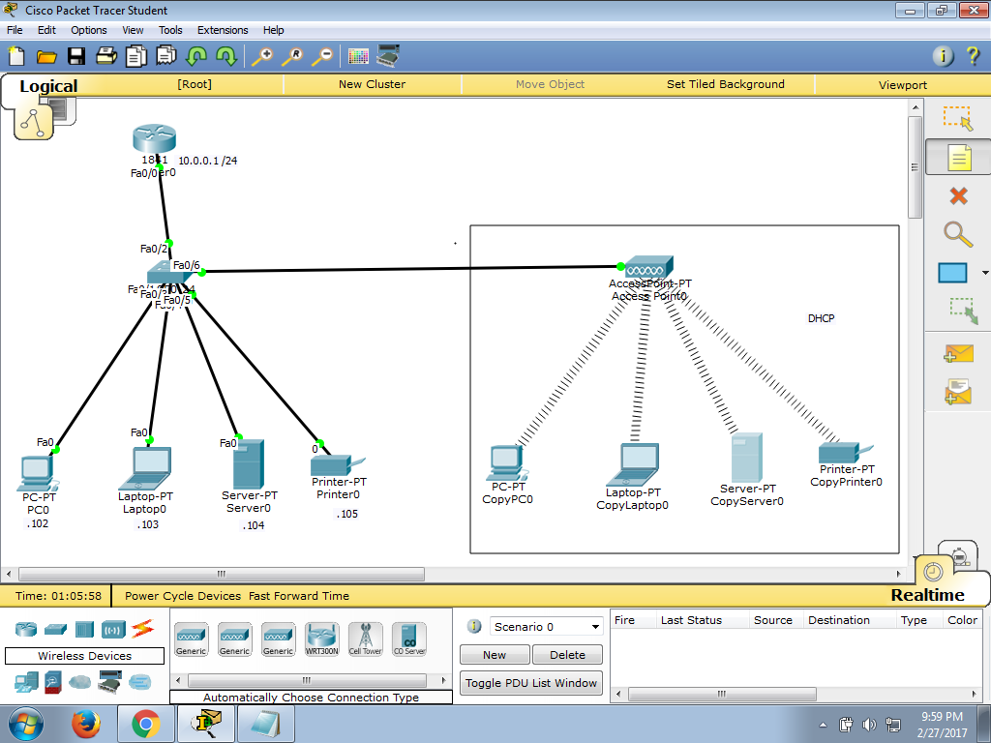
Tema Curs 1

