Slide 1
Git Commit Copilot AI – Automating Git Commits with AI
Using Python & GPT to generate intelligent commit messages

Slide 2
What We Built
-AI-powered agent to handle Git commits for Dart/Flutter projects
Automatically generates meaningful commit messages
Stages, commits, and pushes changes after user confirmation
Works on Windows with GitHub Desktop or Git CLI

Slide 3
Why We Built It
Manual commit messages can be time-consuming and inconsistent
AI ensures consistent Conventional Commits style
Speeds up workflow for developers
Reduces human errors when pushing to GitHub

Slide 4
How We Built It
Set up environment: Python, Git, OpenAI API
Created Python script ai_push.py:
- Reads git status and git diff
- Generates AI commit messages using GPT
- Asks for user confirmation
- Stages, commits, and pushes changes
Automated with .bat file for easy 'push-ai' command
Tested OpenAI API with different commits

Slide 5
AI Agent Components
Brain: GPT-4/GPT-3.5 reasoning
Memory: Optional past commit conventions
Tools: Git CLI / GitHub Desktop commands
Autonomy: Multi-step workflow (analyze → suggest → confirm → push)

Slide 6
Results
AI generates short, meaningful commit messages automatically
Ensures commit style consistency
User confirms before pushing → safe workflow
Easy to run: type 'push-ai' in terminal

Slide 7
Next Steps / Future Improvements
Store past commit messages for better AI suggestions
Auto-generate PR descriptions
Branch safety checks (prevent accidental push to main)

Slide 8
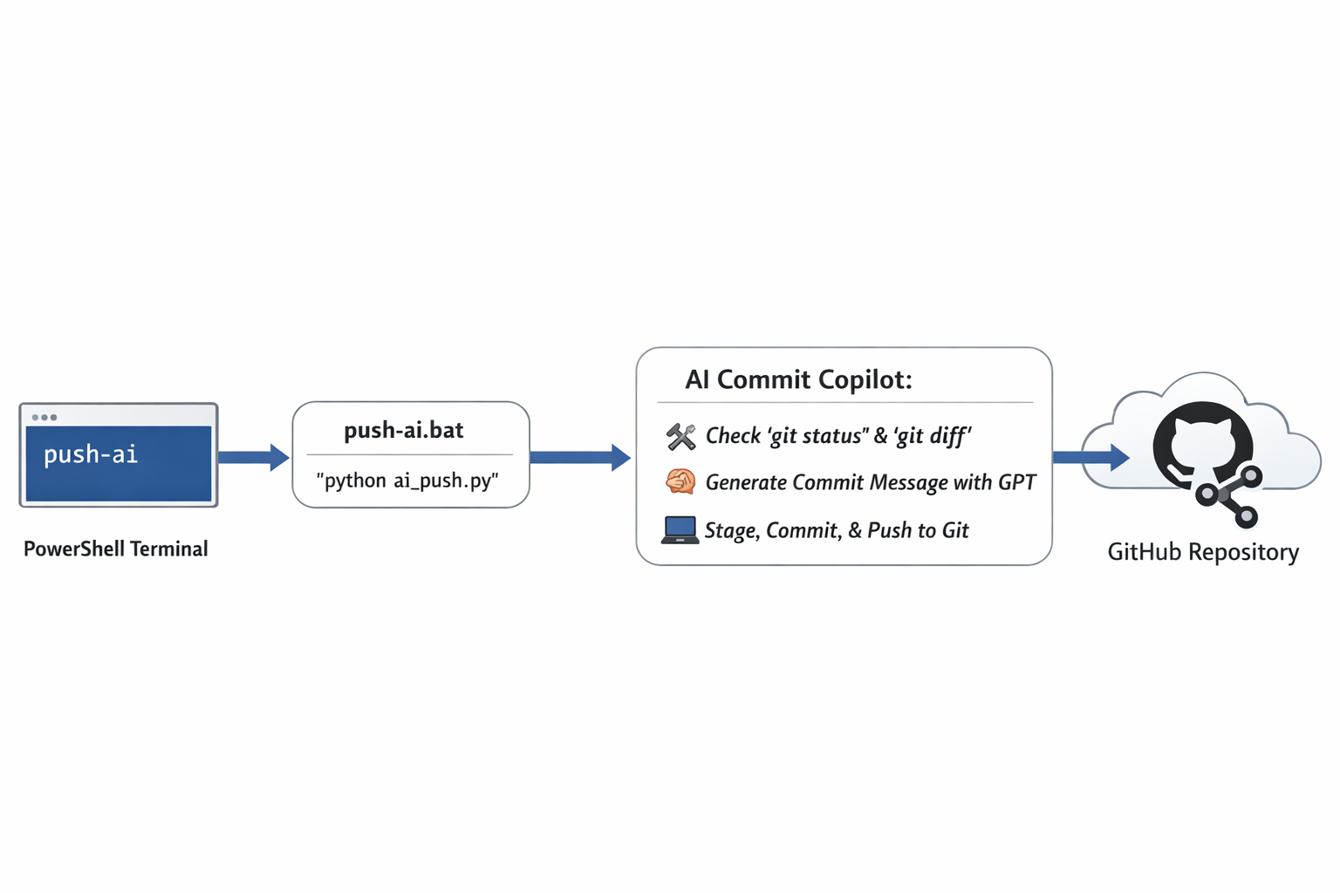
Demo / Visual Summary

